Slide 1
Utilizing Flow Monitoring Technology to Properly Size MSD’s Capital Improvement Program
September 2019
Metropolitan St. Louis Sewer District
Andrew Kaufman, P.E.
James Kauffman, P.E.
Notes:
In theory this is a 5 minute presentation
Identify I/I sources
Meter and Model existing conditions
Design and build I/I removal projects
Re-meter and re-model after I/I work is COMPLETED
Run the appropriate design storm(s) (in our case 5 year and 10 year
Re-evaluate the system capacity and HGL levels
Determine the need for the contingent sanitary replacement project
In practice there are a lot of moving parts
Communication and coordination are the key

Slide 2
Agenda
Introductions
Consent Decree Requirements
Capital Improvement Program (30,000ft View)
Flow Monitoring Technology
Projects Evaluated to Date
Savings (1 Year of Flow Monitoring)
Notes:
In practice there are a lot of moving parts
As with most complex task, communication and coordination are the keys to success
As we discuss this process, keep in mind that each project typically passes through three different groups within Engineering
The Planning Department creates a broad conceptual and/or preliminary study to identify a general project scope and cost. (flow monitoring and modeling are typically managed from within this group)
The Design Department refines project scopes and costs, bids out design projects and manages the Design consultants. Projects (particularly I/I projects) can be broken up and combined with other projects to meet schedules and/or create more cost-effective bid packages.
The Construction Department manages the construction consultants and deal with day-to-day issues of removing I/I and getting pipe into the ground
These Departments are working towards a common goal, but they have different internal priorities and constraints.
Consequently, what gets planned doesn’t always get designed, and what gets designed doesn’t always get built.
This must be kept in consideration when evaluating project effectiveness.

Slide 3
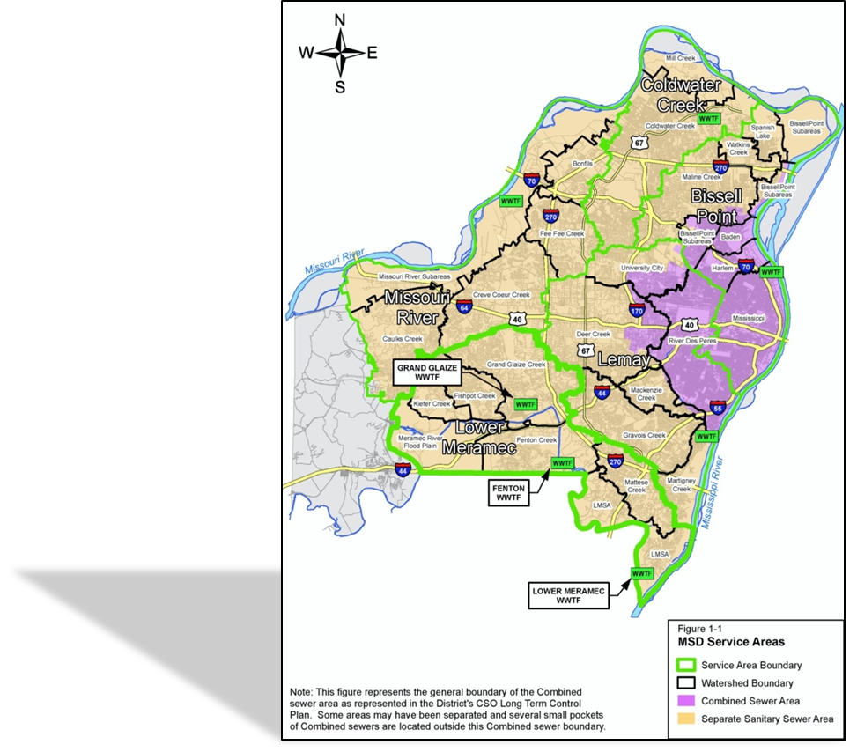
St. Louis MSD
Formed in 1954
525 square miles
City of St. Louis & 90% of the
County
93 Municipalities
Population of 1.3 million
(519,000 accounts)
Treats 350 MGD
Sewer Statistics
3,000 miles Storm sewers
4,800 miles Sanitary Sewers
1,800 miles Combined sewers
Notes:
The District is divided into 5 Service Areas (outlined in green) with 7 Waste Water Treatment Facilities that treat 350 MGD.
21 official Watersheds/Sub-areas (outlined in black)
22 Sanitary sewersheds within those watersheds are modeled in Hydra
The Combined areas are modeled with various versions of SWMM models

Slide 4
CD Requirements
Consent Decree entered April 2012
SSO Master Plan Requirements:
Assess existing and future capacity of the Collection System
Collection System
Conveys flows without surcharging sufficient to cause SSO’s.
Relief sewers shall be designed to convey a 10 year storm
Existing sewers shall convey a 5 year design storm
28-year program*
Notes:
In anticipation of the Consent Decree, the District spent a significant amount of time and effort to identify I/I sources Which included defining hundreds of I/I study areas and conducting Smoke testing, dye flood testing, CCTV, etc.), and create models to quantify the existing conditions of the sanitary sewers in the district.
CD
Estimated cost = $4.7 B (2010 dollars)
$1.3 Billion dedicated to SSO elimination (SSO Master Plan)
23-year program (recently extended to 28 years due to regulatory changes that compel the District to conduct non-Consent Decree work)

Slide 5
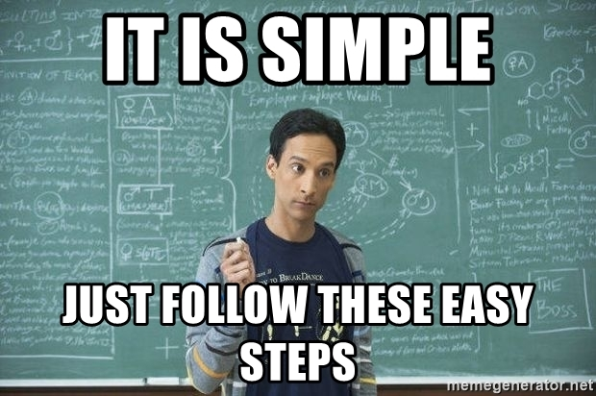
Capital Improvement Program
STEP 4 - MONITORING
STEP 1 - IDENTIFICATION
STEP 2 - CATEGORIZATION
STEP 3 - SCHEDULING
STEP 4 - MONITORING
STEP 5 – EVALUATING
Notes:
For purposes of the presentation I will be simplifying the complex Capital Improvement Program into 5 easy steps.
Step 1 - MSD Projects Identified for our Capital Improvement Program were based on collected field data and hydraulic modeling results THROUGH THE USE OF FLOW MONITORING
Step 2 - MSD Categorized the identified projects using a three (3) tier system.
Tier 1 and Tier 2 are consent decree projects that are held to a strict schedule.
Tier 1 projects have a constructed SSO outfall associated with the project
Tier 2 projects improve the Level of Service in the system such as mitigating known SSO (i.e. Overflowing Manholes) or building backups.
Tier 3 projects provide operation benefits as well as long term system sustainability. (i.e. lining projects to eliminate routine maintenance or pump station elimination)
Step 3 - MSD utilizes Oracle Primavera P6 Software to manage project schedules for all identified capital improvement projects to ensure project goals are met.
To give you an idea of the complexity of MSD Capital Improvement Program, MSD has identified over 430 projects.
Over 100 Projects requires post-construction flow monitoring to evaluate the need for contingency projects.
Using P6, MSD is able to track each projects progress and the effects of successor projects when the predecessor project starts to miss design or construction milestones.
Flow monitoring is also factored into the P6 schedule. Enough time NEEDS to be factored into the schedule to have sufficient time for flow monitoring. That takes us to Step 4 (next slide)
Step 4 – MSD monitors the effectiveness of completed projects with metering, modeling, and other field. What originally identified the project in Step 1 is re-evaluated. This is where new technology has played a major role.
Step 5 – MSD Evaluates the Contingency Projects to determine the need.
For the Purpose of this presentation we will focus majority of our time on Step 4 and Step 5.

Slide 6
Capital Improvement Program
STEP 4 - MONITORING
2017 Collected Data
288 Flow Meters Installed
161 Permanent/Regulatory
119 Post-Construction
8 Pre-Construction
Level and velocity every 15 minutes from March 1st to September 30th.
That’s a total of 41,088 collected level and velocity data.

Slide 7
Capital Improvement Program
STEP 4 - MONITORING

Slide 8
Flow Monitoring Technology – Then and Now
Old Flow Monitoring Technology
Manual & Singular
Manually Collected Data
One Area/Velocity (AV) Sensor
New Flow Monitoring Technology
Telemetry & Redundancy
Records and Transmits Data Automatically
Multiple Sensors

Slide 9
Flow Monitoring Technology – Then and Now

Slide 10
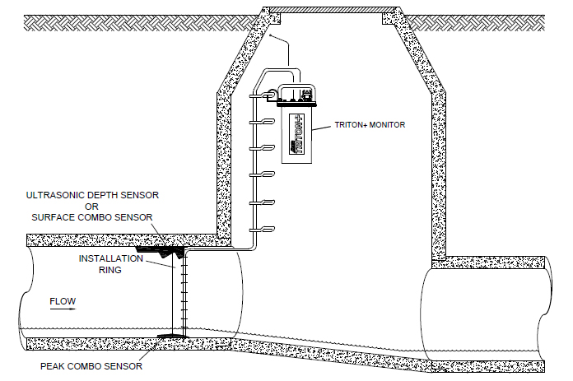
Typical Flow Monitor Setup with Redundancy

Slide 11
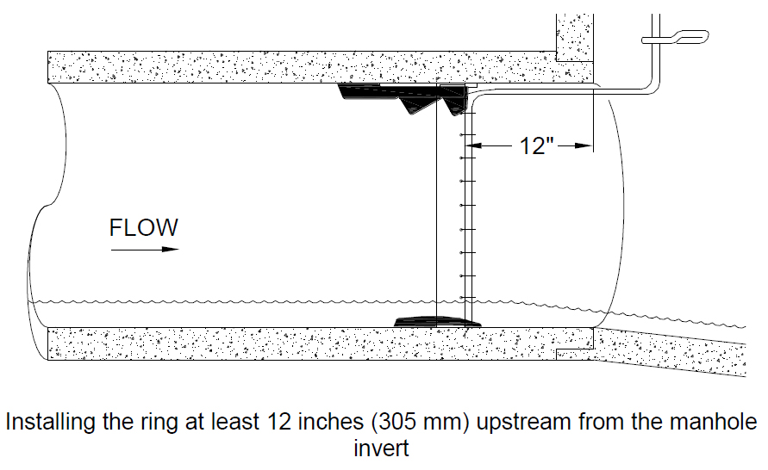
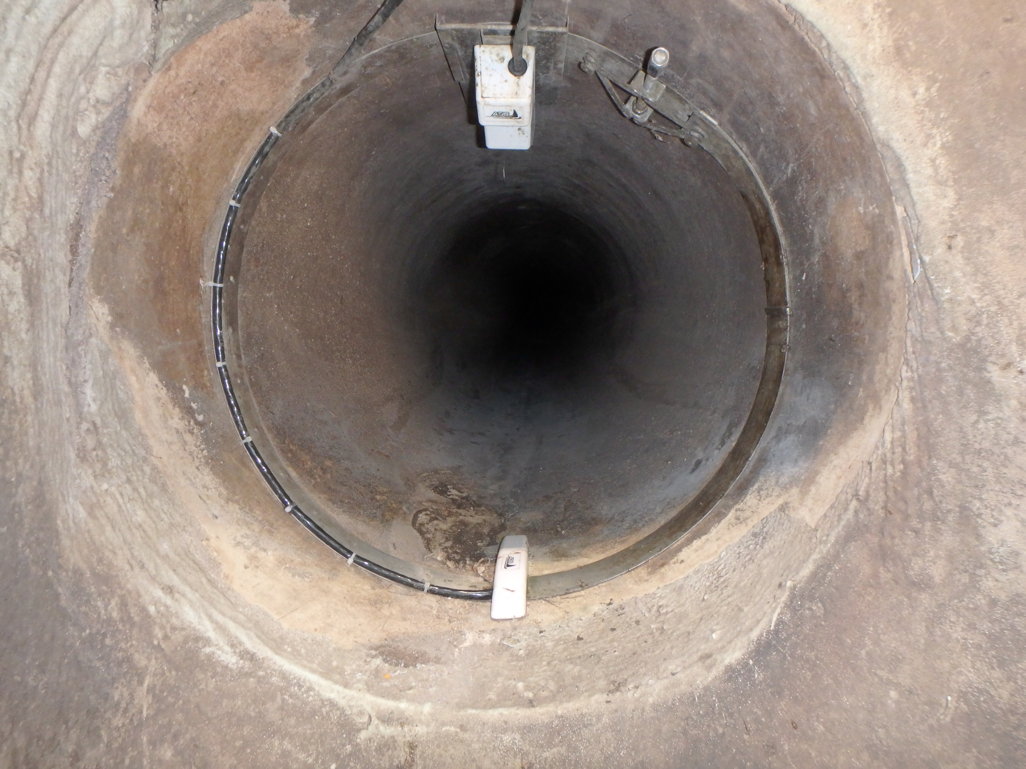
Typical Flow Monitor Setup with Redundancy

Slide 12
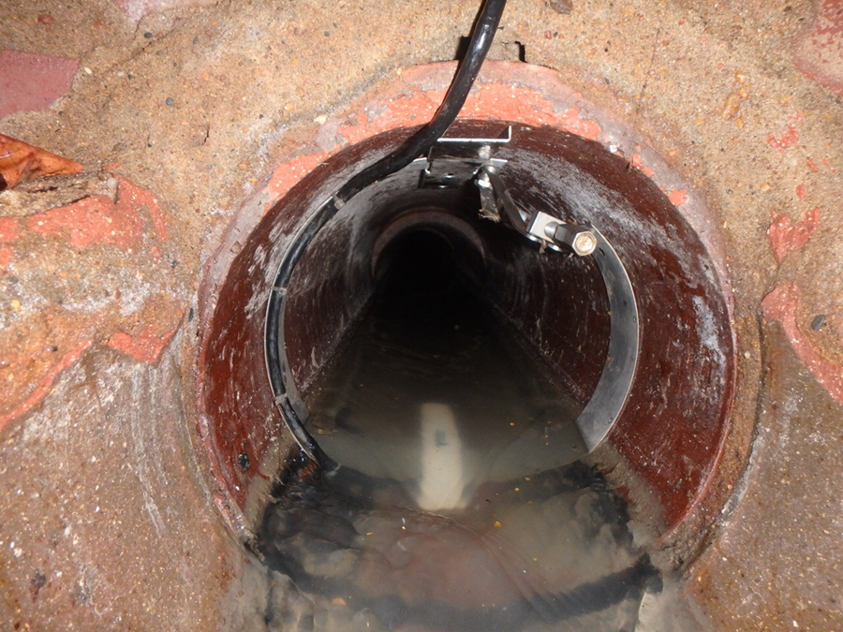
Flow Monitoring Technology – Example

Slide 13
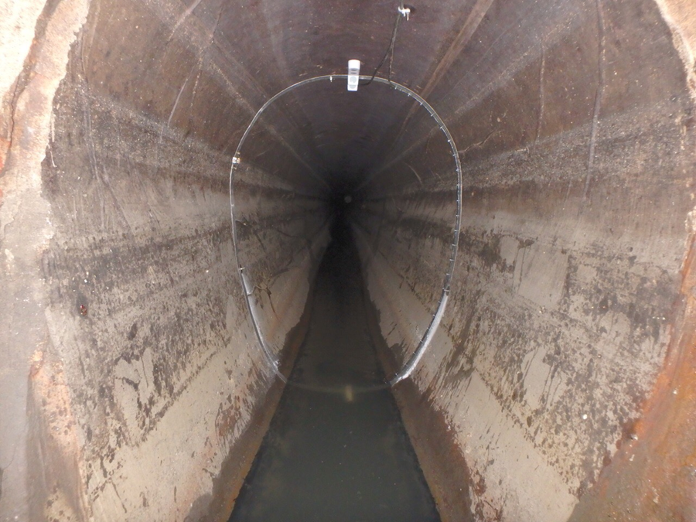
Flow Monitoring Technology – Example

Slide 14
Equipment Used
Flow Monitoring Technology (Flow Monitoring Program)
ADS Triton+
A/V Sensor
Ultrasonic Sensor
ADS Echo
Level-Only Monitoring

Slide 15
Capital Improvement Program
STEP 5 – EVALUATING

Slide 16
Capital Improvement Program
STEP 5 - EVALUATING
MSD evaluates capacity assurance and need for contingency projects.
Four (4) possible outcomes for a contingency project
Project not Needed–WIN($$$$)
Reduction in Scope – WIN($$)
Project Needed – NO SAVINGS
Increase in Scope – WIN ($$$)
Essentially a Win-Win-Win Situation
Notes:
Fifth – What are the possible outcomes of evaluating the need of a contingency project.
There are 4 possible outcomes.

Slide 17
Capital Improvement Program
STEP 5 – EVALUATING
MSD evaluates capacity assurance and need for contingency projects.
2017 Monitoring Season
14 Contingency Projects Evaluated
3 Projects Reduced in Scope (21%)
Total Savings of $3,322,050
Total Metering Cost of $58,375
Approx. $60 Saved per $1 Spent on Metering
4 Projects Dropped (29%)
Total Savings of $4,841,000
Total Metering Cost of $20,450
Approx. $240 Saved per $1 Spent on Metering
7 Projects Scope Verified (50%)
Total Project Cost of $21,044,000
Total Metering Cost of $65,830
Less than a 0.5% total increase in Project cost to confirm project scope.

Slide 18
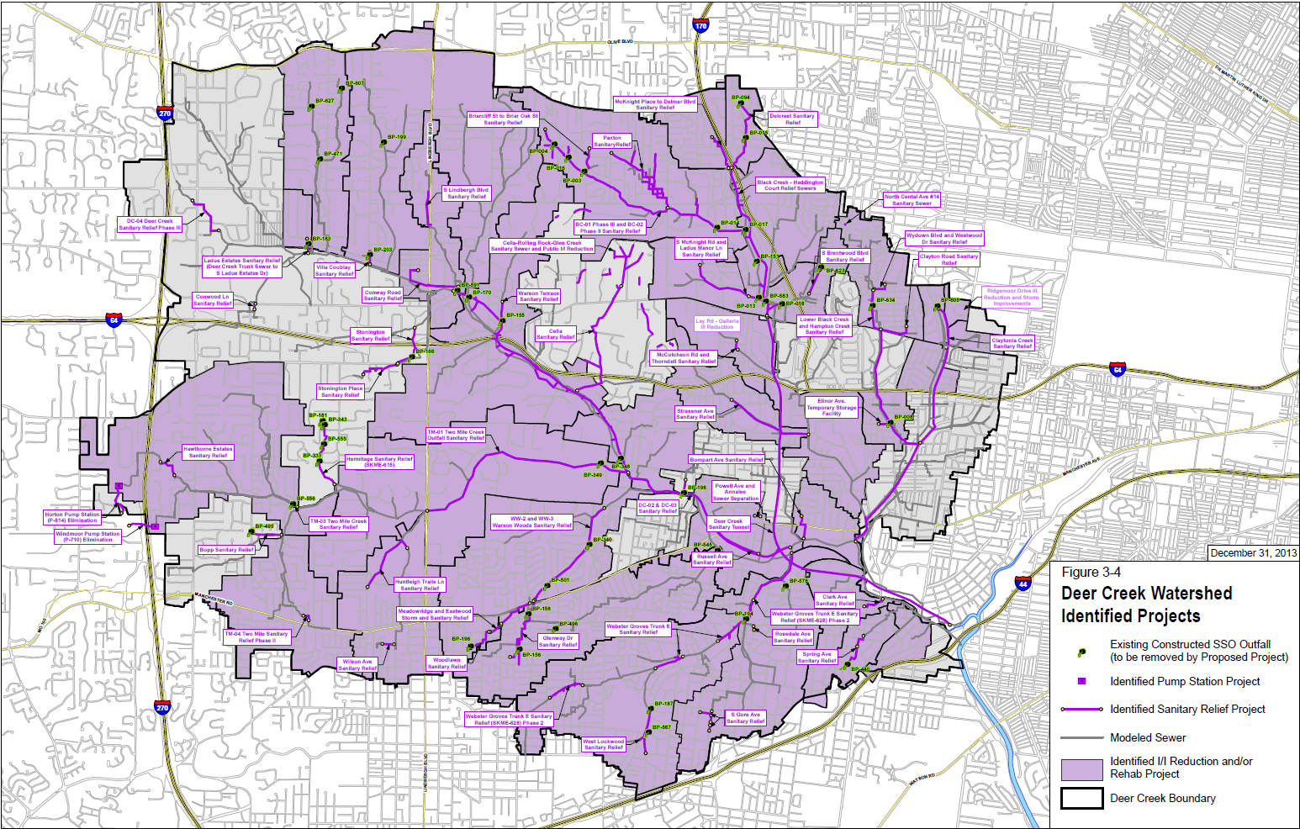
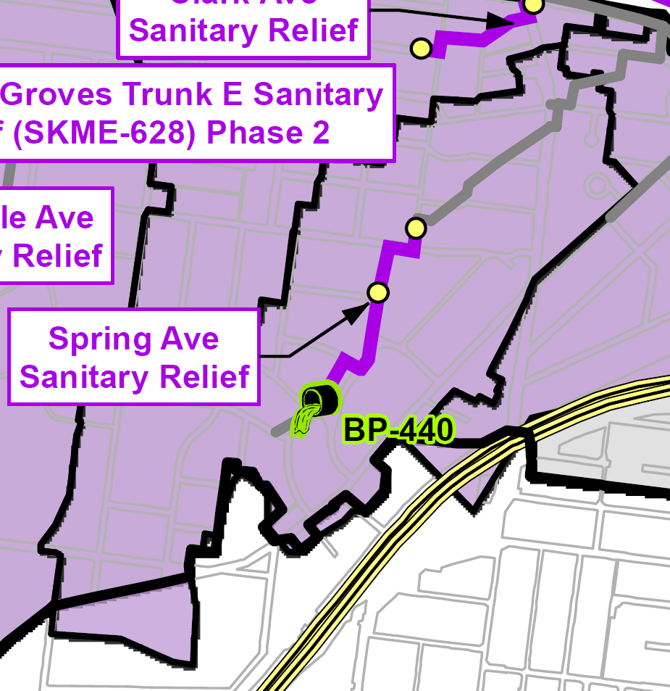
Deer Creek
Spring Avenue
Sanitary Relief
Project
Eliminate Constructed SSO Outfall BP-440
Construct Approx. 4,000 feet of 12-inch to 21-inch sanitary sewer and appurtenances.
Design Cost - $736,000
Construction Cost - $4,332,398
Notes:
The Spring Avenue Sanitary Relief Project is a contingency project located in the Deer Creek Watershed. The Deer Creek Watershed is centrally located in St. Louis.
The Spring Avenue Sanitary Relief predecessor project was the Providence I I/I Reduction.
There is one Constructed SSO Outfall associated with the project. The contingency project, if needed will eliminated Constructed SSO Outfall BP-440 through the construction of approximately 4,000 feet of 12-inch to 21-inch sanitary sewers with a design cost of $736,000 and a construction cost of $4,332,398.

Slide 19
Deer Creek
Spring Avenue
Sanitary Relief
Project
One Modeled Sewer Lateral
Providence Lateral
Existing Conditions
Capacity Issues for 2-year, 5-year, and 10-year rain events.
Updated Model (utilizing 2017 Flow Meter Data)
Capacity for the 5-year and 10-year rain events.
Notes:
Good example of “right-sizing” with proper placement of meters (for post construction metering).
Spring Ave (Providence Lateral, an 8” to 27” lateral) was initially calibrated to a 2005 meter on 84” Deer Creek trunk sewer.
3 2017 meters installed (one at the upstream end of the project, one near the downstream end of the project, one at the downstream end of the lateral, just upstream from the Deer Creek trunk.
Primarily public I/I removal (lining) (Providence I/I removal). Some private I/I done, but not in time for 2017 evaluation.
-2% decrease in total defect area (from ~221,000 ft^2 to ~218,000 ft^2) however…
-27% decrease in total discrete defect area (35% decrease in inflow, 24% decrease in infiltration)
-~3,000% increase in service area (unknown) defects (from ~1,500 ft^2 to ~47,000 ft^2). This increase was isolated downstream from the project area, on a 27” sewer that has plenty of capacity
Resulting flow
-at the upstream end of the project area (near the upstream meter), the Q increases ~ 2% to 3% for the 5 and 10 year design storms (essentially noise in the data and therefore no change)
-at the downstream end of the project, the Q decreased by ~40% for the 5 and 10 year design storms
-near the Deer Creek trunk, the 5 year flow increases by ~9%, the 10 year flow increases by ~3%. Again, the 27” sewer has plenty of capacity to handle the flow.
~ 45% reduction in project scope and cost

Slide 20
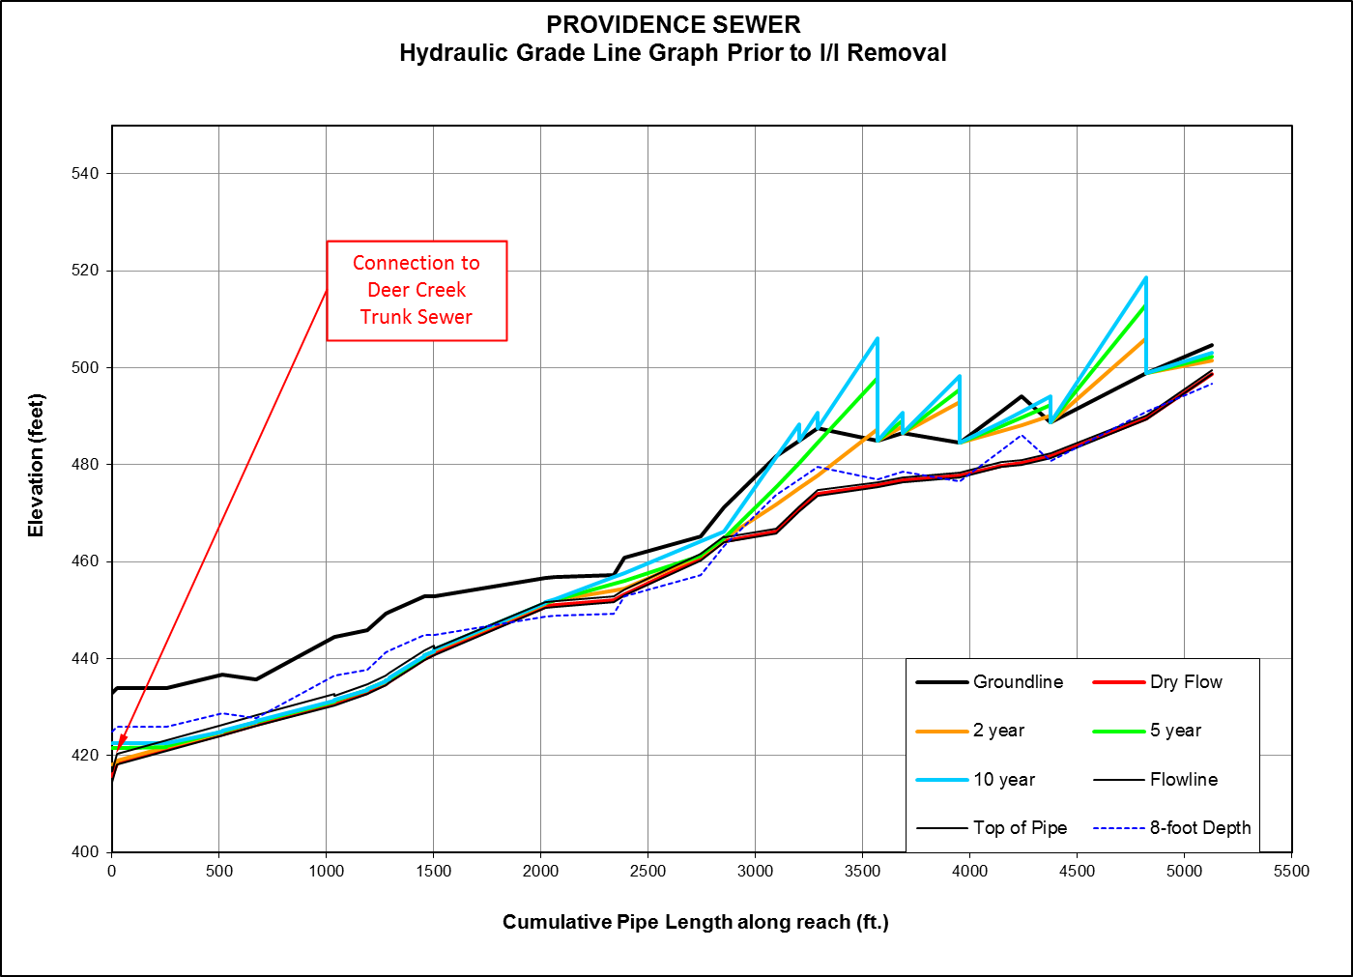
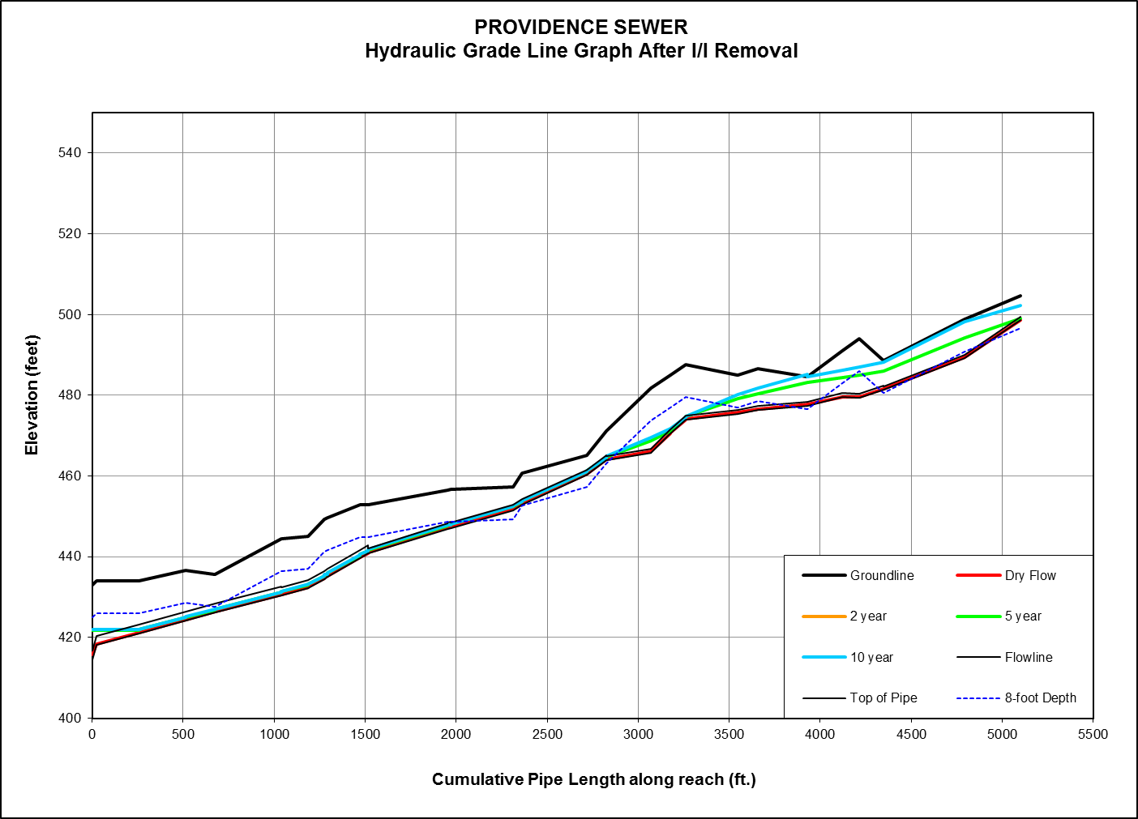
Deer Creek
reduced
Notes:
Good example of “right-sizing” with proper placement of meters (for post construction metering).
Spring Ave (Providence Lateral, an 8” to 27” lateral) was initially calibrated to a 2005 meter on 84” Deer Creek trunk sewer.
3 2017 meters installed (one at the upstream end of the project, one near the downstream end of the project, one at the downstream end of the lateral, just upstream from the Deer Creek trunk.
Primarily public I/I removal (lining) (Providence I/I removal). Some private I/I done, but not in time for 2017 evaluation.
-2% decrease in total defect area (from ~221,000 ft^2 to ~218,000 ft^2) however…
-27% decrease in total discrete defect area (35% decrease in inflow, 24% decrease in infiltration)
-~3,000% increase in service area (unknown) defects (from ~1,500 ft^2 to ~47,000 ft^2). This increase was isolated downstream from the project area, on a 27” sewer that has plenty of capacity
Resulting flow
-at the upstream end of the project area (near the upstream meter), the Q increases ~ 2% to 3% for the 5 and 10 year design storms (essentially noise in the data and therefore no change)
-at the downstream end of the project, the Q decreased by ~40% for the 5 and 10 year design storms
-near the Deer Creek trunk, the 5 year flow increases by ~9%, the 10 year flow increases by ~3%. Again, the 27” sewer has plenty of capacity to handle the flow.
~ 45% reduction in project scope and cost

Slide 21
Over $8 Million Dollars Saved by Flow Monitoring for 1 year!
Notes:
Over $8.1 million in savings with one year of flow monitoring and modeling.

Slide 22
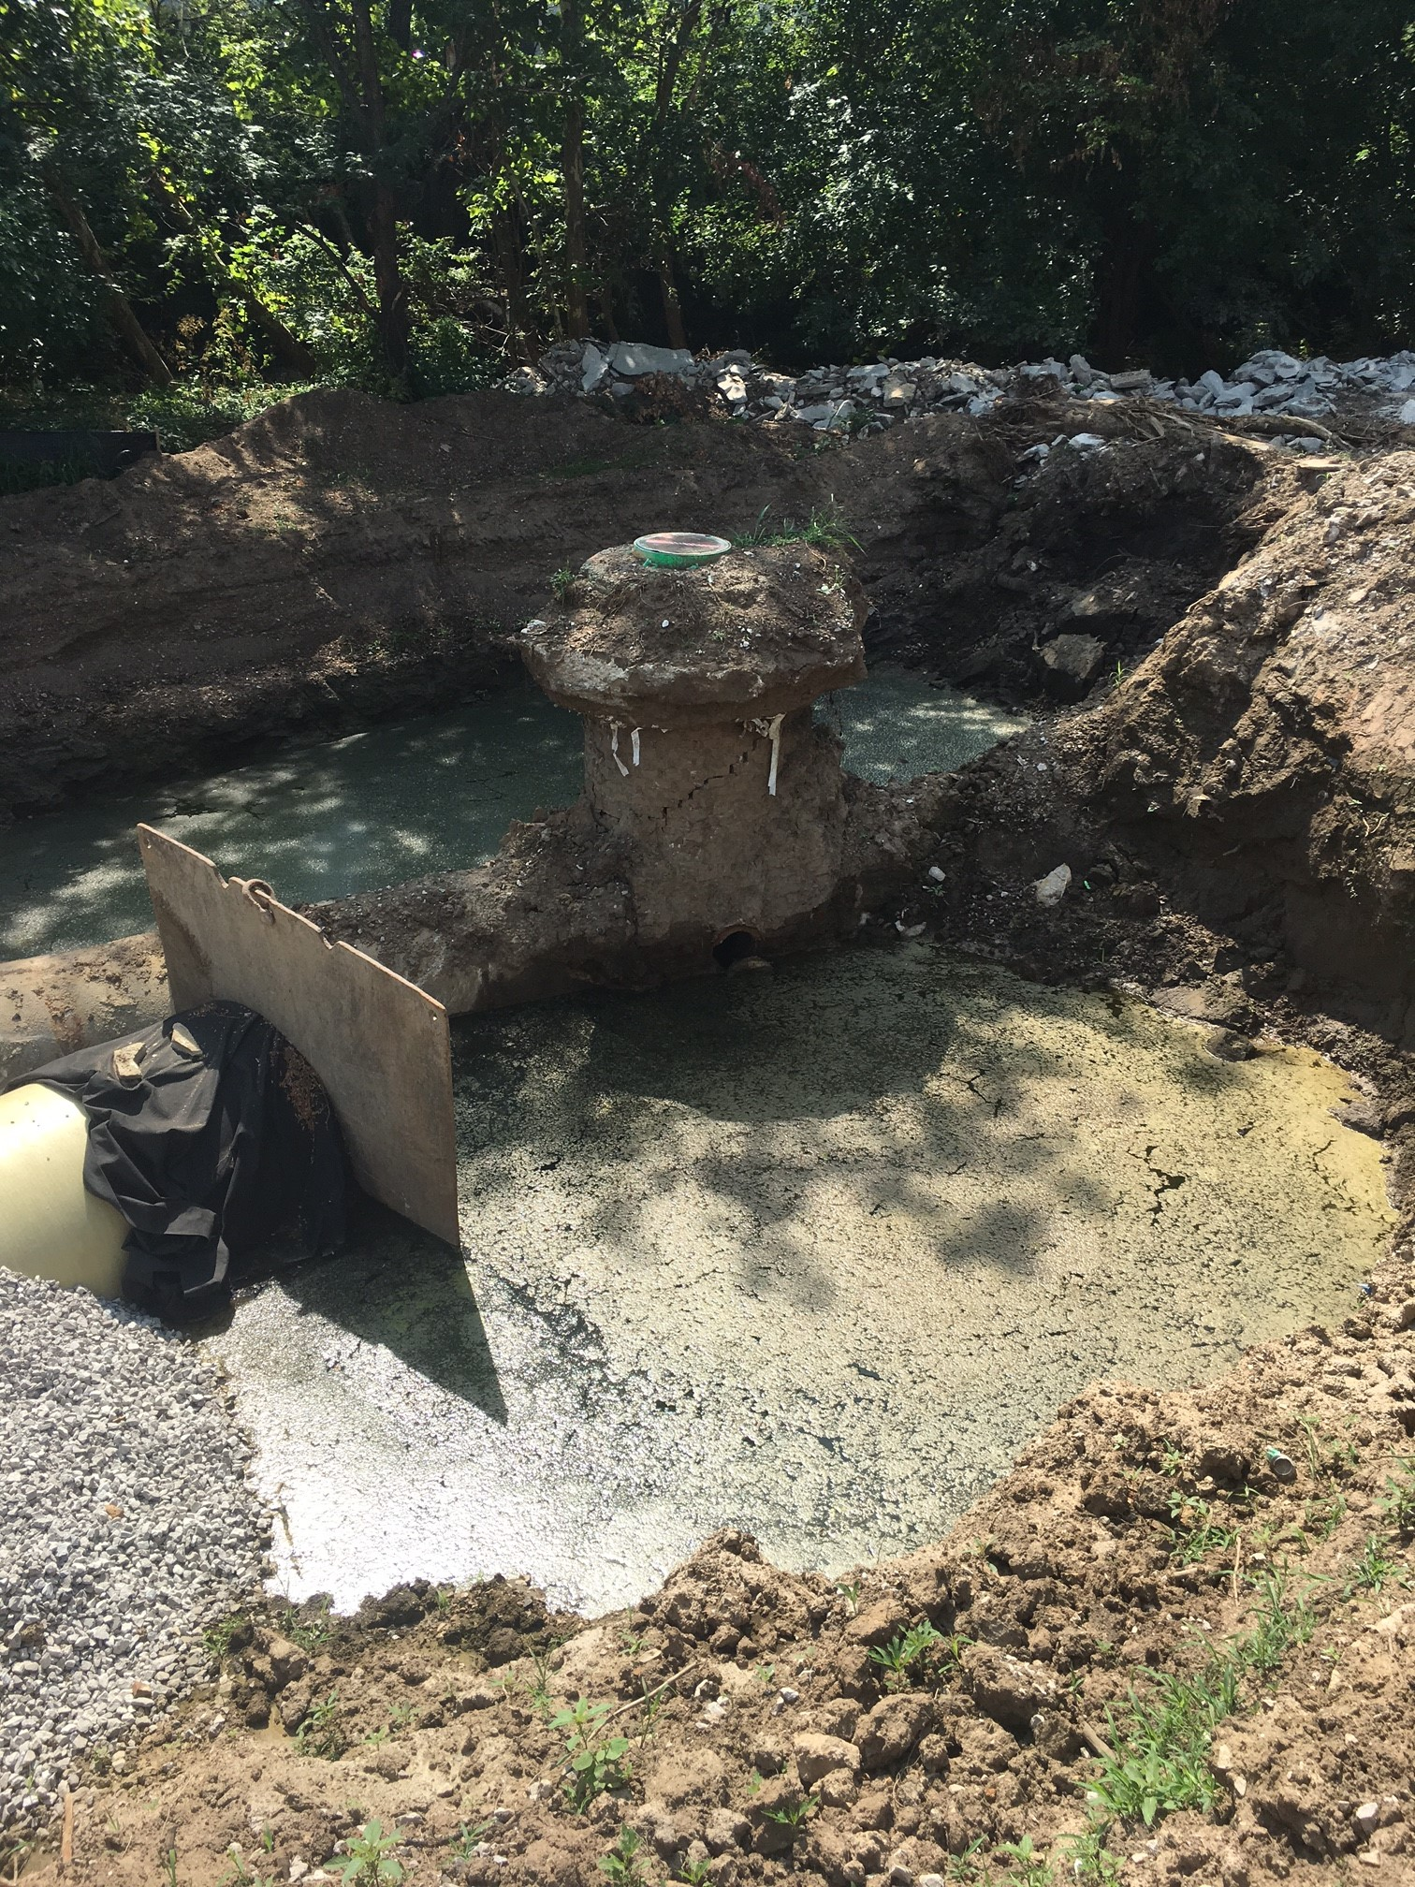
Obstacles, Coordination, and Communication

Slide 23
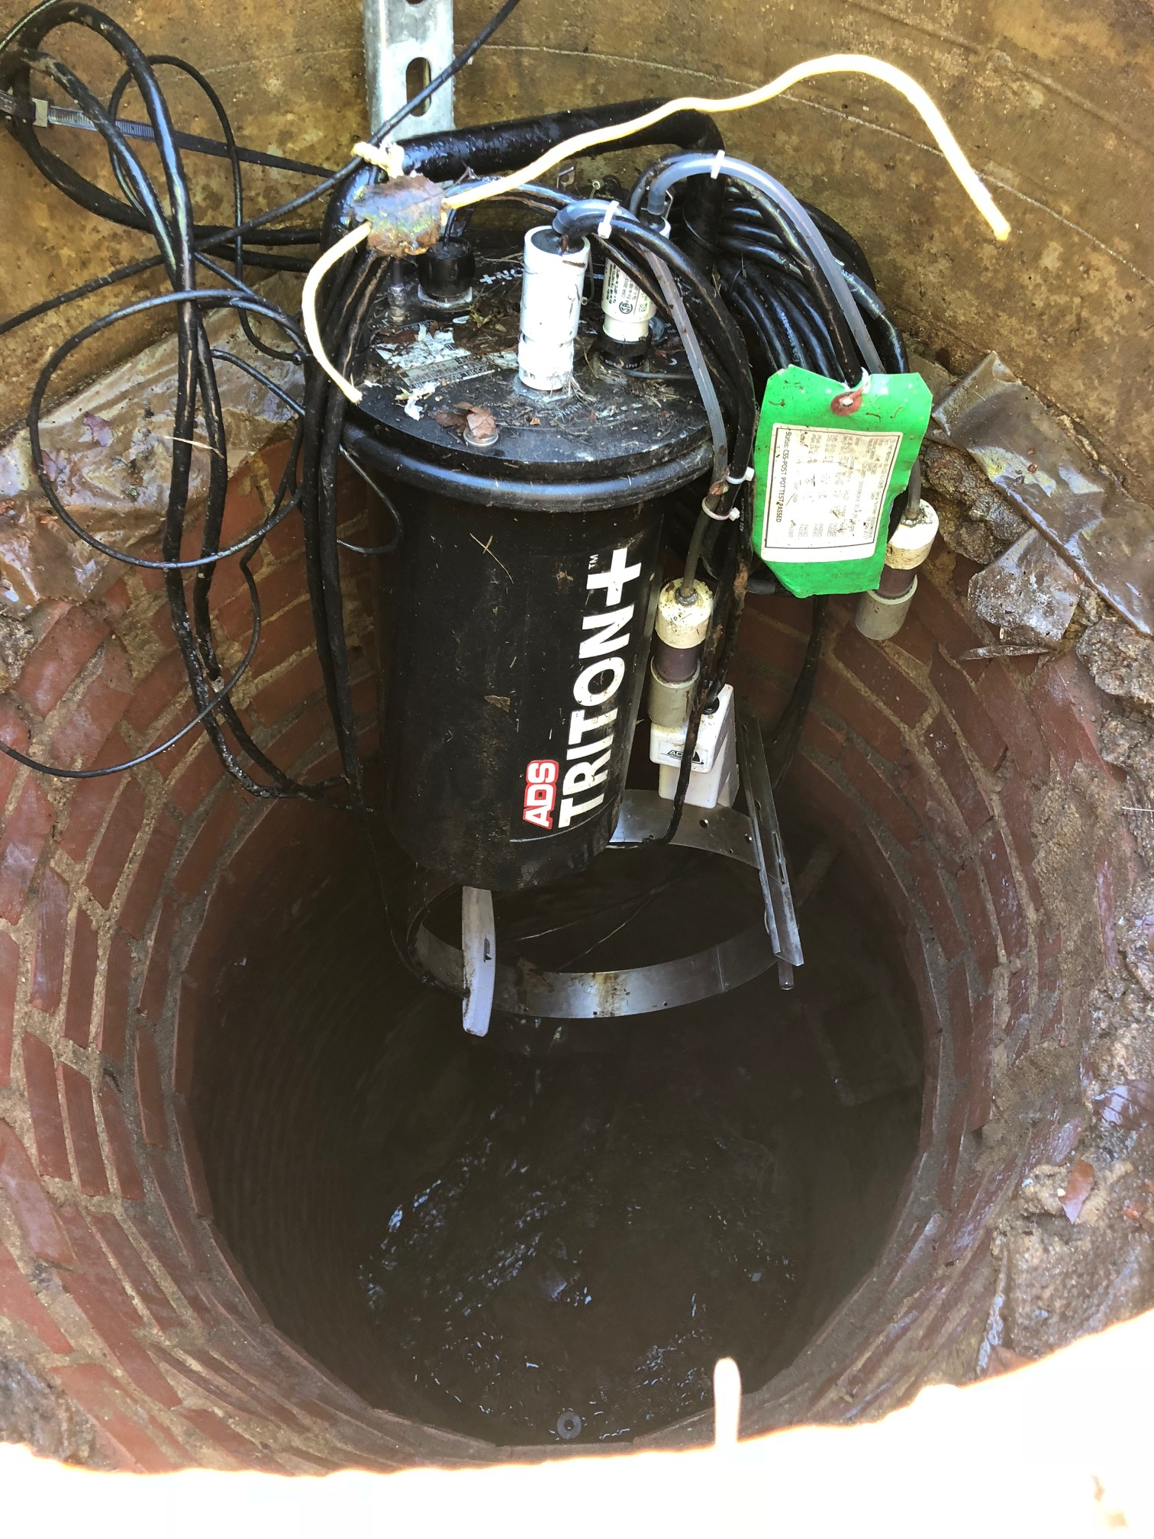
Obstacles, Coordination, and Communication

Slide 24
Obstacles, Coordination, and Communication

Slide 25
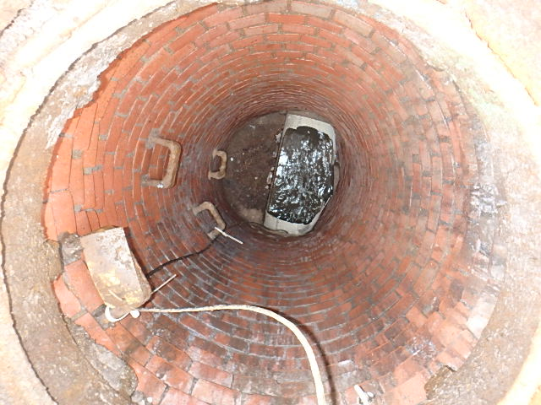
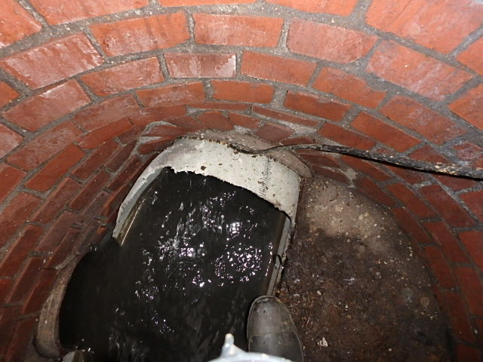
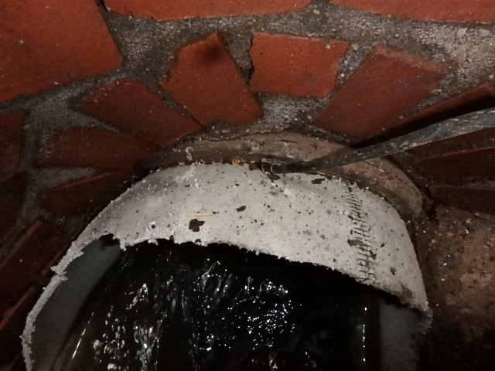
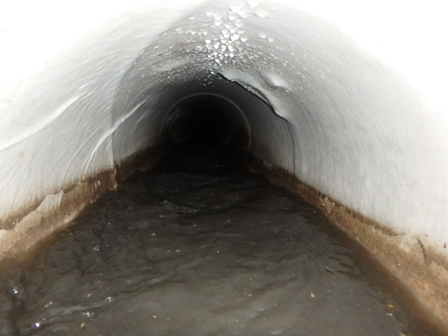
Obstacles, Coordination, and Communication

Slide 26
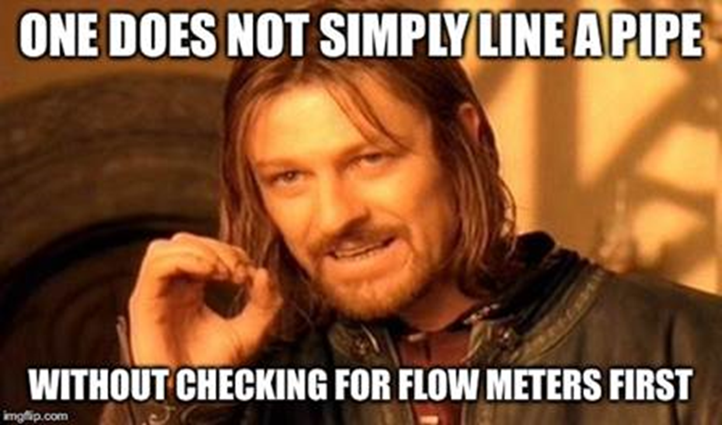
Obstacles, Coordination, and Communication

Slide 27
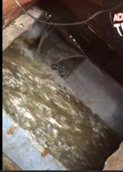
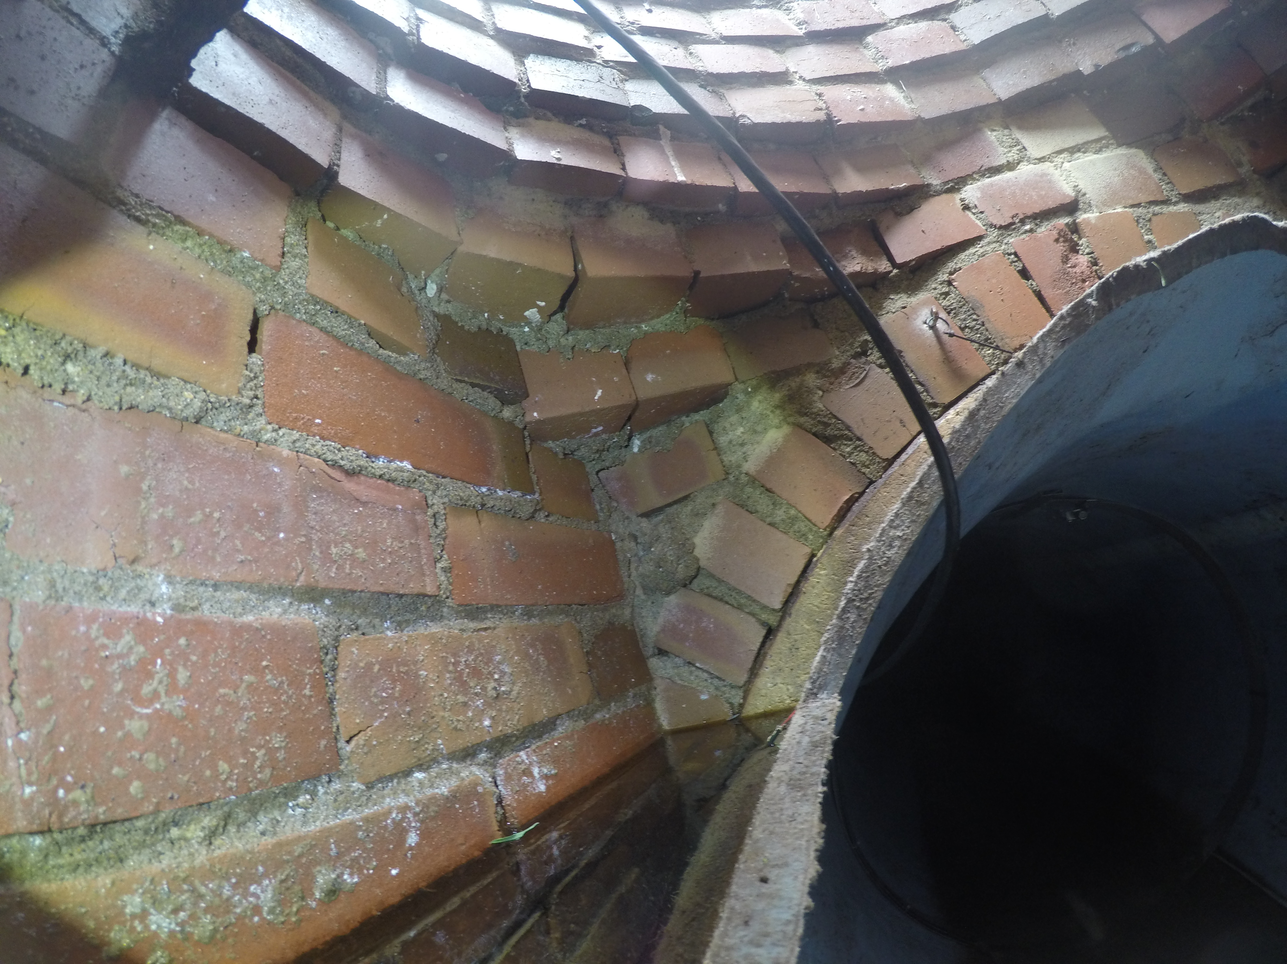
Obstacles, Coordination, and Communication

Slide 28
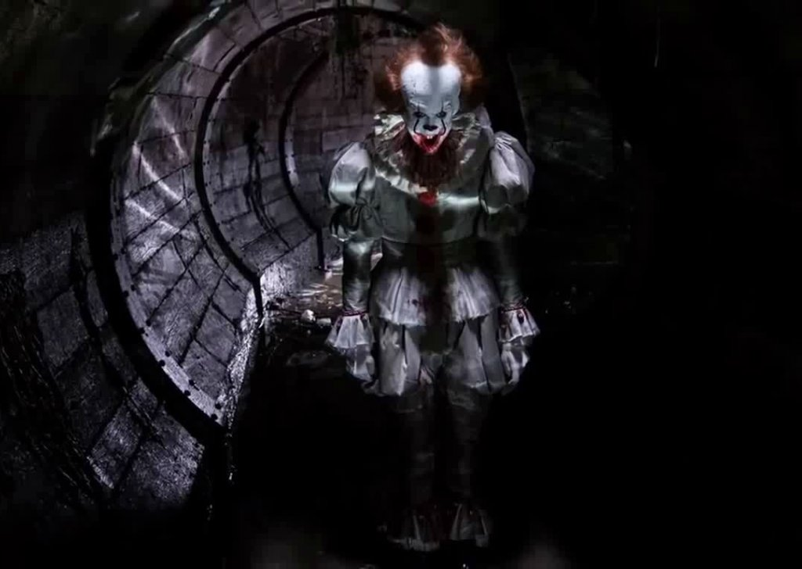
Not spending a few extra dollars on flow metering is Pennywise

Slide 29
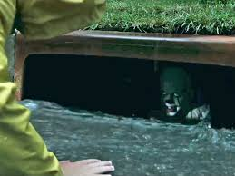
Pound Foolish…
Let’s keep the clowns in the sewer where they belong

Slide 30
Questions?
Thank You!

Slide 31
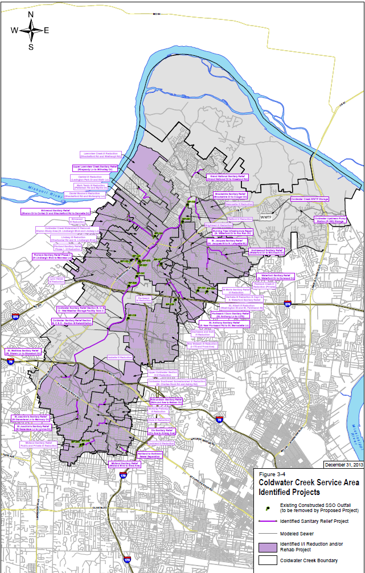
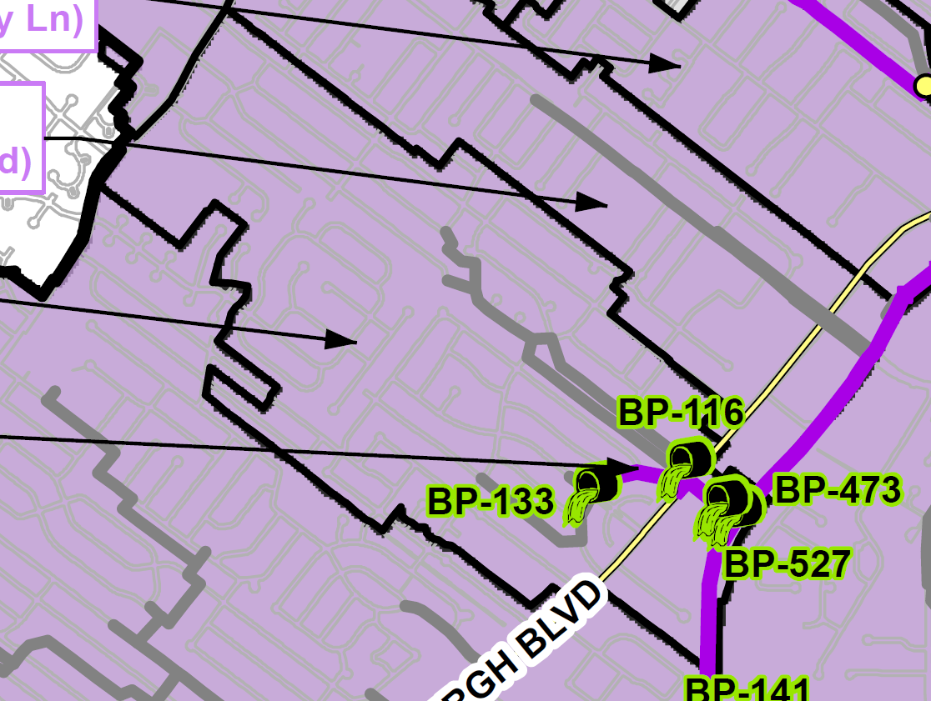
Coldwater Creek
Florland Sanitary
Relief Phase II
Project
Notes:
Next we will discuss three projects that were evaluated during the 2017 Flow Monitoring Year.
The Florland Sanitary Relief Project Phase II is a contingency project located in Coldwater Creek Watershed. Coldwater Creek is located in Northern part of St. Louis.
The Florland Sanitary Relief Phase II predecessor project was the Florland Sanitary Relief Phase I I/I Reduction.
There is one Constructed SSO Outfall associated with the project. The contingency project, if needed will eliminated Constructed SSO Outfall BP-133 through the construction of approximately 1,930 feet of 18-inch to 24-inch sanitary sewers with a design cost of $315,000 and a construction cost of $1,487,000.

Slide 32
Coldwater Creek
Florland Sanitary
Relief Phase II
Project
Eliminate Constructed SSO Outfall BP-133
Construct Approx. 1,930 feet of 18-inch to 24-inch sanitary sewer and a appurtenances.
Design Cost - $315,000
Construction Cost - $1,487,000
Notes:
The Florland Sanitary Relief Project Phase II is a contingency project located in Coldwater Creek Watershed. Coldwater Creek is located in Northern part of St. Louis.
The Florland Sanitary Relief Phase II predecessor project was the Florland Sanitary Relief Phase I I/I Reduction.
There is one Constructed SSO Outfall associated with the project. The contingency project, if needed will eliminated Constructed SSO Outfall BP-133 through the construction of approximately 1,930 feet of 18-inch to 24-inch sanitary sewers with a design cost of $315,000 and a construction cost of $1,487,000.

Slide 33
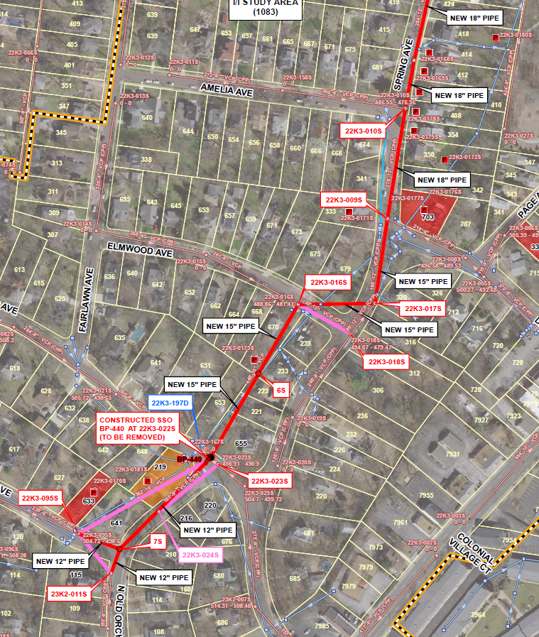
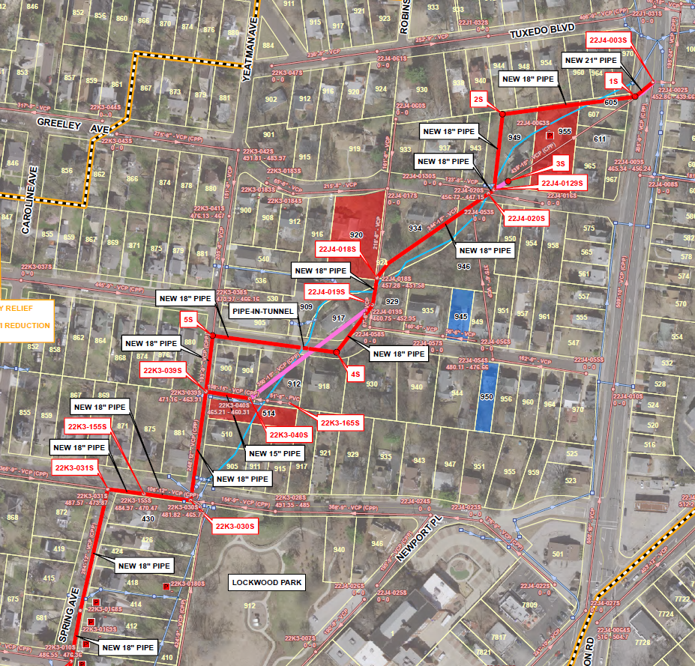
Deer Creek
Spring Avenue
Sanitary Relief
Project
Notes:
The Spring Avenue Sanitary Relief Project is a contingency project located in the Deer Creek Watershed. The Deer Creek Watershed is centrally located in St. Louis.
The Spring Avenue Sanitary Relief predecessor project was the Providence I I/I Reduction.
There is one Constructed SSO Outfall associated with the project. The contingency project, if needed will eliminated Constructed SSO Outfall BP-440 through the construction of approximately 4,000 feet of 12-inch to 21-inch sanitary sewers with a design cost of $736,000 and a construction cost of $4,332,398.

Slide 34
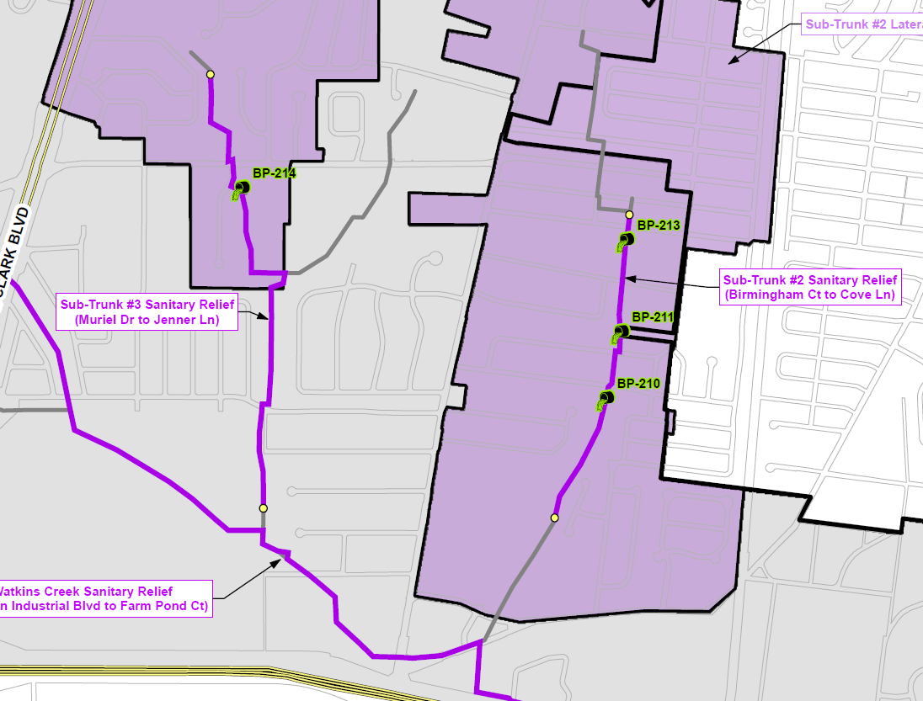
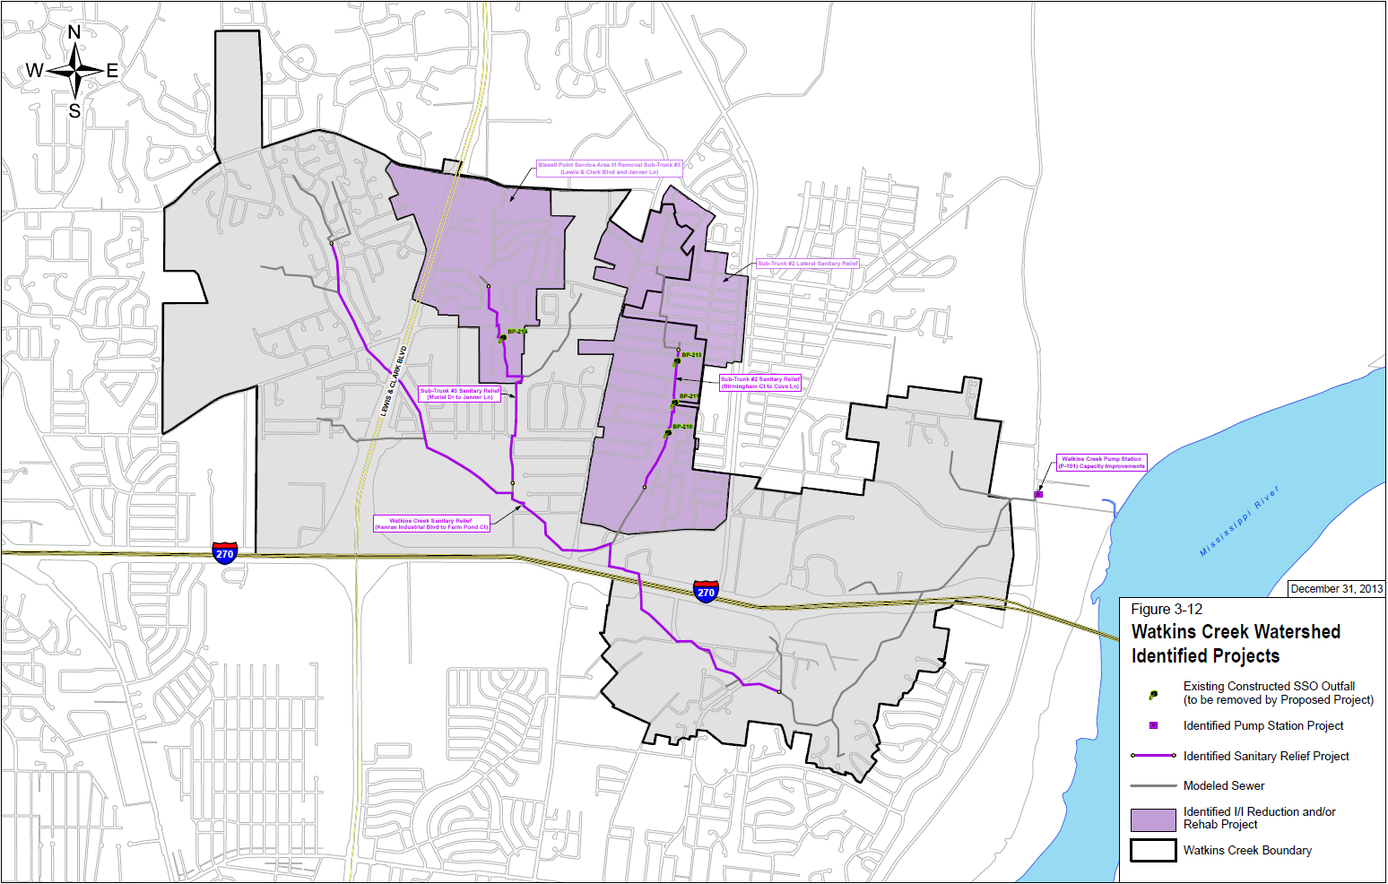
Watkins Creek
Sub-Trunk #2 & Sub-Trunk #3
Sanitary Relief Project
Notes:
Sub-Trunk 2 & Sub-Trunk 3 Sanitary Relief Projects are contingency projects located in the Watkins Creek Watershed. The Watkins Creek Watershed is located Northern part of St. Louis.
The Sub-Trunk 2 & Sub-Trunk 3 Sanitary Relief predecessor projects were the Sub-Trunk #2 Lateral Sanitary Relief and Bissell Point Service Area I/I Removal – SubTrunk #3 Lateral.
There is 4 Constructed SSO Outfall associated with the projects. Three on Sub-Trunk #2 and one on Sub-Trunk #3.
The contingency project, Sub-Trunk #2, if needed will eliminated Constructed SSO Outfall BP-210, BP-211, and BP-213 through the construction of approximately 4,391 feet of 18-inch to 21-inch sanitary sewers.
The contingency project, Sub-Trunk #3, if needed will eliminated Constructed SSO Outfall BP-214 through the construction of approximately 4,282 feet of 8-inch to 27-inch sanitary sewers.
All together, the design cost will be $1,047,000 and a construction cost of $5,564,000.

Slide 35
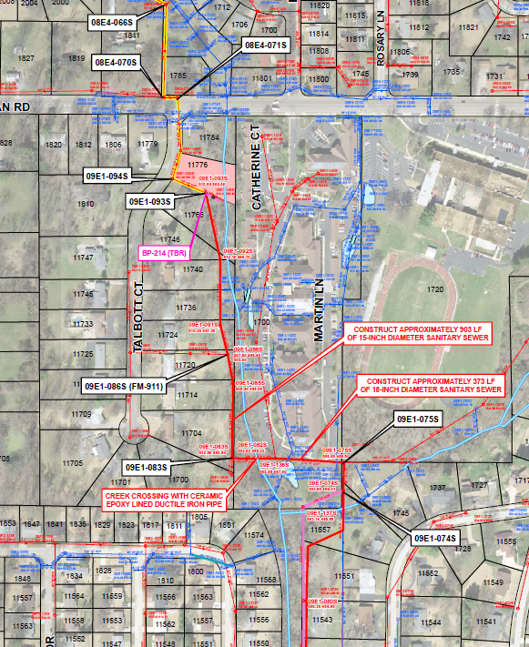
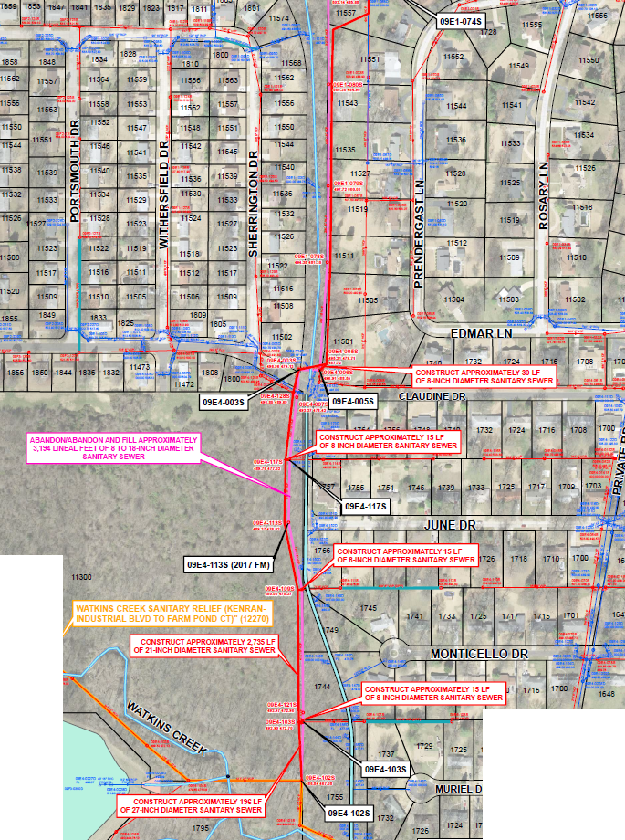
Watkins Creek
Sub-Trunk #2 & Sub-Trunk #3
Sanitary Relief Project
Notes:
Sub-Trunk 2 & Sub-Trunk 3 Sanitary Relief Projects are contingency projects located in the Watkins Creek Watershed. The Watkins Creek Watershed is located Northern part of St. Louis.
The Sub-Trunk 2 & Sub-Trunk 3 Sanitary Relief predecessor projects were the Sub-Trunk #2 Lateral Sanitary Relief and Bissell Point Service Area I/I Removal – SubTrunk #3 Lateral.
There is 4 Constructed SSO Outfall associated with the projects. Three on Sub-Trunk #2 and one on Sub-Trunk #3.
The contingency project, Sub-Trunk #2, if needed will eliminated Constructed SSO Outfall BP-210, BP-211, and BP-213 through the construction of approximately 4,391 feet of 18-inch to 21-inch sanitary sewers.
The contingency project, Sub-Trunk #3, if needed will eliminated Constructed SSO Outfall BP-214 through the construction of approximately 4,282 feet of 8-inch to 27-inch sanitary sewers.
All together, the design cost will be $1,047,000 and a construction cost of $5,564,000.

Slide 36
Watkins Creek
Sub-Trunk #2 & Sub-Trunk #3
Sanitary Relief Project
Sub-Trunk #2
Eliminate Constructed SSO Outfalls BP-210, BP-211, and BP-213
Construct Approx. 4,391 feet of 18-inch to 21-inch sanitary sewer and appurtenances.
Sub- Trunk #3
Eliminate Constructed SSO Outfall BP-214
Construct Approx. 4,282 feet of 8-inch to 27-inch sanitary sewer and appurtenances.
Design Cost - $1,047,000
Construction Cost - $5,564,000
Notes:
Sub-Trunk 2 & Sub-Trunk 3 Sanitary Relief Projects are contingency projects located in the Watkins Creek Watershed. The Watkins Creek Watershed is located Northern part of St. Louis.
The Sub-Trunk 2 & Sub-Trunk 3 Sanitary Relief predecessor projects were the Sub-Trunk #2 Lateral Sanitary Relief and Bissell Point Service Area I/I Removal – SubTrunk #3 Lateral.
There is 4 Constructed SSO Outfall associated with the projects. Three on Sub-Trunk #2 and one on Sub-Trunk #3.
The contingency project, Sub-Trunk #2, if needed will eliminated Constructed SSO Outfall BP-210, BP-211, and BP-213 through the construction of approximately 4,391 feet of 18-inch to 21-inch sanitary sewers.
The contingency project, Sub-Trunk #3, if needed will eliminated Constructed SSO Outfall BP-214 through the construction of approximately 4,282 feet of 8-inch to 27-inch sanitary sewers.
All together, the design cost will be $1,047,000 and a construction cost of $5,564,000.

Slide 37
Coldwater Creek
Florland Sanitary
Relief Phase II
Project
Two Modeled Sewer Laterals
Florland Lateral
Loyola Lateral
Existing Conditions
Capacity Issues for 2-year, 5-year, and 10-year rain events.
Updated Model (utilizing 2017 Flow Meter Data)
Capacity for the 5-year and 10-year rain events.
Notes:
Prior to a discussion of the results, lets talk about the 2017 metering year: The District typically installs temporary meters for seven months (March through September). This allows us to capture the wet season baseline flows and rain events, the cloudburst summer events, and true dry weather baseline flows. In 2017 we had a Huge April/May, District wide ,multi storm rain event that nearly took out one of our treatment plants. This doesn’t happen very often (this was only the second time we had such a huge event in the past 16 months). Typically Infiltration leaves the system within hours or days. In this case, some sewers saw increases in baseline flows for weeks and months after that rain event. This affected both dry weather and wet weather model calibration efforts throughout the District in 2017.
In order to compare apples to apples for the three example projects, I will compare both the reduction in defect area obtained by recalibration of the model after the I/I reduction project as well as the resulting change in flow rates at the flowmeter location during the 5 and 10 year design storms
Defect reductions:
19% reduction in overall defect area
4% reduction in discrete private defect area
70% reduction discrete public defect area
16% reduction in Service Area (unknown) defect area
Resulting changes in flow rates at the flowmeter locations:
Florland Lateral Loyola Lateral
29.2% decrease in 5 year flow (from 4.6 cfs to 3.2 cfs) 16.8% increase in 5 year flow (from 1.5 cfs to 1.8 cfs)
28.6% decrease in 10 year flow (from 5.1 cfs to 3.7 cfs) 13.3% increase in 10 year flow (from 1.7 cfs to 2.0 cfs)

Slide 38
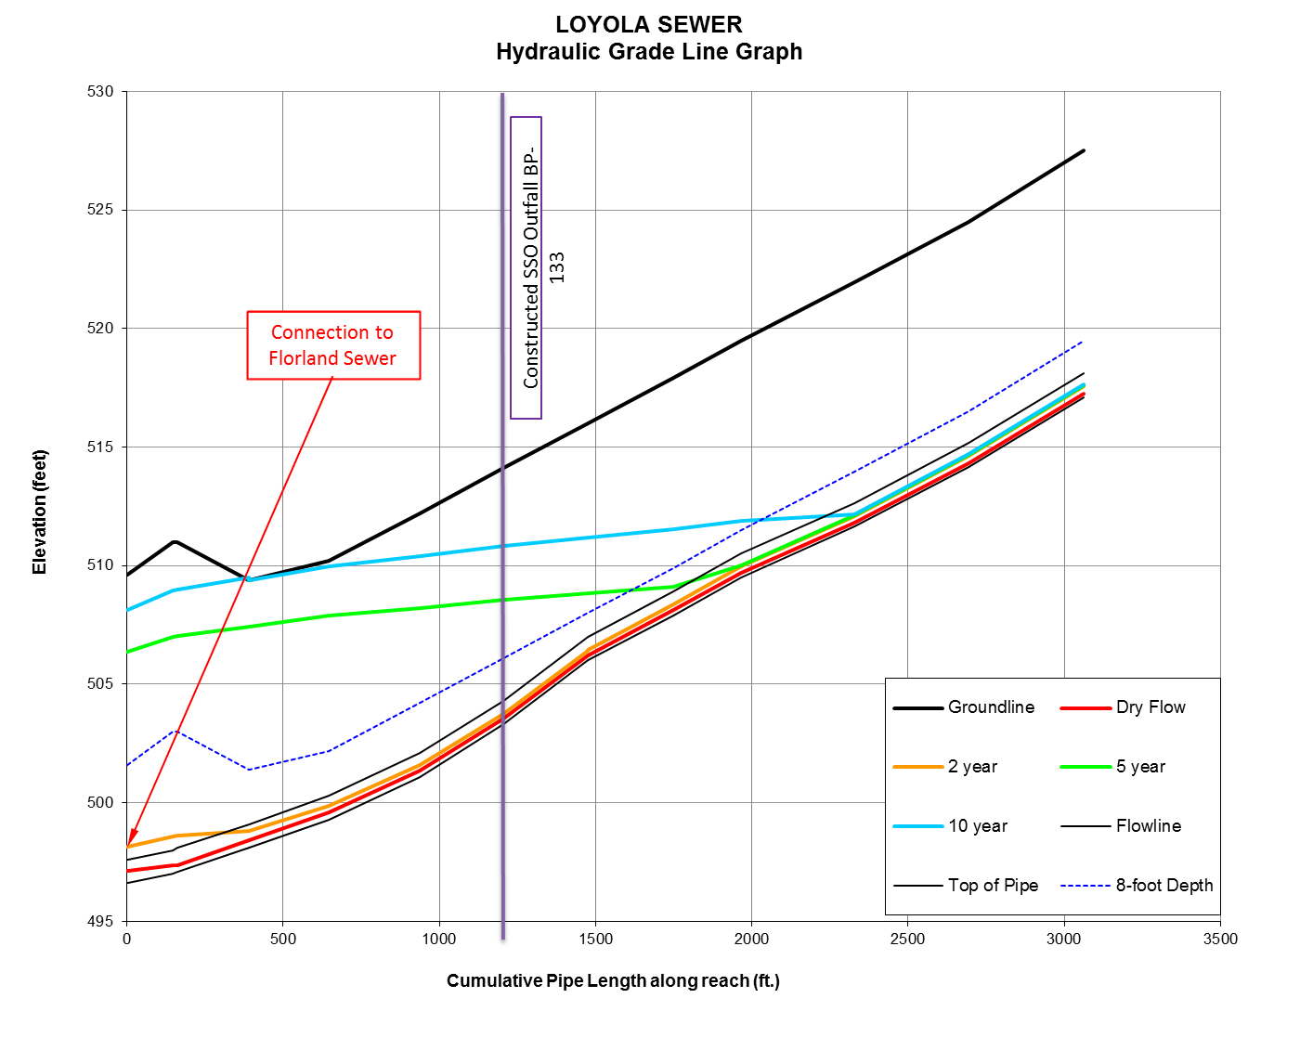
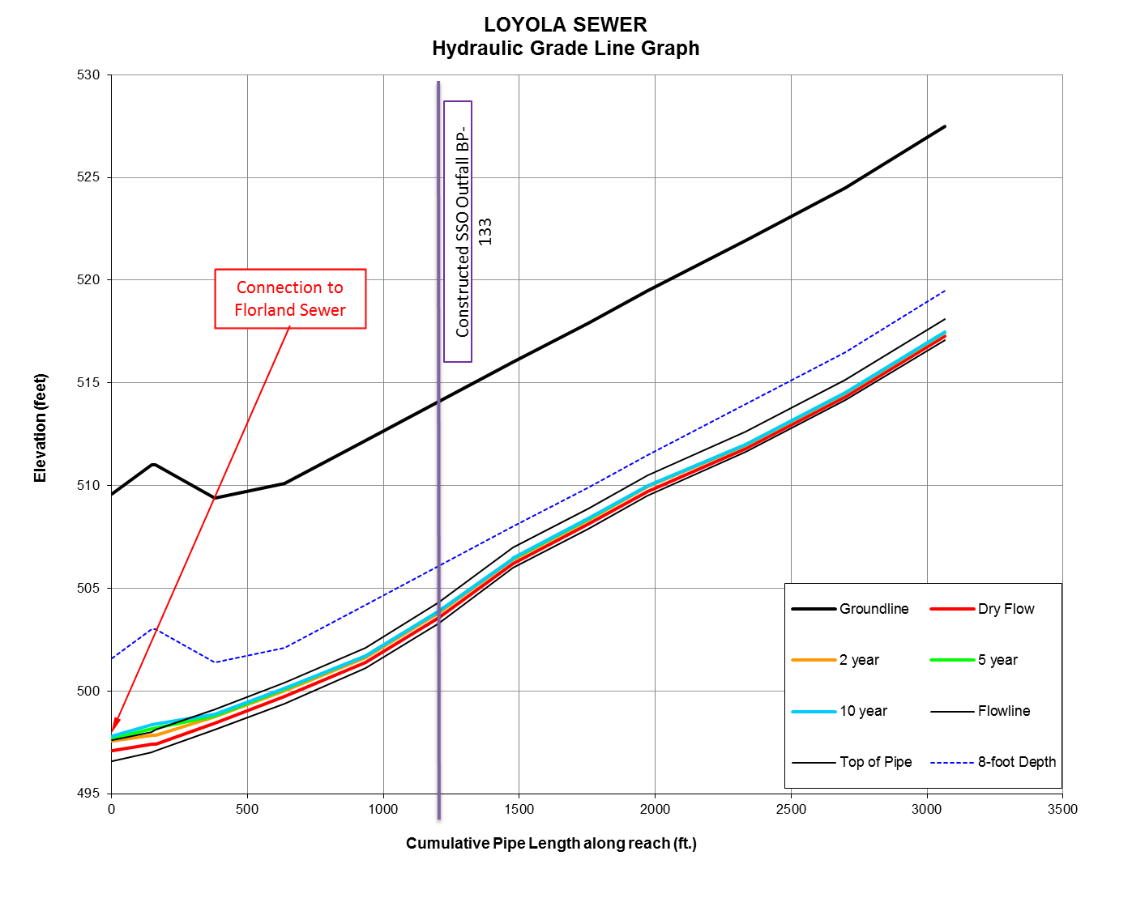
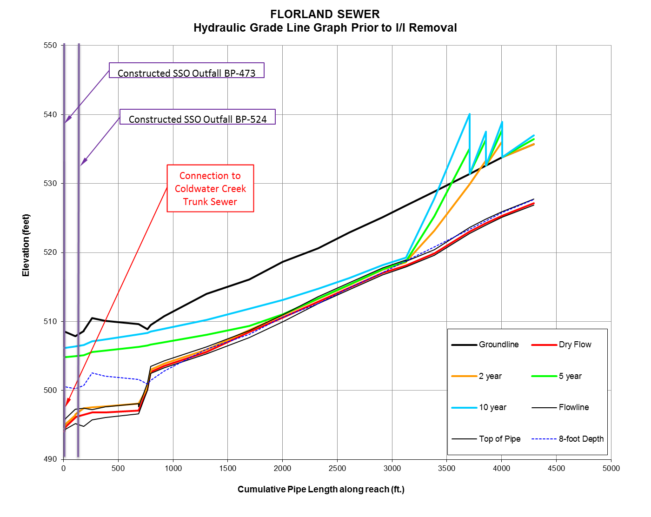
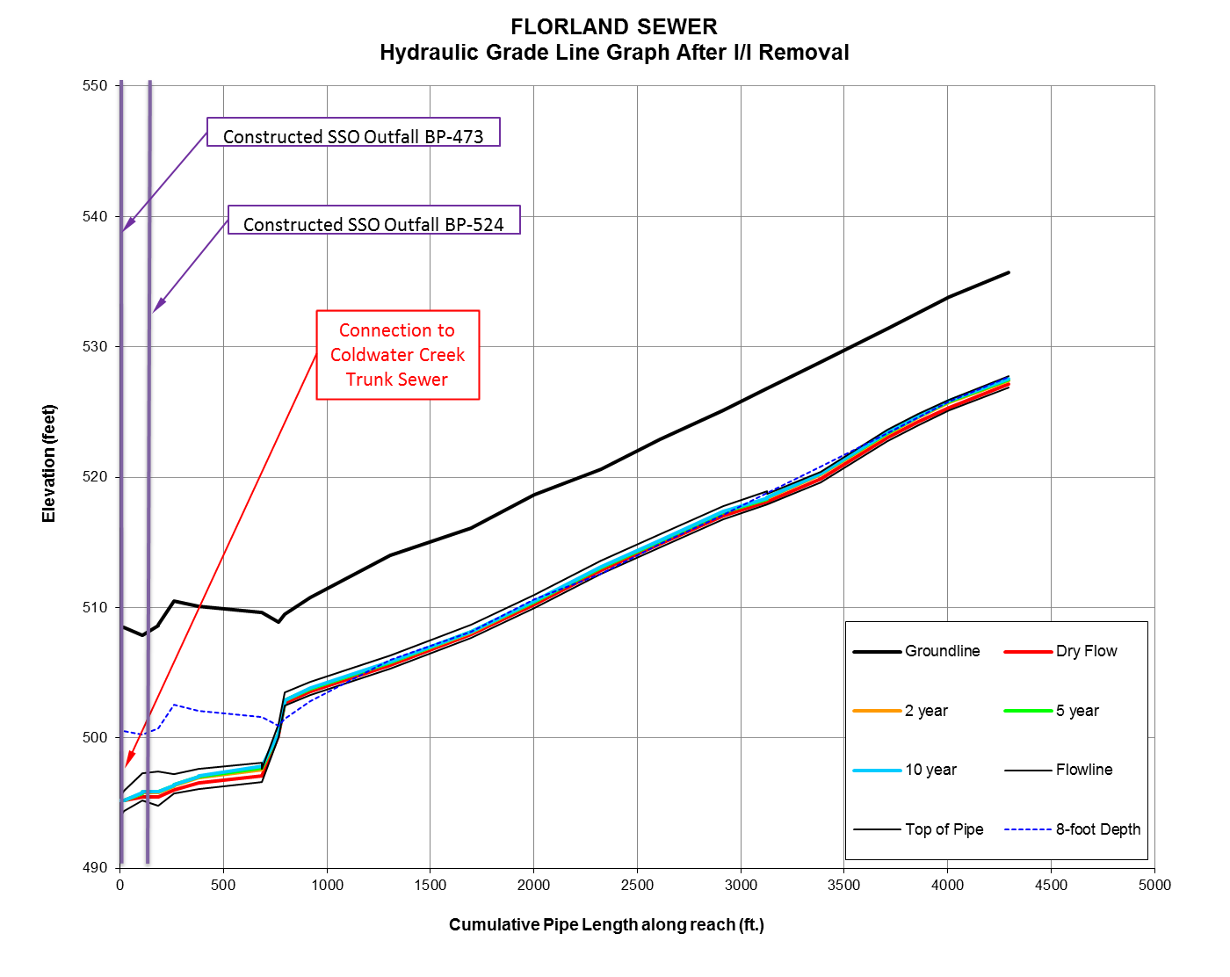
Coldwater Creek
CANCELLED
Notes:
In order to compare apples to apples for the three example projects, I will compare both the reduction in defect area obtained by recalibration of the model after the I/I reduction project as well as the resulting change in flow rates at the flowmeter location during the 5 and 10 year design storms
Florland Sanitary Relief
Defect reductions:
19% reduction in overall defect area
4% reduction in discrete private defect area
70% reduction discrete public defect area
16% reduction in Service Area (unknown) defect area
Resulting changes in flow rates at the flowmeter locations:
Florland Lateral
29.2% decrease in 5 year flow (from 4.6 cfs to 3.2 cfs)
28.6% decrease in 10 year flow (from 5.1 cfs to 3.7 cfs)
Loyola Lateral
16.8% increase in 5 year flow (from 1.5 cfs to 1.8 cfs)
13.3% increase in 10 year flow (from 1.7 cfs to 2.0 cfs)

Slide 39
Watkins Creek
Sub-Trunk #2 & Sub-Trunk #3
Sanitary Relief Project
Sub-Trunk #2
One Modeled Sewer Lateral
SubTrunk #2
Existing Conditions
Capacity Issues for 2-year, 5-year, and 10-year rain events.
Updated Model (utilizing 2017 Flow Meter Data)
Capacity Issues for 2-year, 5-year, and 10-year rain events.
Sub-Trunk #3
One Modeled Sewer Lateral
SubTrunk #3
Existing Conditions
Capacity Issues for 2-year, 5-year, and 10-year rain events.
Updated Model (utilizing 2017 Flow Meter Data)
Capacity Issues for 2-year, 5-year, and 10-year rain events.
Notes:
Subtrunk#2 & Subtrunk#3 Sanitary Relief
Defect reductions:
19% reduction in overall defect area (similar to the first example in Coldwater Creek)
Most of the defect area reductions were seen in the Subtrunk #2 (26% overall decrease, bust most of that was attributed to infiltration defects (35% decrease))
Subtrunk #3 had a 3% overall decrease in defect area, but a 12% decrease in the inflow defect areas.
Resulting changes in flow rates at the flowmeter locations:
Subtrunk#2 Lateral
6.2% decrease in 5 year flow (from 5.7 cfs to 5.4 cfs)
9.2% decrease in 10 year flow (from 6.7 cfs to 6.1 cfs)
Subtrunk#3 Lateral at the downstream flowmeter location
5.0% decrease in 5 year flow (from 7.8 cfs to 7.4 cfs)
5.6% decrease in 10 year flow (from 8.8 cfs to 8.3 cfs)
The upstream end of this branch saw a nearly 22% decrease in 5 and 10 year flows, but it wasn’t enough to cause any reduction in project scope

Slide 40
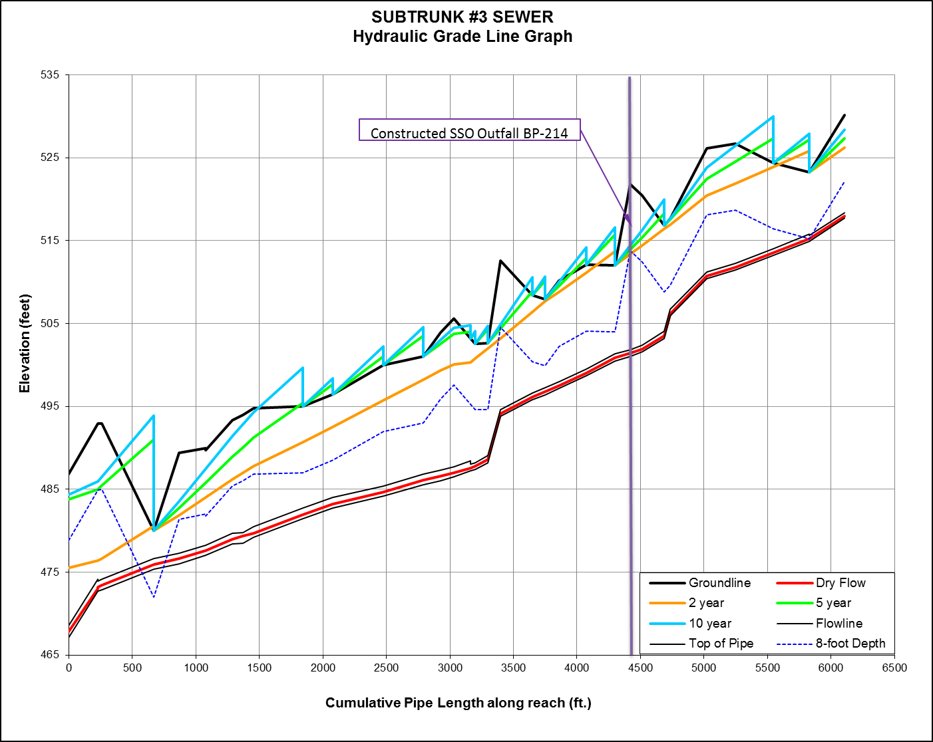
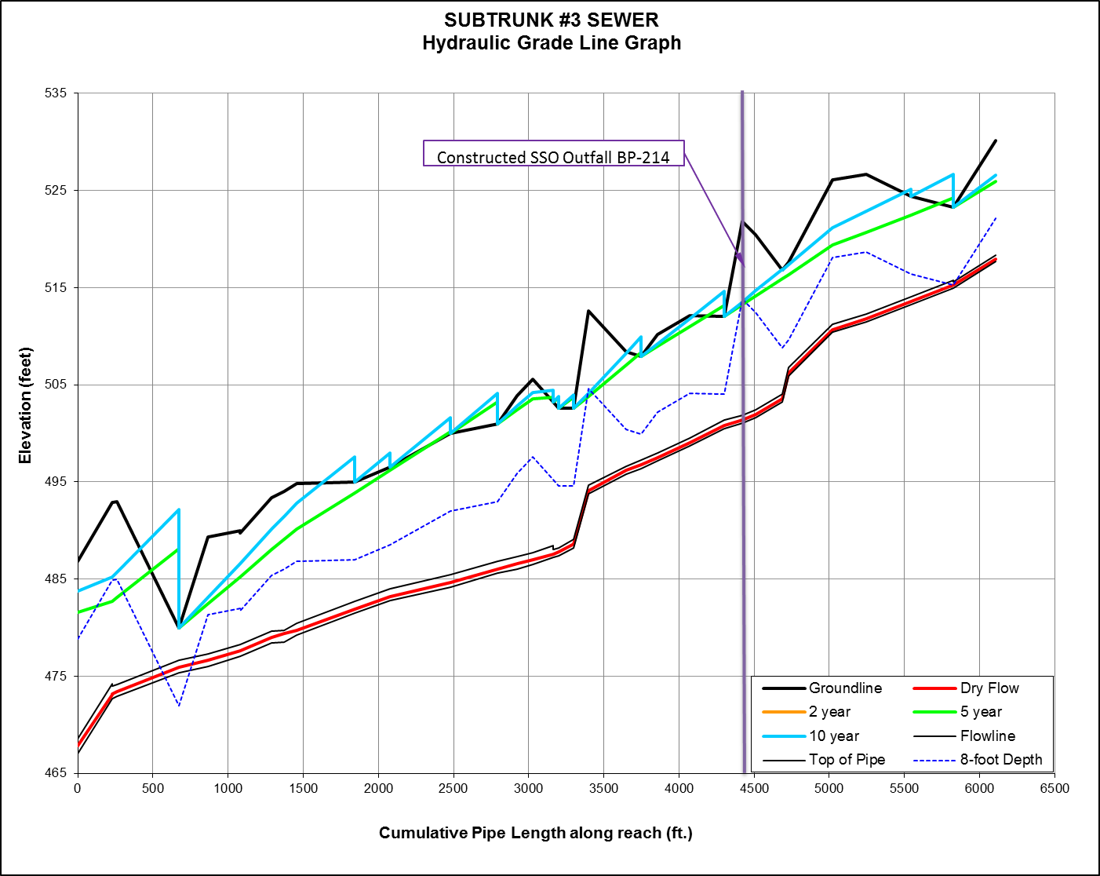
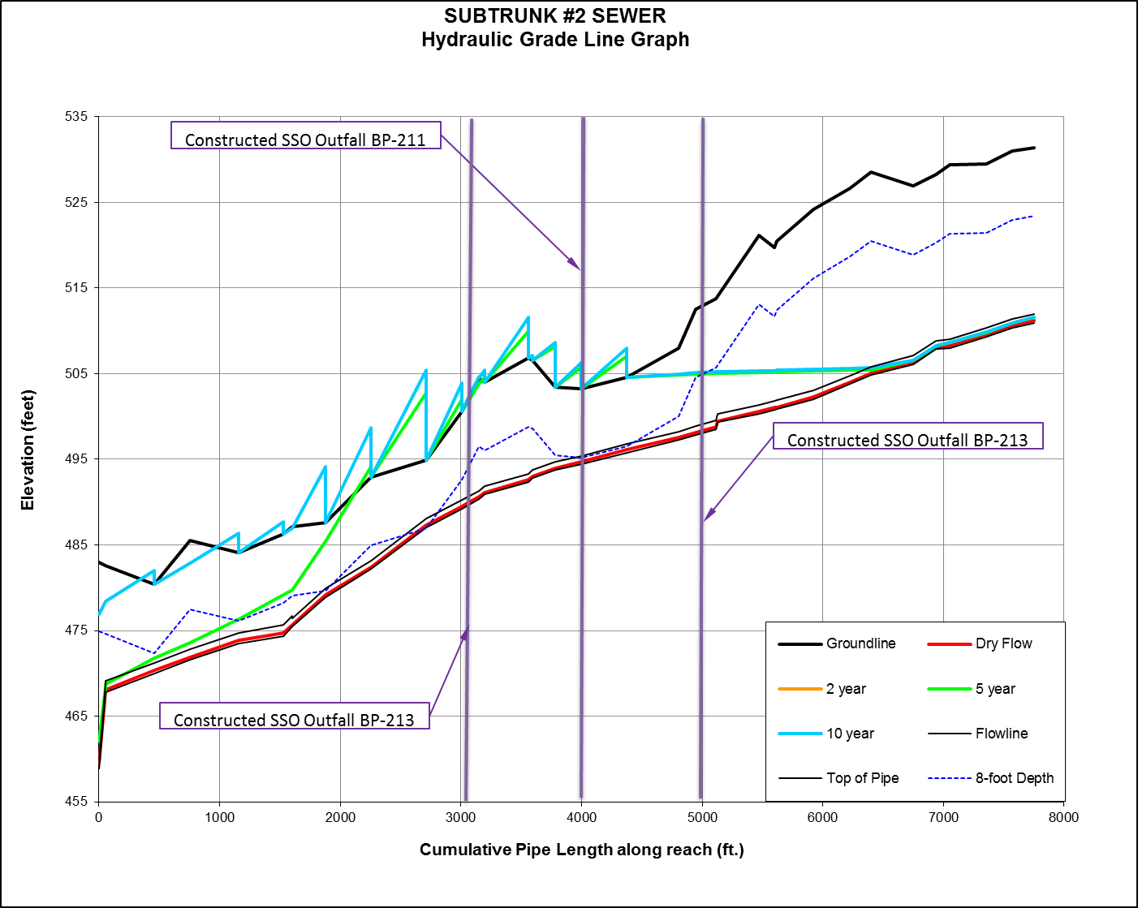
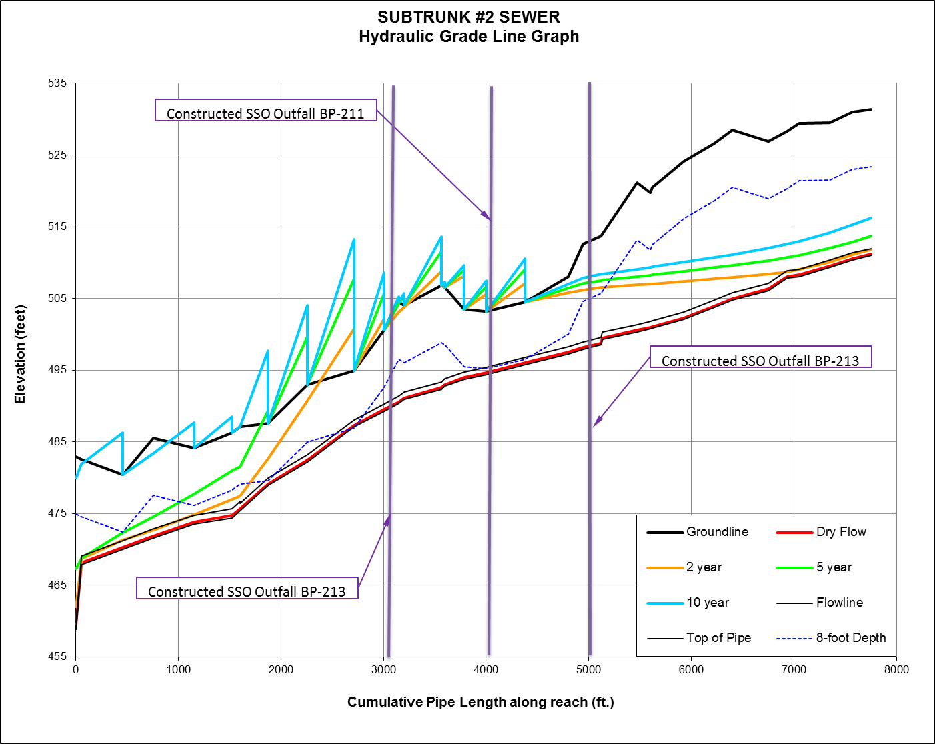
Watkins Creek
NO CHANGE
NO CHANGE
Notes:
Defect reductions:
19% reduction in overall defect area (similar to the first example in Coldwater Creek)
Most of the defect area reductions were seen in the Subtrunk #2 (26% overall decrease, bust most of that was attributed to infiltration defects (35% decrease))
Subtrunk #3 had a 3% overall decrease in defect area, but a 12% decrease in the inflow defect areas.
Resulting changes in flow rates at the flowmeter locations:
Subtrunk#2 Lateral
6.2% decrease in 5 year flow (from 5.7 cfs to 5.4 cfs)
9.2% decrease in 10 year flow (from 6.7 cfs to 6.1 cfs)
Subtrunk#3 Lateral at the downstream flowmeter location
5.0% decrease in 5 year flow (from 7.8 cfs to 7.4 cfs)
5.6% decrease in 10 year flow (from 8.8 cfs to 8.3 cfs)
The upstream end of this branch saw a nearly 22% decrease in 5 and 10 year flows, but it wasn’t enough to cause any reduction in project scope

Slide 41
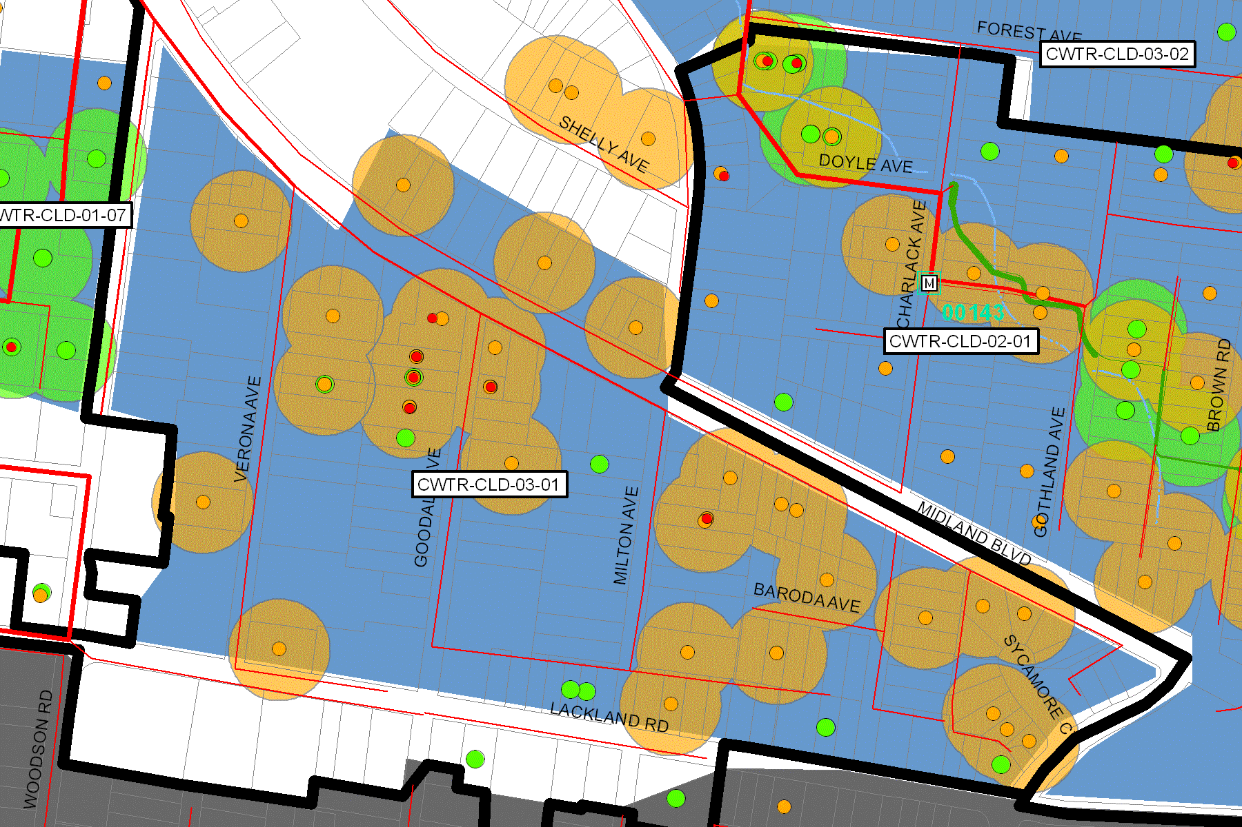
Capital Improvement Program
STEP 1 - IDENTIFICATION
MSD identifies potential projects based on collected data and hydraulic modeling results.
Hydraulic Modeling (HYDRA)
Calibration of Existing Conditions
Propose Projects to Provide Capacity Assurance
Suspected Problem Areas (SPAs)
Constructed SSO Outfalls
Reported Water Backups due to Overcharged Mains
Flow Monitors reporting high flows
Notes:
First – What and How do we, MSD Identify to justify and potential project?
MSD Projects Identified for our Capital Improvement Program were based on collected field data and hydraulic modeling results
MSD, utilizing HYDRA Modeling Software, to calibrate our model to simulate base sanitary flow, infiltration, rainfall-dependent infiltration, and inflow prior to the beginning on the capital improvement program.
Having a model simulating existing conditions allowed watershed engineers to properly size relief projects to convey peak flows and to have the assurance of capacity within the system.
Early on in the program, the district determined that reducing public I/I, along with eliminating cost-effective private property sources of I/I would mean that the existing sewers could have capacity and the constructed SSO outfall could be eliminated. I/I Projects always include a post-construction monitoring period and usually a contingency project.
Projects are not identified solely on modeling output rather than additional collected data such as Constructed Sanitary Sewer Overflow (SSO) Outfalls, known SSOs, Reported water backups due to Overcharged Mains, Inflow and Infiltration results, insurance claims, flow meters reporting high flows, etc. This collected data when grouped together assist in identifying suspected problem areas. (SPAs)
This collected data, utilizing GIS, was mapped to determine whether a pattern in the data indicates a potential problem. MSD was able to visually see the density and distribution of problem, via cluster maps.
Here is an example of a cluster map showing the density and distribution of suspected problem areas.
Once MSD was able to identify projects based on existing modeling simulation and collected SPAs, MSD then Categorized each project. (Next Slide)

Slide 42
Capital Improvement Program
STEP 2 - CATEGORIZATION
MSD categorizes projects using a three tier system support CD initiative.
MSD categorizes projects into 3 categories/tiers
Tier 1 - Consent Decree & SSO Outfall Elimination Compliance
Tier 2 - Consent Decree Level of Service Compliance
Tier 3 - Asset Management & System Renewal/Sustainability
TIER 3
TIER 2
TIER 1
Notes:
Second – How do we Categorized the potential projects based on priority and consent decree requirements?
MSD Categorized the identified projects using a three (3) tier system.
Tier 1 and Tier 2 are consent decree projects that are held to a strict schedule.
Tier 1 projects have a constructed SSO outfall associated with the project
Tier 2 projects improve the Level of Service in the system such as mitigating known SSO (i.e. Overflowing Manholes) or building backups.
Tier 3 projects provide operation benefits as well as long term system sustainability. (i.e. lining projects to eliminate routine maintenance or pump station elimination)
Categorizing projects into a tier system helped prioritize and schedule identified projects held to consent decree requirements.
Projects were then scheduled over the course of 28 years* and approved by the EPA.
Now lets talk about Step 3 – Scheduling (Next Slide)

Slide 43
Capital Improvement Program
STEP 3 - SCHEDULING
MSD scheduling software tracks all projects and relationships to ensure deadlines are met.
MSD utilizes Oracle Primavera P6
Primavera P6 scheduling software is used to manage project schedules to ensure project goals are met
Track Progress
Displays Actual vs. Planned
Integrated with MSDs Oracle EBS
Maintains Project Relationships
Notes:
Third – How does MSD Schedule a 23+ year program in order to effectively have time to flow monitor and evaluate contingency projects?
MSD utilizes Oracle Primavera P6 Software to manage project schedules for all identified capital improvement projects to ensure project goals are met.
To give you an idea of the complexity of MSD Capital Improvement Program, MSD has identified over 430 projects.
Over 100 Projects requires post-construction flow monitoring to evaluate the need for contingency projects.
Using P6, MSD is able to track each projects progress and the effects of successor projects when the predecessor project starts to miss design or construction milestones.
Flow monitoring is also factored into the P6 schedule. Enough time NEEDS to be factored into the schedule to have sufficient time for flow monitoring. That takes us to Step 4 (next slide)

Slide 44
Capital Improvement Program
STEP 4 - MONITORING
MSD monitors the effectiveness of completed projects with metering, modeling, and other field data.
The originally identified I/I projects must be re-evaluated with new data.
Hydraulic Modeling
Evaluate updated flows
Suspected Problem Areas (SPAs)
Water backups
Constructed SSO Outfall Activations
MSD identifies potential projects based on collected data and hydraulic modeling results.
MSD categorizes projects using a three tier system support CD initiative.
MSD scheduling software tracks all projects and relationships to ensure deadlines are met.
MSD monitors the effectiveness of completed projects with metering, modeling, and other field data.
Notes:
Fourth – What is monitored to determine the effectiveness of the predecessor project?
A typical flow monitoring period is approximately 7 months (March through September) plus an additional 4 months to calibrate the existing conditions model to simulate new flows.
Just like in (step 1 – identification) the same data evaluated that identified the project must be re-evaluated to verify the need for the project still exists.
Do the updated simulated model flows still show capacity issues?
Are we still seeing water backup due to overcharged mains?
Is the constructed SSO Outfall still activating in a less than 5yr/10yr rain events?
Once the questions, plus many more, are answered, MSD then can evaluate the need for the contingency project. (Next Slide)

Slide 45
Capital Improvement Program
STEP 4 - MONITORING
2017 Collected Data
288 Flow Meters Installed
Collecting Every 15min
100 Rain Gauges Installed
Collecting every 5min
Over 450 Constructed Sanitary Sewer Overflow Activations
Over 12,000 Customer Service Requests
Over 4,500 Involve capacity issues

Slide 46
Capital Improvement Program
STEP 4 - MONITORING
2017 Monitoring
288 Flow Meters Installed
## Permanent/Regulatory
119 Post-Construction
## Pre-Construction
100 Rain Gauges Deployed
Supporting over 2,200 Gauge Adjust Radar Rainfall (GARR)

Slide 47
Capital Improvement Program
STEP 4 - MONITORING
2017 Monitoring (Continued)
Over 12,000 Customer Service Requests
Over 4,500 involved capacity issues
Water Backups (WBU)
Vent Pipe Overflowing (VPO)
Manhole Overflowing (MHO)
Manhole Holding (MHH)
Notes:
All of this data is used to identify new project, modify previously identified project, or evaluating upcoming projects.

Slide 48
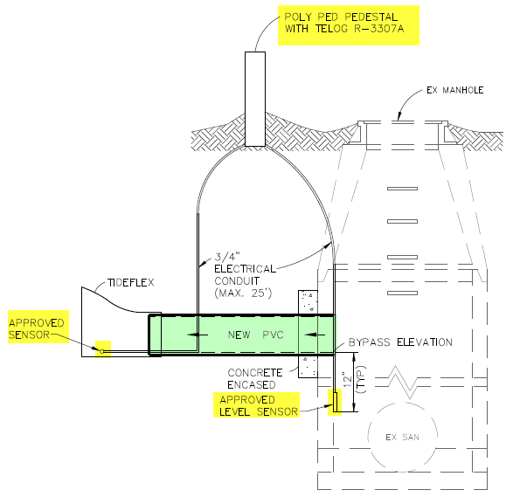
Typical Constructed SSO Outfall Monitoring Setup
Level Sensor 12-in Below
Overflow Elevation

Slide 49
Typical Constructed SSO Outfall Monitoring Setup
Data Logger with Modem

Slide 50
Tideflex Valve with Proximity Sensor

Slide 51
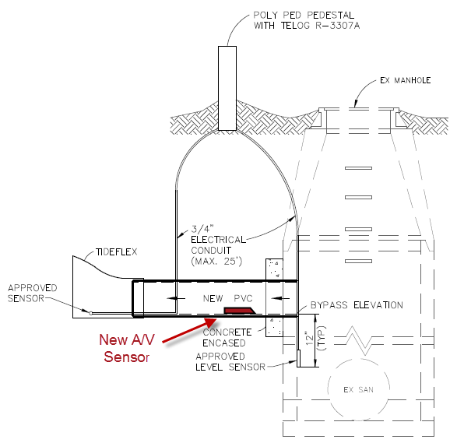
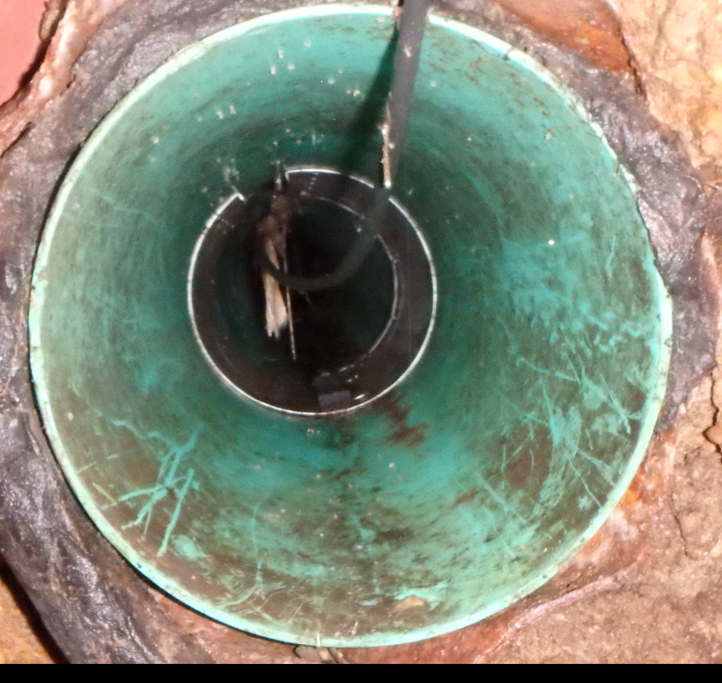
Typical Constructed SSO Monitoring Setup with Redundancy

