Slide 1
Planning for Sustainability: Transitioning to Online Training for SORP Compliance Dan French
9/4/2019

Slide 2
Agenda
SORP History at MSD
How Does SORP Work at MSD?
Why Change?
What Does It Look Like?
How Has It Been Received?
Lessons Learned
What’s Next?

Slide 3
SORP History at MSD
Sewer Overflows Treatment Bypasses Effluent Violations
Prior to Consent Decree, overflow response very much ad-hoc
MSD entered Consent Decree August 2005
Brick-and-mortar SORP training formalized 2006
Online SORP delivery developed 2017
All SORP training delivered online 2019
2005 Consent Decree 2009 Amended Consent Decree
Properly Manage, Operate & Maintain Sewer System Assets
Build Additional Wet Weather Storage &Treatment Capacity
Respond, Document, Mitigate, Cleanup & Report Overflows & Bypasses
CMOM / NMC No End
IOAP Projects Complete by 2024
SORP No End
Eliminate Dry Weather CSOs Eliminate SSOs Eliminate WQTC Bypasses Meet Effluent Limitations Reduce Wet Weather CSOs

Slide 4
How Does SORP Training Work at MSD?
Quarterly – Detailed Training
Employees responsible for response (~250)
Across all shifts
Staff in Operations
Staff in Engineering
Annually – Overview / Process Training
All Employees – Over 700
Across all shifts
Engineering, Operations, Facilities, Finance, Executive Leadership, the Board etc.

Slide 5
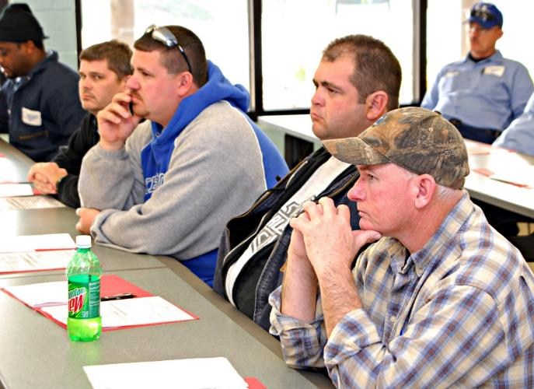
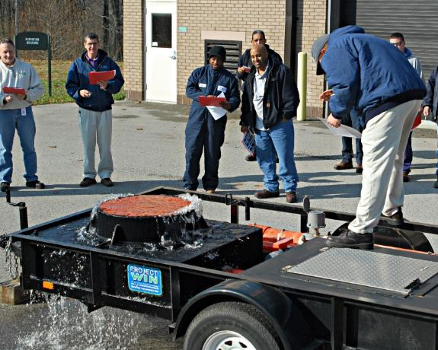
Why Change?
Brick-and-mortar training became routine
Ran like a well oiled machine
Attendance high, but disruptive to schedules
Logistics
Quarterly – 13-14 training sessions
Annually – 23-25 training sessions
All shifts, all hours of the day
Preparation, scheduling adds many additional hours
Message not necessarily consistent between presenters
Training data and comprehension available, but manually entered
Brick-and-mortar training not flexible – not necessarily available as needed

Slide 6
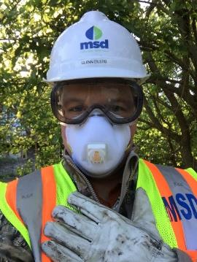
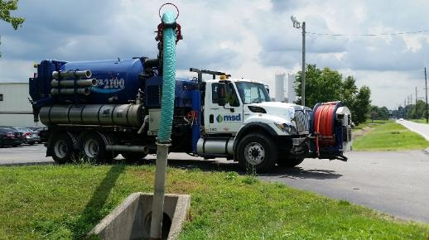
What Does It Look Like?
Outline and general content existed from brick-and-mortar training
Tweaked outline to deliver 5-15 minute “digestible” training modules
Developed scripts to make recording smooth and to ensure content is covered
Outsourced photos, video from Training & Operations

Slide 7
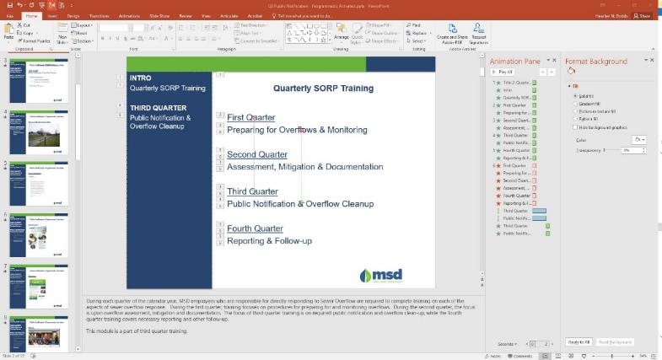
What Does It Look Like?
Created slide deck, animations in PowerPoint
Originally added quizzes, audio in PowerPoint using Adobe Presenter Add-on
No longer supported
Moved to Articulate 360
Same functionality in PowerPoint
Smoother integration

Slide 8
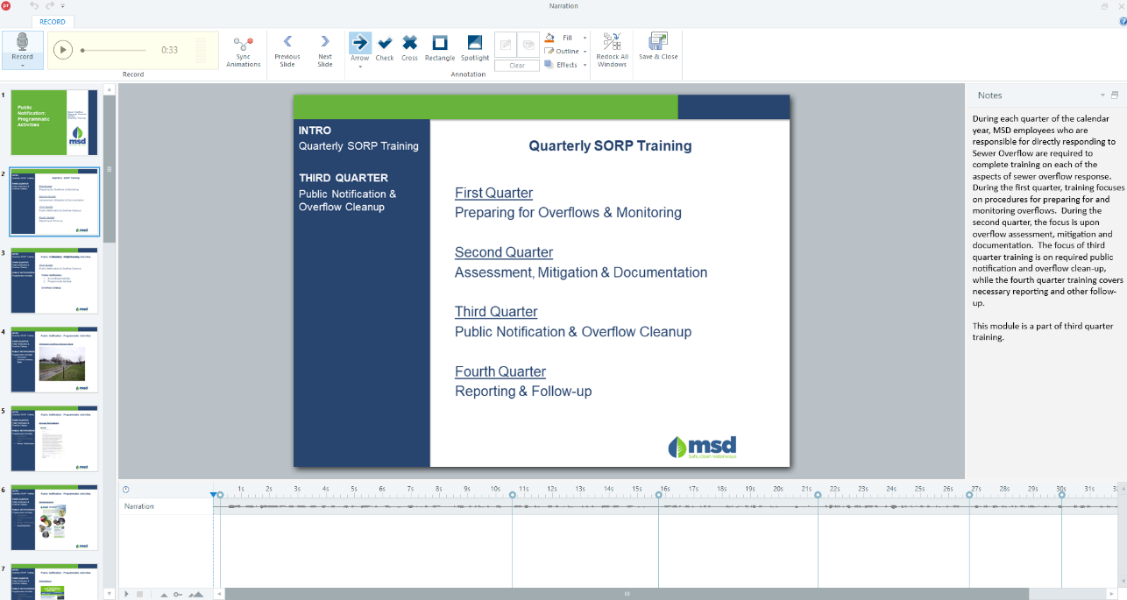
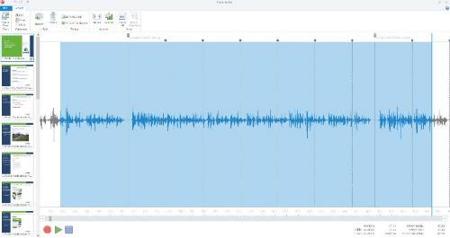
What Does It Look Like?
Script written in notes section for easy voice recording and animation sync
Voice narration recorded and edited with add-on or audio app

Slide 9
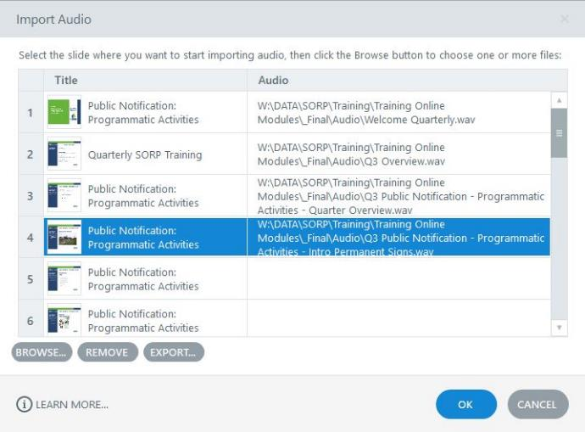
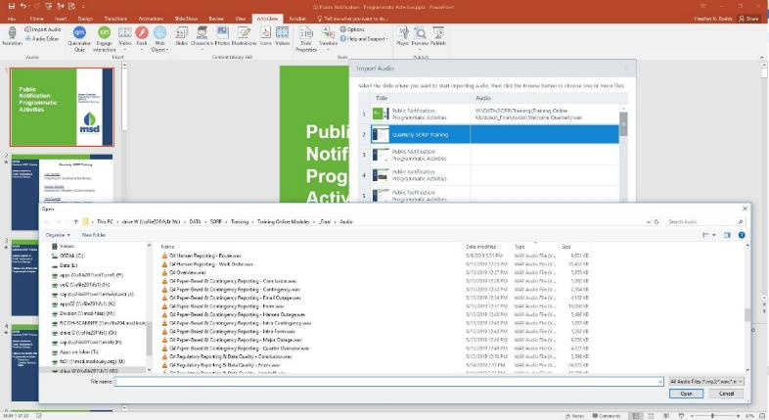
What Does It Look Like?
Import audio to individual slides
Sync voice narration and audio with animation changes
Animation Change
Audio Marker

Slide 10
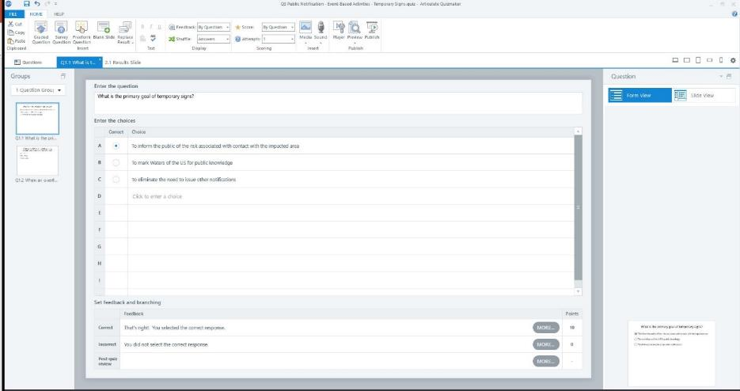
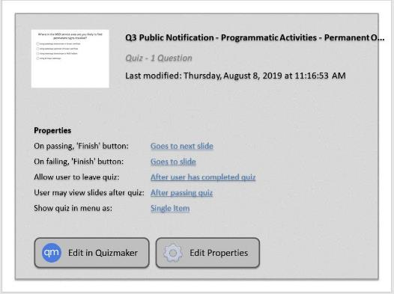
What Does It Look Like?
Add quizzes with graded to monitor comprehension, with lots of options
Multiple question and answer types available
Prevent advancement until questions are answered correctly
Require passing scores or review
Can include photos, video in questions
Can include surveys

Slide 11
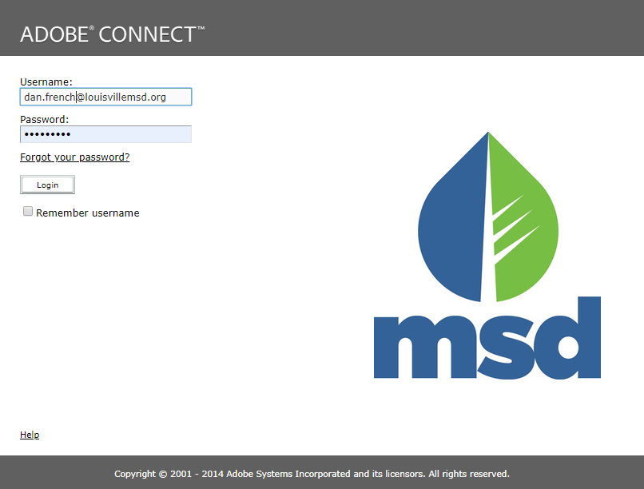
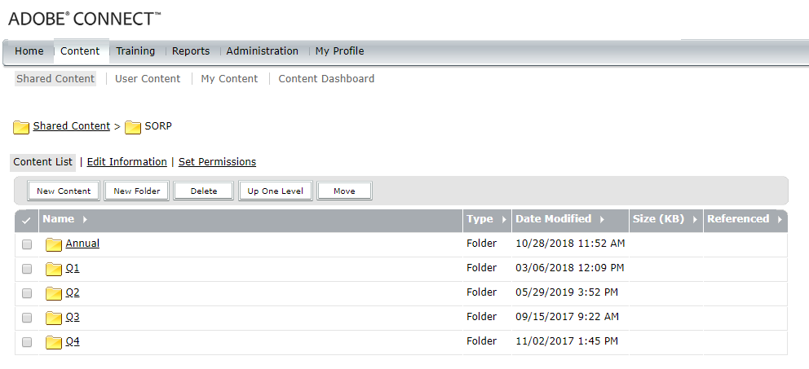
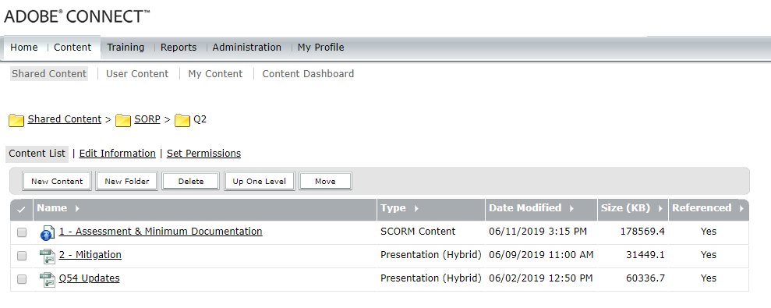
What Does It Look Like?
Online training platform developed in-house using Articulate 360
Adobe Connect used to deliver training
Content developed by SMEs in Regulatory Compliance, administered by Training
Content reviewed, updated, uploaded each quarter as HTML/Flash in SCORM 1.2 format

Slide 12
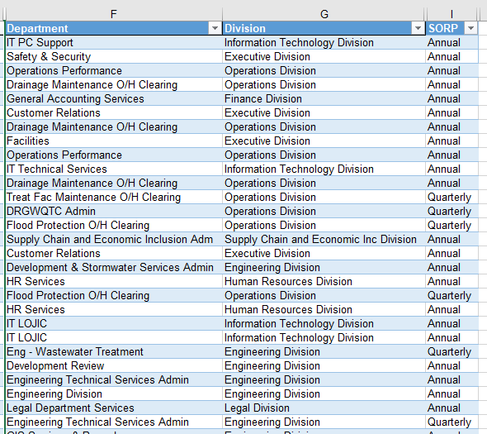
What Does It Look Like?
Enrollees are managed in Adobe Connect
Updated quarterly by job title
Currently manual process working with HR and IT
Each user assigned a login and role (administrator, learner, author, etc.)

Slide 13
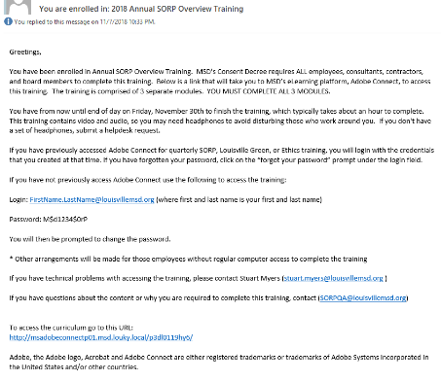
What Does It Look Like?
Each training session managed through a curriculum that handles
Training modules
Allowed, allowable, or required enrollees
Reminder policy including multiple frequencies, recipients, and customizable message
Open and close schedule
Email a welcome message

Slide 14
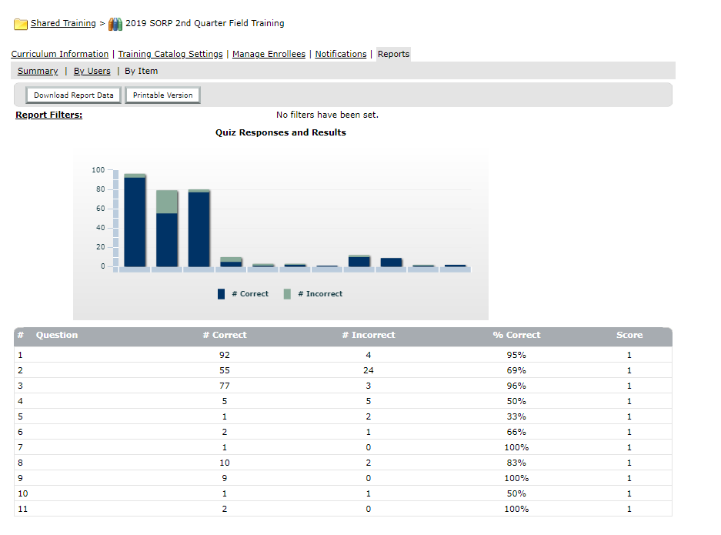
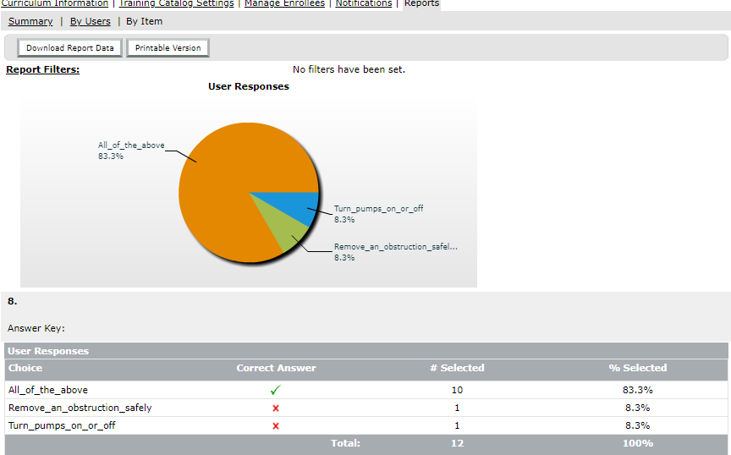
What Does It Look Like?
Staff complete training at their convenience and at a pace that suits them and management within the schedule
Reports instantly available for participation, comprehension and feedback

Slide 15
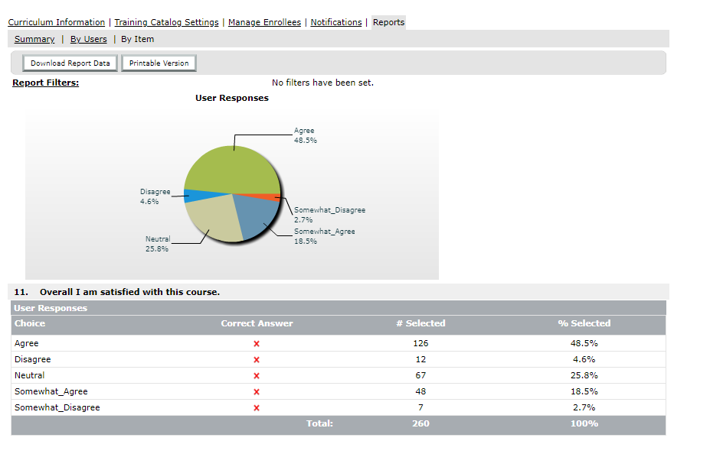
How Has It Been Received?
Every session, every quarter documents feedback through required survey
Feedback positive
Most staff prefer online format
Some still prefer brick-and- mortar training
Some modules more popular than others
Length
Correctable technical issues
Not enough time to take the full course

Slide 16
Lessons Learned
Pick a software package carefully
Edit files in a native software (i.e., video editor for video, audio editor for audio)
Allow time for staff to complete at their own pace
Send reminders regularly
DO NOT send out calendar invites unless you really mean it!

Slide 17
What’s Next?
Growing to include other required training programs
Louisville Green
Ethics
Expanding to onboarding experience with NeoGov
Non-mandatory training for applications
LOTS OF POSSIBILITIES

Slide 18
Questions
August 2019

