Slide 1
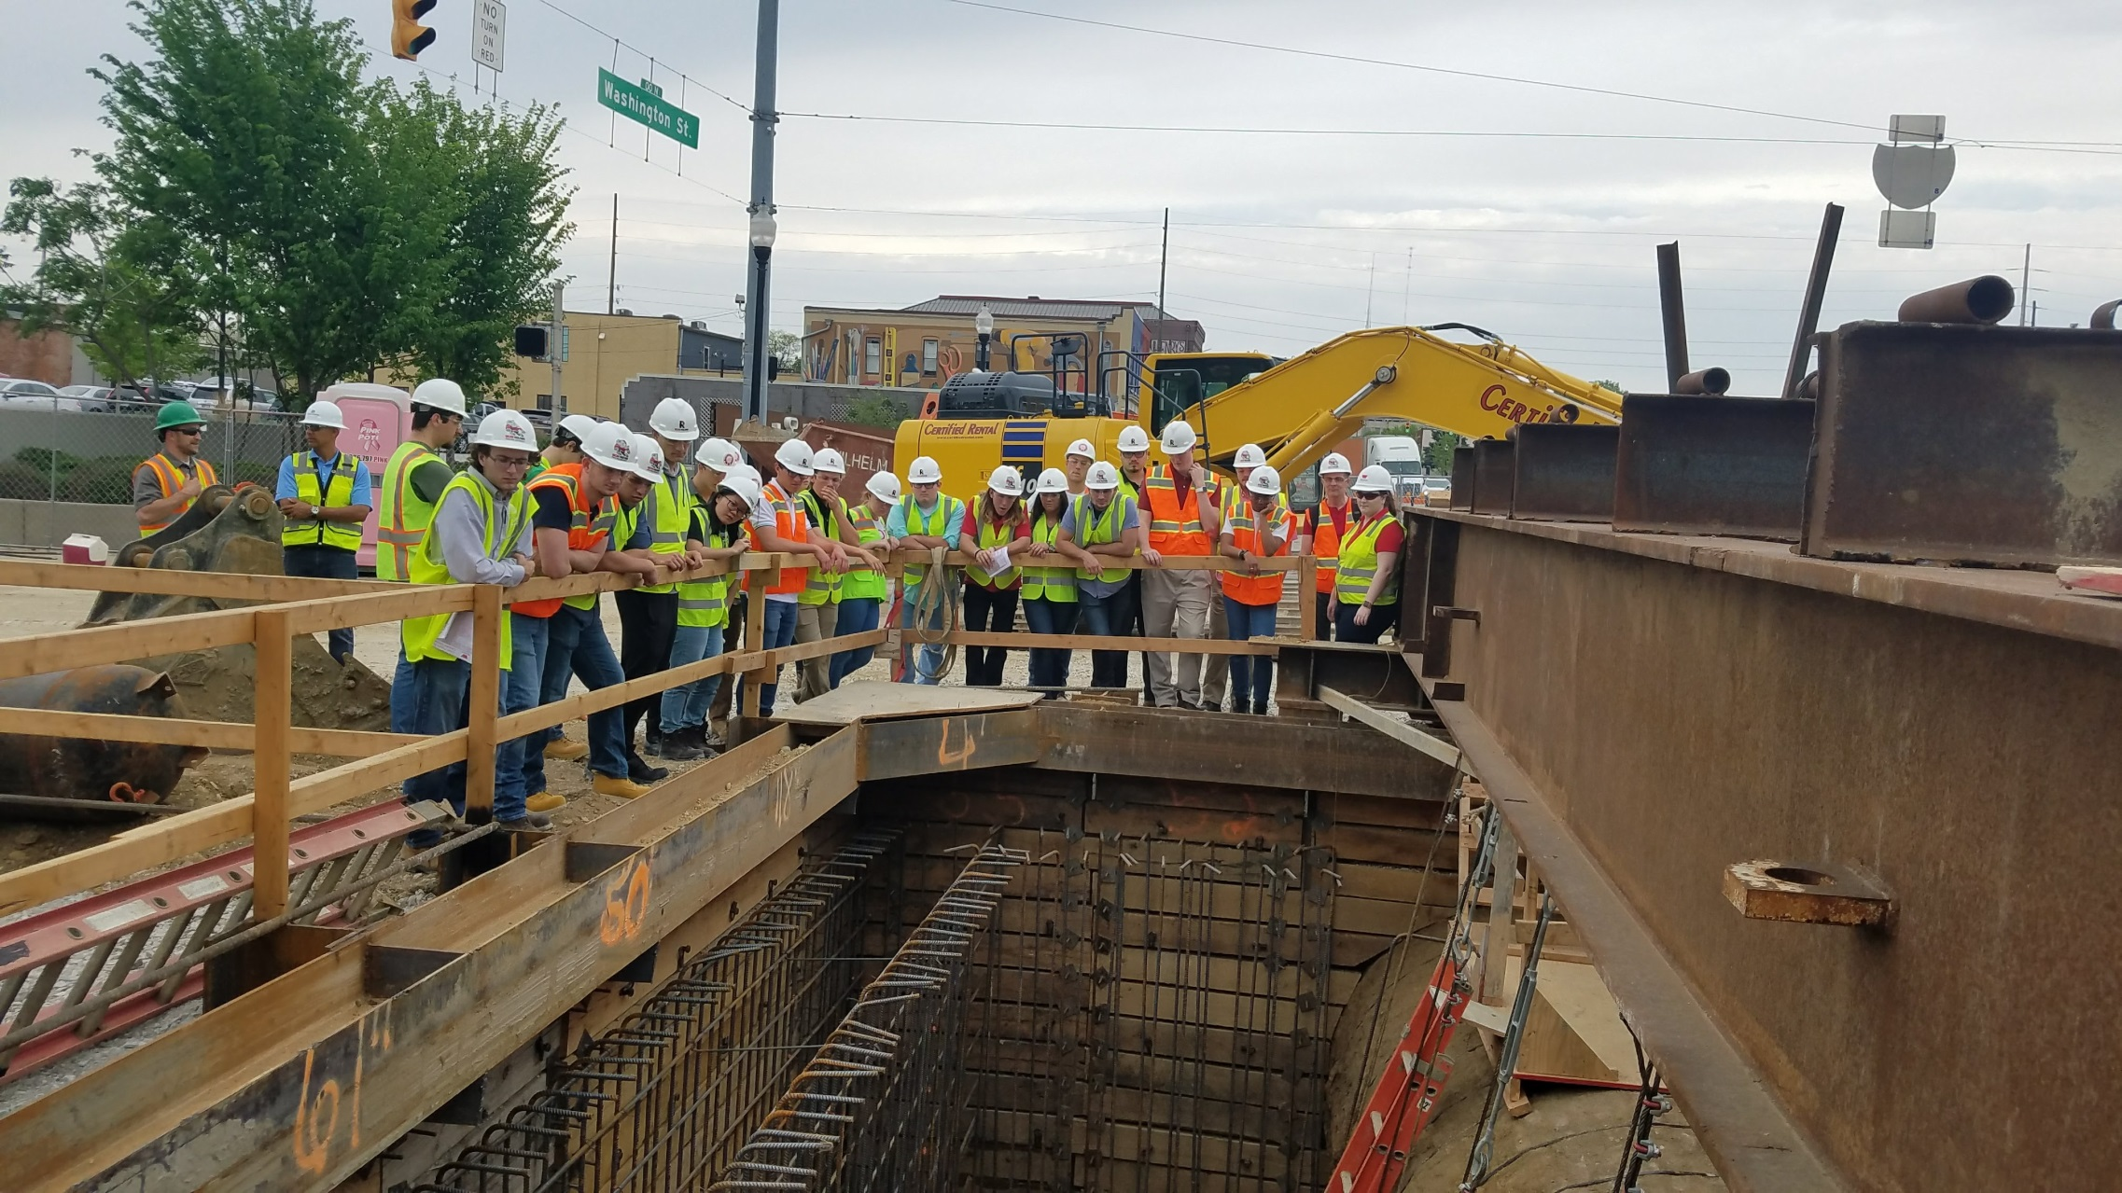

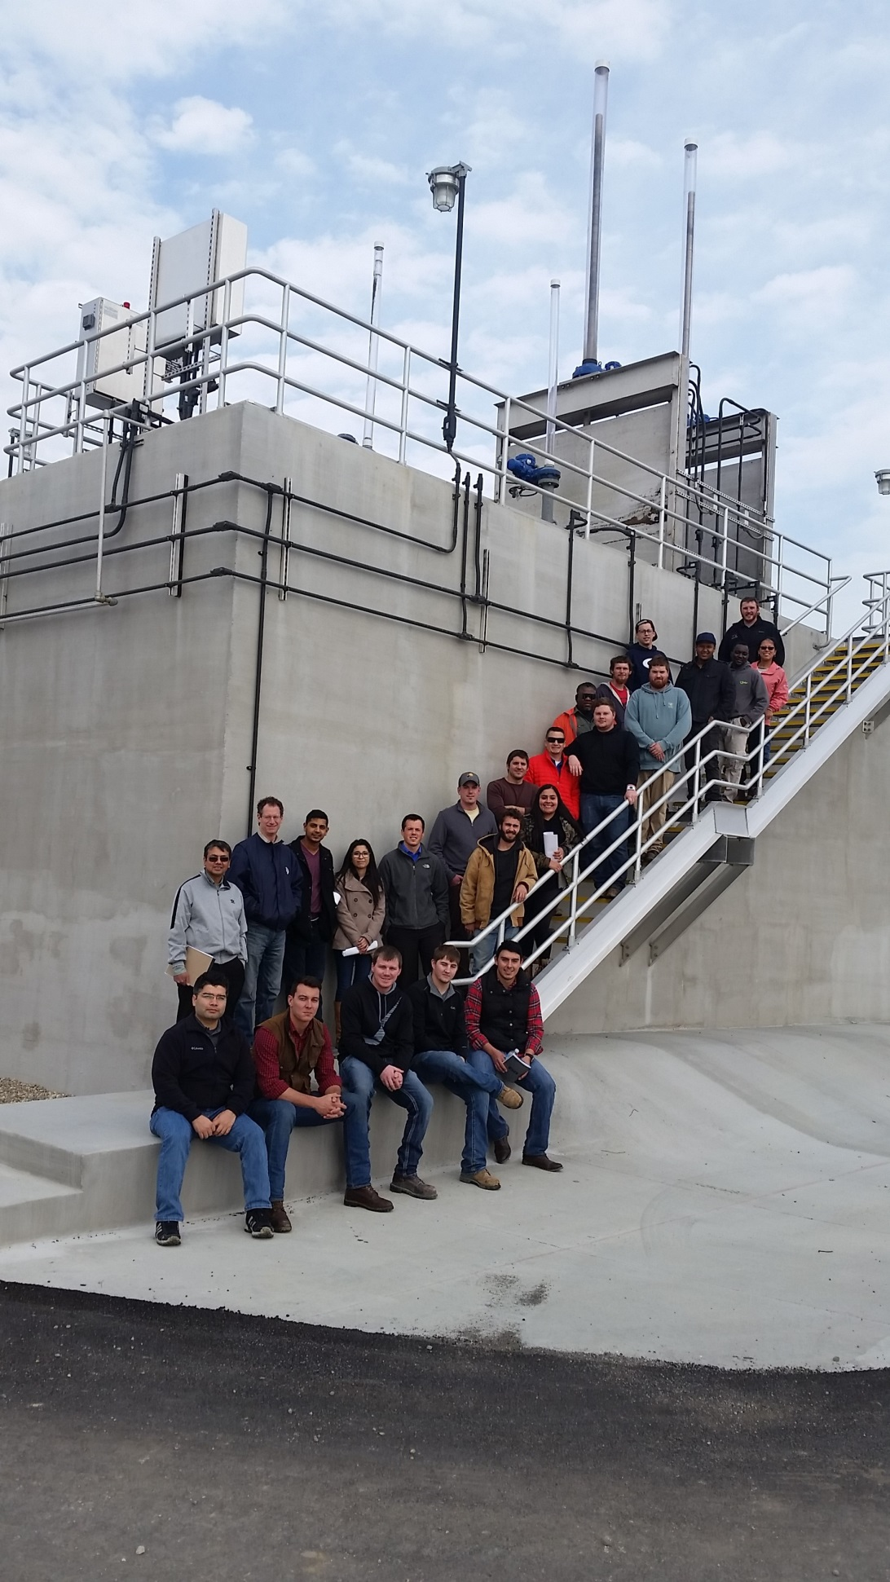
Partnership
for Excellence
in Research
and Learning
(PERL)
Notes:
Our initiative to partner with many talent-rich and internationally recognized universities in recruit quality new talent, especially because a large portion of Citizens’ workforce is retiring in the next 10 years.

Slide 2

Citizens Energy Group Today
We’re creating a more livable, sustainable city by improving customer service; enhancing our environment; and controlling costs
Natural gas utility serving Indianapolis
Nation’s second largest steam utility serving downtown Indianapolis
Largest water and wastewater utilities in Indiana
Other for-profit businesses

Slide 3
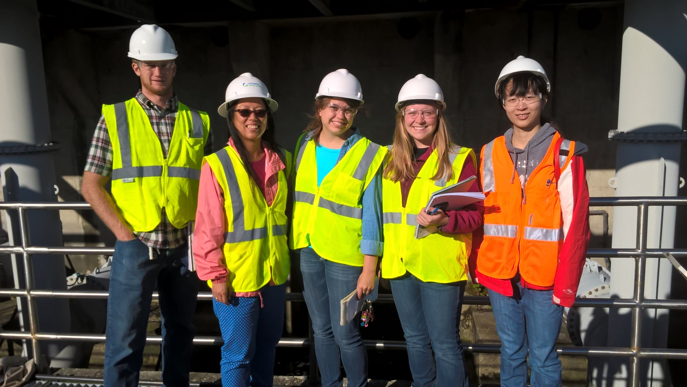
Agenda
Program Overview
Example Collaborations
Student Benefits/Feedback
Metrics
Full Time Hires

Slide 4
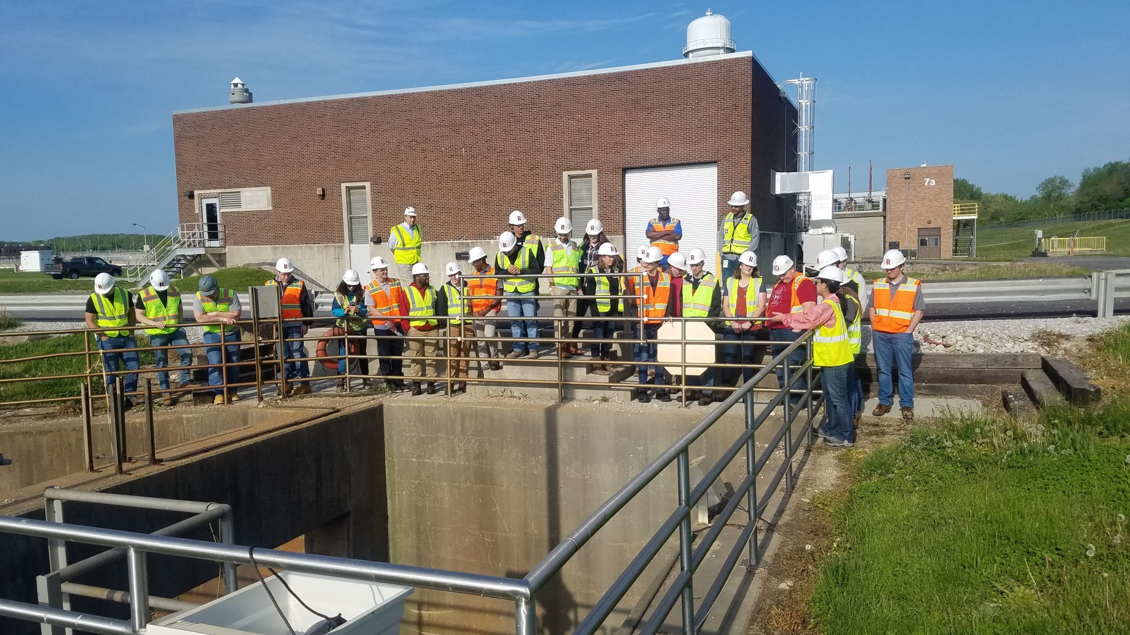
What is PERL?
Partnership for Excellence in Research and Learning (PERL) is an initiative started by Citizens in 2015 to recruit and retain top talent in the state of Indiana.
Notes:
The PERL concept was identified by Citizens in 2013 to address the need for extraordinary talent to support long-term business success. Citizens had occasionally partnered with universities in the past for research and learning opportunities; the creation of PERL in 2015 formalized those relationships and is a more expansive, proactive, collaborative and strategic partnership effort.

Slide 5
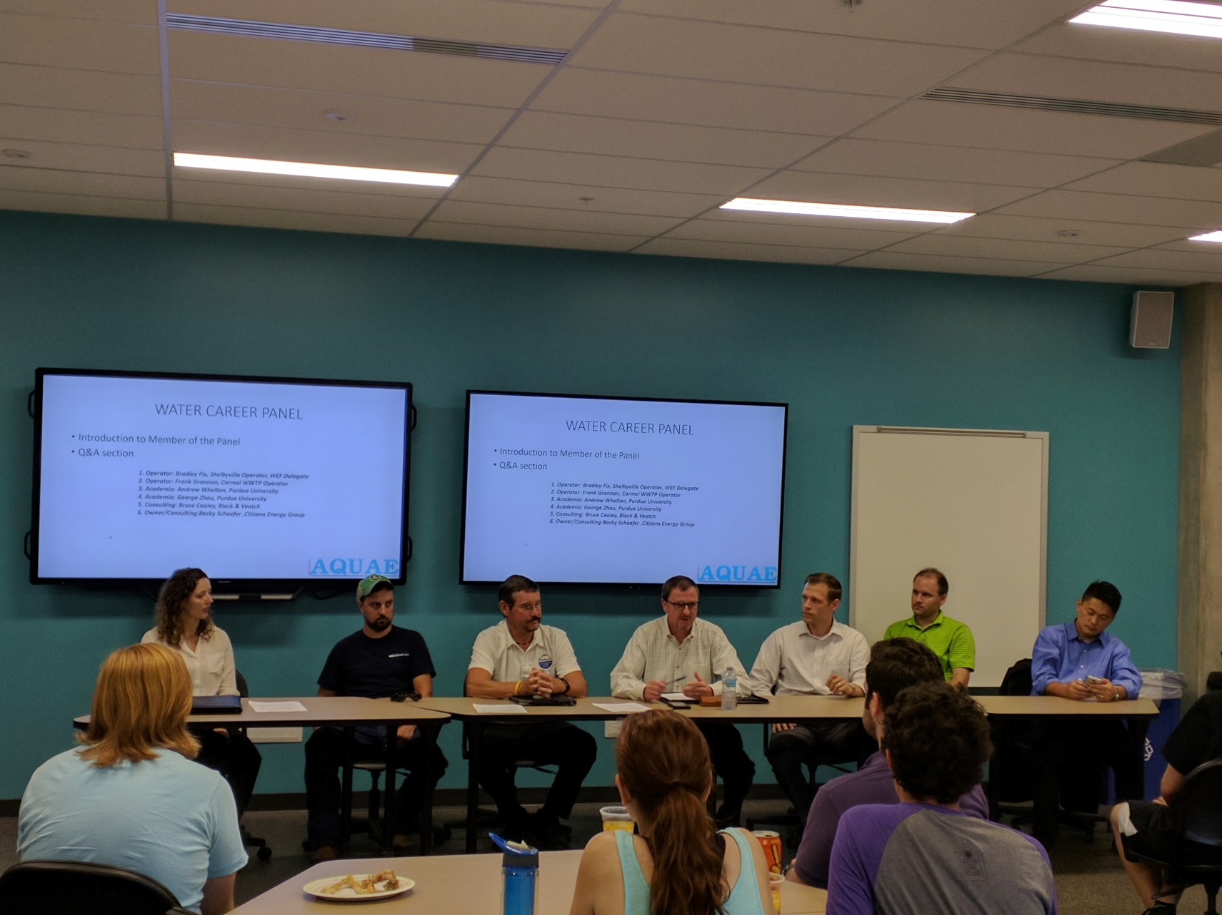
PERL Goals
Encourage graduating students to remain in Indiana and the Indianapolis area after graduation to fulfill workforce needs
Create more professional development opportunities for students as emerging talent and future business leaders
Create an improved exchange of industry and collegiate data that will better address research, technology and industry challenges
Notes:
Students are passionate about public health, sustainability and innovation, however the utility industry is typically under the radar regarding these topics. By engaging students in projects that address these issues such as a dam hydropower feasibility project, the development of a solar powered pressure transmitter and the use of artificial intelligence to predict water demand in order to improve preparedness, the PERL Program shines a light and promotes public health, sustainability and innovation.

Slide 6
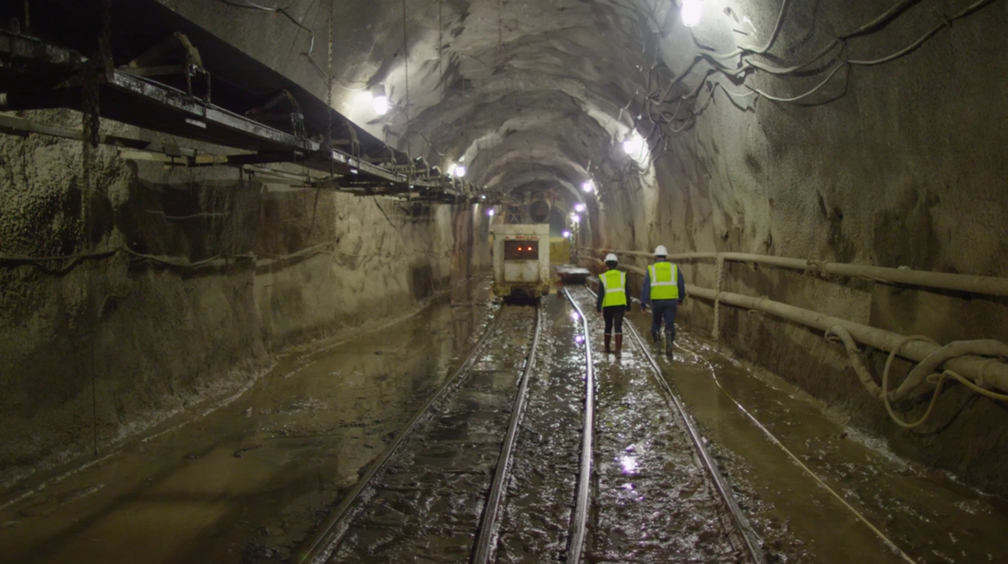
Current Academic Partners
Our Academic Partners are paired with Citizens PERL Ambassadors, typically alumni of the partner university
Anderson University
Ball State University
IUPUI
Purdue University
Trine University
University of Evansville
University of Indianapolis
Notes:
Citizens proactively meets with university partners to identify needs and potential mutually beneficial collaboration opportunities.
Citizens assigns a PERL University Ambassador to each PERL university partner. The ambassador is a current Citizens employee who is still connected to their alma mater and is willing to act as a liaison between the universities and Citizens. The Ambassadors are tasked with either coming up with creative learning opportunities for students or simply being a contact for students who might be searching for someone to speak to their class, a job shadow opportunity or even an internship.
The PERL University Ambassadors meet with their respective universities to identify needs and potential mutually beneficial collaboration opportunities. The Ambassador works with the university to develop an annual plan to outline collaborative opportunities, including student projects, tours, guest lectures, and student-led research. The plan is reviewed after it is implemented and updated every school year.

Slide 7

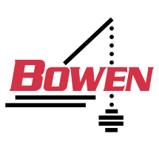





Careers/Job Shadowing
PERL Vendor Network
  American Council of Engineering Companies
  American Structurepoint, Inc.
  Bowen Engineering
  Christopher B. Burke Engineering
  F.A. Wilhelm
  HNTB
  Powers Engineering
Notes:
PERL has seven official vendor partners that have agreed to work with us to achieve common goals related to workforce development. It reflects our real-life working partnership, and we are excited to expand our relationships to workforce development.
PERL provide students an opportunity to network within Citizens and the dozens of supporting vendor partners. Two students have become full time employees with vendor partners to date though connections they made as a Citizens PERL.

Slide 8
PERL
Accounting
Quality
Communications
Environmental
Human Resources
Operations
Engineering
PERL Disciplines
PERL is pursuing partnerships in all disciplines in support of our business.
Notes:
PERL started with a focus on engineering, but has expanded to several areas in the utility.

Slide 9

Collaboration Examples
Student Projects
Internships
Tours
Research
Guest Lectures
Careers
Job Shadowing
Notes:
We engage young professionals by collaborating on student projects, internships, tours, research, guest lectures and job shadowing.
Engineering students are craving and demanding more real-world experiences alongside their studies. People and specifically prospective employees are increasingly on information overload. The PERL Program is one way for Citizens to stand out and provide an experience that will make an impact on prospective talent.

Slide 10
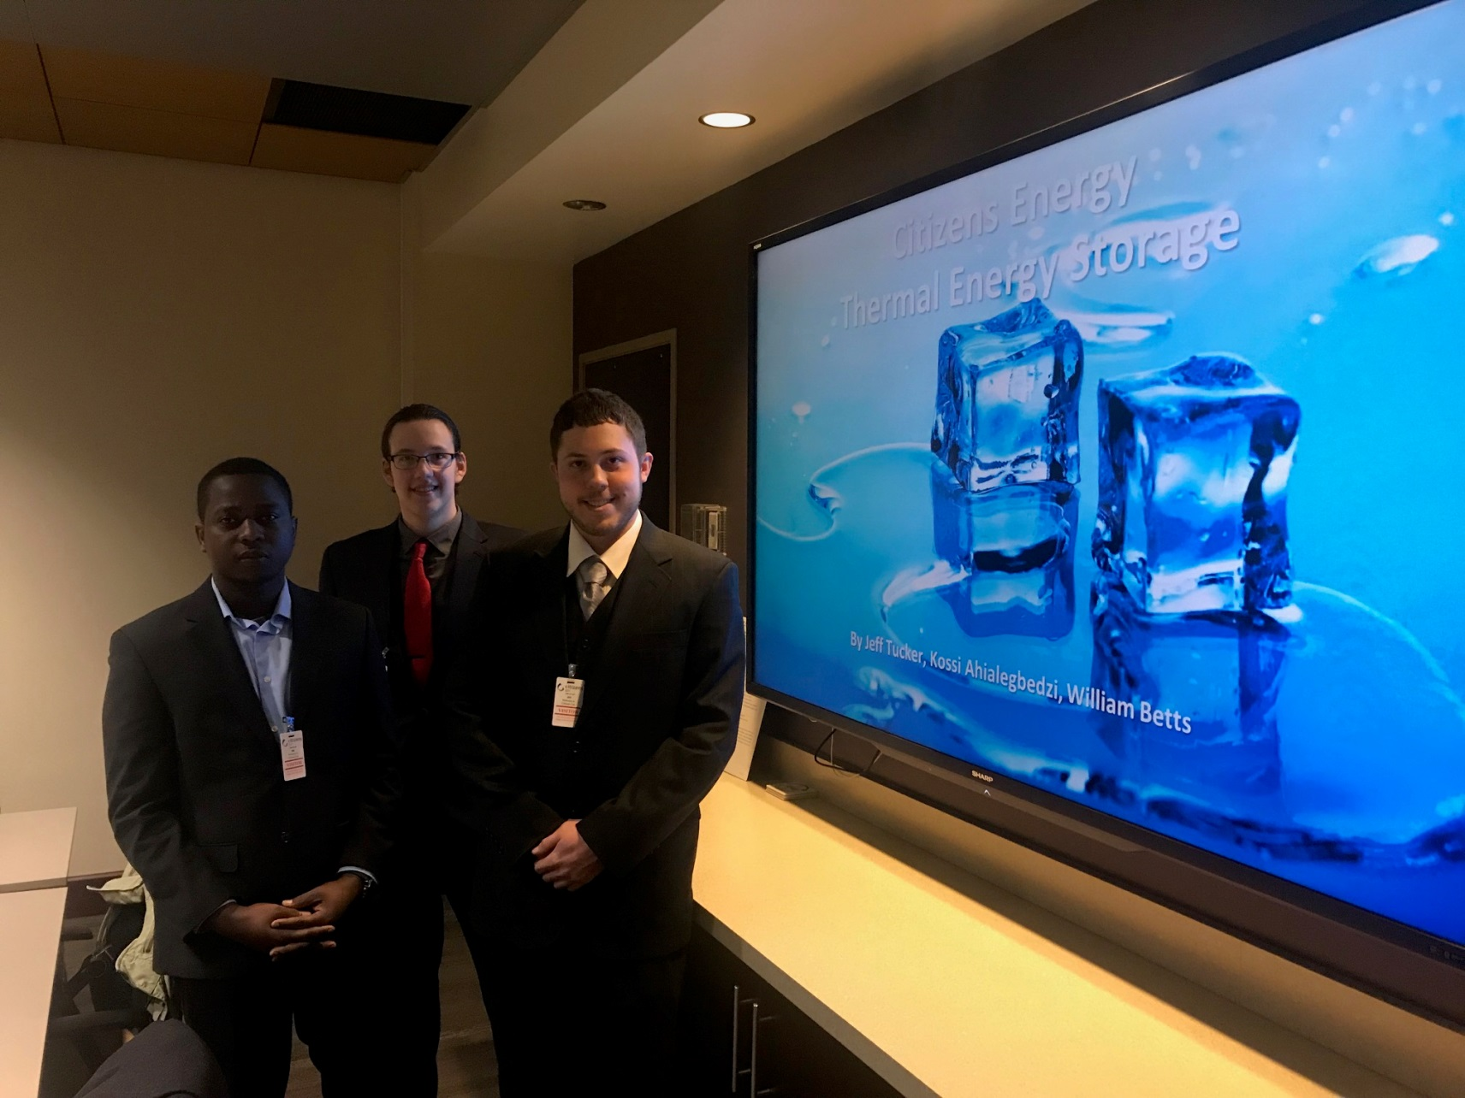
Successful Projects
WWTP anaerobic digester feasibility study
Energy audits
3D renderings of large capital projects
Designing pumps for a water reservoir
Thermal energy storage
WWTP expansion design
Pump predictive maintenance study
Water residuals testing project
Notes:
Many have resulted in practical solutions to real problems and presented opportunities for cost savings.
We are coordinating future projects related to an engineering reference library, solar power, capital program benchmarking and data visualization, and wastewater treatment phosphorous removal.

Slide 11
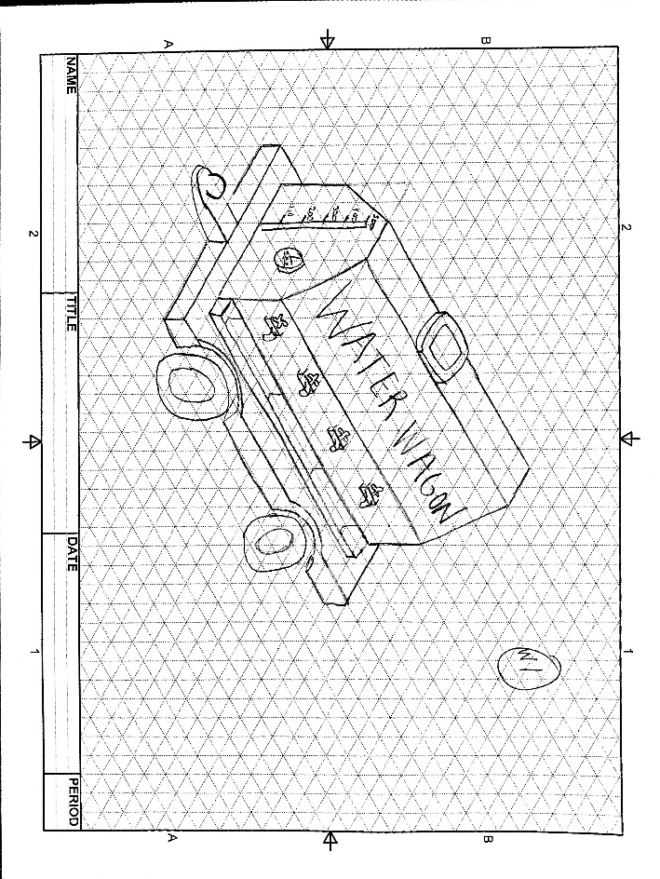
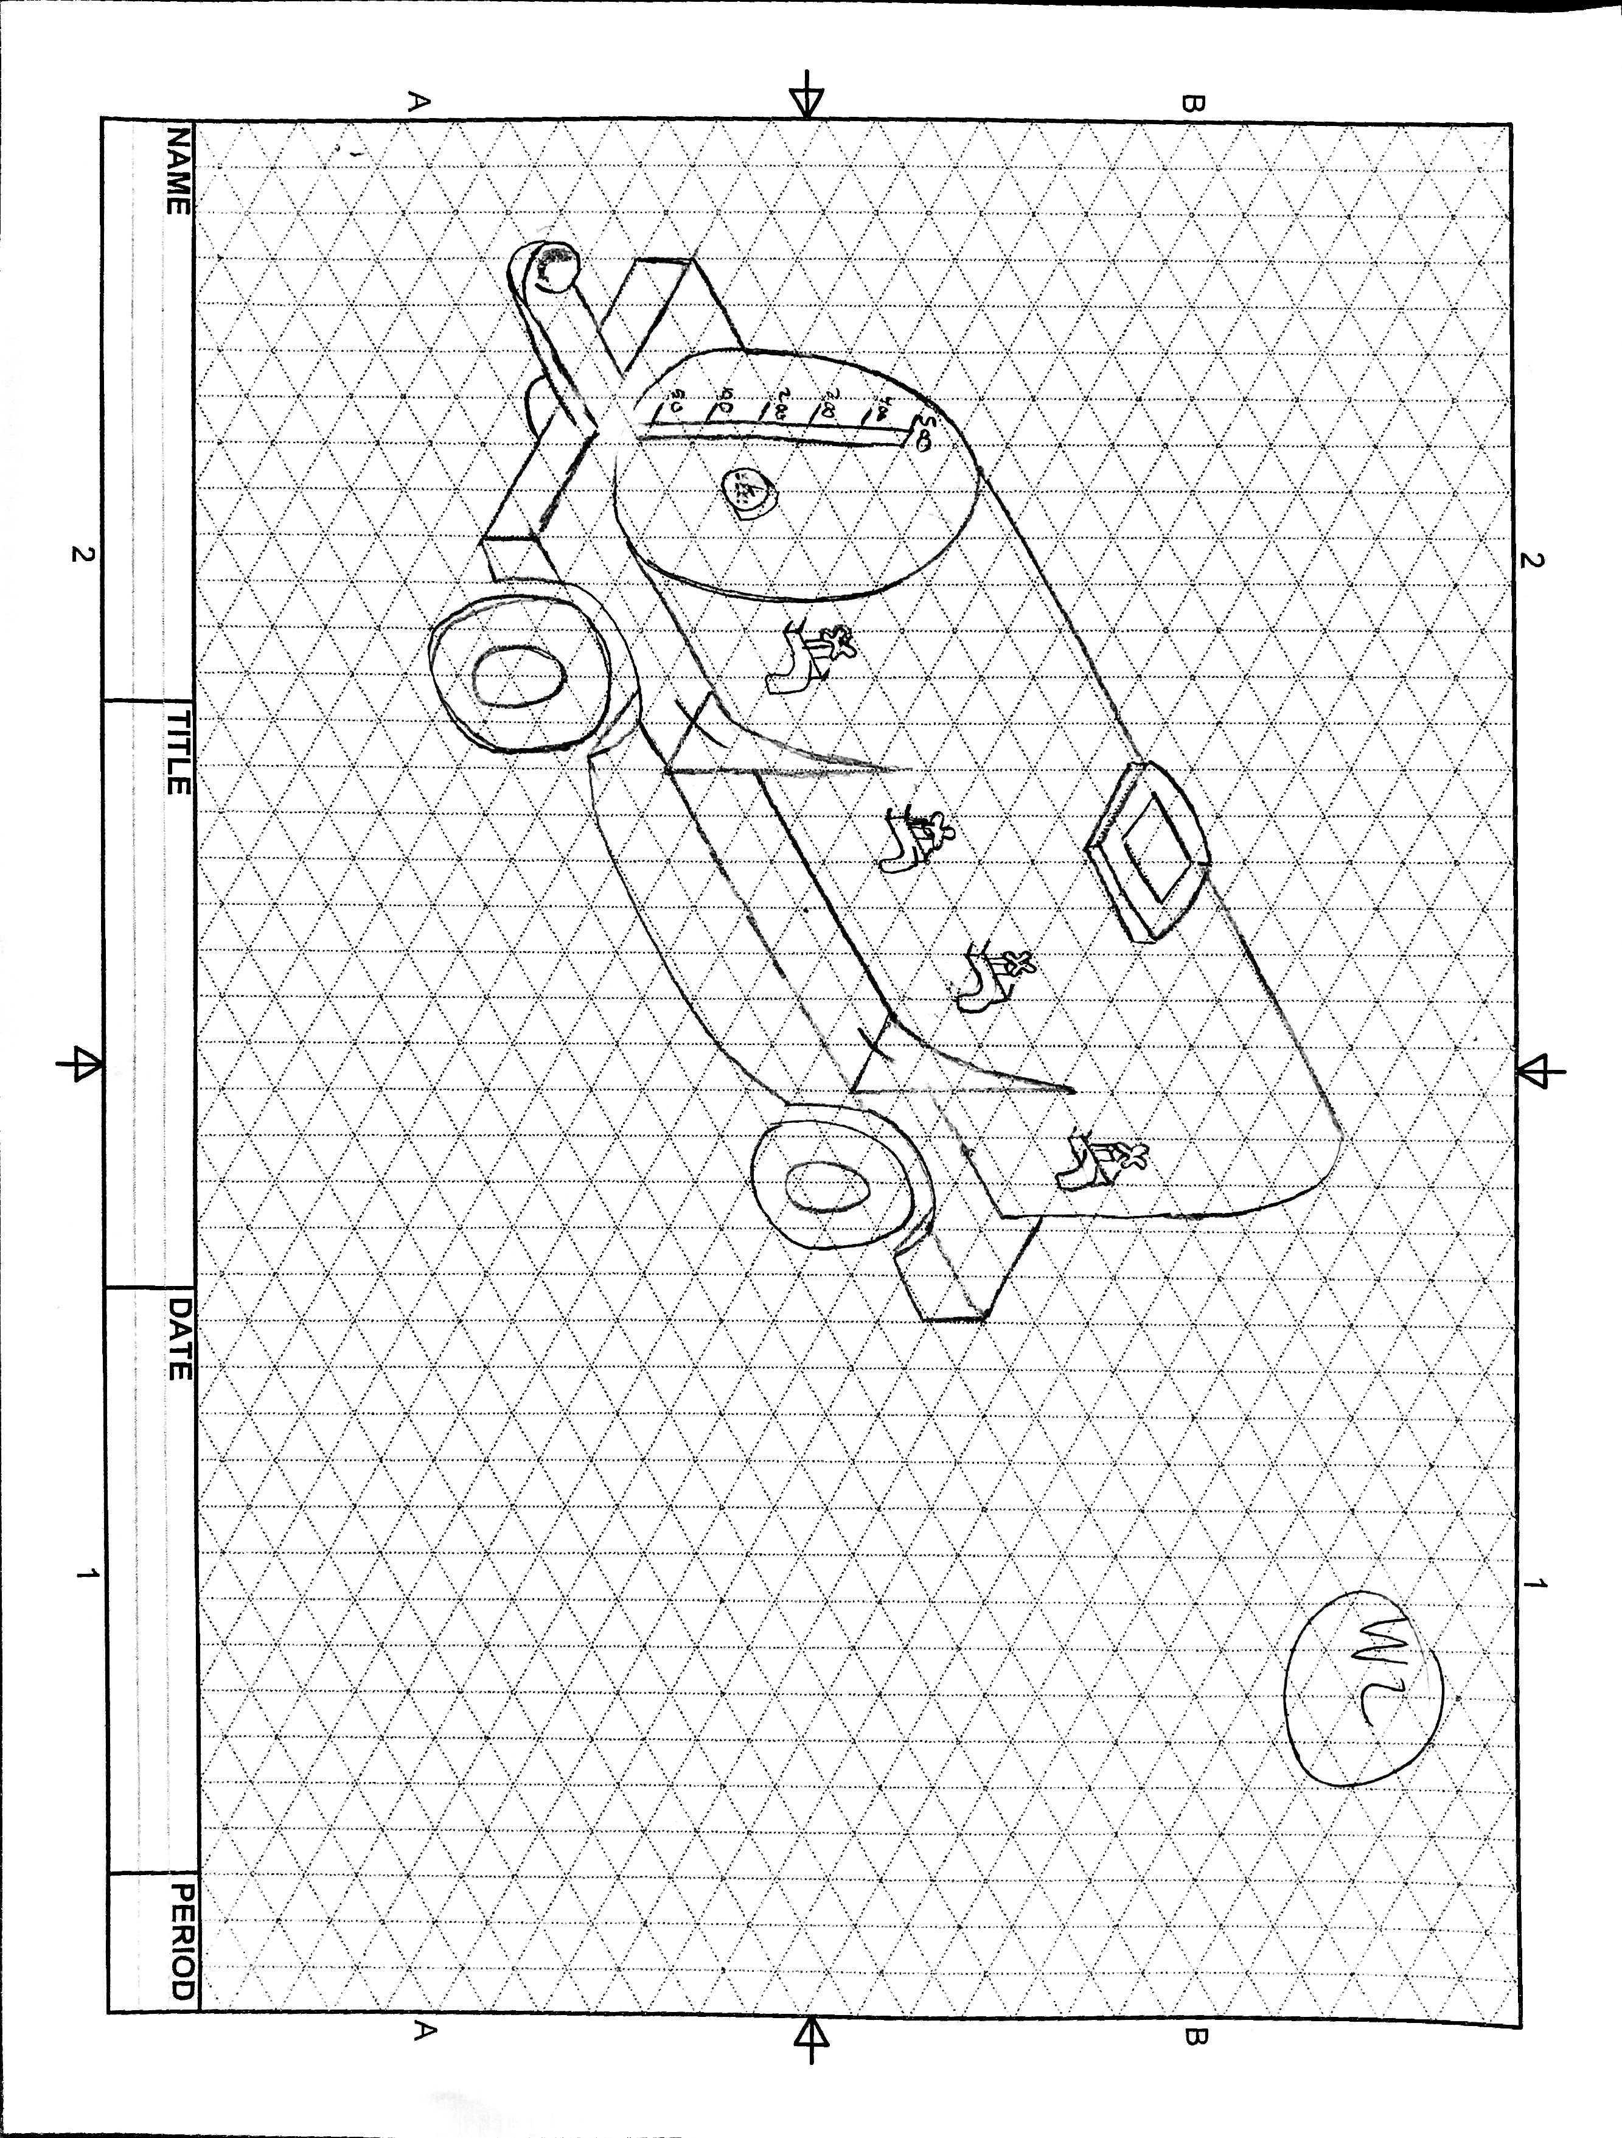
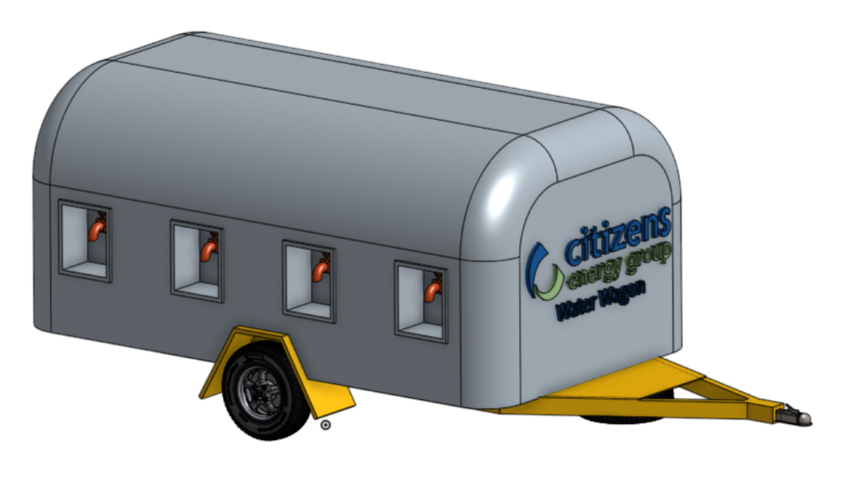
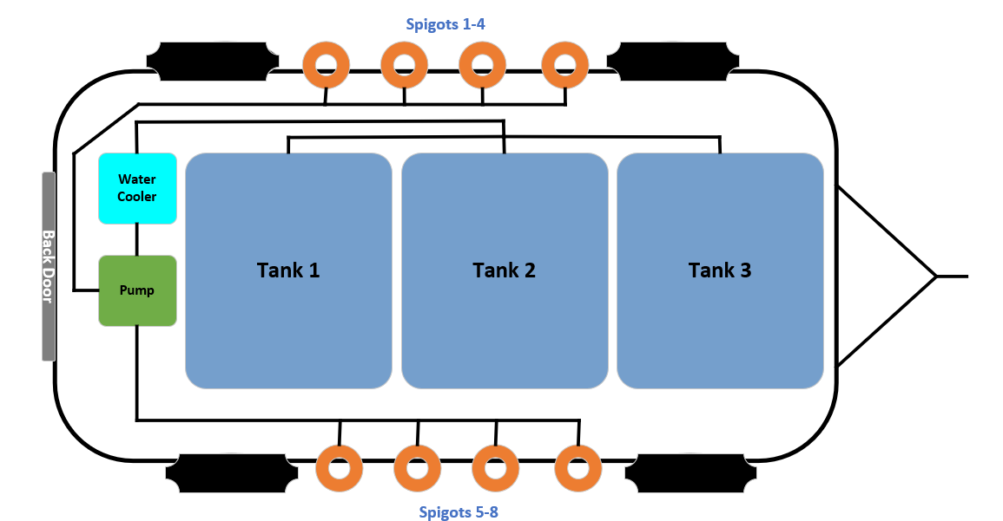
Feature
Project
Water Wagon
Notes:
In support of our commitment to being good stewards of the environment, Citizens Energy Group (Citizens) partnered with the University of Indianapolis to develop a “water wagon,” a mobile water distribution vehicle, for use at various festivals, fairs and events around Central Indiana for community outreach and education.

Slide 12
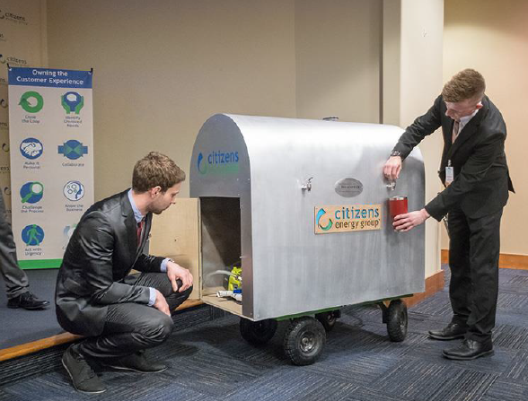
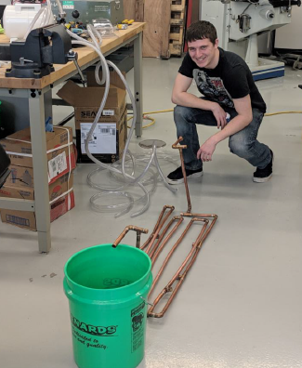
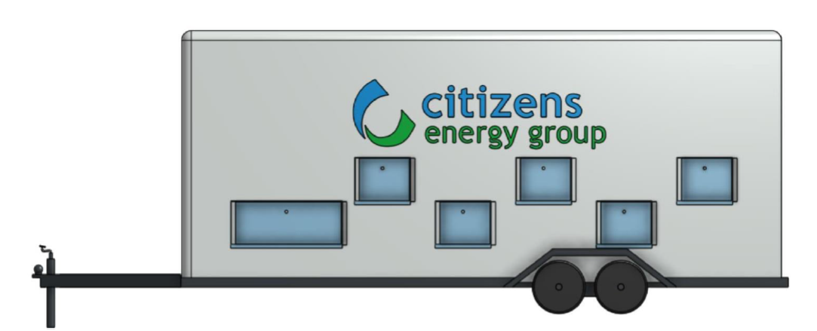
Notes:
Back in February, a team of four University of Indianapolis R.B. Annis School of Engineering students presented a prototype of a “water wagon” to be used by Citizens as a way to provide safe, reliable drinking water to the community at public events while supporting its commitment to sustainability by reducing the number of plastic water bottles used and disposed at such events.
Citizens had discussed for several years the possibility of constructing a water wagon, but it wasn’t until the PERL project came about that it became a reality.
The prototype was the product of 10 weeks of planning, design and testing by the students, who were guided through the project by university faculty and staff. The team operated on the timeline and budget set forth in the project charter, documenting processes, expenditures and challenges they faced along the way, much like they would in a professional engineering role. After 10 weeks of hard work and dedication, the team delivered an on-time, under-budget water wagon prototype.
What resulted from this PERL collaboration was a potentially useable product that could both benefit the community and fulfill a longtime Citizens goal. It was the ideal partnership

Slide 13
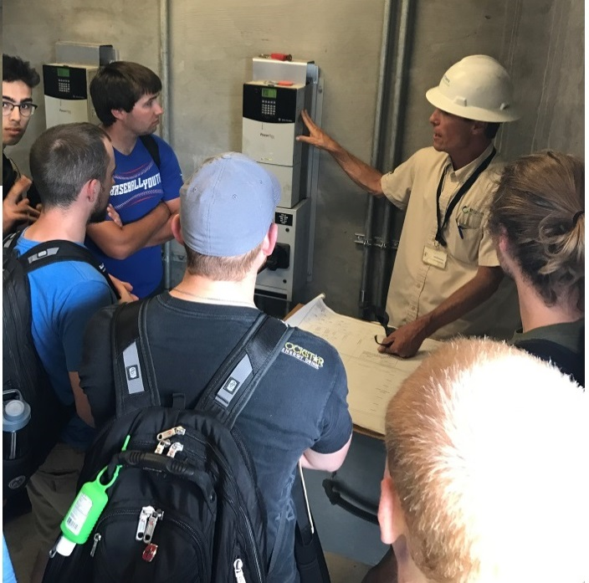

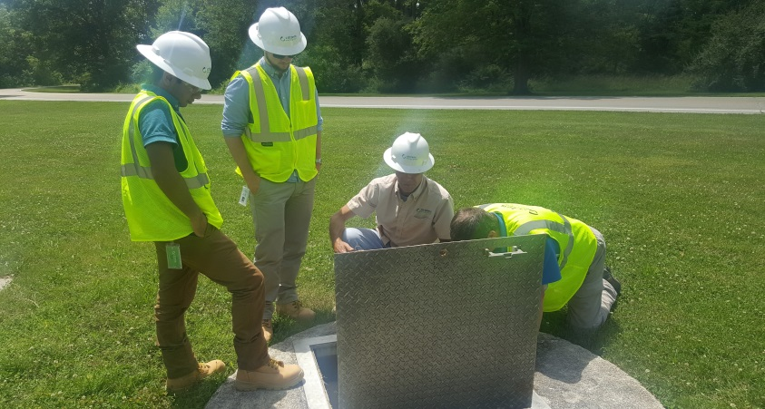

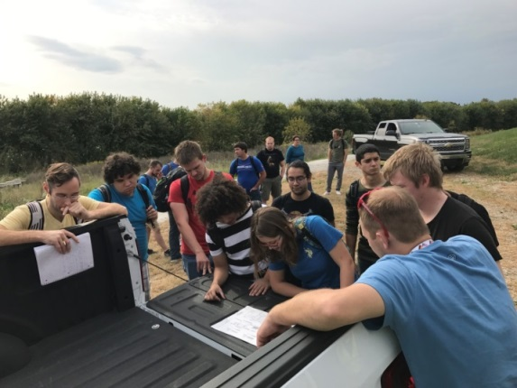
Educational Tours
Notes:
Annually we provide a tour list to our partners for approximately 20 tour opportunities from treatment plants to air pollution control equipment, to CSO storage tanks to lift stations, to active construction sites.

Slide 14
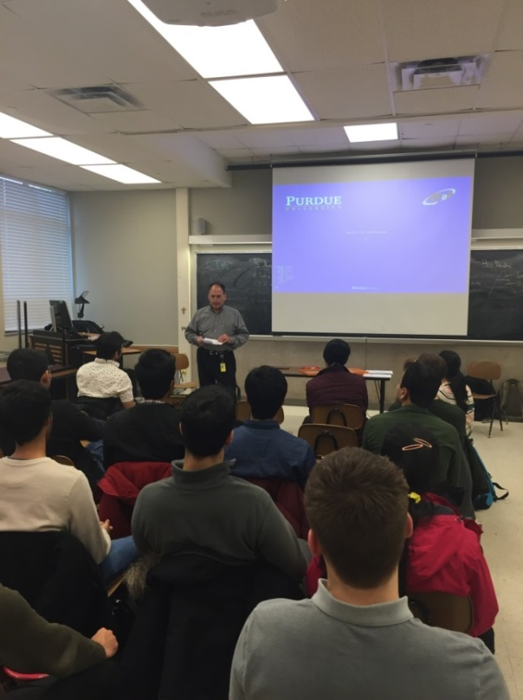
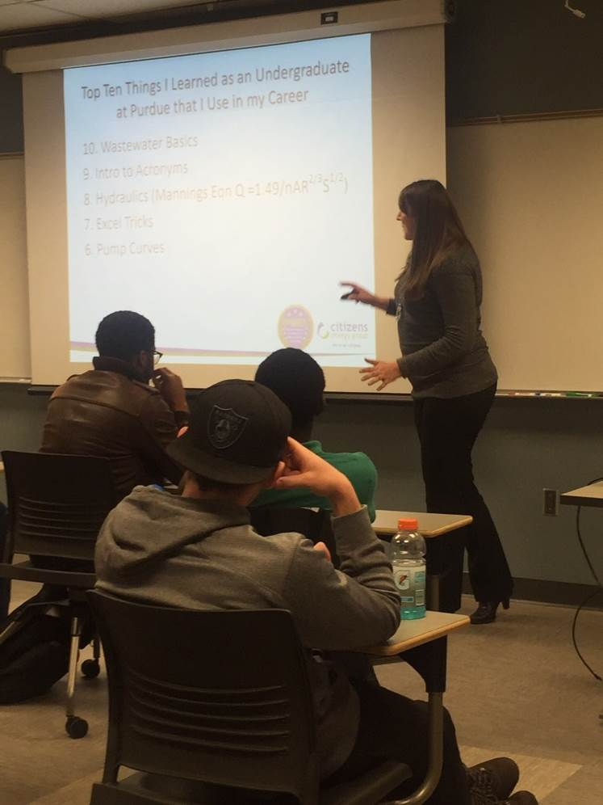
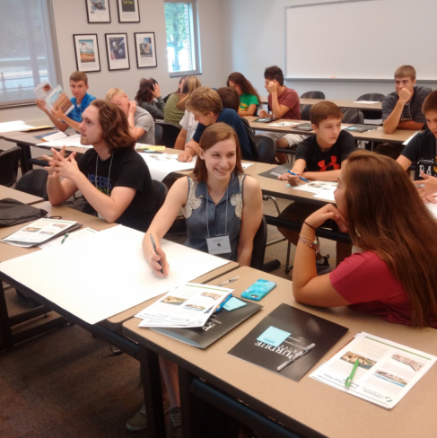
Guest Lectures/Presentations
Notes:
We are guest lecturers, speaking on topics ranging from ‘A Day in the Life of an Engineer’ for an intro to engineering course to ‘Data used in wastewater treatment’ for a statistics class.

Slide 15
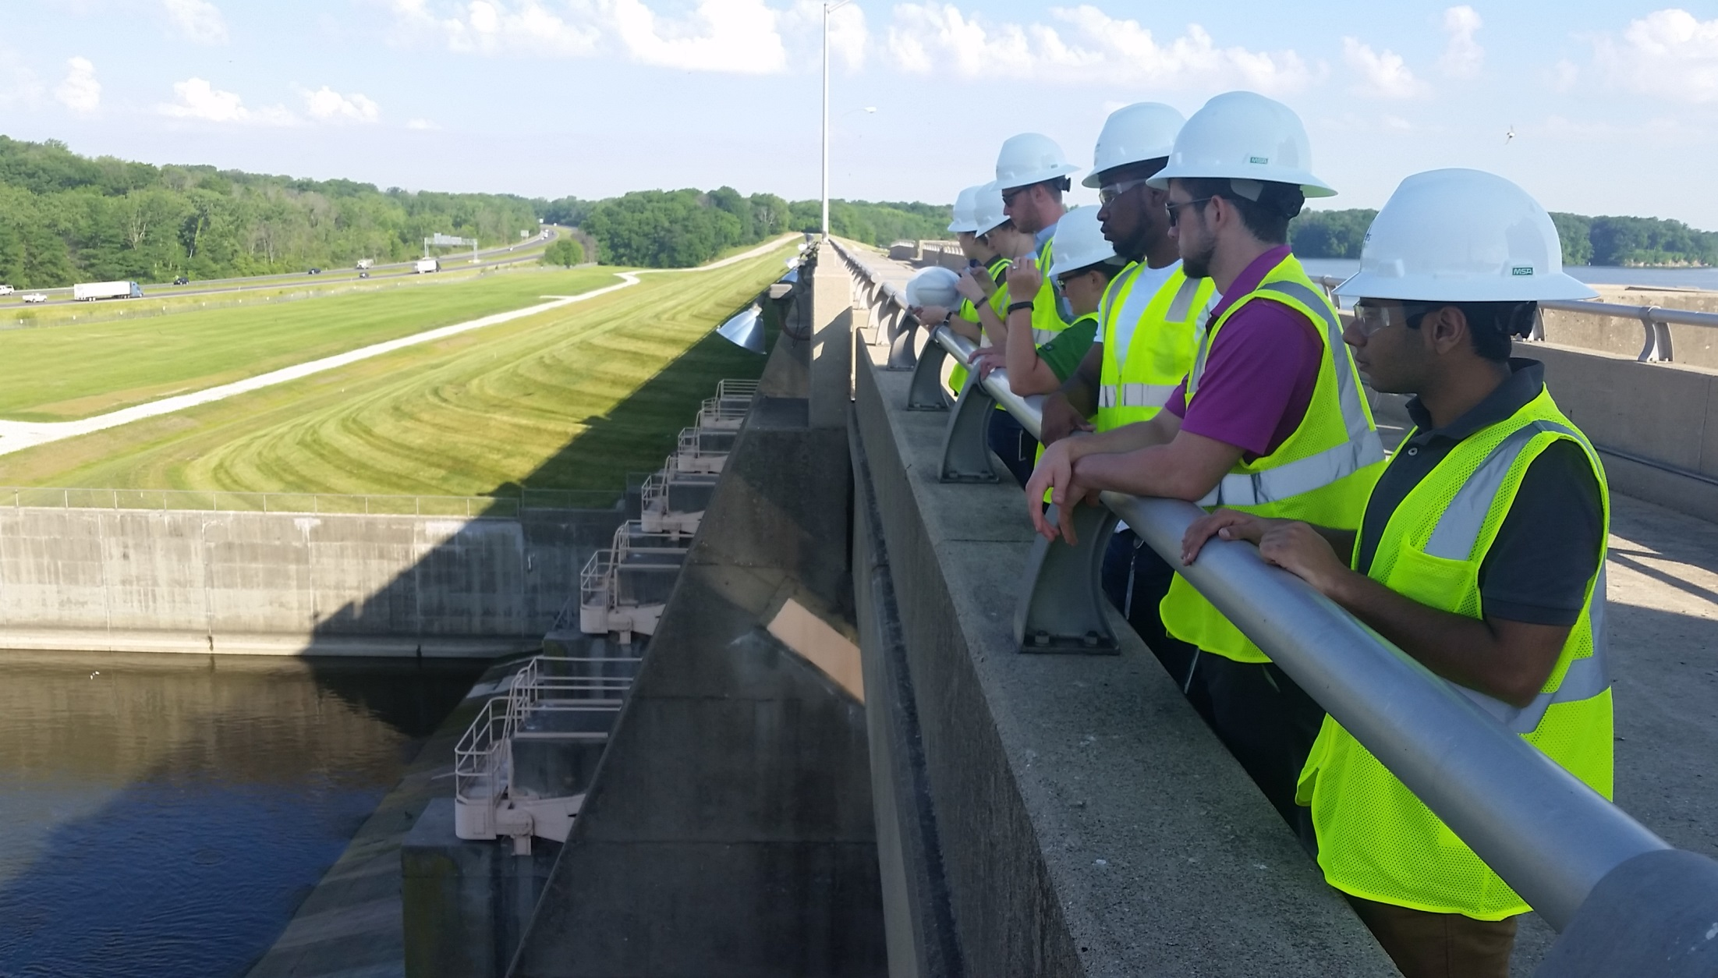
Internships
Citizens Internship Program
Orientation
Site visits
Exchange program
Notes:
We provide our interns with meaningful real-world work and experiences rather than just busy work.
We also give former interns/recent graduates/new hires the opportunity to further develop the PERL internship program.
PERL interns are mentored to improve networking and practice communication with executives. PERL facilitates a popular ‘speed networking’ hour long event where each intern has 10 minutes with each executive to ask questions and they rotate through executives in the hour.
The PERL internship program helps students identify their niche within the engineering field by exposing them to a wide range of projects and engineers specializing in different areas.

Slide 16
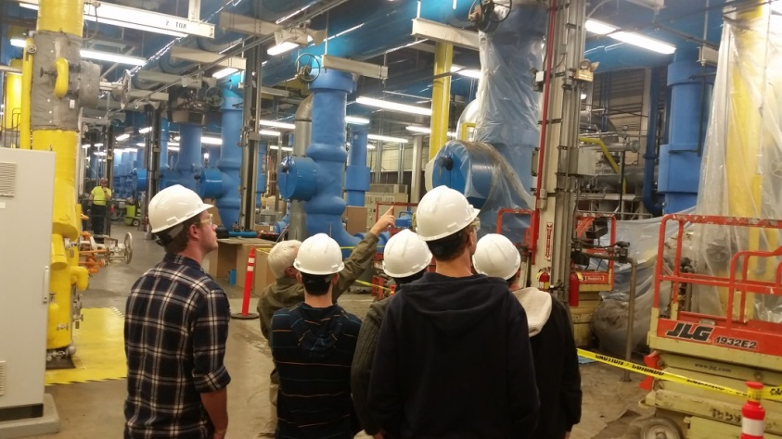
Participation Benefits
Gain real world industry skills and knowledge
Resume builder (experience, references, etc.)
Apply classroom knowledge/skills
Career path, opportunities and decision-making assistance
Develop professional contacts
Access to industry expertise
Behind-the-scenes tour opportunities

Slide 17
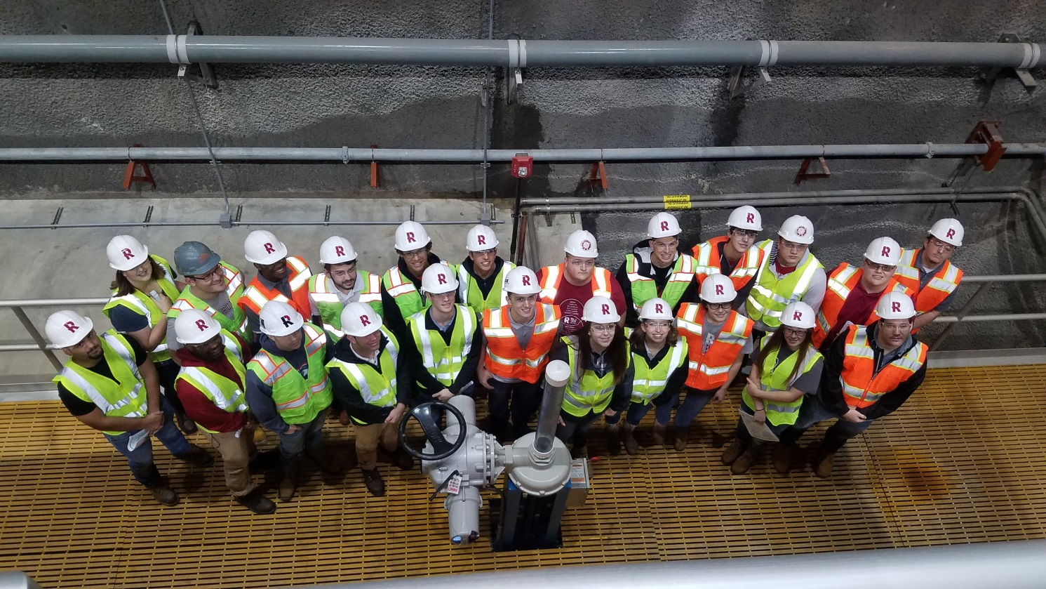
Student Lessons Learned
Delegation – if you try to do all the work yourself, it will yield worse results
Overcoming unforeseen obstacles – creating a plan and executing that plan are two different processes
Utilizing resources/experts
Positive attitude, trust
Team work
Notes:
Students have shared their top lessons learned through PERL projects.
Exposing students to cross-functional teams and collaborative projects in areas such as operations and engineering has given students a range of experiences.

Slide 18
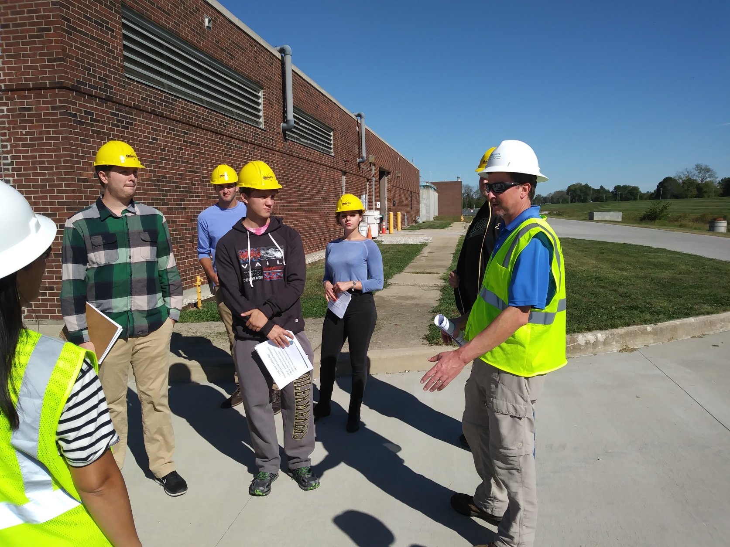
Metrics
2,000 students engaged
Over 50 employees engaged
Hosted 25 interns
Collaborated on over 50 projects
Participated in 60 events
Notes:
As the program continues to grow and the number of partnerships increases, Citizens remains committed to forming collaborative, mutually beneficial relationships in Indianapolis and throughout the state.

Slide 19
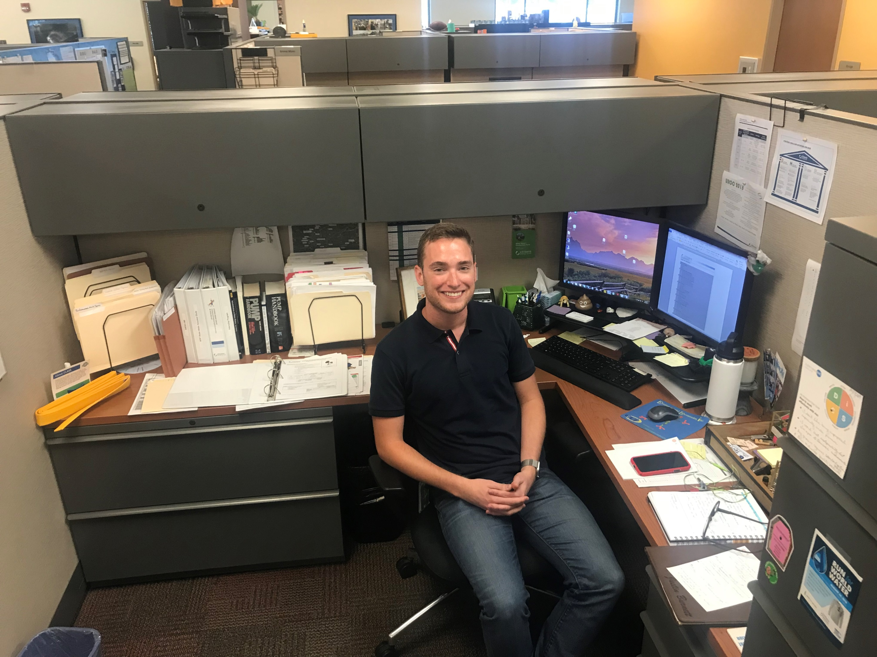

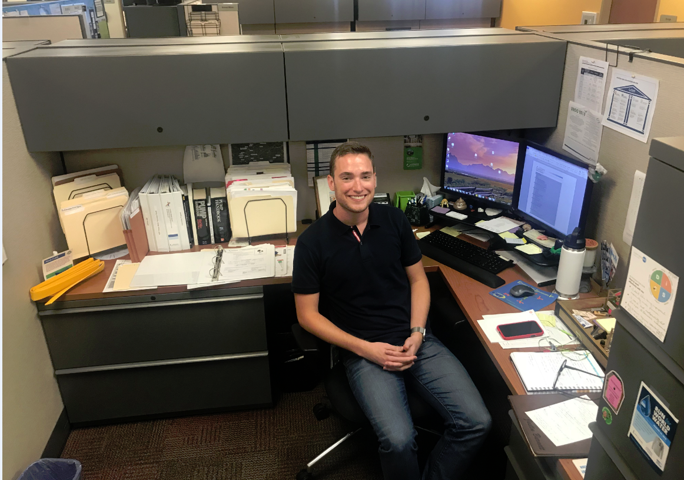
Full Time hires
Five full time hires in leadership positions
Three hires with partner vendors
Notes:
The new hires lead various capital programs such as the lift station replacement program, sewer rehabilitation program and the sanitary sewer master plan initiative.

Slide 20
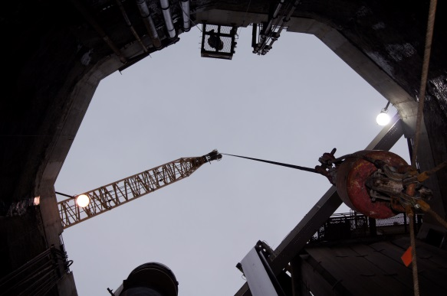
Testimonials
“Being lowered into the tunnel and seeing all of the large scale equipment up close was not something I could have grasped via pictures in a textbook. The size of the tunnel, both length and diameter, were truly impressive.”
- Amy Getchell, Purdue University Graduate Student and PERL participant
Notes:
We often receive feedback that students’ experience through PERL have a lasting impact.
We’ve seen the impact that PERL has on the students come full circle when we are hiring for open positions that list their PERL projects as experience on their resumes.

Slide 21
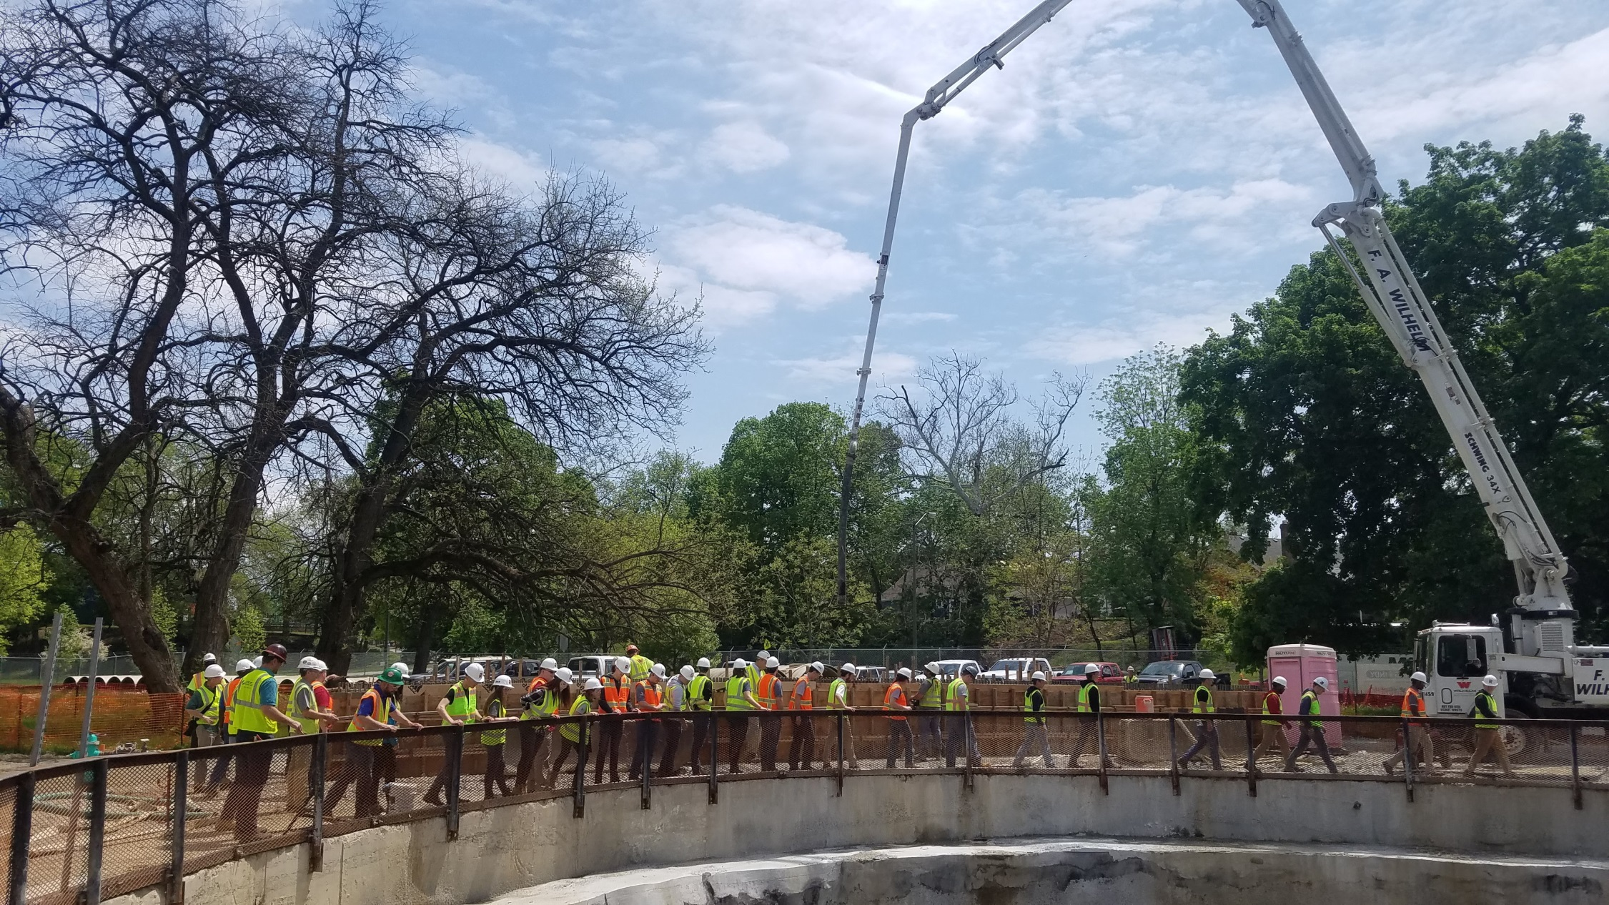
Lessons Learned
Delegation – if you try to do all the work yourself, it will yield worse results
Overcoming unforseen obstacles – creating a plan and executing that plan are two different processes
Utilizing resources/experts
Positive attitude, trust
Team work
Questions?
Notes:
PERL is a model of an innovative program that has led to real-world opportunities with real-world results for the utility industry, university students and academic experts.

Slide 22
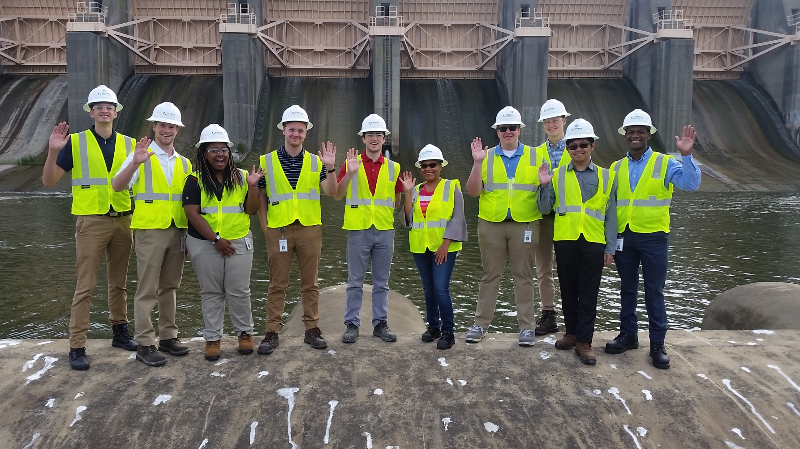

Slide 23
