Slide 1
Citizens Energy Group’s Septic Tank Elimination Program: STEPin’ Forward to Cost-Efficiently Eliminate Septic Tanks

Slide 2
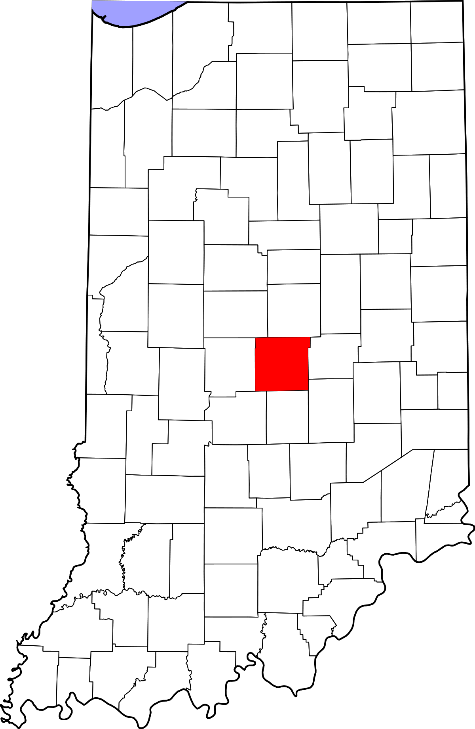
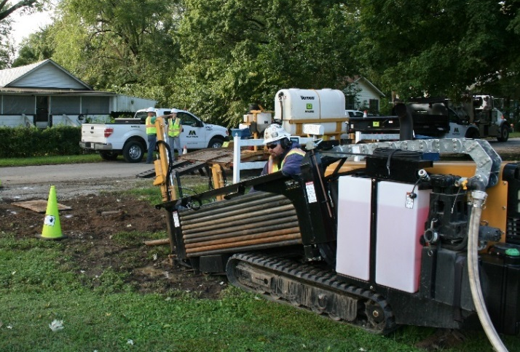
Agenda
Marion County (Indianapolis)
Citizens Energy Group
Indianapolis’ Septic Tank Problem
The Solution: Septic Tank Elimination Program (STEP)
Evolution of the Program
Project Prioritization and Selection
Program Implementation
Customer Engagement
2019 IURC Compliance Filing
IN Senate Bill 472
Program Successes

Slide 3
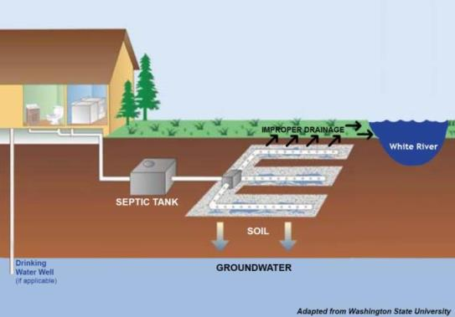
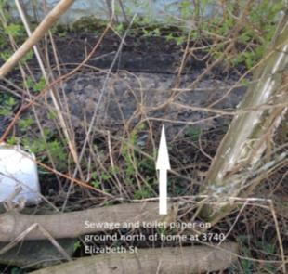
The Problem: Failing Septic Tanks
Originally, approximately 30,000 homes on septic systems in Indianapolis
Failing septic systems discharge human waste into inhabited areas
Can create contaminated areas
Impact ditches and streams
Impact quality of life
Impact floodplain areas
Impact well field areas
Indianapolis is one of the largest cities in the US with respect to the number of septic systems per capita

Slide 4
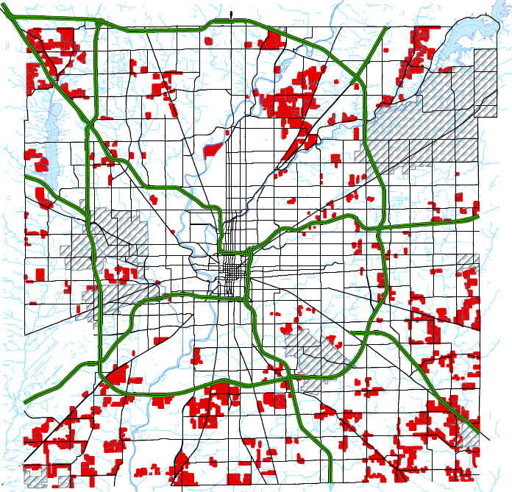
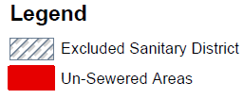
The Problem: Failing Septic Tanks
Notes:
First picture shows un-sewered areas (as of today). Second picture (appears on click) shows proximity to streams

Slide 5
The Solution: Septic Tank Elimination Program (STEP)
Septic Tank Elimination Program
Sewer extension program for developed, unsewered areas with failing septic systems
Supports Indianapolis’ Consent Decree efforts by improving water quality
Reduces health hazards and environmental risks
Cleaner streams from reduced failed septic
system runoff
If Citizens doesn’t continue to implement STEP,
U.S. EPA may require more CSO controls

Slide 6
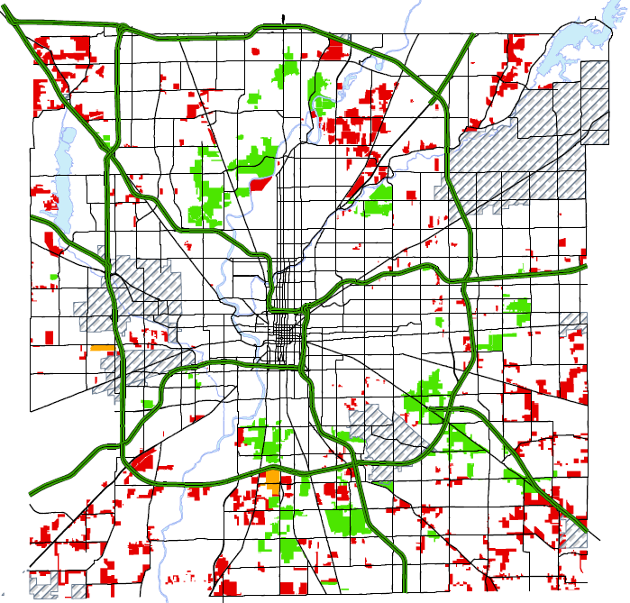
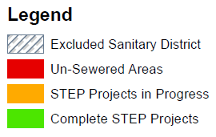
The Solution: Septic Tank Elimination Program (STEP)
STEP has provided sewer availability to 15,000 homes

Slide 7
Evolution of the Program
Barrett Law
Septic Tank Elimination Program – City
“New” Septic Tank Elimination Program
Septic Tank Elimination Program – Citizens
Pre- 2006
2006
2011
2016
Notes:
Discuss the evolution of STEP and how 2016 was a big year where CEG evolved the program once more…and that is what we’ll talk about in the next few slides.

Slide 8
Evolution of the Program
Neighborhood Prioritization
Prioritization Method
Project Clustering
Program Implementation
Type of Service
Project Delivery
Customer Engagement
Public Involvement/ Outreach
Homeowner/ Utility Responsibilities
Design/Build/ Inspection Approach
Notes:
These are the three main points CEG hit on during the 2016 evolution.

Slide 9
Evolution of the Program
Neighborhood Prioritization
Prioritization Method
Project Clustering
Program Implementation
Type of Service
Project Delivery
Customer Engagement
Public Involvement/ Outreach
Homeowner/ Utility Responsibilities
Design/Build/ Inspection Approach

Slide 10
Citizens Prioritization Methodology (Post-2016)
Use an internal, collaborative approach to project identification and prioritization
Emphasize a holistic view of the capital program (water and wastewater)
Project
Planning
Prioritization
Methodology
Process
3PMAP
Notes:
No need to explain what 3PMAP is other than Citizens’ internal project prioritization method/system

Slide 11
Historical STEP Prioritization (Pre-2016)
STEP Prioritization Criteria (Historic)
Criteria | Weight | Criteria Explanation
Septic Failure Rate | 5 | Percent of homes with failing septic systems as determined by Health Department
Housing Density Factor | 5 | Homes per acre
Presence of Residential Wells | 3 | Percent of homes using wells
Presence of 100-Year Flood Plain | 3 | Percent of project within the 100-year flood plain
Wellfield Protection District | 1 | Percent of project within a wellfield protection district
Notes:
Go through each criteria

Slide 12
New STEP Prioritization (Post-2016)
STEP Prioritization Criteria (New)
Criteria | Weight | Criteria Explanation | Score | Notes
Housing Density Factor | 5 | Rates the project based on the number of homes per acre | 1 3 5 | 0.0 – 0.6 homes/acre 0.61 – 1.5 homes/acre 1.51 < homes/acre
Presence of Residential Drinking Water Wells | 1 | Compares if a project on individual residential wells has water service available | 0 1 3 5 | 0.0% 0.1% - 45% 45.01% - 85.0% > 85.01%
Presence of 100-year Flood Plain | 1 | Compares if a project lies within the 100-year flood plain | 0 1 3 5 | 0.0% 0.1% - 15% 15.01% - 40.0% > 40.01%
Notes:
Go through each criteria and explain why these better align with STEP (since the goal is assisting improving water quality)

Slide 13
Project Clustering (Post-2016)
Criteria | Conclusion
Offsite main extension through a lower priority project area | Include as a cluster.
Offsite main extension adjacent to a lower priority project area AND the adjacent project is a high density area. | Consider including in cluster if high density. Do not include if low density.
Maximum of 500 homes in a cluster. | Do not add project to cluster if project results in a cluster of greater than 500 homes.
Notes:
Used to leverage buying power and increase efficiency in areas where multiple projects existed

Slide 14
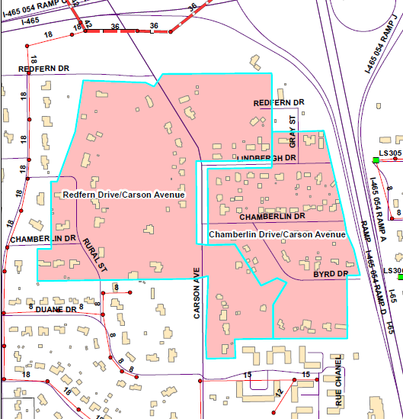
Project Clustering (Post-2016)
The two independent projects were clustered to form one single project
Larger, single projects allow Citizens to leverage its buying power and increase efficiency during construction

Slide 15
Evolution of the Program
Neighborhood Prioritization
Prioritization Method
Project Clustering
Program Implementation
Type of Service
Project Delivery
Customer Engagement
Public Involvement/ Outreach
Homeowner/ Utility Responsibilities
Design/Build/ Inspection Approach

Slide 16
Type of Service
Pre-2006
Barrett Law
Gravity sewers & lift stations
2006
STEP (City)
Gravity sewers & lift stations & limited low pressure systems
2011
STEP (Citizens)
Gravity sewers & lift stations & limited low pressure systems
Post-2016
STEP
All low pressure systems

Slide 17
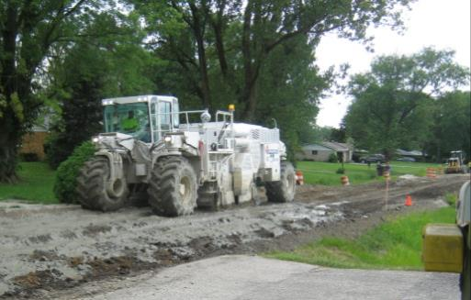
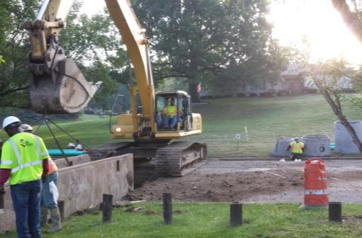
Pre-2016 – Gravity Systems
Mechanical components
Open-cut installation
Significant disruption within neighborhood
Long project duration
Invasive
Messy and noisy
Extremely expensive

Slide 18
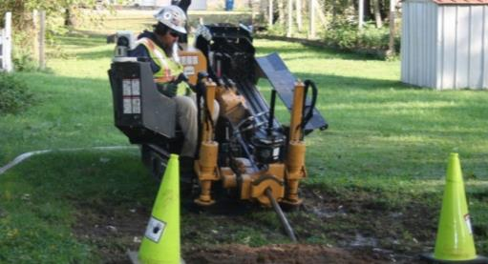
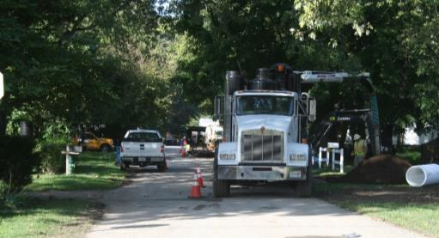
Post-2016 – Low Pressure Systems
No mechanical components
Horizontal direction drill installation
Minimal disruption within neighborhood
Shorter project duration
Minimally invasive
Grinder pumps required
Cost effective

Slide 19
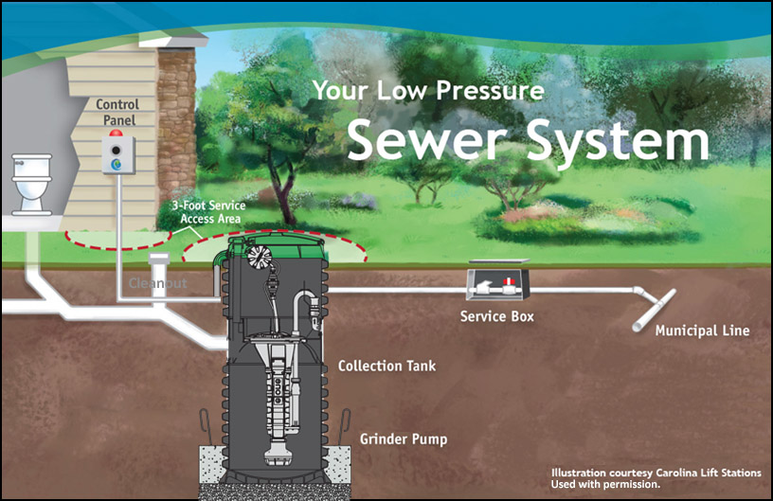
What is a Low Pressure System?
*Property owner responsible for future maintenance of grinder pump
*2-year parts and labor warranty included
Notes:
Discuss ownership of infrastructure

Slide 20
Project Delivery
Pre-2006 Barrett Law
Design – Bid – Build (traditional method)
2006 - STEP
Design – Bid – Build (traditional method)
2011 - STEP Citizens
Design – Solicit Proposals – Build (traditional method)
2016 - STEP
Modified Design/Build/Inspection
Public Bid – Lowest responsive and responsible
Public Bid – Lowest responsive and responsible
Solicit Proposals (Participants Invited) – Best Value
Solicit Programmatic Proposals (Participants Invited) – Best Value

Slide 21
Project Inspection
Pre-2006
Barrett Law
Consultants & Internal – Full time & some part time
2006 - STEP
Consultants – Full time
2011 – STEP Citizens
Consultants – Full time with some part time
2016 - STEP
100% Internal – part time

Slide 22
Evolution of the Program
Neighborhood Prioritization
Prioritization Method
Project Clustering
Program Implementation
Type of Service
Project Delivery
Customer Engagement
Public Involvement/ Outreach
Homeowner/ Utility Responsibilities
Design/Build/ Inspection Approach

Slide 23
Public Involvement/Engagement
Pre-2006 Barrett Law
2006 – STEP (City)
2011 – STEP (Citizens)
2016 – STEP
One public meeting for every 100 properties
Two Public Meetings
No hearings or assessment appeals – Eliminated the legal requirements of Barrett Law
Three public meetings
Public meetings(s)
Hearing – Legal requirement– Board of Public Works
Assessment appeals – Board of Public Works

Slide 24
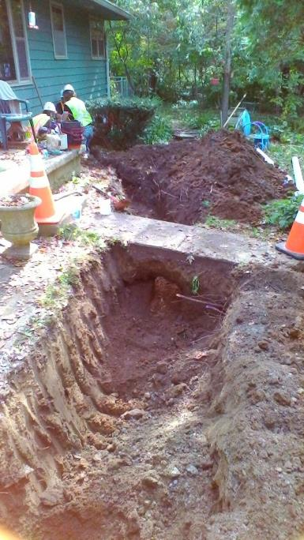
Homeowner Responsibilities
Pay Total Cost - $2,766.00
Lateral Construction
Grinder Pump Procurement and Installation
Limited Electrical Work
Abandonment of Septic Tank
Sign STEP Enrollment Agreement
Right-of-entry
Selection of payment option
Meet with contractor to determine equipment location

Slide 25
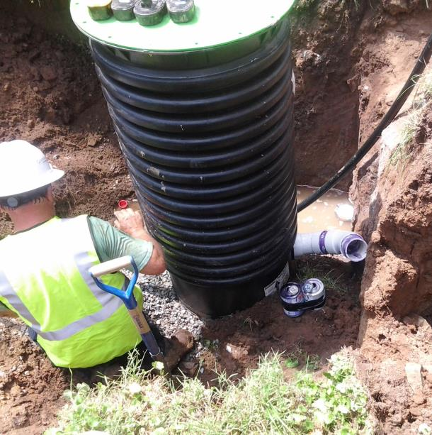
Homeowner Responsibilities
Payment Options
All property owners are eligible
Lump Sum
60-Month Payment Plan
$46.10/month
Added to monthly sewer bill
Notes:
All property owners are eligible for payment plan not. In the past, financial need either did not exist, or it was based on financial need.
Reduced homeowner responsibility and opened payment plan to everyone.

Slide 26
Program Successes: Average Project Costs
 | Barrett Law | Pre-2016 STEP | Post-2016 STEP
Homeowner Costs
Assessment (% of main) | $10,000 | - | -
Lateral Construction | $4,000 | $4,000 | -
Connection Fee / Permit | - | $2,766 | $2,766
Total Homeowner Cost | $14,000 | $6,766 | $2,766
City of Indianapolis / Citizens Energy Group Costs
Construct Mains & Stubs | $15,000 | $20,000 | $10,000
Grinder Pump Installation | - | - | $6,000
Total Utility Cost | $15,000 | $20,000 | $16,000
Total Project Cost/Home | $29,000 | $26,766 | $18,766

Slide 27
Program Successes: Average Project Costs (by home)

Slide 28
Program Successes: STEP Voluntary Enrollment Trends
Project | # of Potential Connections | Actual Connections | Percentage of Connections
82nd St.-Meridian St. STEP | 167 | 121 | 72%
Michigan St.-Pleasant Run Pkwy. STEP | 102 | 66 | 65%
Morris Street-Tibbs Avenue STEP | 238 | 97 | 41%
Earlham Dr.-Thompson Rd. STEP | 100 | 46 | 46%
62nd Street/Lafayette Road STEP | 96 | 50 | 52%
77th Street/Hoover Road STEP | 177 | 116 | 66%
Pre-2016 Totals: | 880 | 496 | 56%
24th Street/Eustis Drive STEP | 37 | 34 | 92%
75th Street/Keystone Avenue STEP | 421 | 402 | 95%
75th Street/Westfield Boulevard STEP | 148 | 148 | 100%
Madison-Lilac STEP | 91 | 89 | 98%
82nd Street/Westfield Boulevard STEP | 262 | 257 | 98%
Post-2016 Totals: | 959 | 930 | 97%
Rockville Road/High School Rd STEP | 221 | 204 | 92%
Thompson/Meridian St STEP, Ph 1 | 111 | 98 | 88%
Pre-2016 STEP
Post-2016 STEP
Notes:
Homeowners
Reduced cost by ~80% from original Barrett Law
No longer need to hire contractor
Much happier with new program
Citizens Energy Group
Reduced cost from 2006 STEP by ~25%
More people connected and quicker
Happier customers

Slide 29
Program Successes: Average Voluntary STEP Enrollments
97%
Notes:
Homeowners
Reduced cost by ~80% from original Barrett Law
No longer need to hire contractor
Much happier with new program
Citizens Energy Group
Reduced cost from 2006 STEP by ~25%
More people connected and quicker
Happier customers

Slide 30
IN Senate Bill 472 – What Does it Mean for STEP?
Provides that if, within a county containing a consolidated city: (1) a main sewer line is extended for the purpose of connecting one or more residential or commercial properties to a sanitary sewer system; and (2) the extension, when completed, will be located within a certain distance of the property line of a residential property served by a septic system; the Health and Hospital Corporation of Marion County (corporation) or its board may not order that the residential property served by a septic system be connected to the extension. Provides, however, that the connection of a residential property served by a septic system to such an extension may be ordered if: (1) the state department of health; or (2) the corporation or its board; determines that the septic system serving the residential property is failing. Specifies that these provisions do not affect a septic tank elimination program approved by the IURC. Urges the legislative council to assign to an appropriate interim study committee the task of studying, on a statewide basis, the connection of unserved properties to sanitary sewer systems owned or operated by various public and private entities.
Notes:
Homeowners
Reduced cost by ~80% from original Barrett Law
No longer need to hire contractor
Much happier with new program
Citizens Energy Group
Reduced cost from 2006 STEP by ~25%
More people connected and quicker
Happier customers

Slide 31
IN Senate Bill 472 – What Does it Mean for STEP?
Led to many questions and few answers
Specifically excludes Citizens’ STEP Projects
Impacts enforcement approach from Marion County Health and Hospital
Future state of collaboration is currently unknown
Notes:
Homeowners
Reduced cost by ~80% from original Barrett Law
No longer need to hire contractor
Much happier with new program
Citizens Energy Group
Reduced cost from 2006 STEP by ~25%
More people connected and quicker
Happier customers

Slide 32
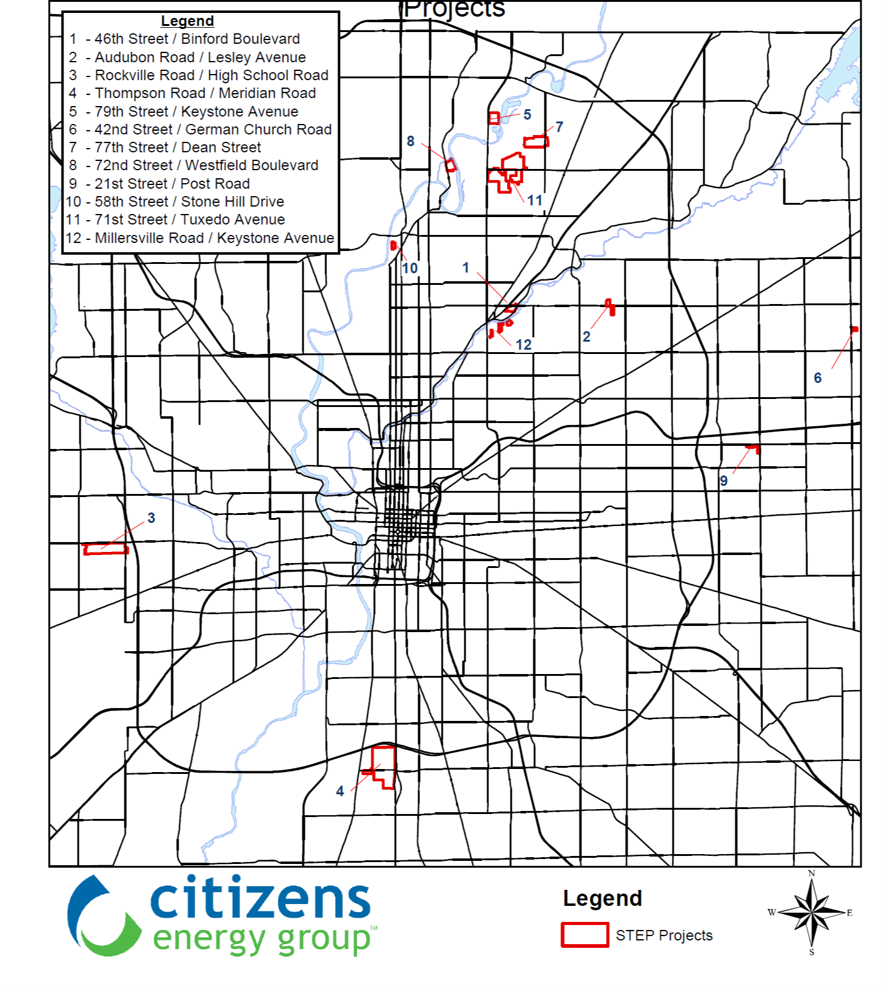
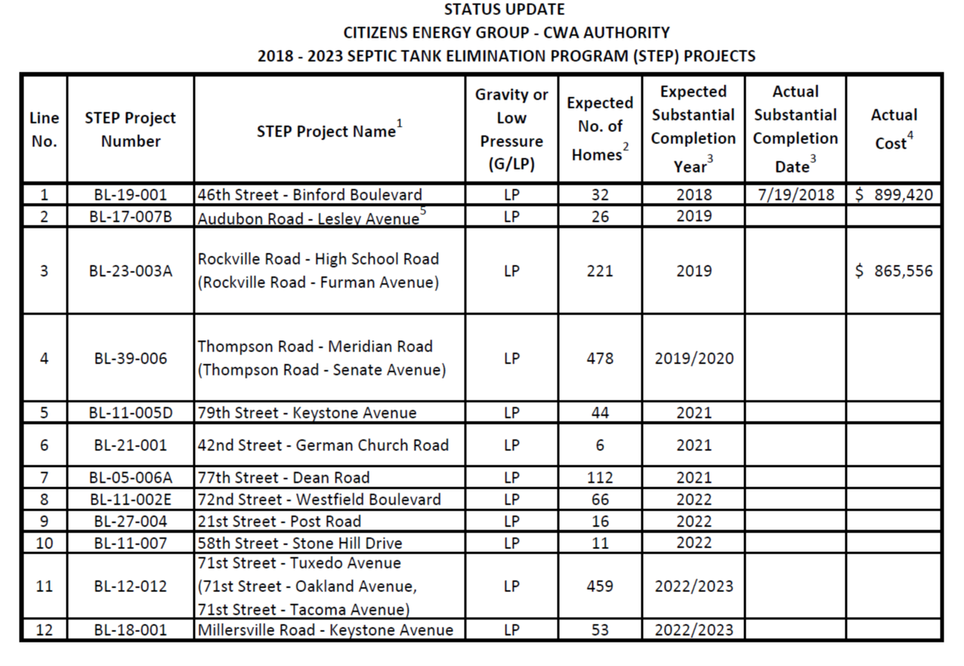
2019 IURC Compliance Filing
Notes:
Homeowners
Reduced cost by ~80% from original Barrett Law
No longer need to hire contractor
Much happier with new program
Citizens Energy Group
Reduced cost from 2006 STEP by ~25%
More people connected and quicker
Happier customers

Slide 33
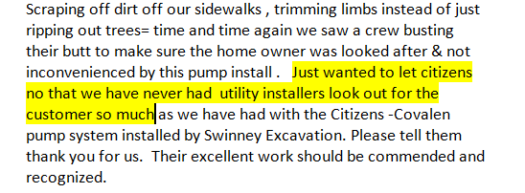
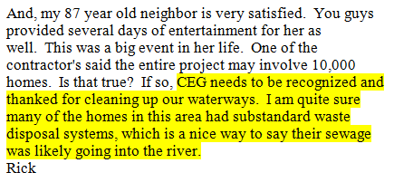
Program Successes: Customer Feedback

Slide 34
STEP’in Forward into the Future
Program Successes
Reduced overall project cost and reduced homeowner cost
Increased enrollment rates
Increased customer satisfaction and improved program perception
Continue to evaluate all STEP processes for improvement
Reduce Costs
Streamline processes
Keep our customers happy!
Notes:
We have accomplished the program successes and now will continue to look for ways to improve.

