Slide 1
City of Columbus
Department of Public Utilities
Division of Sewerage & Drainage
Southwesterly Composting Facility
Odor Reduction Improvements Project
September 4, 2019

Slide 2
Agenda
Columbus Biosolids Management Program
Southwesterly Composting / ‘Compost Facility’
Odor Reduction Improvements Project
Project Lessons Learned

Slide 3
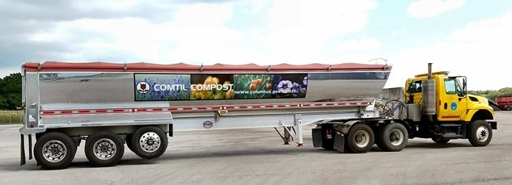
Columbus Biosolids Management Program

Slide 4
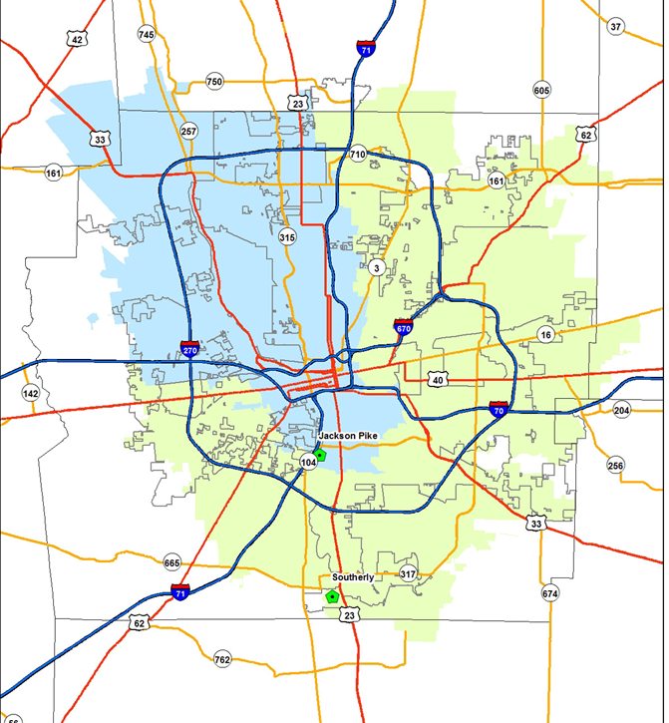
DOSD Overview
Jackson Pike WWTP
150 mgd peak
45% of Treated Flow
Southerly WWTP
330 mgd peak + 110 CEPT (4Q19)
55% of Treated Flow
Compost Facility
200 wtpd
33% - 50% total solids produced
``
JACKSON PIKE
COMPOST
``
SOUTHERLY

Slide 5
Biosolids Management Overview
Traditional Activated Sludge WWTPs
Class B Anaerobic Digestion to Thickening or Dewatering
Intermittent Unclassified WAS to Dewatering
Residuals Management
24,000 dry tons of biosolids per year
4 Primary Outlets
Incineration Ceased in 2015
Landfilling Ceased in 2016
Residuals Mgr
Josh Lutz
Soil Application Coordination
Heather Curtis
Compost
2 Supervisors
12 Equip Operators
4 Support
Commercial Digestion
Contractor
Land Application
Contractor
Tree Farm
Contractor
Emergency and Smaller Outlets

Slide 6
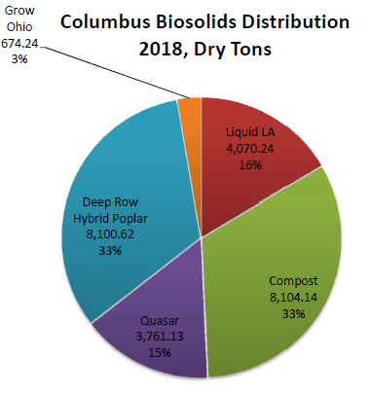
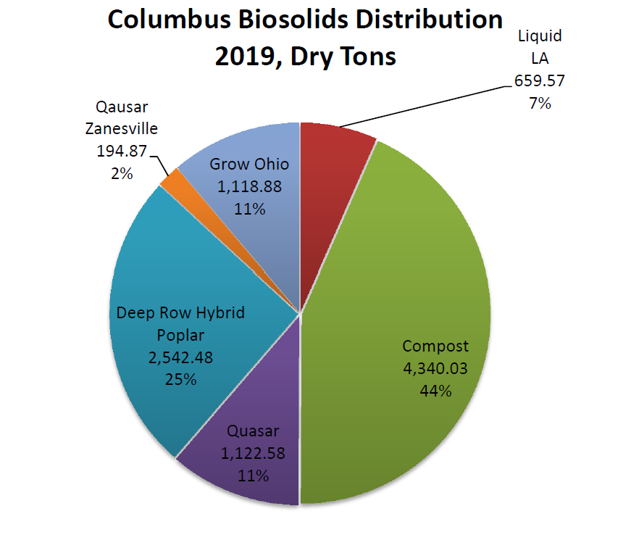
Biosolids Management Outlets
Land Application: Class B Liquid
Deep Row Tree Farms: Class B Cake
Commercial Digesters Feedstock (& Land App): CLB/UNCL Cake
Class A Compost, Com-Til: CLB/UNCL Cake
2018, DT
2019 Jan-May, DT

Slide 7
Solids Management Program Overview - Current
CLASS B
BIOSOLIDS
UNCLASSIFIED
SOLIDS
THICKENING
DEWATERING
DEWATERING
AG LAND
APPLICATION
TREE
FARMS
EMERGENCY
TO LANDFILL
COMMERCIAL
DIGESTION
COMPOST
FACILITY
(JP Only)

Slide 8
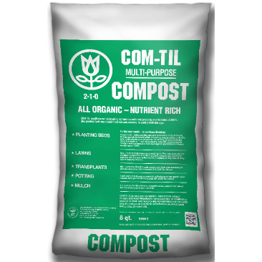
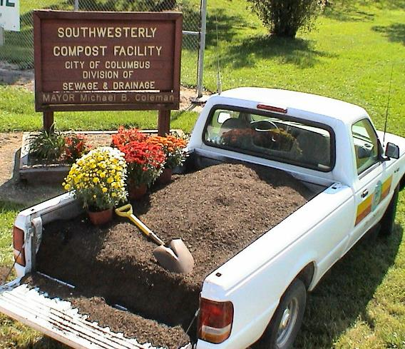
Biosolids Program Drivers
Continue a 100% Beneficial Use Program
Lower long-term costs / steady sewer rates
Recycling organics back to environment
Transition mindsets to think of biosolids as a commodity
Outlet diversity to increase reliability

Slide 9
Biosolids Program Changes & Challenges
Less Land & Fewer Days: weather, change in agricultural practices, less winter wheat recently
Keeping Vendors Fed: Such as thing as “too many” outlets?
Wet Weather: Plant Production, Outlet Reliability
Managing Outlet Performance
Vendor contracts
Truck management
Matching outlets to plant production
New Ohio regulations for on-site storage, application, monitoring and recordkeeping

Slide 10
Compost Facility
Background

Slide 11
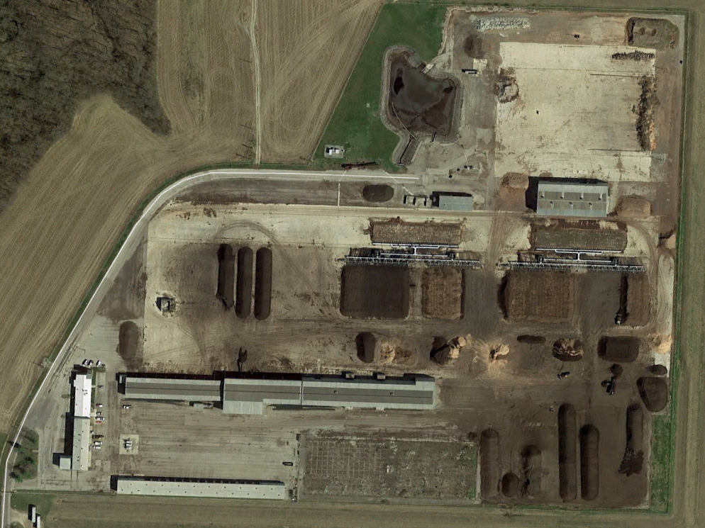
Compost
Facility
Notes:
-Compost Facility to the west of Southerly
-45 acres fences surrounded by approximately 400 acres of City owned farmland

Slide 12
Compost Facility – Background
Site developed in 1980 using static pile composting
Several projects completed in 1980’s increased efficiency and capacity
Due to odor complaints from static pile composting, the site switched to negative aerated static pile composting in 2001
160 wtpd average, 200 wtpd peak capacity, 7 – 9 trucks /day
Two pads with dedicated biofilters
44 legs per pad, 3 trucks per leg
Notes:
-Compost Facility to the west of Southerly
-45 acres fences surrounded by approximately 400 acres of City owned farmland

Slide 13
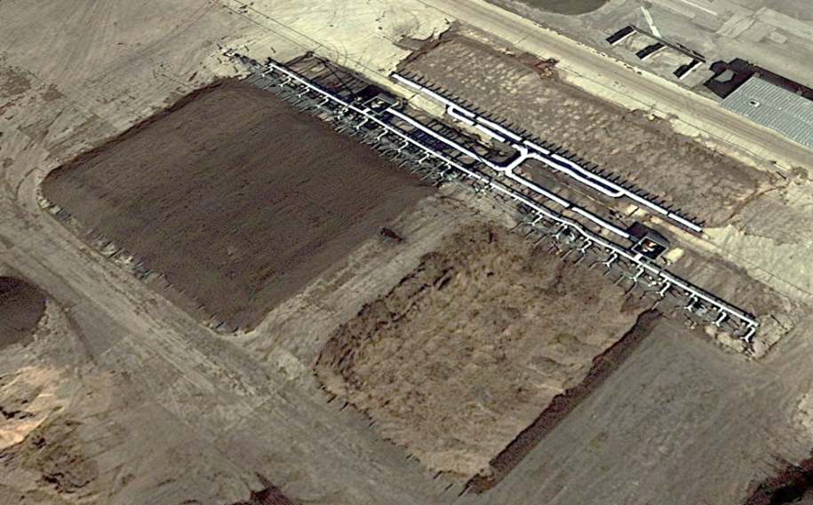
Composting Pad 2 and Biofilter 2
Notes:
-Compost Facility to the west of Southerly
-45 acres fences surrounded by approximately 400 acres of City owned farmland

Slide 14
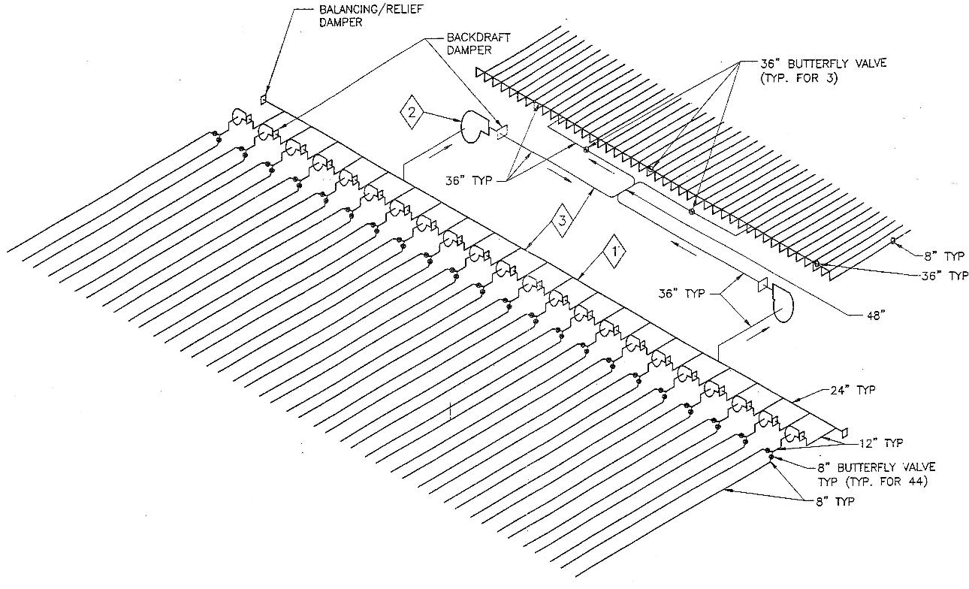
Composting Pad and Biofilter
Notes:
-Compost Facility to the west of Southerly
-45 acres fences surrounded by approximately 400 acres of City owned farmland

Slide 15
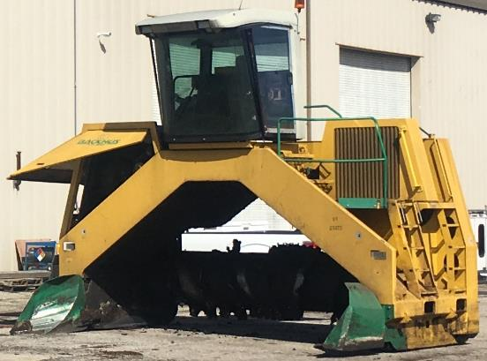
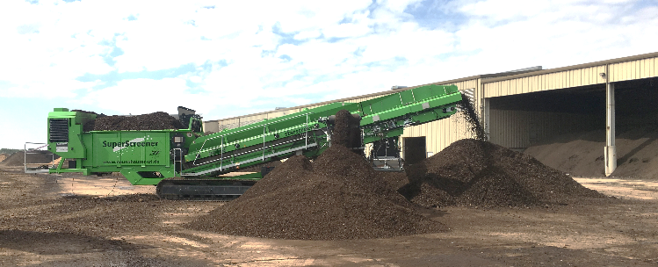
Compost Facility - Operations
Compost Process Steps:
Mixing
Composting
Curing
Screening & Woodchip Recycling
Finished Product
Support Functions:
Leachate Management
Air Pollution & Odor Control
Bulking Agent
Notes:
-Compost Facility to the west of Southerly
-45 acres fences surrounded by approximately 400 acres of City owned farmland

Slide 16
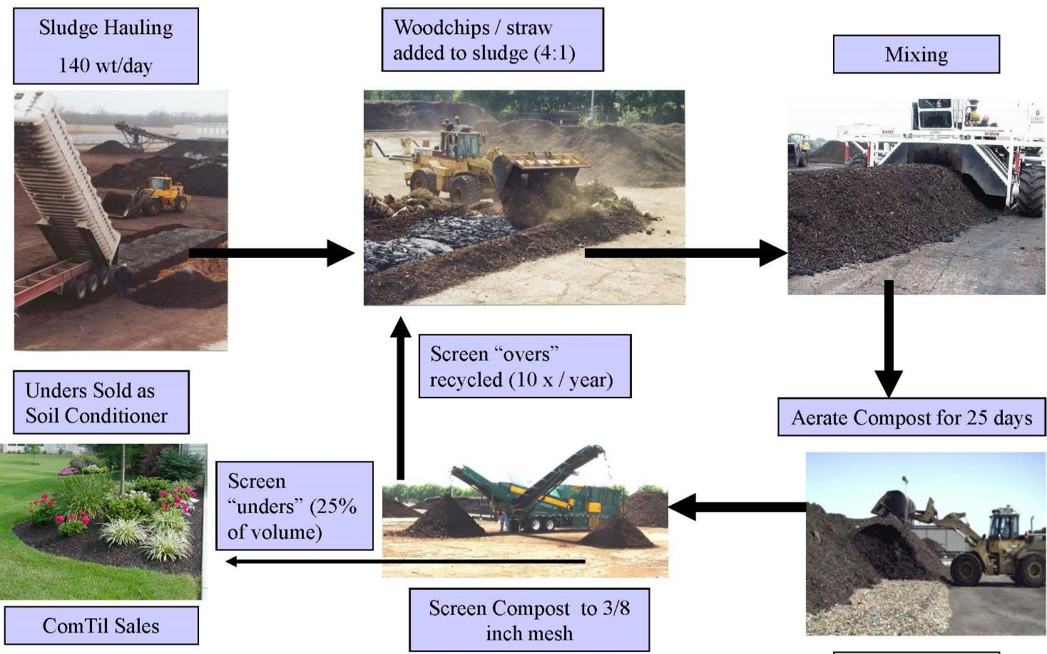
Compost Facility – Process Diagram

Slide 17
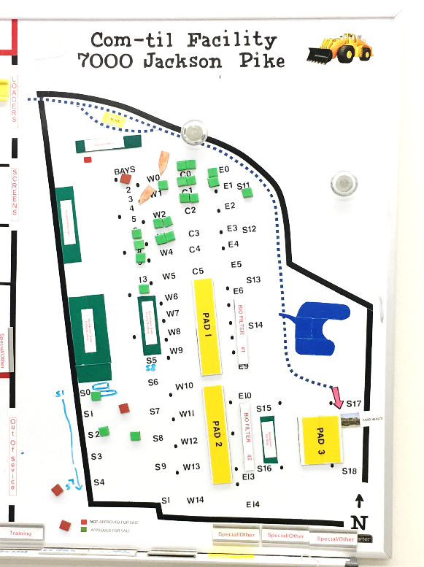
Compost Facility - Benefits
Class A, Exceptional Quality Product
Triple Threat! - Processing, Storage, &
Beneficial Use Outlet
Revenue Stream: They pay Us to take it!
$12 - $19/CY
Simple operations and equipment
Wide spot in biosolids program able to
ramp up & down
Reliable during wet weather
Accepts Class B and Unclassified
City-Controlled!
Notes:
-Compost Facility to the west of Southerly
-45 acres fences surrounded by approximately 400 acres of City owned farmland

Slide 18
Odor Reduction Improvements

Slide 19
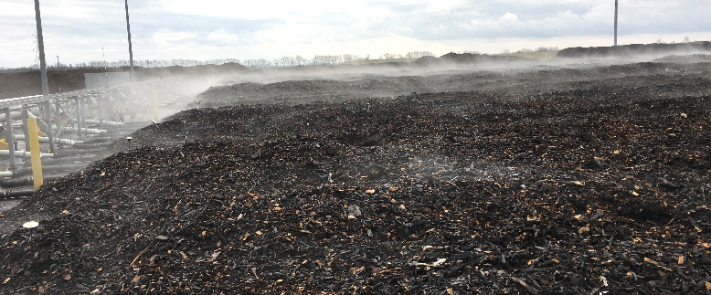
Odor Reduction Improvements
Project Drivers
Update technology and techniques to reduce odors
Be the best neighbor possible
Aeration equipment at end of useful life
Restore flexibility lost with Incinerators
Increase resiliency for wet weather and outlet underperformance
Continue average growth, allow for 150% increase to peak

Slide 20
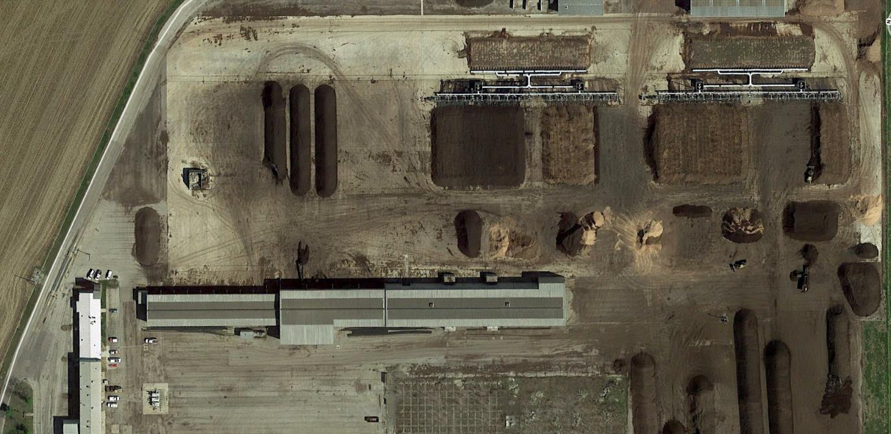
Compost Facility – Existing Site
BIOFILTERS
CURING
COMPOST PAD 1
COMPOST PAD 2
STAGING
SCREEN
COMTIL
SCREEN
HEADERS
CURING

Slide 21
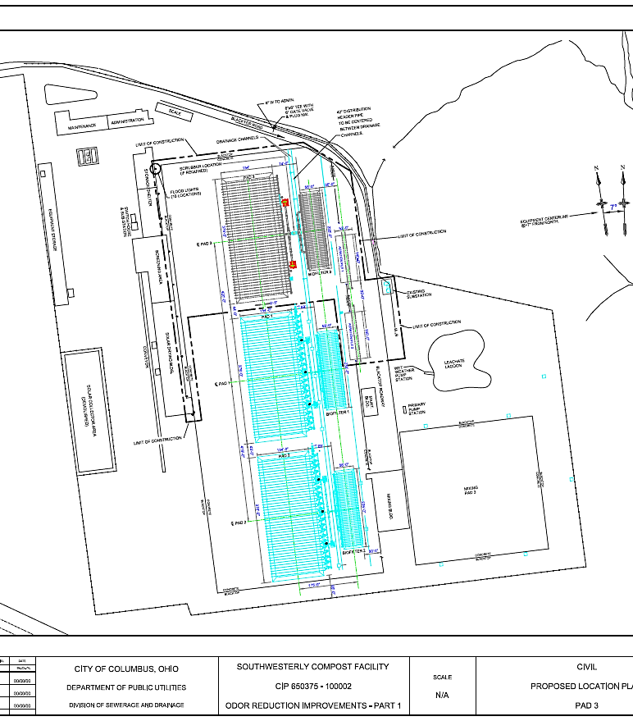
Odor Reduction Improvements
Project Description
Day 1
Add 3rd Pad & Biofilter
Increase capacity from
200 to 300 wtpd
$8M CCE
Planning started 1Q2017

Slide 22
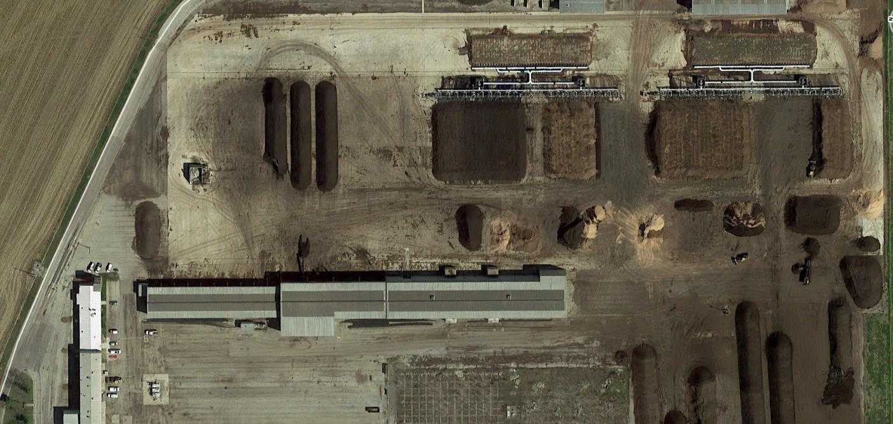
Compost Facility – Project Plan Day 1
BIOFILTERS
COMPOST PAD 0
COMPOST PAD 1
COMPOST PAD 2
STAGING
COMTIL
CURING

Slide 23
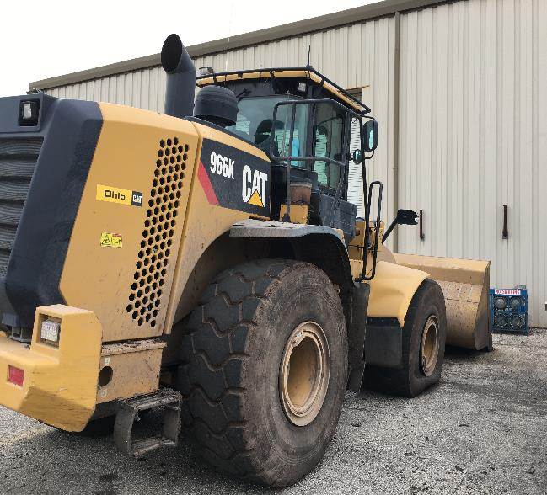
Compost Facility – Project Challenges
Increased capacity, reduced footprint
Tight logistics; semis, screens and 160’ headers
Limited compost staging area
Haul distance & number of trips
Aged, “patch-worked” electrical
infrastructure
Stormwater Regulations
Notes:
-Compost Facility to the west of Southerly
-45 acres fences surrounded by approximately 400 acres of City owned farmland

Slide 24
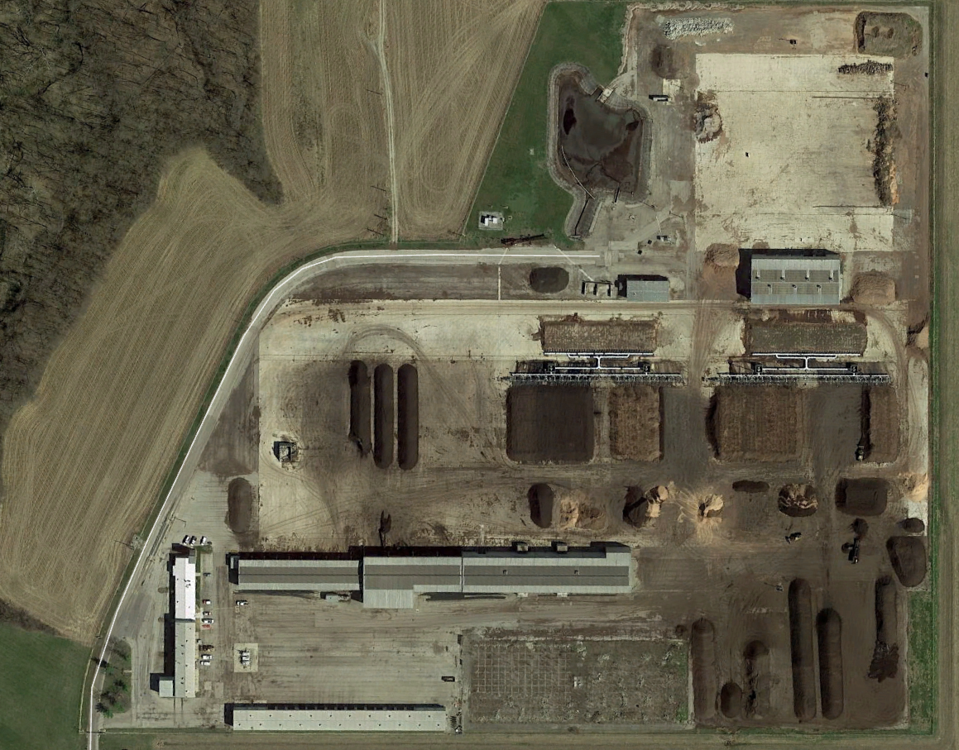
Compost Facility – Updated Project Plan
BIOFILTERS
LEACHATE LAGOON EXPANSION
PAD 3
CURING
PAD 2
MATERIAL STOCKPILES
STAGING
COVERED MATERIAL STORAGE
PAD 1

Slide 25
Odor Reduction Improvements
Project Description – Day 1,125
Demolished 2 pads & Construct 3 in new location
Maintained process type and pile geometry
Updated technology and techniques
Common bank of biofilters (vs. dedicated)
Open space on compost pad used for aerated curing
$38M CCE
Phase II planned for work that got cut
Accommodate future ammonia scrubber and 4th pad

Slide 26
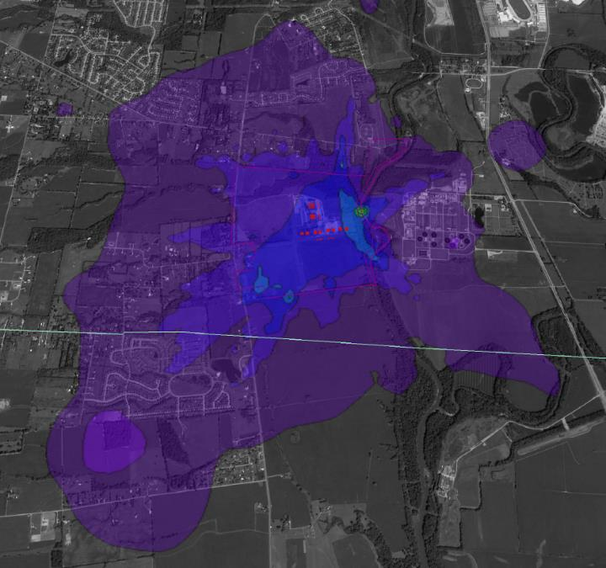
Odor Reduction Improvements
Composting Process
Curing
Monitoring & Control
Leachate Management
Biofilter

Slide 27
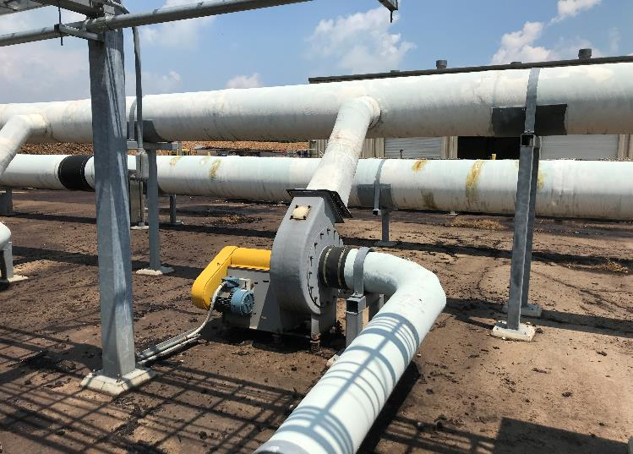
Odor Reduction Improvements
Composting Process Improvements
Pile geometry, configuration and pile recipe largely unchanged
Increased air rate and defined the demand curve
Engineered header
Improved leachate management in pile

Slide 28
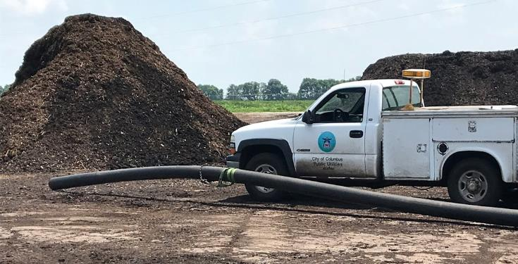
Odor Reduction Improvements
A Third Pad = Better Curing
Increased peak capacity
Provides aerated curing during average periods
More consistent product
Increased VS reduction
Greater moisture removal
Better compost maturity
Evens out load to biofilter

Slide 29
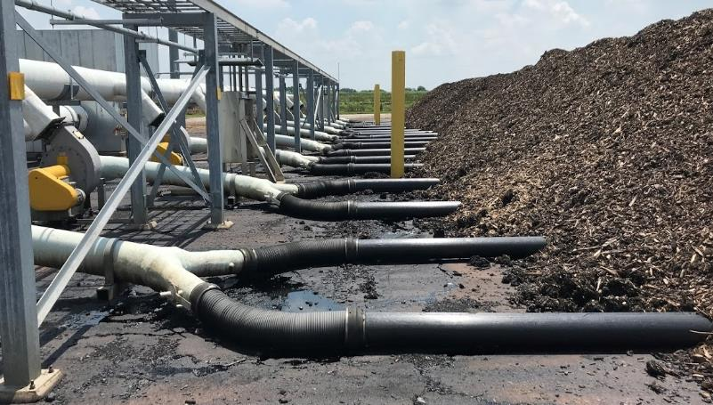
Odor Reduction Improvements
Monitoring & Control
Automated control during non-staffed hours via motorized valves
Match air rates to demand
Balance biofilter needs with foul air supply

Slide 30
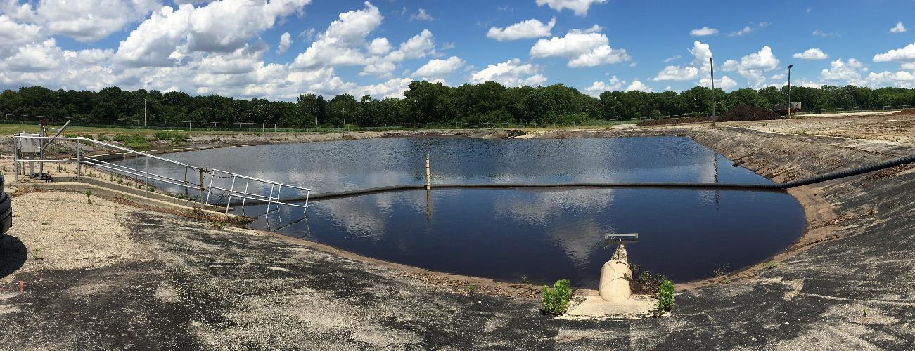
Odor Reduction Improvements
Leachate Management
In pipe, free drainage & precipitation runoff

Slide 31
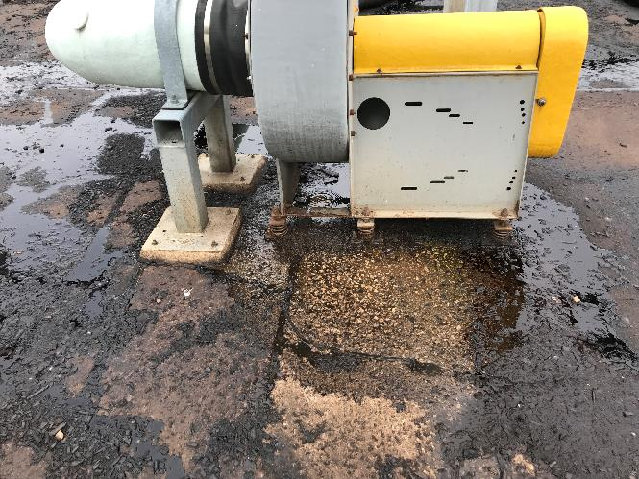
Odor Reduction Improvements
Leachate Management Improvements include:
Remove moisture in pipe before pile blowers
Add drain point in settling zone for free drainage.
Plumbed drains and increased air flow will reduce free drainage
Improved leachate removal reduces anaerobic conditions

Slide 32
Odor Reduction Improvements
Update leachate lagoon to current code
Discharge to sanitary sewer
6’ Deep
Restrict effluent to match sewer capacity
Negligable leachate during dry weather
During wet weather, leachate regulated as contaminated stormwater
Existing | Proposed
1.5 MG | 5 MG
2.5 Year Storm Event | 100 Year Storm Event
0.5 Overflows / year | No Overflows
Pump Station Conveyance | Gravity Sewer Outfall

Slide 33
Odor Reduction Improvements
Biofilter
Optimized size
Common interconnected header to balance loading
Maintenance friendly, facilitates timely rehab
Process improvements anticipated to benefit biofilters; lower ammonia will result in better bacteria for odor control

Slide 34
Lessons Learned

Slide 35
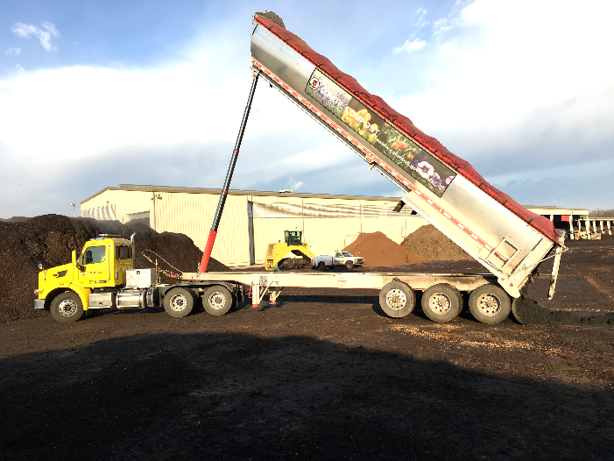
Odor Reduction Improvements –
Lessons Learned
Big Picture; balancing Capital with Operating
Unusual
Planning Stage
Scientific basis vs. precedent
Finalize concepts
Process approach vs. cost iterations
Design
Permit coordination
Construction
See you in Cincinnati 2020!

Slide 36
Thank you!
Questions?
PLEiden@columbus.gov
Tours Welcome!
7000 Jackson Pike, Lockbourne, Ohio 43137
Lutz@columbus.gov
September 4, 2019

