Slide 1
KEEPING THE FUNDS FLOWING

Slide 2
Presentation Topics
Citizens Financial Policy and Objectives
CWA Authority
Funding Requirements
Funding Mechanisms – Rates, Trackers, Bonds and Lines of Credit
CWA Authority Current Debt Profile
Transition to Pay-Go
Monitoring Approaches
Lessons Learned

Slide 3
Financial Policy and Objectives
Financial policy:
Improve and maintain long-term financial stability through disciplined cost control and optimization of net revenues available for capital expenditures in order to provide delivery of affordable essential services
Financial objectives include:
Sustain strong debt service coverage throughout Consent Decree construction
Post Consent Decree achieve industry average all-in annual debt service coverage through sustained 100% pay-go funding and improving revenue stability
Capitalize on economic refunding and debt service reduction opportunities
Enhance Citizens’ cost consciousness culture while delivering safe and reliable service

Slide 4
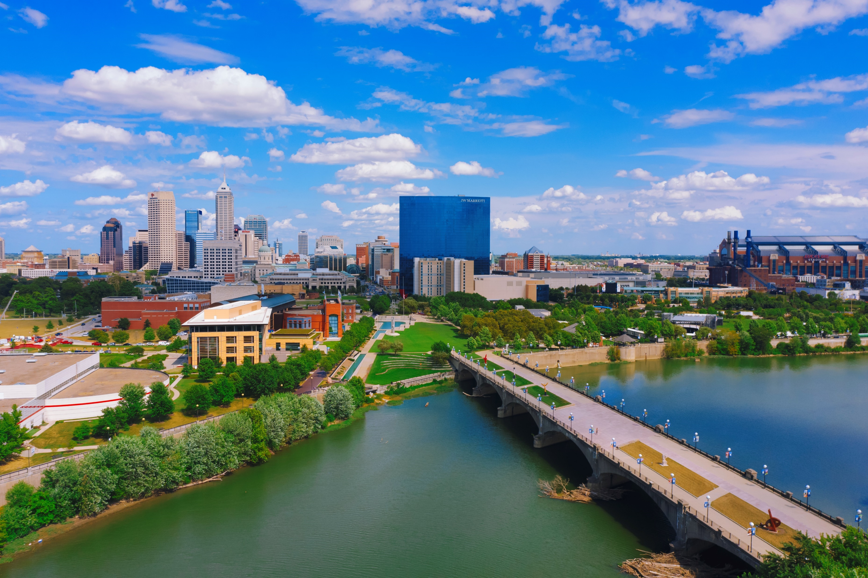
CWA Authority
Serve 254,000 customers in Marion County plus 6 satellite communities
Two advanced wastewater treatment facilities – Belmont and Southport
Combined Sewer System – Covers 34 square miles through 900 miles of pipe
Sanitary Sewer System – Covers 225 square miles through 2,300 miles of pipe
63,000 manholes
258 small-medium lift stations and 10 major ones
131 diversions/outfalls
58 siphons
166 flow meters and 22 rain gauges

Slide 5
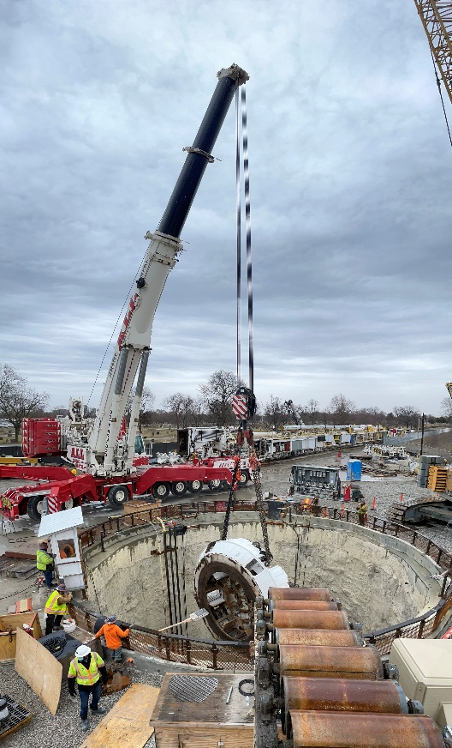
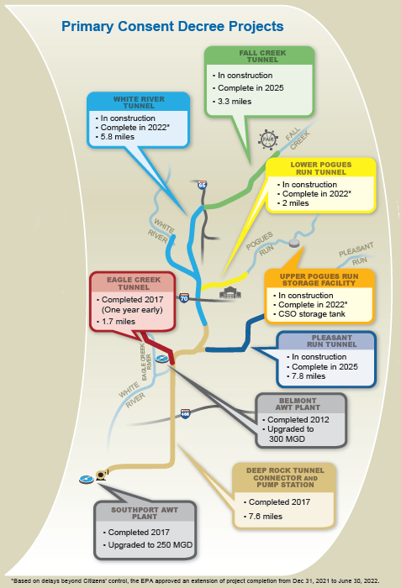
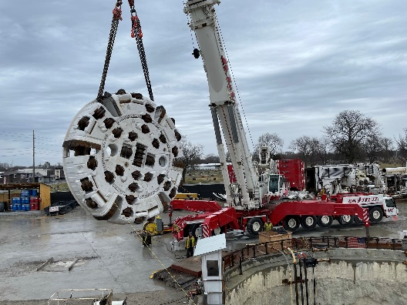
Consent Decree
Includes 32 CSO control measures
Eliminates 7 sanitary sewer discharges
Involves 2 Supplemental Environmental Program projects
Captures 95-97% of wet weather CSOs
Limits overflows to 2-4/year or less
Has approved Use Attainability Analysis
Is in compliance per last status report dated 4/8/2022

Slide 6
Funding Requirements
Consent Decree + STEP + System Improvements + Other
Negotiated original Consent Decree in 2006 with 12/31/2025 completion date
CD estimated budget: $2.0 billion (2016 dollars)
Spent $1.56 billion to date
STEP budget: $6.2 million/year
Other (avg): $5.7 million/year
System Improvements (avg): $56.4 million/year

Slide 7
Funding Mechanisms
RATES
Approved by the Indiana Utility Regulatory Commission
Include: Operations & Maintenance + Extensions & Replacements + Debt Service
Current monthly residential rate: $54.33
Have low-income assistance program (LICAP) approved through SEA 416

Slide 8
Funding Mechanisms
TRACKERS
State legislative acts have improved CWA’s cost recovery framework
Provides funding between rate cases
Environmental Compliance Plan (ECP) Recovery Mechanism
Designed for timely recovery of debt service, debt service reserve funds and cost of issuance related to Consent Decree that is not already in rates
Focused on Consent Decree since it is more than 60% of capital expenditures between 2018-2025
Rates are adjusted based on annual reconciliation of revenues generated from ECP and actual debt cost for the same period
Citizens has yet to utilize it since rates have included Consent Decree costs and needed debt service

Slide 9
Funding Mechanisms
TRACKERS
System Integrity Adjustment (SIA)
Established by SEA 383: eligible utility may petition IURC for approval after experiencing a 2% deficit in annual revenues compared to authorized revenue
Once approved, requires annual filings to reconcile deviations from authorized revenues
94% of deficit/excess is recovered from/credited to non-industrial customers over the following 12 months
Eligible utility may continue use of SIA for 48 months after approval, or until new rates are established in a full rate case before the IURC, whichever comes first
Previously approved adjustments include:
 | Date | Authorized Amount | Rate | Minimum Charge
1 | 12/28/2017 | $6.14M | $0.1948/ccf | $0.78
2 | 12/19/2018 | $9.86M | 0.3316/ccf | $1.33

Slide 10
Funding Mechanisms
BONDS
Have 16 bond series starting in 2012
Amounts, rates and final maturity years vary
Work with Indiana Finance Authority and State Revolving Fund
Green Bonds
Attracts different investors
Has minimal impact on rate
Requires separate disclosure

Slide 11
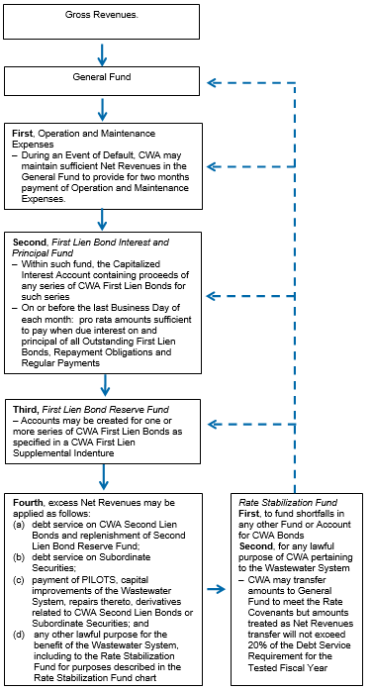
Flow of Funds
O&M expenses has priority over bond interest and principal
Interest and principal are paid monthly
Often a reserve account is required
Second lien bonds are subsequent to first lien bonds
CWA pays PILOT to City of Indianapolis

Slide 12
Debt Profile
Have approximately $1.94 billion of debt outstanding
Overall level annual debt service (through 2041) provides strong and consistent debt service coverage
Wastewater Utility Revenue Bonds Debt Service

Slide 13
Debt Coverage
Historical Wastewater System Debt Service Coverage ($000s)
 | FY 2015 | FY 2016 | FY 2017 | FY 2018 | FY 2019 | FY 2020 | FY 2021
Utility Operating Revenues | $ 212,698 | $ 221,317 | $ 263,684 | $ 279,247 | $ 274,000 | $ 296,978 | $ 313,978
Operations and Maintenance Costs | 68,001 | 74,614 | 78,745 | 76,556 | 78,832 | 79,064 | 79,033
Depreciation & Amortization | 61,900 | 64,924 | 68,518 | 78,024 | 63,996 | 58,038 | 59,267
Taxes | 17,168 | 18,949 | 22,000 | 24,953 | 27,480 | 28,502 | 29,155
Total Operating Expenses | $ 147,069 | $ 158,487 | $ 169,263 | $ 179,533 | $ 170,308 | $ 165,604 | $ 167,455
Total Operating Income | 65,629 | 62,830 | 94,421 | 99,714 | 104,496 | 131,374 | 146,523
Other Income (Expense) | 153 | 807 | 926 | 2,936 | 3,580 | 1,639 | (169)
Interest Charges | 54,320 | 52,613 | 58,780 | 71,221 | 69,177 | 67,342 | 57,393
Net Income | $ 11,462 | $ 11,024 | $ 36,567 | $ 31,429 | $ 38,899 | $ 65,671 | $ 88,961
Adjustments
Add System Development Charges | 8,422 | 7,767 | 9,195 | 9,223 | 7,304 | 5,470 | 6,412
Add Depreciation and Amortization | 61,900 | 64,924 | 68,518 | 78,024 | 63,996 | 58,038 | 59,266
Add Interest Charges | 54,320 | 52,613 | 58,780 | 71,221 | 69,179 | 67,342 | 57,393
Add PILOT | 17,168 | 18,932 | 21,927 | 24,918 | 27,343 | 28,531 | 29,049
Total Net Income Available for DS | $ 153,272 | $ 155,260 | $ 194,987 | $ 214,815 | $206,720 | $ 225,052 | $ 241,081
First Lien Bonds:
Existing First Lien Bonds | 78,314 | 83,072 | 97,390 | 105,248 | 104,786 | 115,517 | 120,051
Future Debt | -- | -- | -- | -- | -- | -- | --
Total First Lien Debt Service | $ 78,314 | $ 83,072 | $ 97,390 | $ 105,248 | $ 104,786 | $ 115,517 | $ 120,051
First Lien DS Coverage | 1.96x | 1.87x | 2.00x | 2.04x | 1.97x | 1.95x | 2.01x
Second Lien Bonds: | $ 19,485 | $ 19,525 | $ 20,455 | $ 20,460 | $ 20,460 | $ 20,458 | $ 19,437
First and Second Lien DS Coverage | 1.57x | 1.51x | 1.65x | 1.71x | 1.65x | 1.66x | 1.73x
General Obligation Bonds¹ | 8,214 | 7,684 | 7,678 | 7,672 | N/A | N/A | N/A
Total Debt Service | 106,013 | 110,281 | 125,523 | 133,380 | 125,336 | 135,975 | 139,488
Net Income Available for All-In Debt Service² | 136,104 | 136,328 | 173,060 | 189,897 | 179,377 | 196,521 | 212,032
All-In Debt Service Coverage | 1.28x | 1.24x | 1.38x | 1.42x | 1.43x | 1.45x | 1.43x
1. Last GO debt service payment was made in 2018
2. Net income available for debt service less PILOT

Slide 14
Debt Reduction
Debt Service Reduction
DEBT SERVICE REDUCTION OPTIONS
Tax-exempt Refunding - Within 90 days of bond series maturity
Forward Delivery
Involves initial close in near term
Bonds are held in escrow until final close in future
Convertible Advance (Cinderella)
Taxable loan until 90 days prior to 1st call date
Requires a qualifying event
Converts to tax-exempt loan based on pre-established rate
Citizens has only considered this option
Goal is to maximize Net Present Value Savings
Cost of issuance vary

Slide 15
Funding Mechanisms
LINES OF CREDIT
Provide liquidity
Interest rate = index + set percentage
Moving away from LIBOR index
No current draws
Will re-evaluate amounts when Consent Decree is complete
Lines | Amount | Term
1 | $45M | 4 year
2 | $50M | 3 year

Slide 16
Liquidity
Historical and Projected Wastewater System Cash Balances ($000s)
Historical
Projected
 | FY 2018 | FY 2019 | FY 2020 | FY 2021 | FY 2022 | FY 2023 | FY 2024 | FY 2025 | FY 2026
Beginning Cash Balance | $ 54,263 | $ 32,503 | $ 38,604 | $ 108,750 | $ 168,303 | $ 106,017 | $ 198,518 | $ 108,072 | $ 68,408
Cash Flow from Operating Activities | 101,021 | 103,209 | 119,232 | 143,365 | 127,906 | 119,256 | 123,190 | 127,189 | 131,091
Cash Flow from Investing Activities | (106,592) | (124,995) | (234,806) | (135,926) | (192,718) | (188,046) | (154,352) | (104,906) | (72,562)
Cash Flow from Financing Activities | (16,189) | 27,887 | 185,720 | 52,114 | 2,526 | 161,291 | (59,284) | (61,947) | (64,744)
Ending Cash Balance | $ 32,503 | $ 38,604 | $ 108,750 | $ 168,303 | $ 106,017 | $ 198,518 | $ 108,072 | $ 68,408 | $ 62,193
Unrestricted Cash | $ 32,503 | $ 17,474 | $ 18,738 | $ 64,703 | $ 106,017 | $ 198,518 | $ 108,072 | $ 68,408 | $ 62,193
Unspent Proceeds for Construction | -- | 21,130 | 90,012 | 103,600 | -- | -- | -- | -- | --
Unspent SRF Proceeds* | 67,518 | 3 | 14,384 | -- | -- | -- | -- | -- | --
Total Funds Available | $ 100,021 | $ 38,607 | $ 123,134 | $ 168,303 | $ 106,017 | $ 198,518 | $ 108,072 | $ 68,408 | $ 62,193
* SRF proceeds are reported as Investments instead of Cash in GAAP-based financial statements
Historical and Projected Days Cash

Slide 17
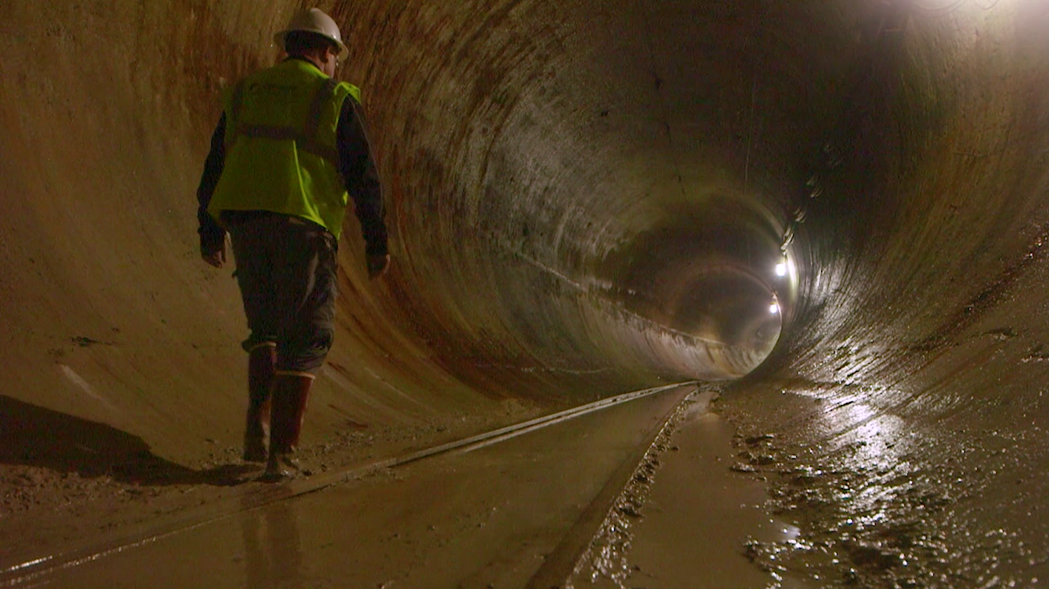
Transition to Pay-Go
Rate funded improvements
2019 rate order increased Pay-go:
$66 million
$70 million
$75 million
Expectation – fund capital plan 100% through pay-go in 2026

Slide 18
Monitoring Approaches
INTERNAL REPORTS
Monthly performance tracking
O&M and capital spending
Debt coverages
Budget to actual prior year to current year
Officer roundtable discussions
Strategic initiative status reporting
Debt summary
Weekly cash balances
Cash forecasting

Slide 19
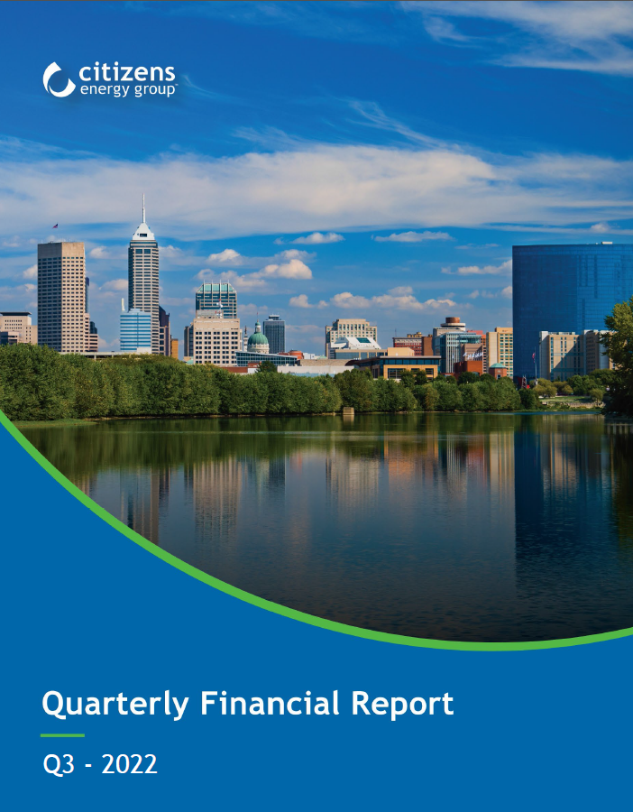
Monitoring Approaches
EXTERNAL REPORTS
GAAP-based financial statements
Extensive debt footnotes
Quarterly financial reports
Independent quarterly reviews and annual audits
Annual disclosures
Preliminary and official statements
Financial Capability Analysis – Consent Decree requirement

Slide 20
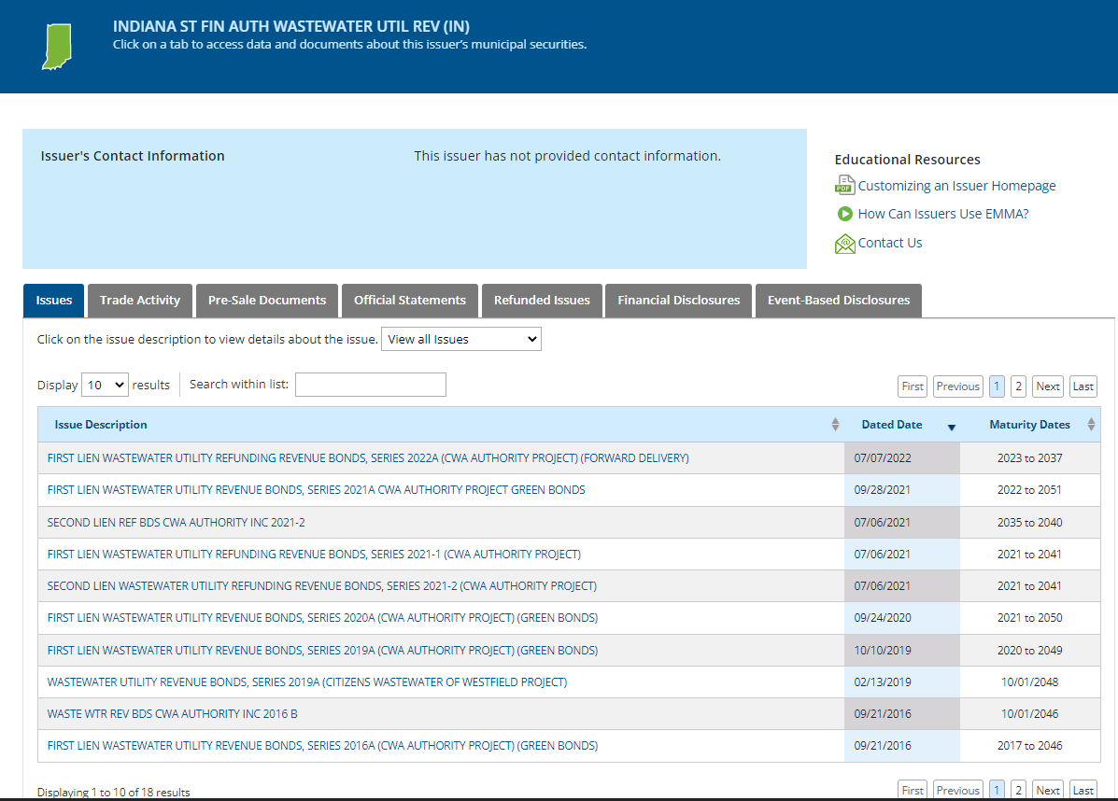
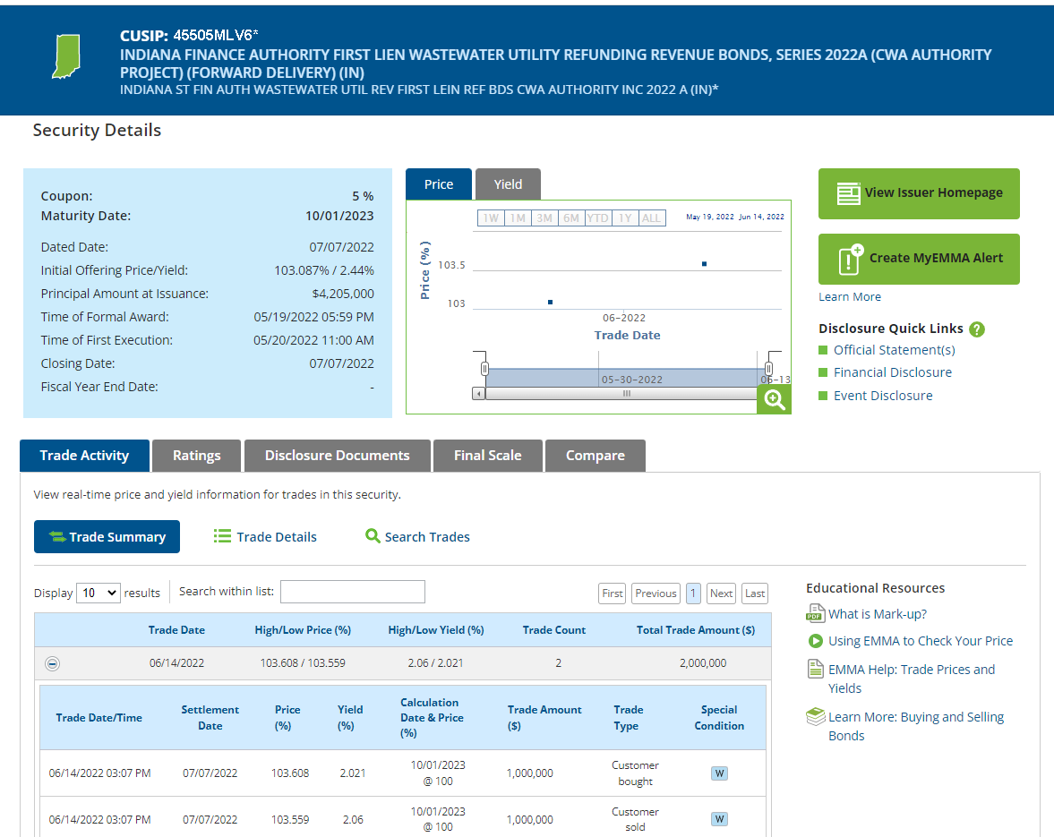
Published Information
EMMA
Electronic Municipal Market Access and supported by Municipal Securities Rule Making Board
Facilitates posting for the bonds
Shows trade information

Slide 21
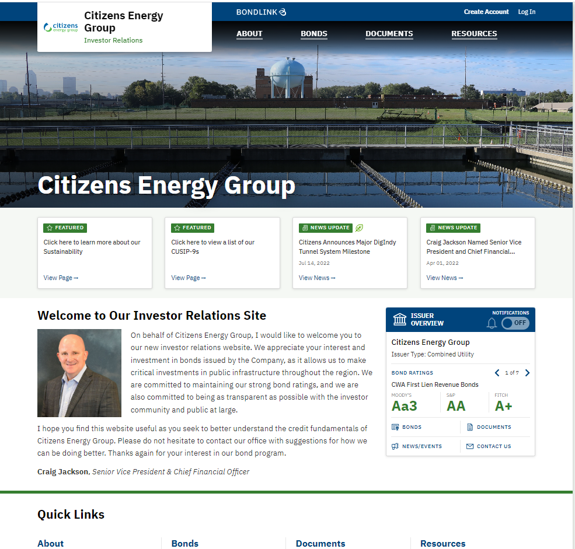
Published Information
BONDLINK
Used for investor relations
Broadcasts bond activities
Provides preliminary and official statements
Post
Press releases
Ratings reports
Quarterly and annual financial reports
Annual disclosures
Maintained by Citizens

Slide 22
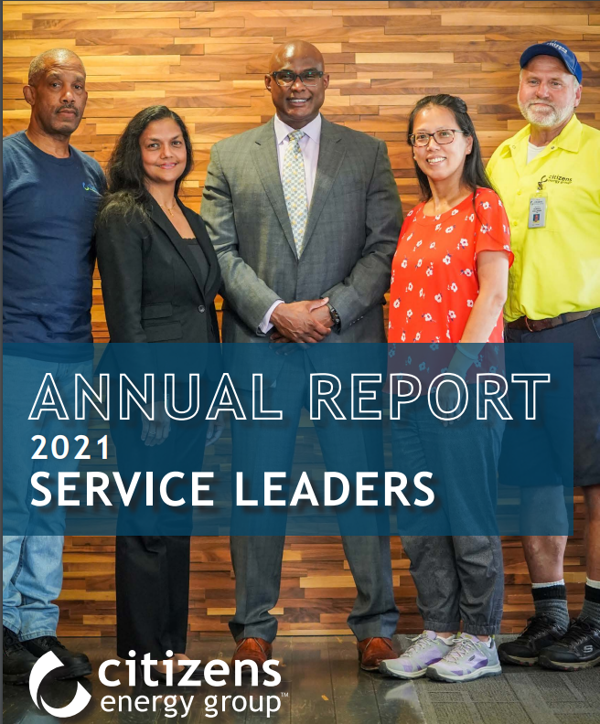
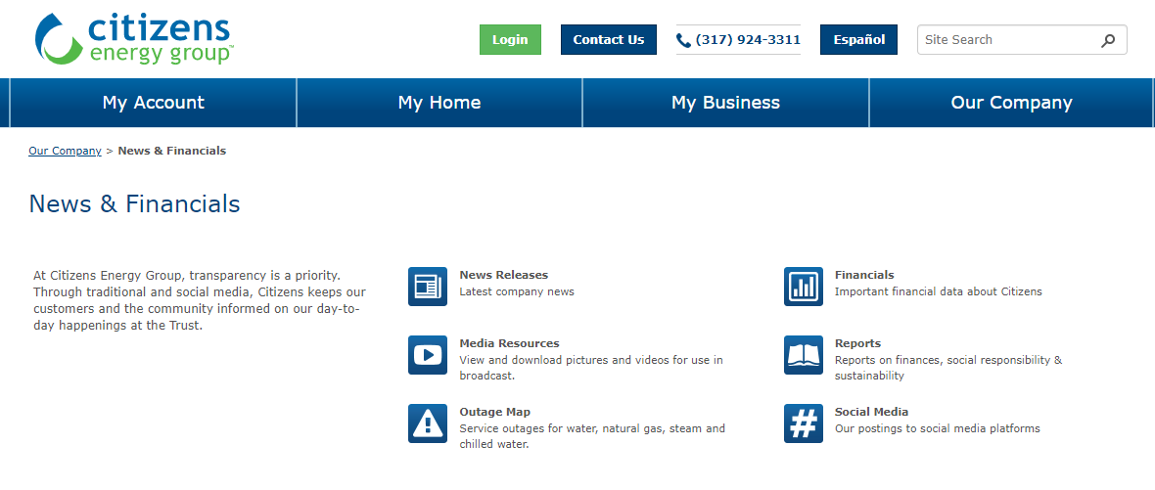
Published Information
CITIZENS WEBSITE
News & Financials
Includes
News releases
Financial reports
Annual Report
Sustainability Reports

Slide 23
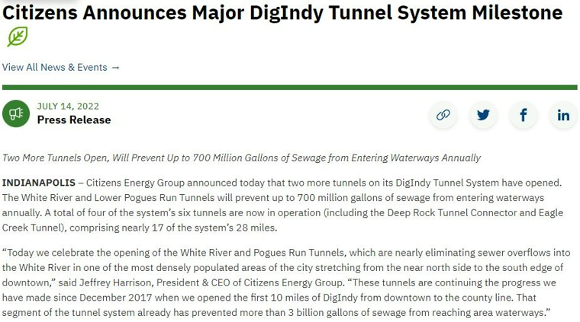
Lessons Learned
Communicate the benefits
Press releases
Postings on Twitter, Facebook & LinkedIn
Videos – Include community partners
Maintain Relationships
Regulators
Ratings Agencies – Fitch, Moody’s and S&P
Banking partners
Bond counsel
Monitoring is essential
Debt service coverage
Rate case timing
Lines of credit

Slide 24
Summary
Funding Requirements – Consent Decree, STEP and System Improvements
Funding Mechanisms – Rates, Trackers, Lines of Credit and Bonds
Reducing debt service through refundings
Tracking is essential
Communicating needs to stakeholders

Slide 25
KEEPING THE FUNDS FLOWING
QUESTIONS?
Please contact JENNIFER BAILEY at jbailey@citizensenergygroup.com or 317-927-6108

