Slide 1
MSD of Greater Cincinnati Past, Present and Future
5Cities+ Conference
September 28, 2022

Slide 2
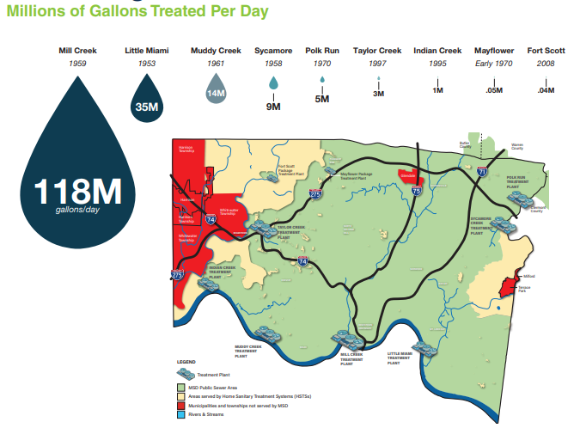
MSD Greater Cincinnati at a Glance
$13B Infrastructure:
3,000 miles of conveyance
9 WWTPs
100 Pump Stations
9 Wet Weather Facilities
$136M Capital Budget
$231M Operating Budget

Slide 3
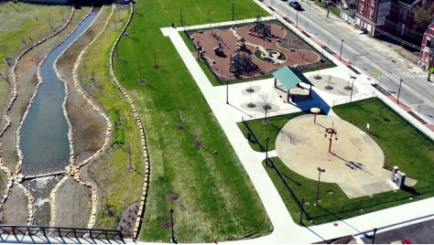
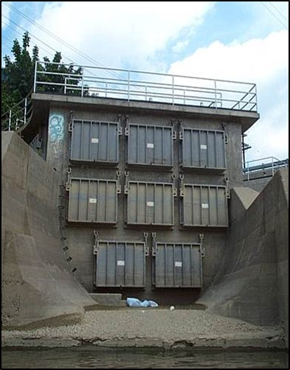
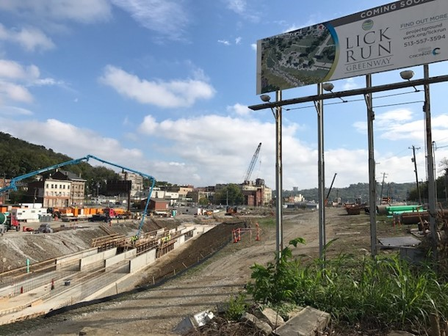
Our Past Accomplishments
Successfully completed Phase 1 of our $1.1B Consent Decree Wet Weather Program:
Construction of the Lick Run Greenway as a National award-winning green infrastructure project.
Community engagement a model for future projects.
Eliminated 6 billion gallons of sewer overflows.
Improved water quality in local streams including the Mill Creek, which is home to nine new fish species.
Overall completion of 150 projects since 2009.

Slide 4
Phase 1 Accomplishments
The Lick Run Project is a system:
underground stormwater sewers
aboveground green infrastructure including bioswales, stormwater detention basins, and the Lick Run Greenway
Eliminated 800 million gallons of sewer overflows from CSO 5
Community reinvestment revitalizing our South Fairmont neighborhood.

Slide 5
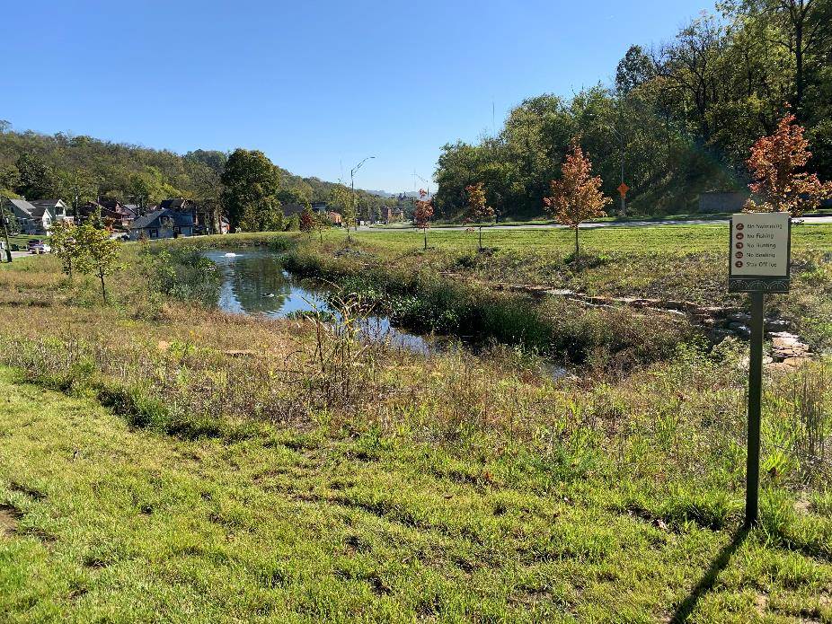
Forebay Pond

Slide 6
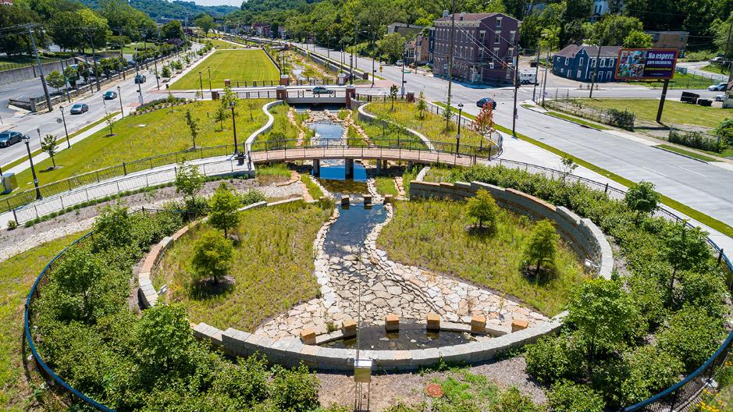
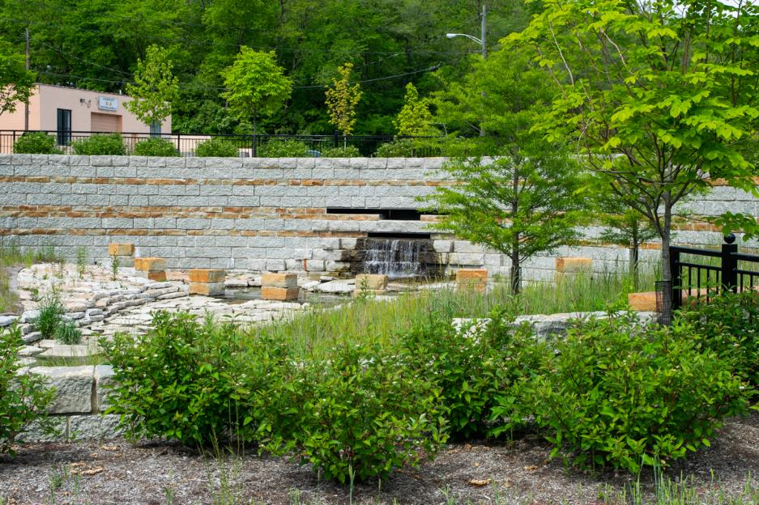
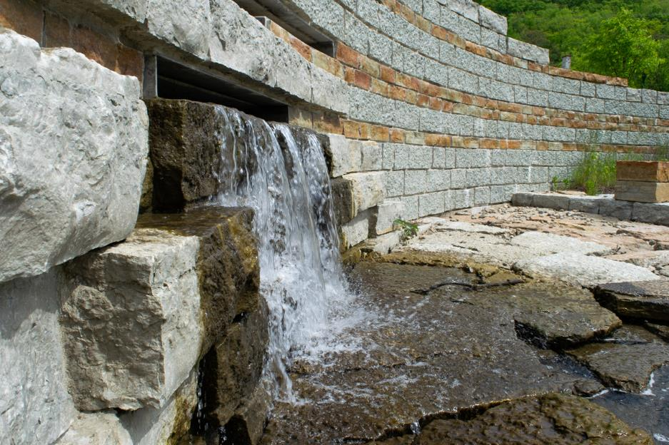
Headwaters Area

Slide 7
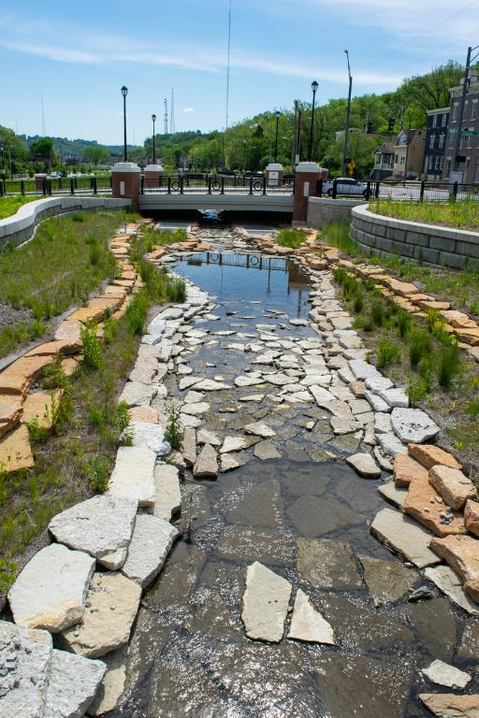
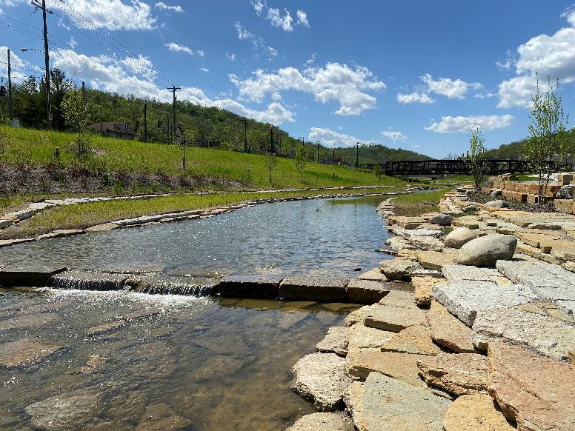
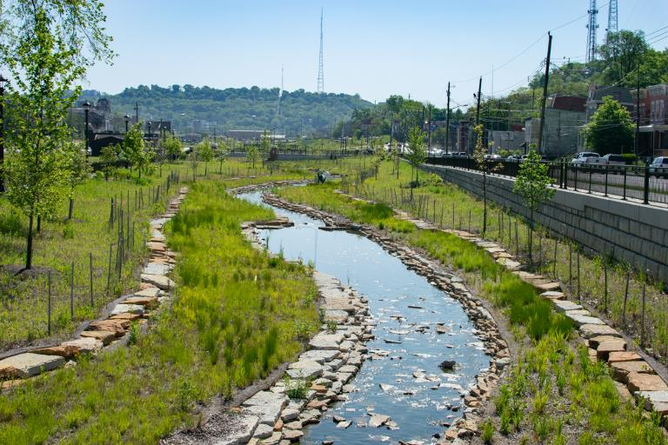
Urban Waterway

Slide 8
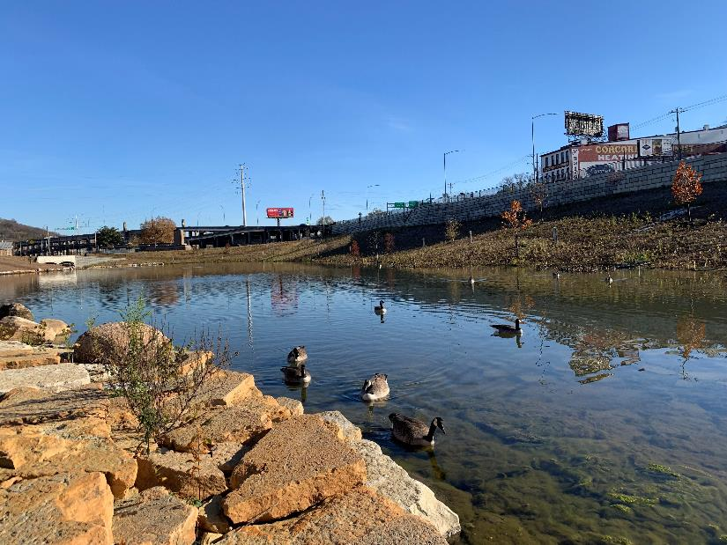
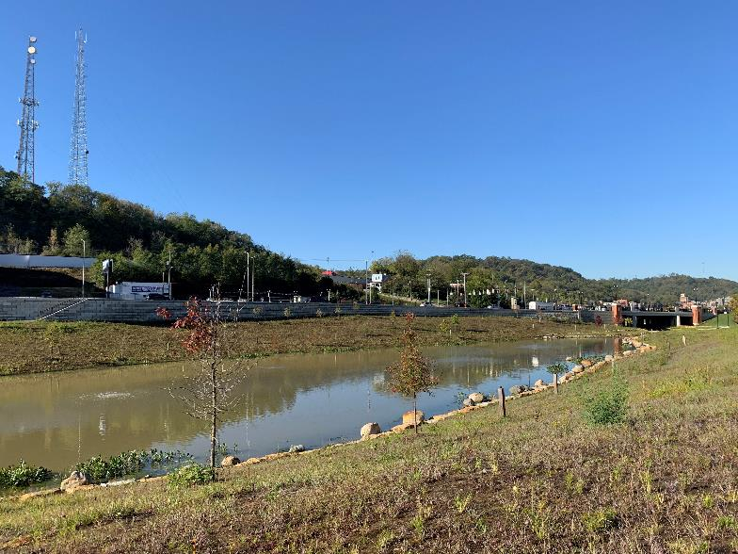
Pond

Slide 9
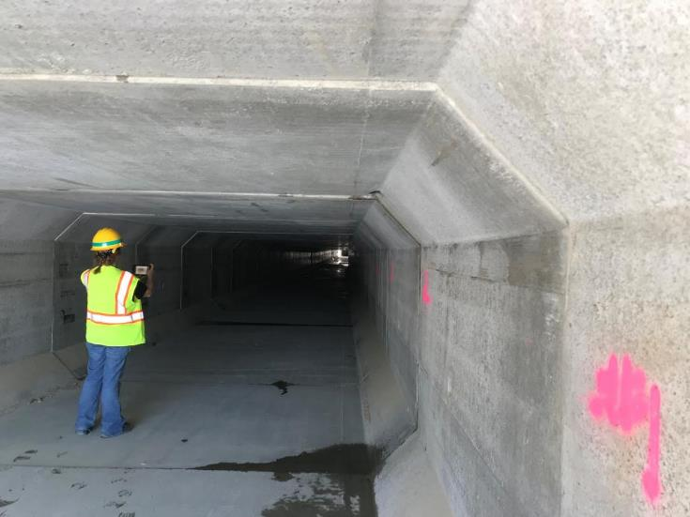
Stormwater Conveyance Box

Slide 10
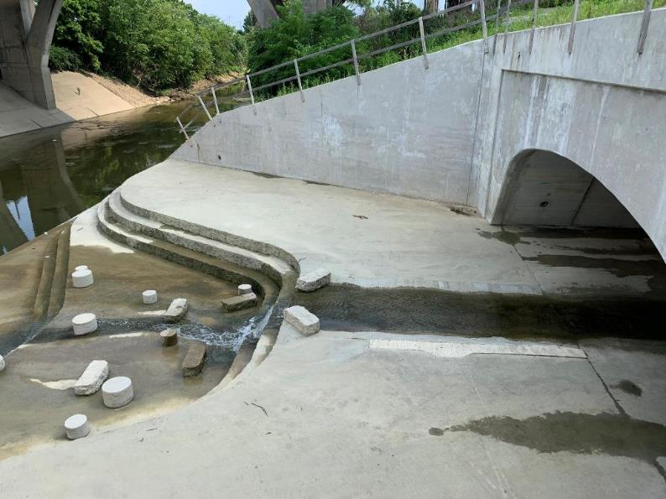
Outfall into the Mill Creek

Slide 11
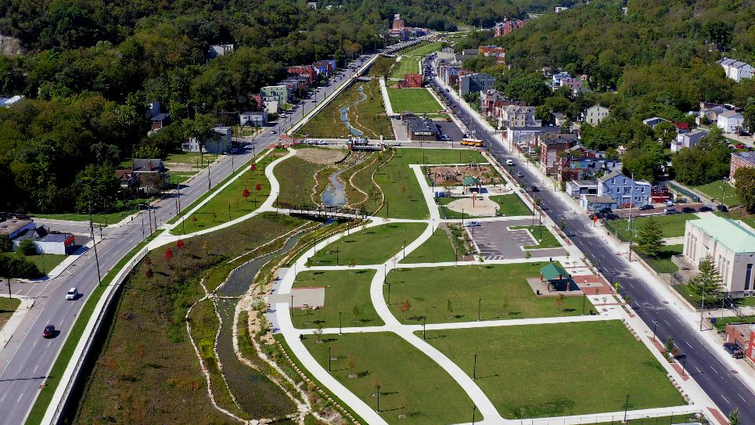
Civic Recreation Area

Slide 12
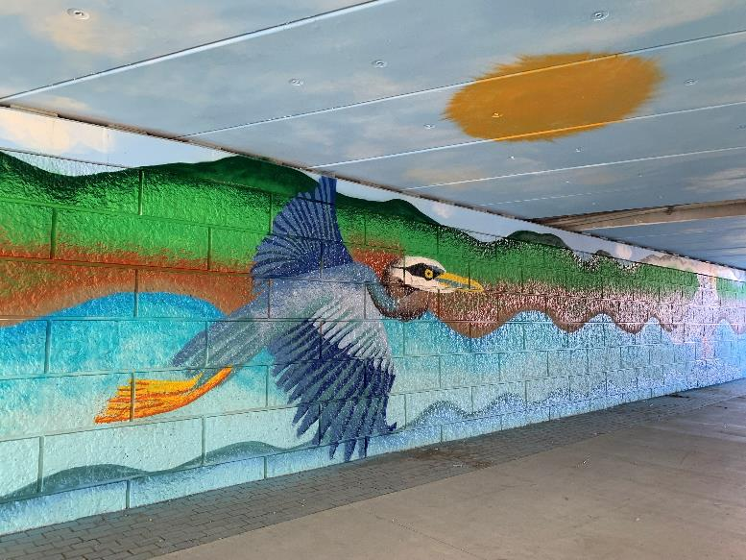
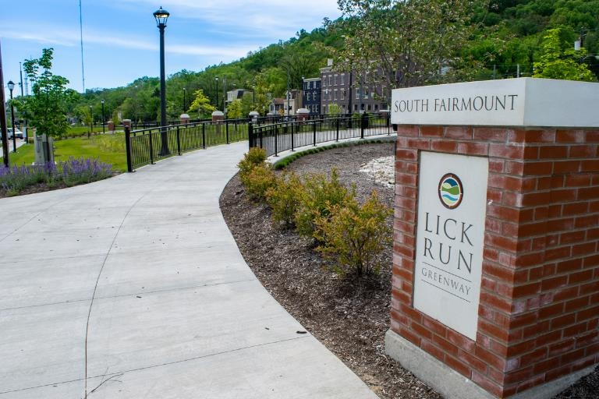
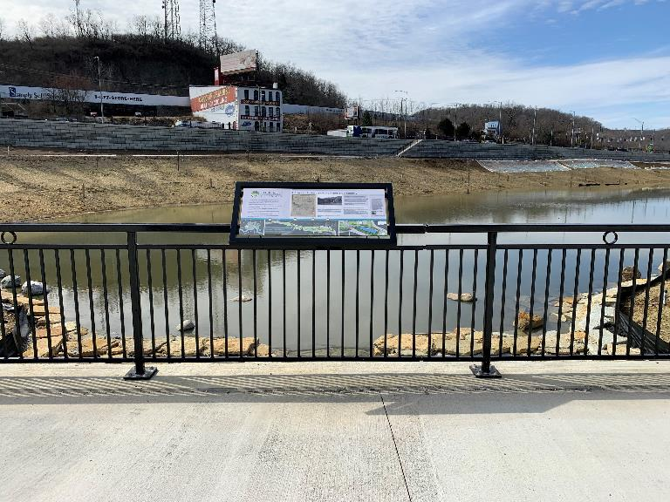
Branding, Educational Signage, Murals

Slide 13
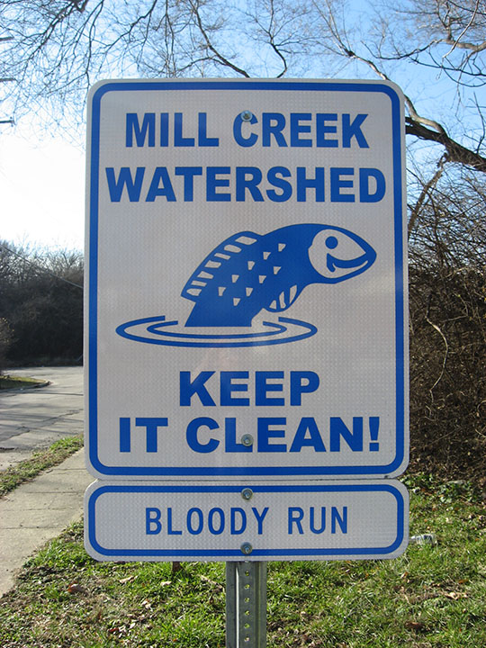
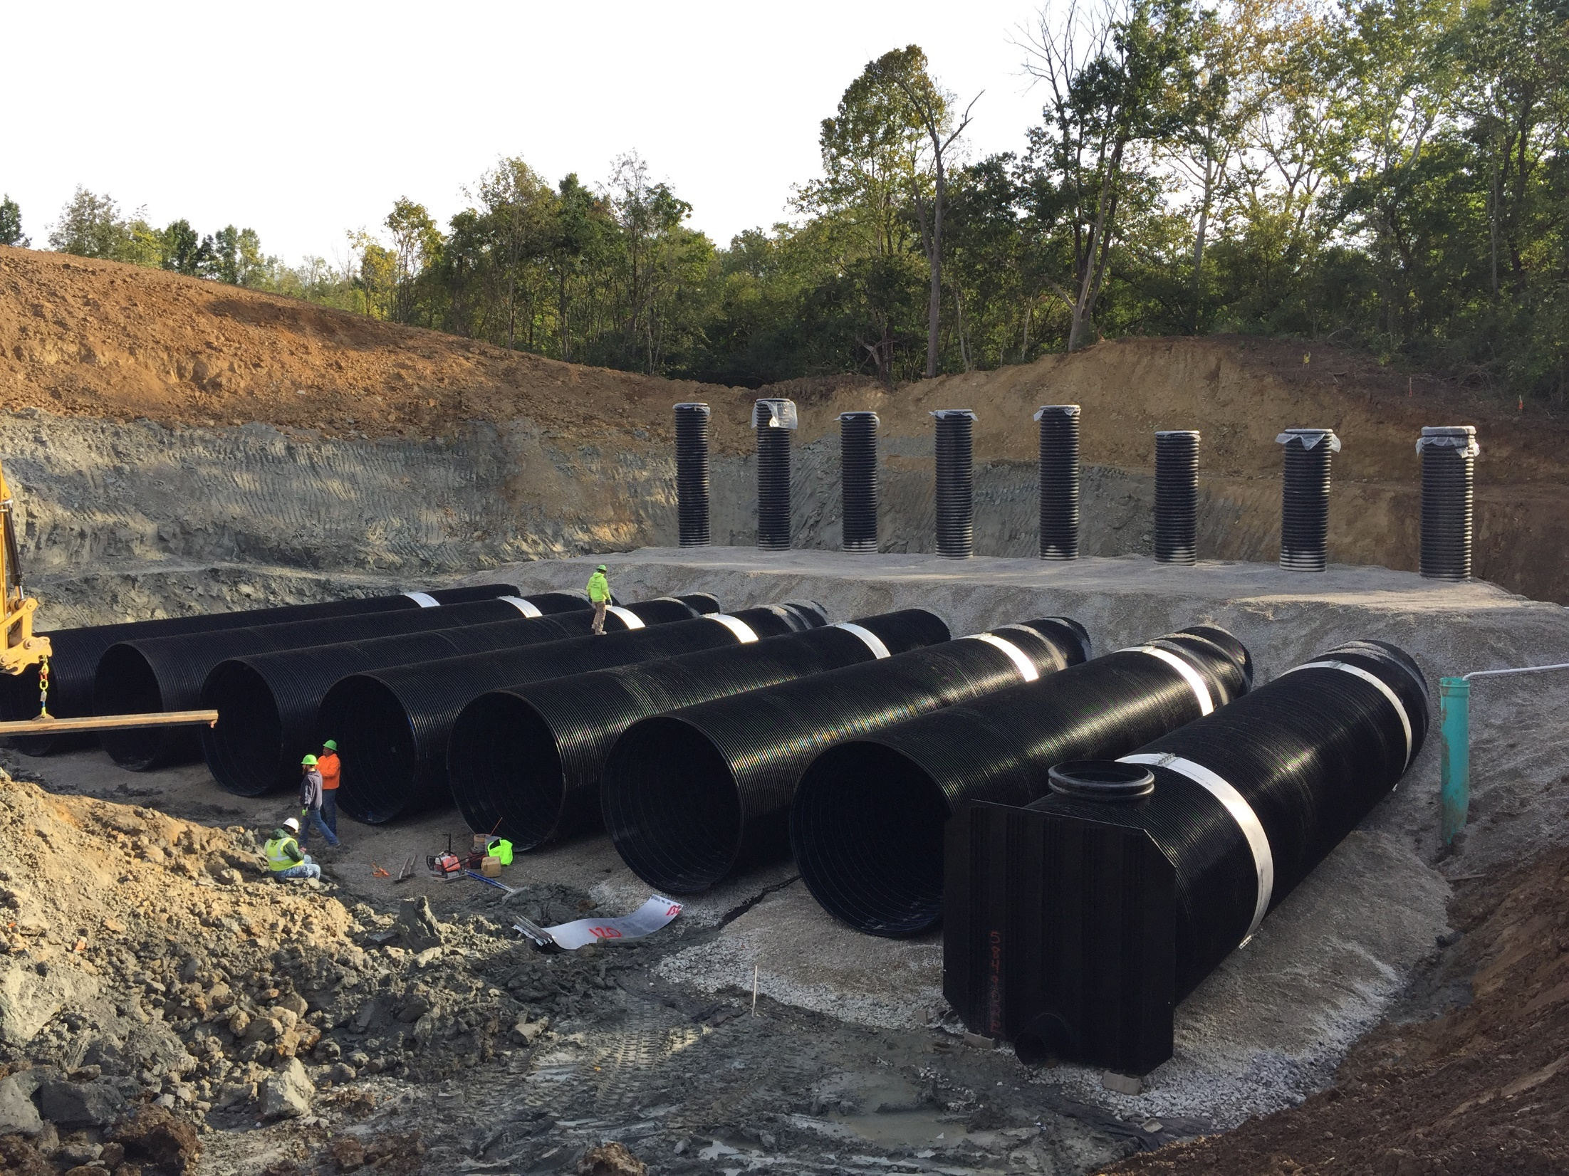
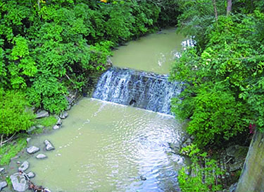
Phase 1 Accomplishments
Lower Mill Creek Partial Remedy (LMCPR) - a suite projects within the Lick Run, Kings Run, West Fork, and Bloody Run watersheds.
MSDGC proposed a source control approach to achieve CSO reductions while also utilizing right-sized conveyance and storage solutions.
Mill Creek is now considered a recovering waterway.
SUCCESS!
LMCPR Post Construction Monitoring report completed in May 2022 demonstrated that the significant overflow reduction goal was achieved.

Slide 14
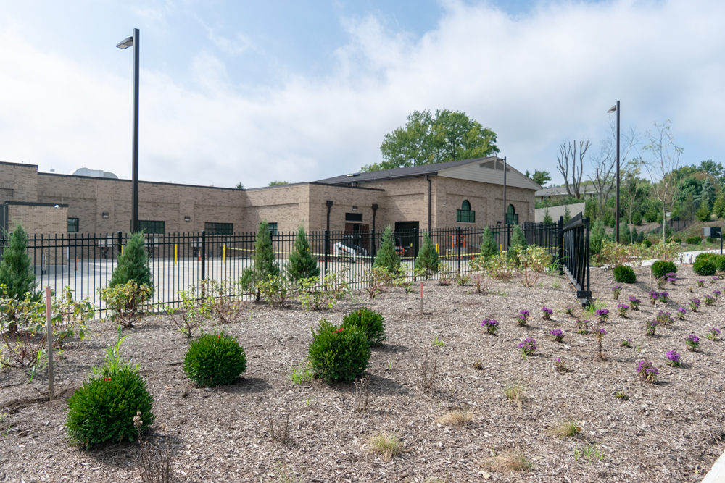
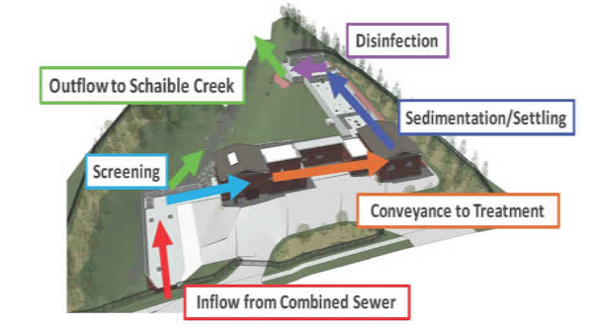
Phase 1 Accomplishments
Werk & Westbourne EHRT facility, located in Green Township, completed 2018.
This EHRT is capturing, storing and treating overflows before they can overflow into Schaible Creek through CSO Outfall 522.
Schaible Creek is a tributary of Muddy Creek.
Community engagement influenced design and operation.

Slide 15
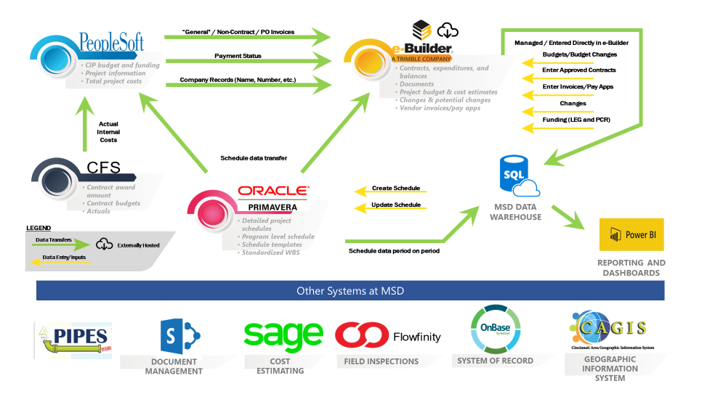
Our Present Focus
Systems Integration to Datawarehouse
Leveraging Technology for Delivery of our Annual CIP:
New PMIS for managing all capital projects
New Integrated Watershed and Facility Planning tied to GIS based tools
New Hydraulic Modeling Guidelines and Tools
Datawarehouse for dynamic dashboards for project to program level reporting
Baseline Budgets and Schedules for all projects
New Project Nomination Process to validate project need, scope, costs and schedules
New Project Delivery System (PDS)

Slide 16
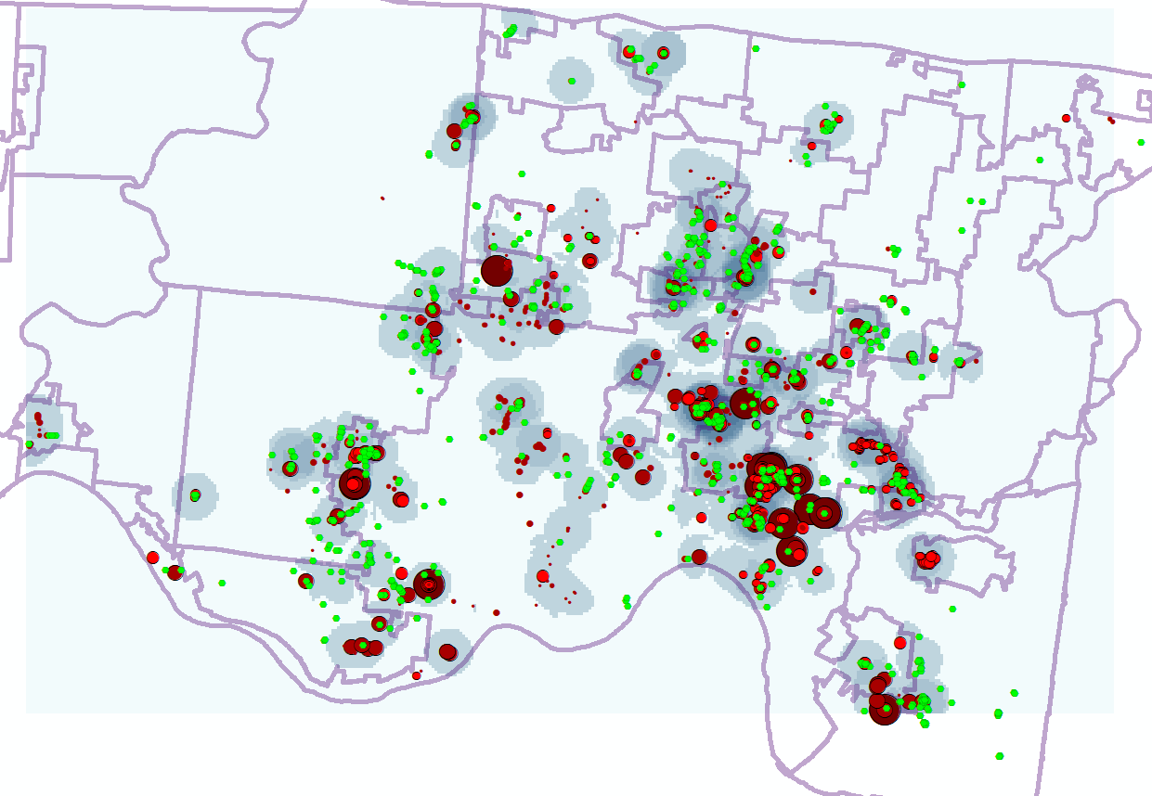
Present Focus - Sewer Backup Prevention Program
MSD has spent $148 million on SBU Program since 2004
SBU Prevention Program:
Total Properties Protected = 1,300
Total Dollars Spent = $63,000,000
Average SBUPP cost/home = $48,000
LEGEND
Heat map SBU response areas (2017 to present)
Confirmed capacity related SBU; the larger the red circle, the smaller the storm event that caused the mainline capacity problem
SBU Prevention Devices Installed since 2004

Slide 17
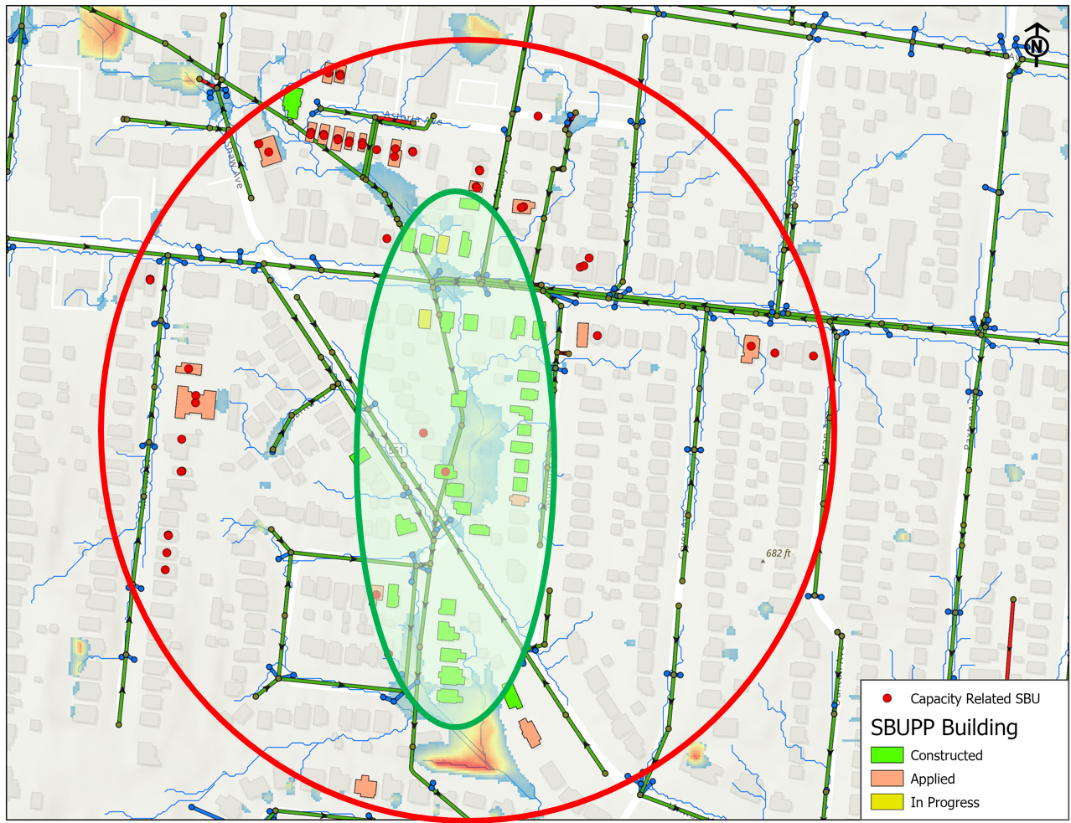
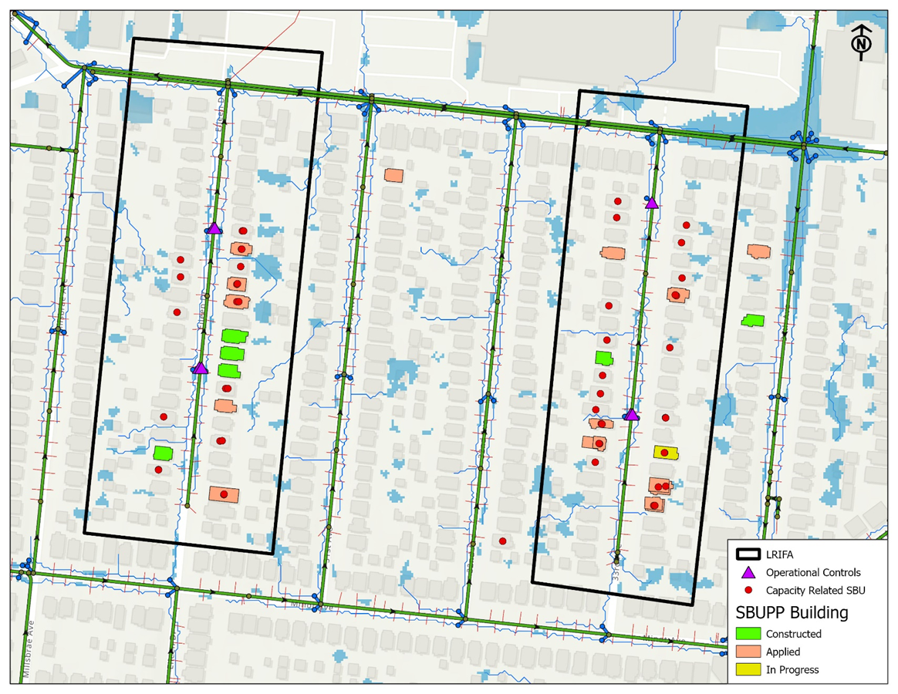
SBU Mitigation Strategies
Operational Controls
Capital Solutions
Private Property Incentives
Multi-Agency Coordination
FEMA Grants
Notes:
Typical SBUPP
Operational controls
Capital Study
Private Property

Slide 18
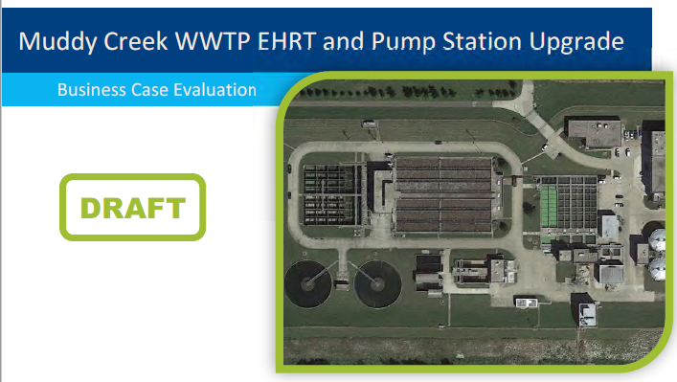
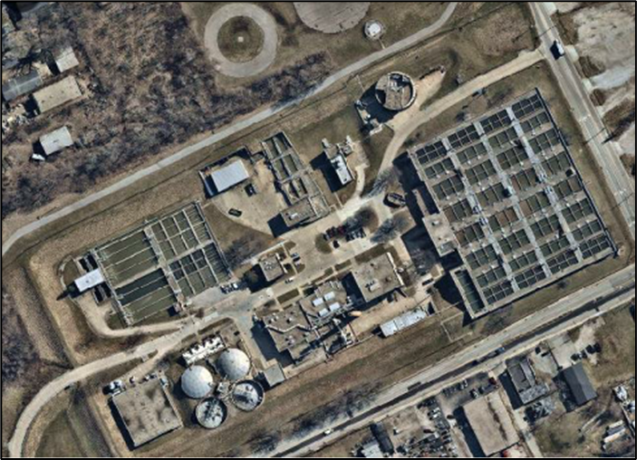
Our Future Plans
Preparing for Future Phase 2A Consent Decree Wet Weather Program:
Ongoing regulatory negotiations…
High-rate treatment (HRT) facilities at our major WWTPs as Foundation of the Program ($660M)
Major Ancillary Projects to prepare for the HRTs
Balanced investment in Asset Management to address sewer renewal and facilities ($600M)
Watershed and Facility Planning across the service area to identify priorities
Continued investment in our Smart Sewer technologies and operations
Little Miami WWTP

Slide 19
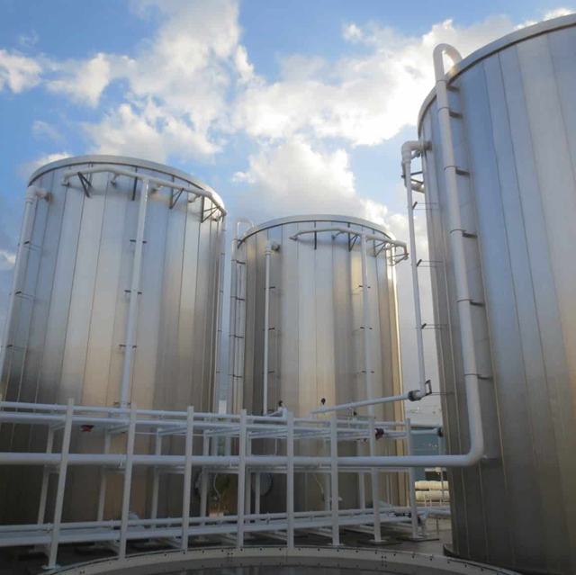
Our Future Plans
Little Miami Solids & Odor Control
Construct anaerobic digestion facility to produce Class A biosolids
Biogas conditioning and onsite use
Sludge thickening facility, hauled waste and liquid sludge receiving facilities, sludge dewatering and loadout facilities, and odor control for associated processes.
New site entrance and roadway loop around the new solids facilities. Existing levee will need to be extended around the majority of the plant property to the west.
Design-Build construction estimated for 2025.

Slide 20
Questions?

