Slide 1



1. Overview of LOT
2. Connection to OARS
3. Vibration Concerns
4. Construction Status
LOWER
OLENTANGY TUNNEL (LOT)
An extension to OARS

Slide 2
LOWER OLENTANGY TUNNEL
(LOT)
An extension to OARS
LOT is a 12-foot diameter, soft ground tunnel (about 50 feet deep) extending 17,300 LF from OARS to upstream relief points.
LOT combined with several Blueprint Areas replaced the ORT (~80,000 LF of 14-foot Tunnel) saving the city more than $500 Million in tunnel construction.

Slide 3
LOT
Operational Requirements
Prevent overflows to the river from 7 combined (rain & sewage) overflows up to a “Typical Year” flow event.
Prevent sanitary sewage overflows from 3 sewer structures to the river up to a 10-year peak flow recurrence.
Prevent and/or mitigate sanitary sewage basement flooding and overflows to the river from 4 sewer structures in the Fifth by Northwest Blueprint Area up to a 10-year peak flow recurrence.

Slide 4
LOT
Operation in simple terms
Catch the flow before it overflows to the river
Get it to the Wastewater Treatment Plants
Only discharge untreated flow to the river after the Treatment Plants are full

Slide 5

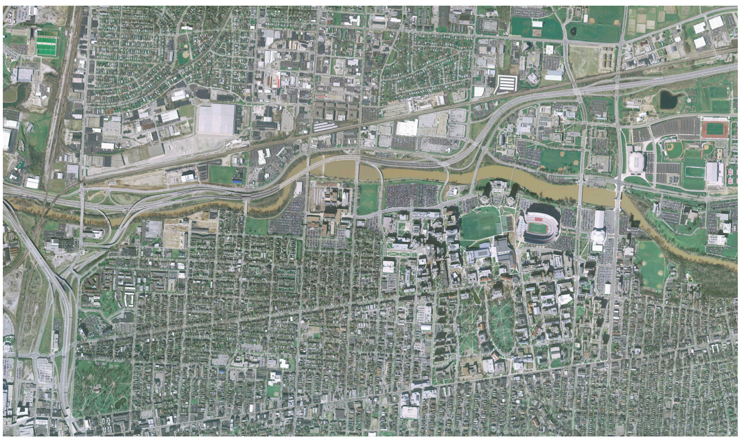
LOT
Challenges
SR-315
RELIEF HERE
OLENTANGY RIVER
I-670
OHIO STATE UNIVERSITY
DENSE URBAN CORRIDOR
POINT A: OARS
POINT B:
TUTTLE PARK

Slide 6
LOT
Obstacles
Roadway and Highway Crossings
River Crossings
Bridges – supported by piles
Utility Crossings
High Groundwater & Varied Geology

Slide 7
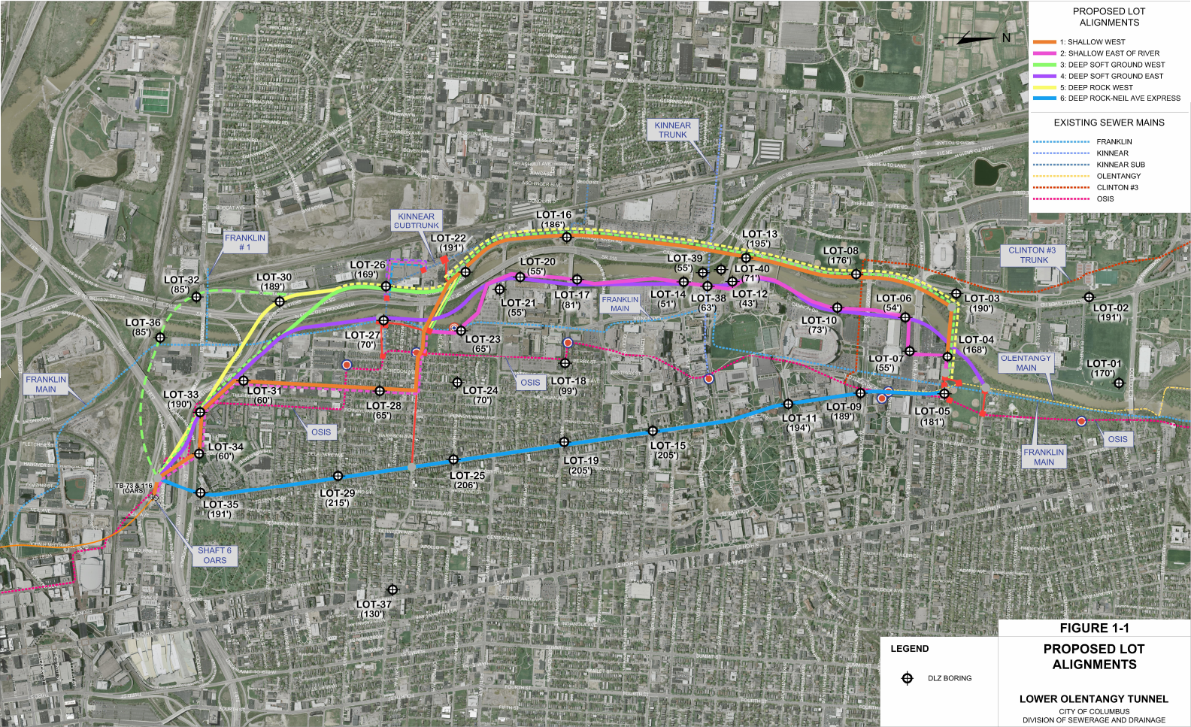
LOT
Alignments Evaluated

Slide 8
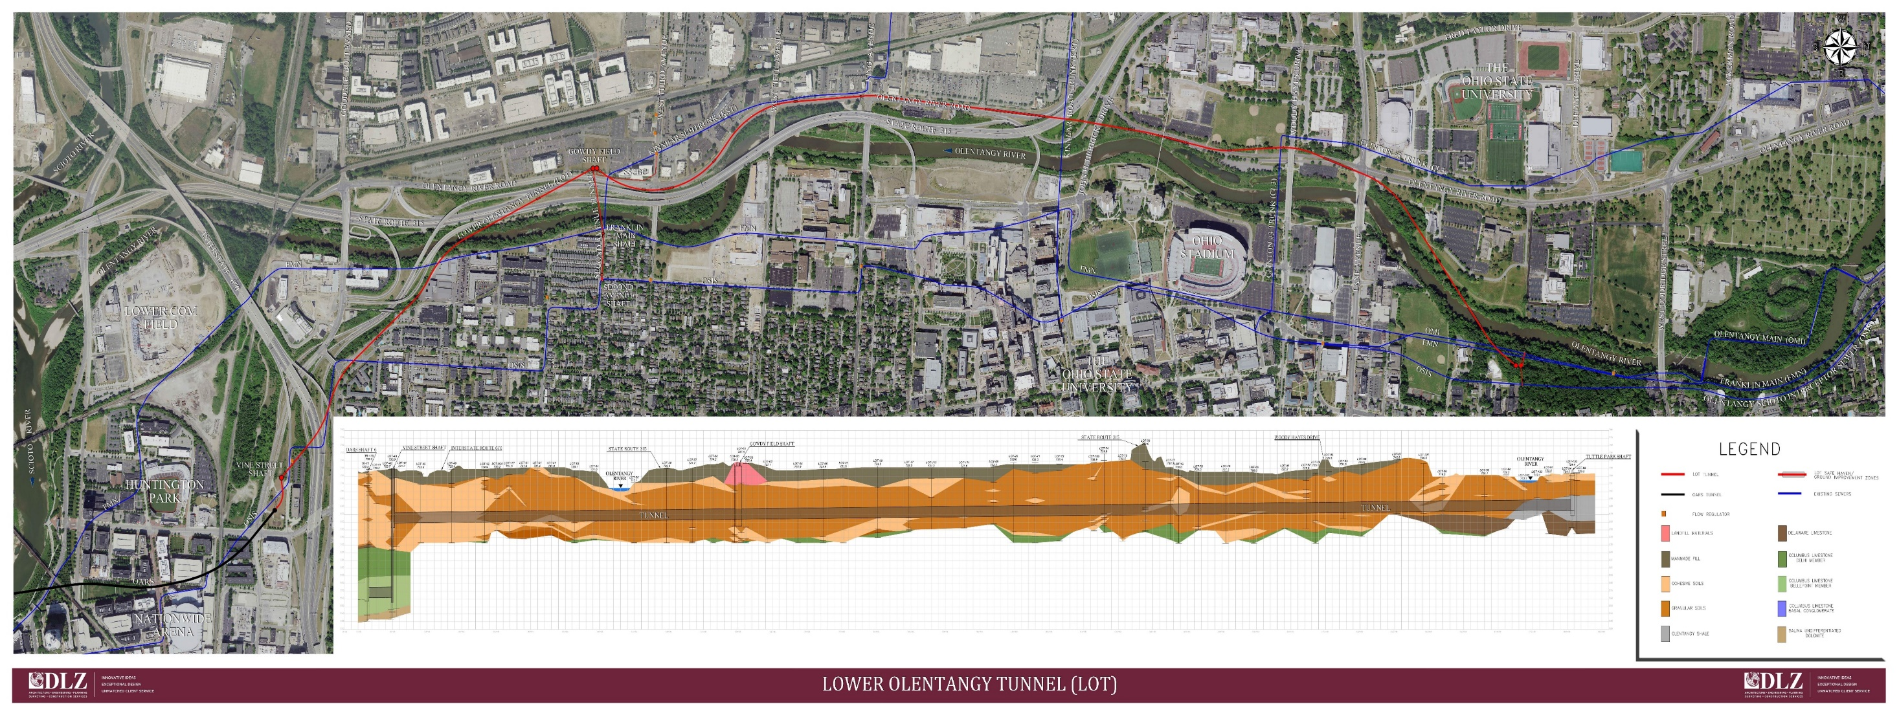
LOT – Selected Alignment
LOT

Slide 9
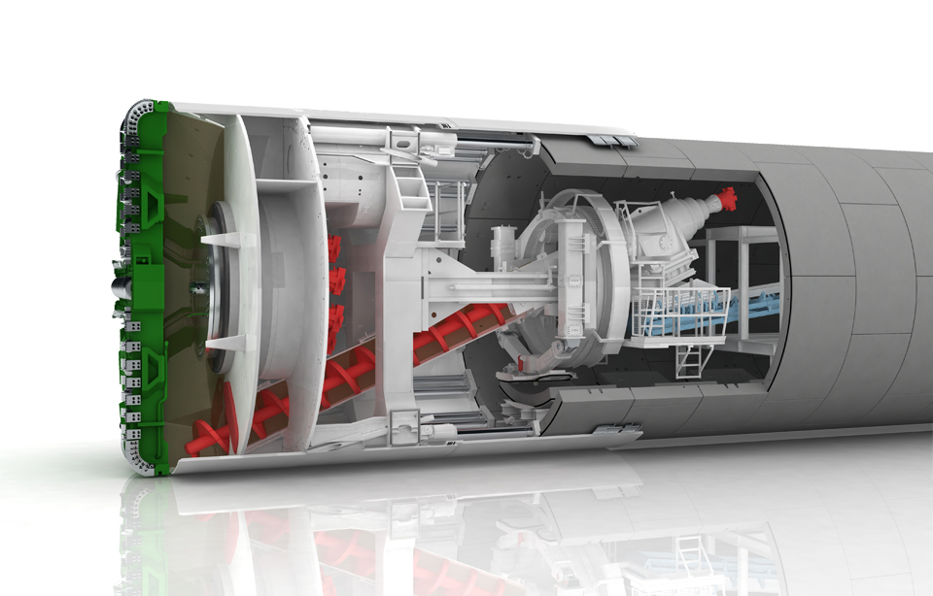
LOT
Soft Ground
~ 70 feet deep
Tunnel Boring Machine
Pressurized Cutter Face

Slide 10
LOT
Components
3 ½ Miles of 12-foot tunnel
1,100 LF of 90” Microtunnel
950 LF of 36” Jack & Bore
320 LF of 30” Jack & Bore
5 Shafts
(51’ deep up to 170’ deep)

Slide 11
LOT
Connections
2nd Avenue – OSIS and Franklin-Main Relief Structures and connections
Tuttle Park – 1 Relief Structure with adjustable weir gates controlling flow from 3 Diversion Structure connections on the 54” OSIS, 78” Olentangy Main Interceptor, and the 30” Franklin-Main
Odor Control Facilities Upgrades

Slide 12
LOT
Odor Controls
Vine Street Odor Control Facility - Upgraded to handle air from LOT by raising the biofilter beds, replacing the irrigation system, and installing new biofilter bark
Short Street Odor Control Facility – changed the biofilter media and updated the sprinkler heads

Slide 13
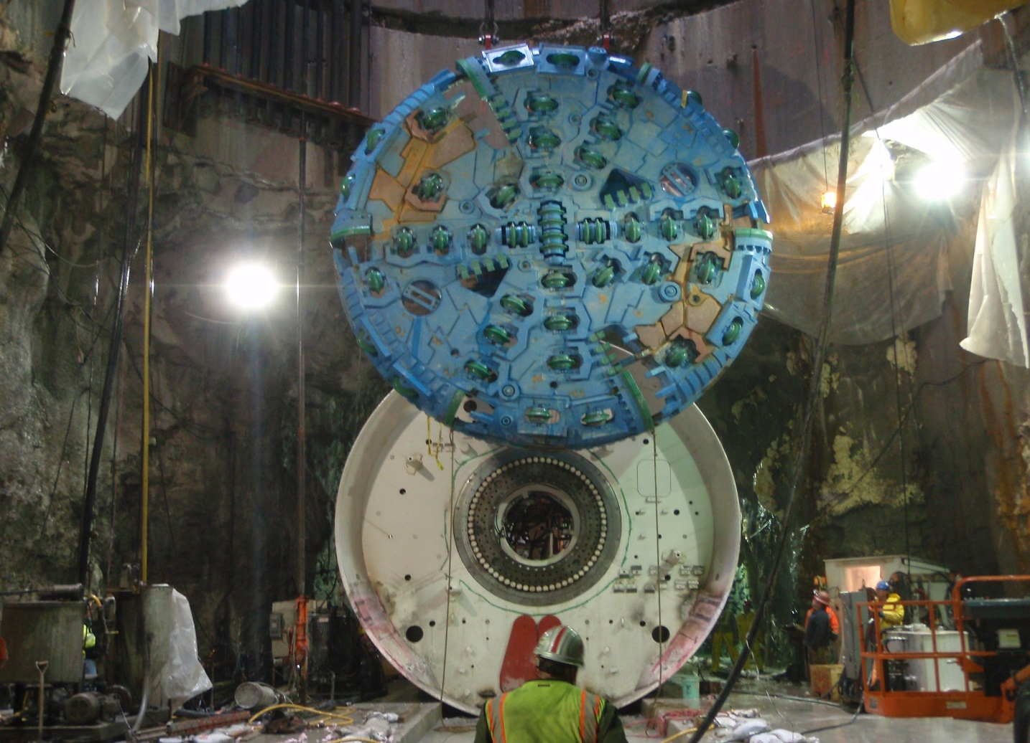
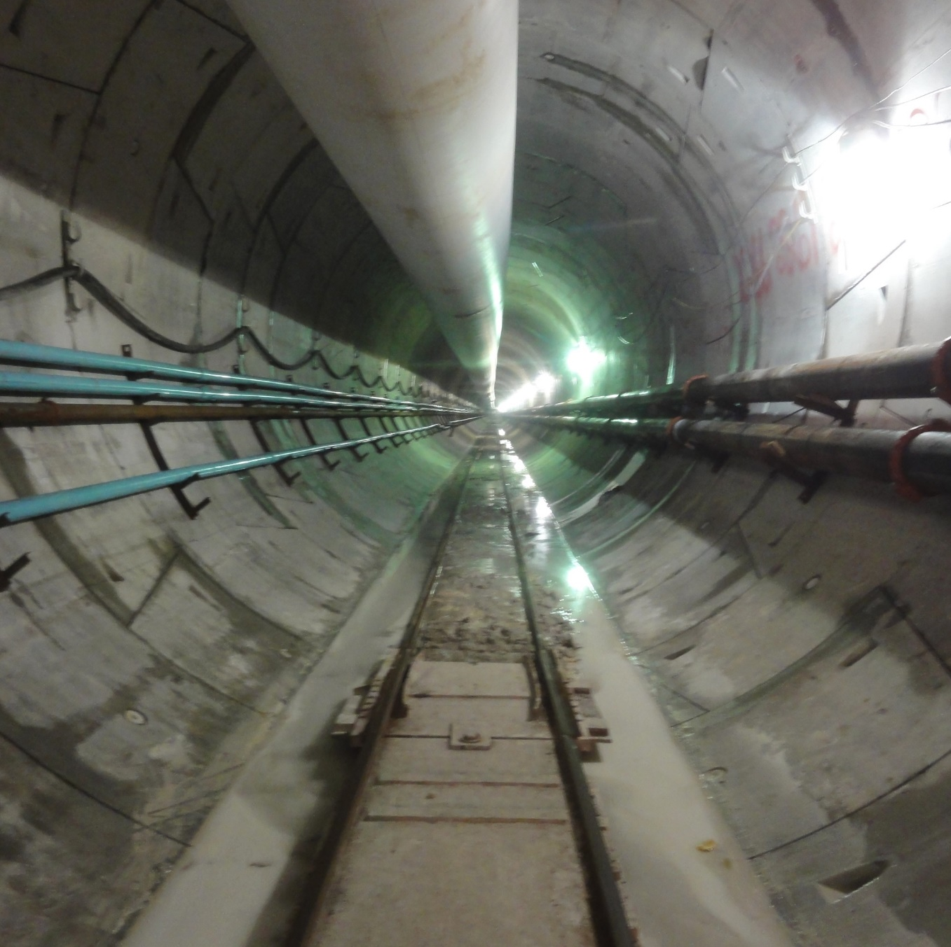
LOT discharges to the OARS Tunnel
OARS Tunnel
  General Information:
  4 ½ miles long, 20-Foot Diameter,
  180 feet deep
  6 Shafts
  Completed in 2017
  Eliminated 13 downtown CSOs
  Closed off the WSST
  Operational (August 31, 2017):
  Empty during dry weather
  Peak flows of up to 1,100 MGD
  Provides 60 million gallons of in-line storage
  A 60 MGD pumping system dewaters the tunnel
  Provides relief to the OSIS (Olentangy Scioto Interceptor Sewer), a combined sewer that was built in the 1930s and is the main sewer flowing through Columbus to the Jackson Pike WWTP.

Slide 14
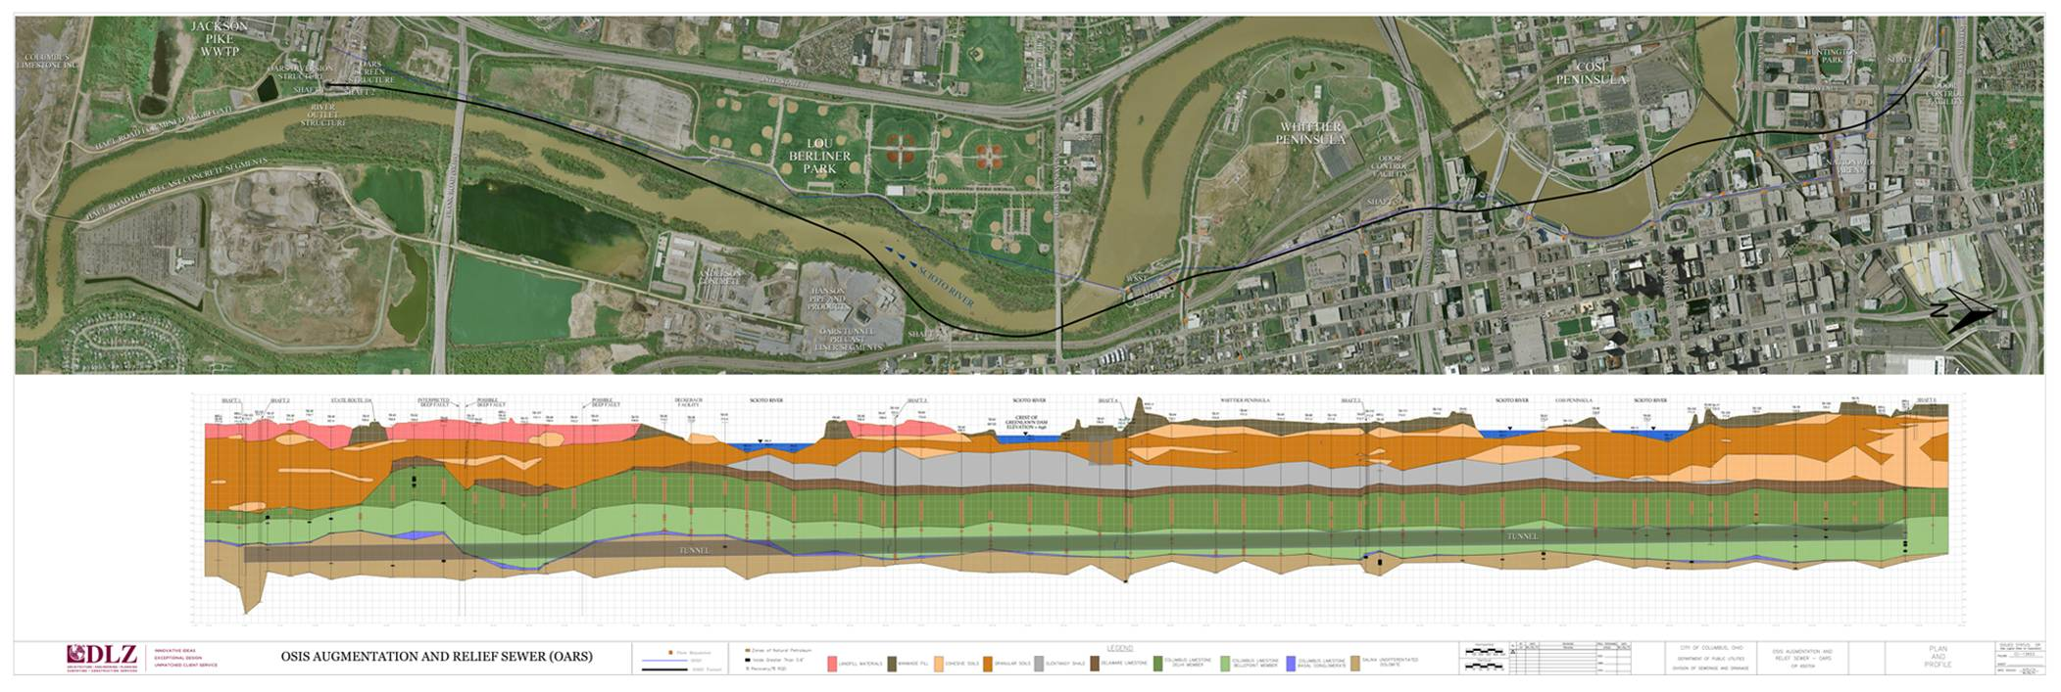
OARS TUNNEL ALIGNMENT
OARS System

Slide 15
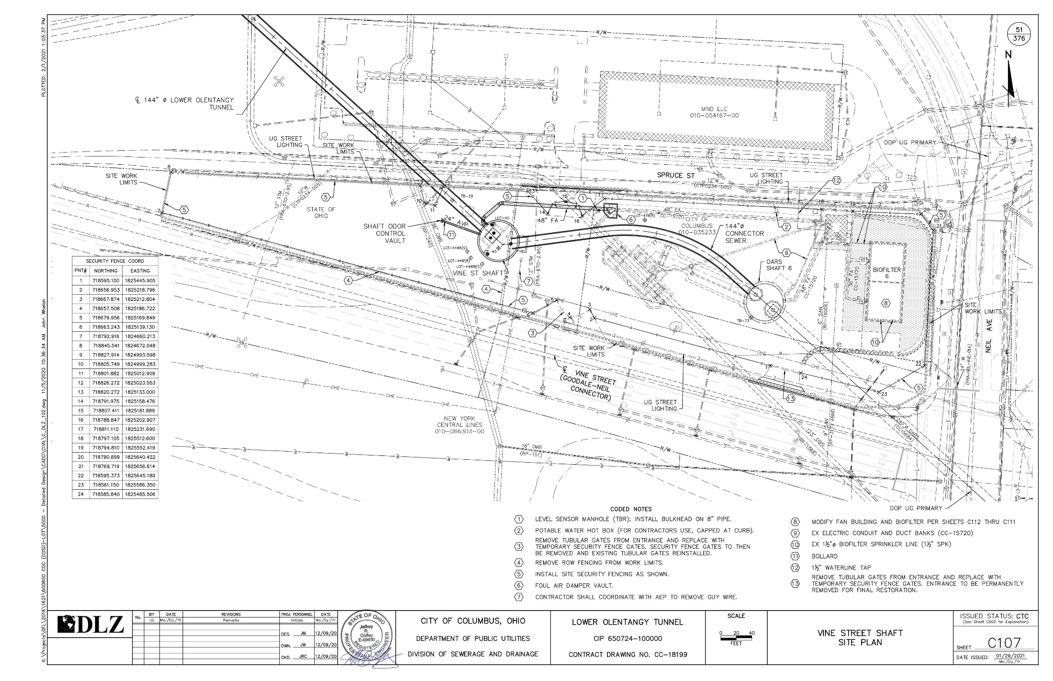
LOT
Connection to OARS
LOT
What’s Next?
Lower
Olentangy
Tunnel (LOT)

Slide 16
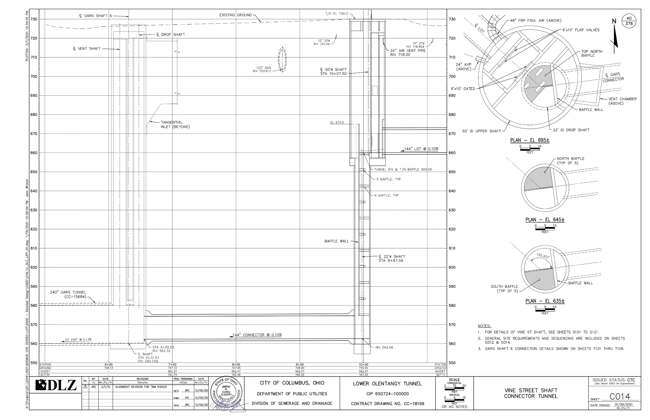
LOT
Connection to OARS
LOT
What’s Next?
Lower
Olentangy
Tunnel (LOT)

Slide 17
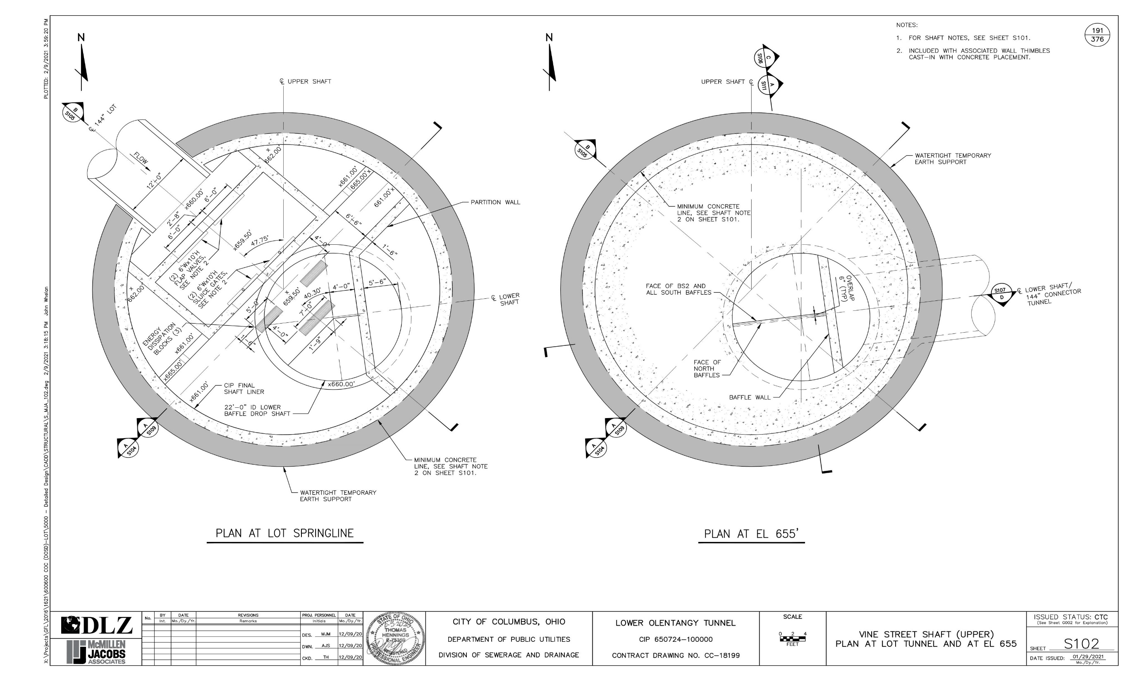
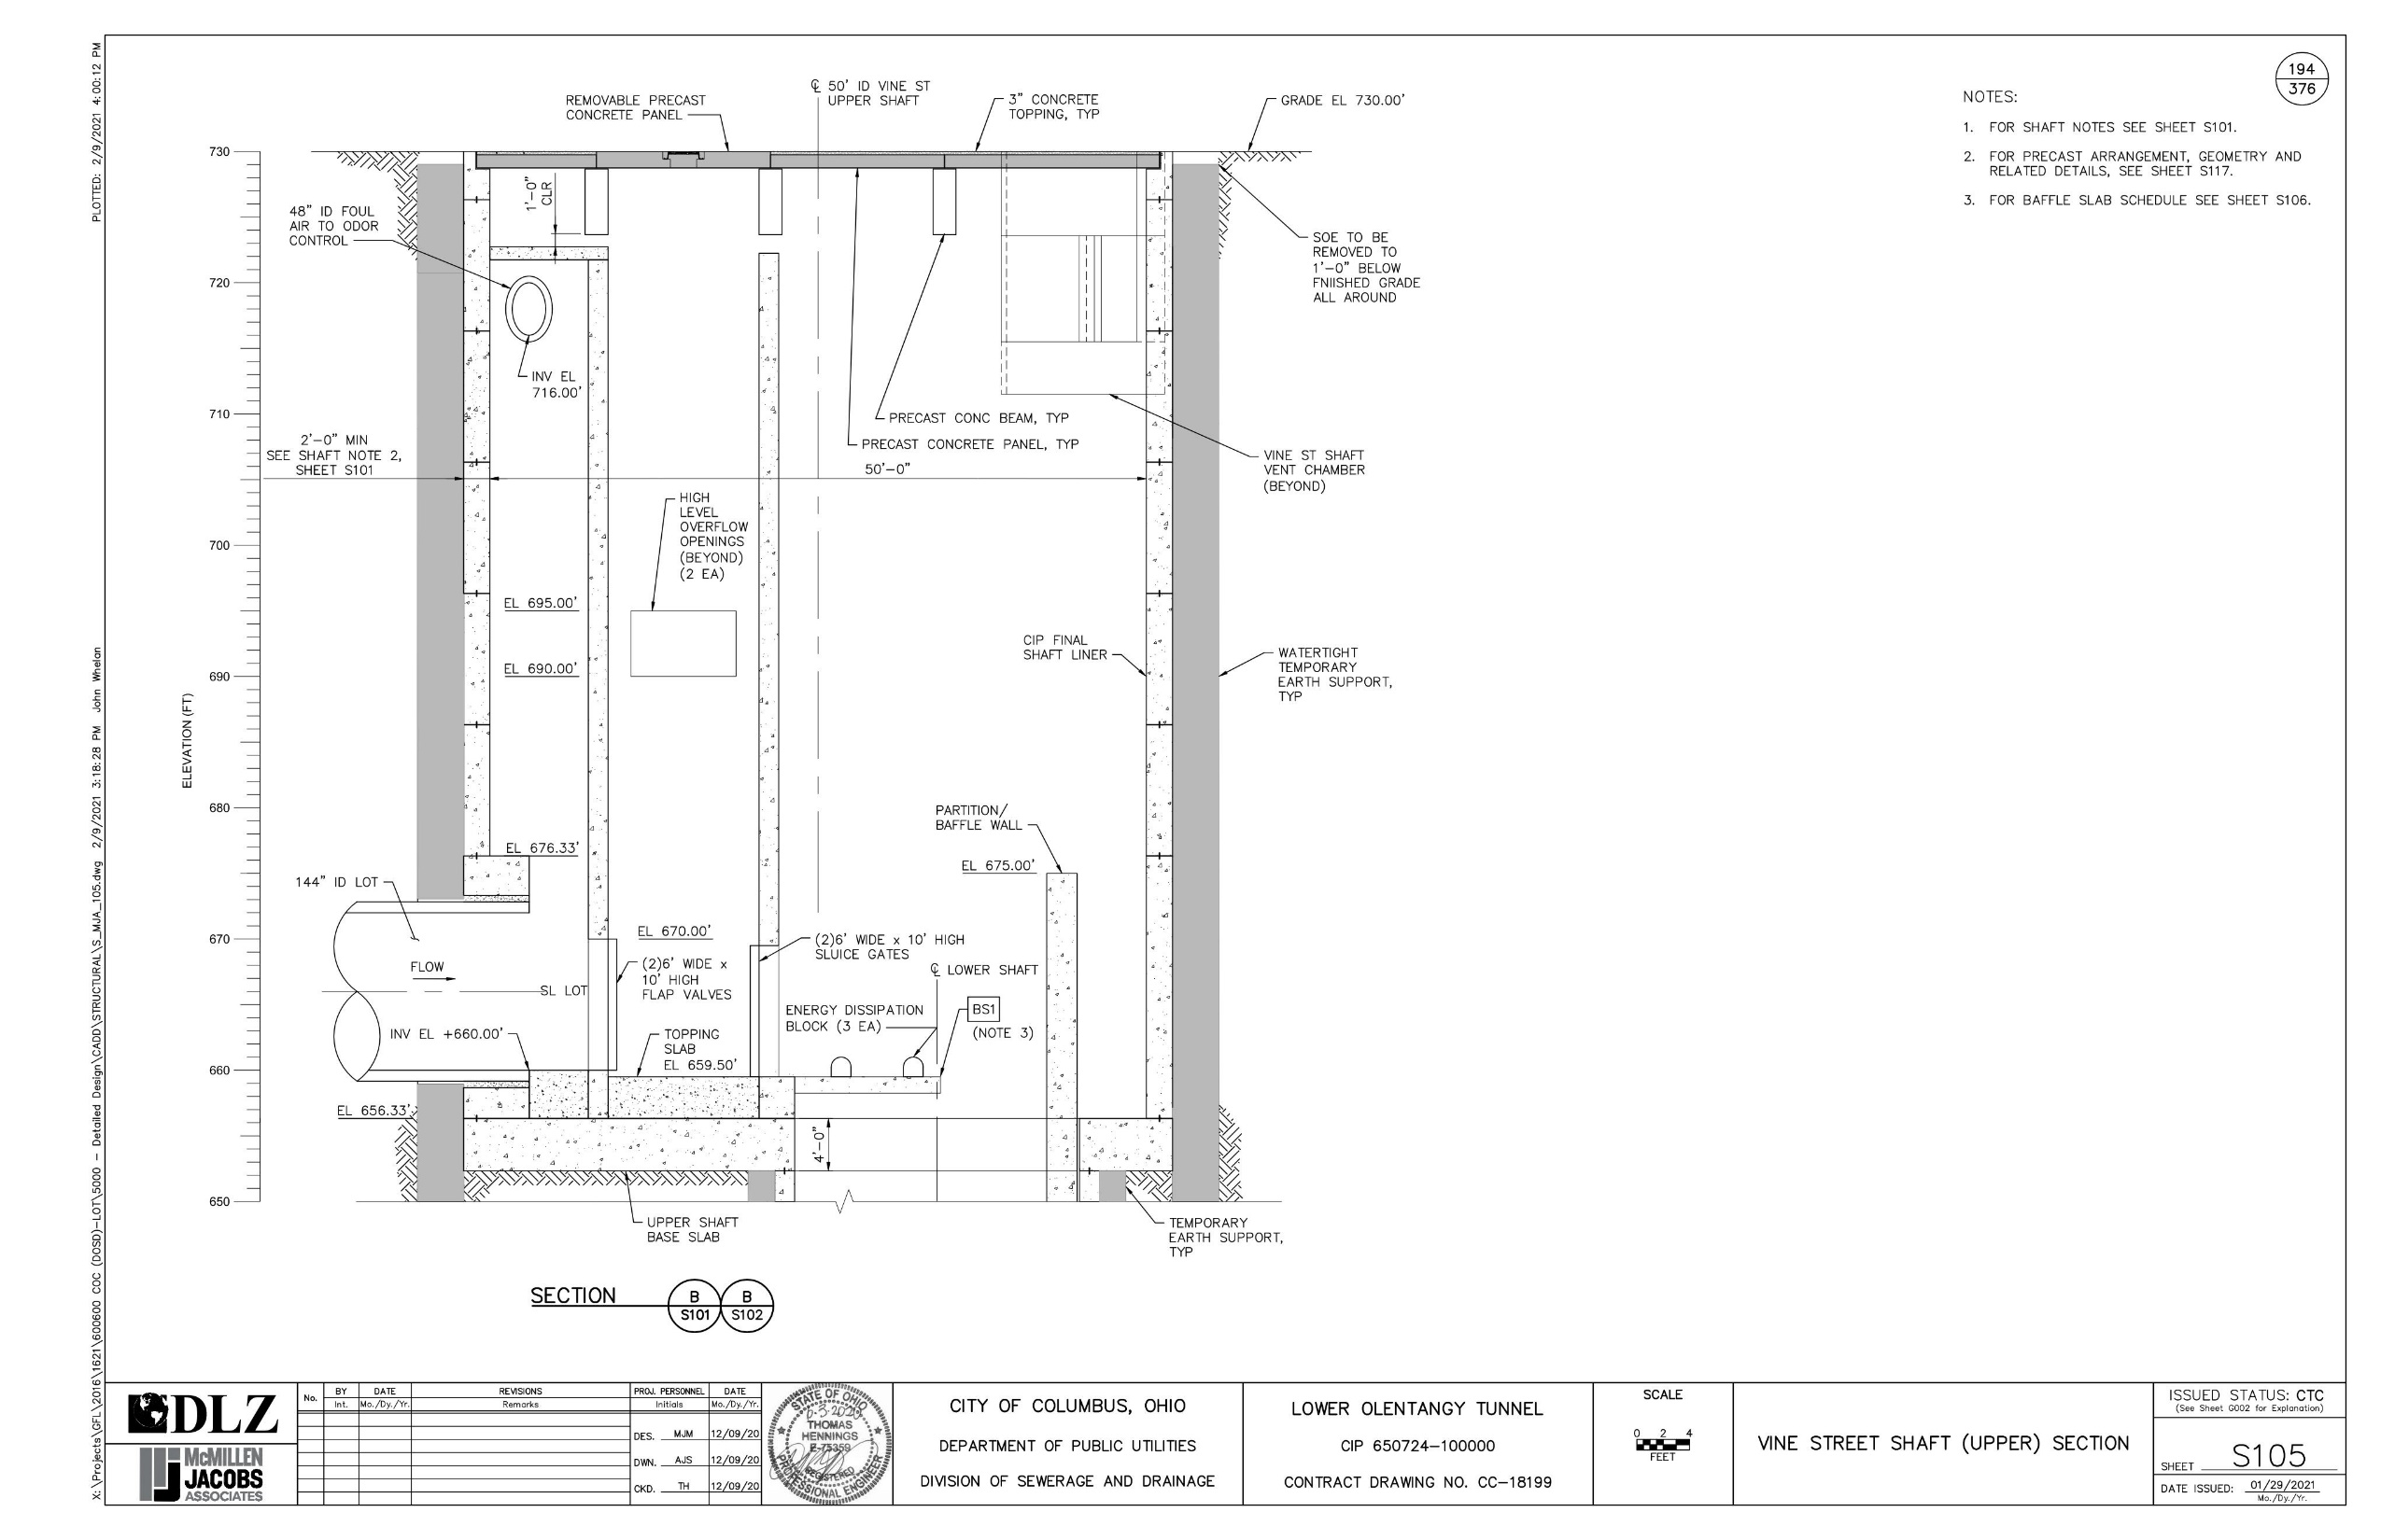

LOT
Connection to OARS
LOT
What’s Next?
Lower
Olentangy
Tunnel (LOT)

Slide 18
LOT
Tunnel Dewatering Plan
After rain event occurs, tunnels are full, and dewatering is started:
Close LOT downstream gates
Dewater OARS while storing 15 MG in LOT
Open LOT gates – release the 15 MG to flow achieve scouring velocity in both tunnels
What’s Next?
Lower
Olentangy
Tunnel (LOT)

Slide 19
LOT
Tunnel Dewatering Plan
Anticipated Benefits:
Resuspend settled solids and transport to the downstream OARS pump station.
Reduce solids accumulation in both tunnels.
The flow through the screens should also assist in pulling debris off the screens with the clamshell screen clearing mechanism
What’s Next?
Lower
Olentangy
Tunnel (LOT)

Slide 20
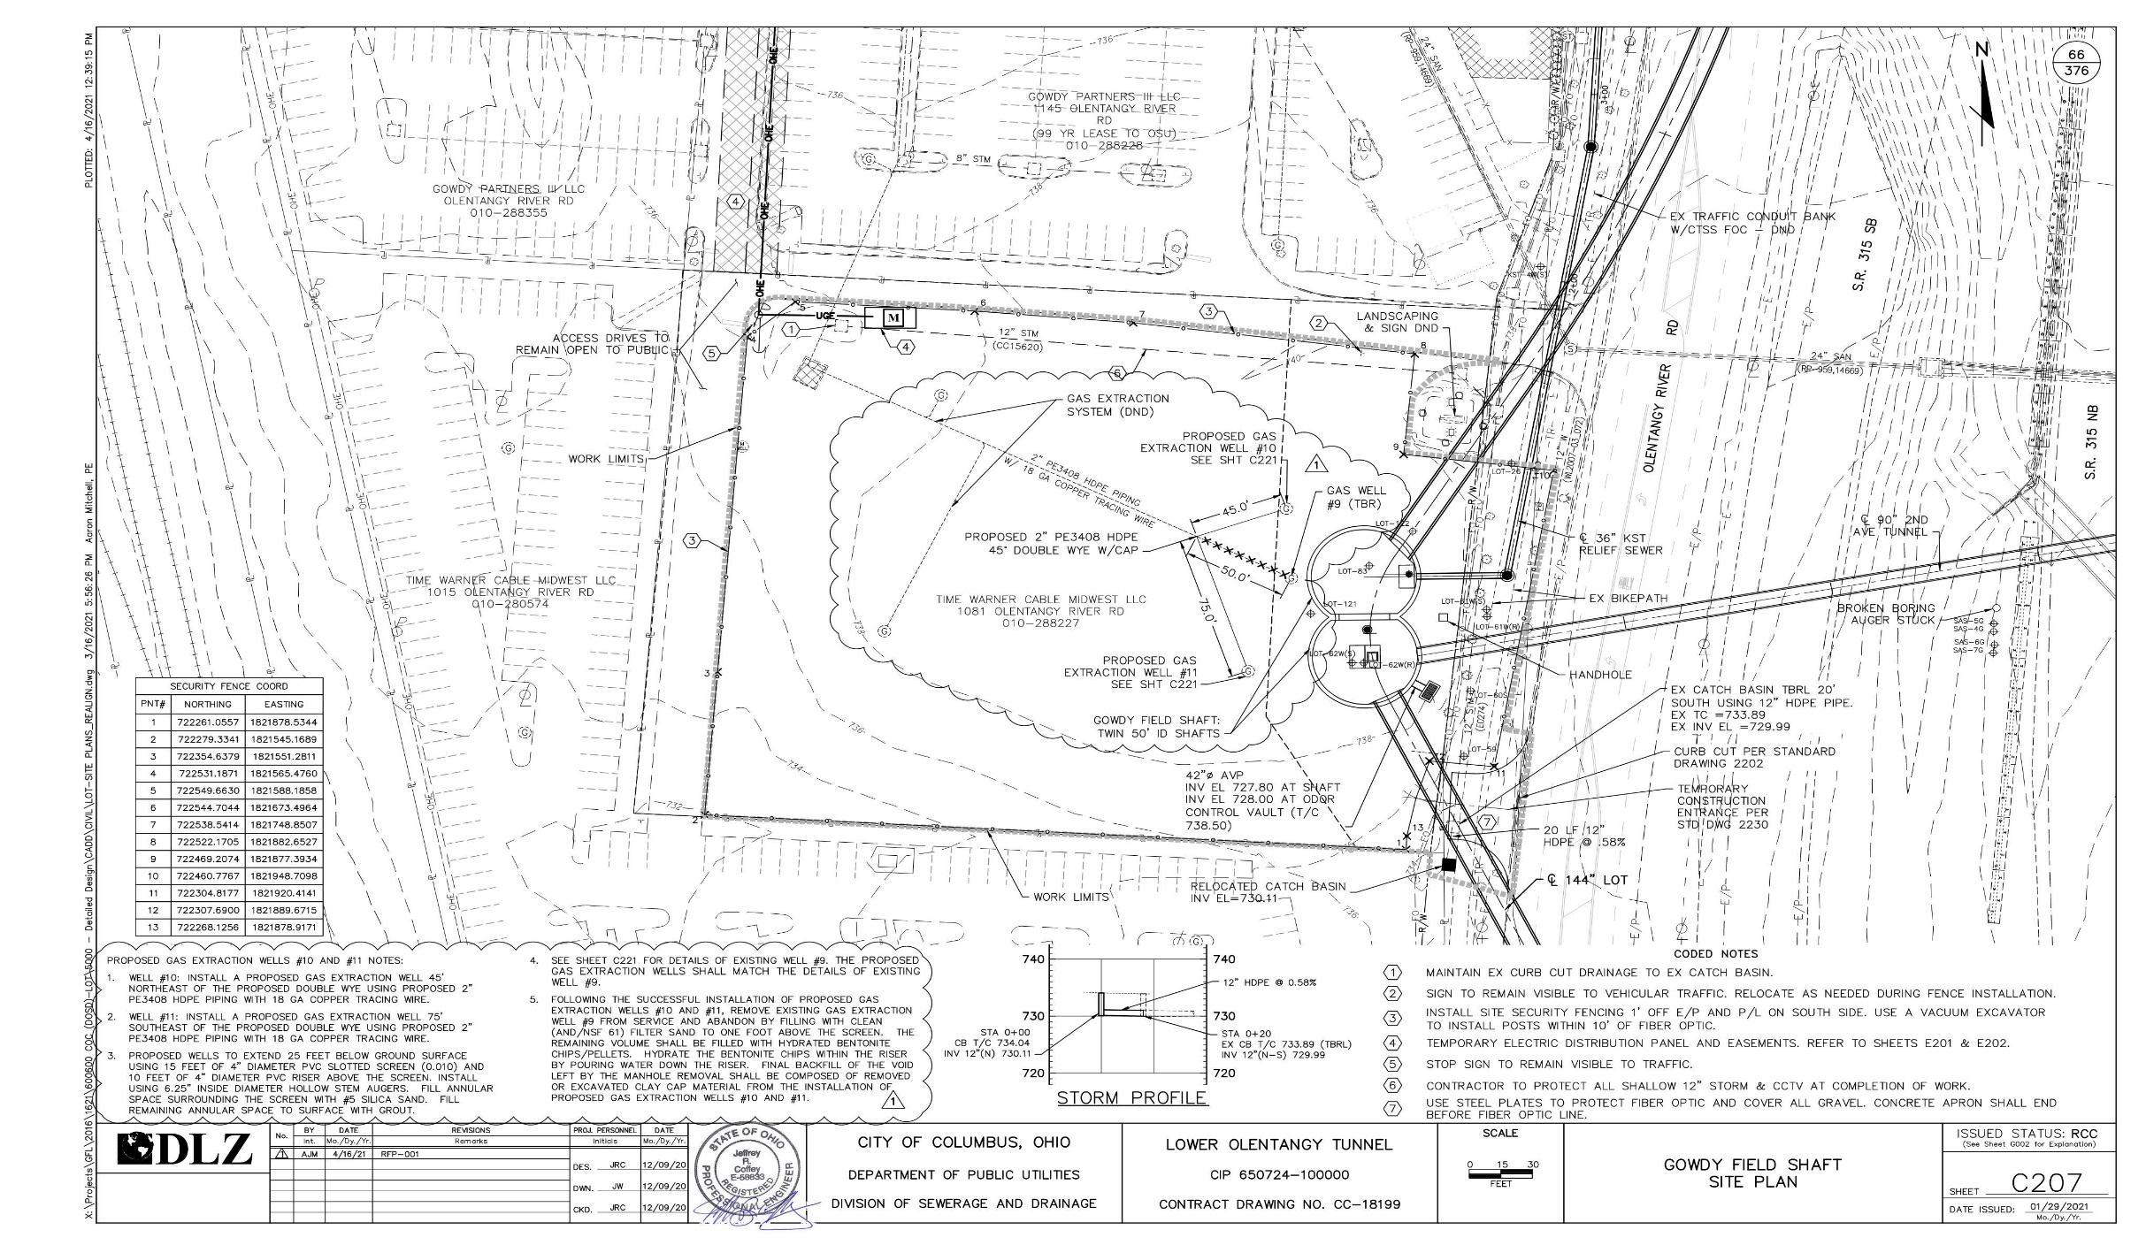
Gowdy Field
Shaft
Site
Primary tunneling work location

Slide 21
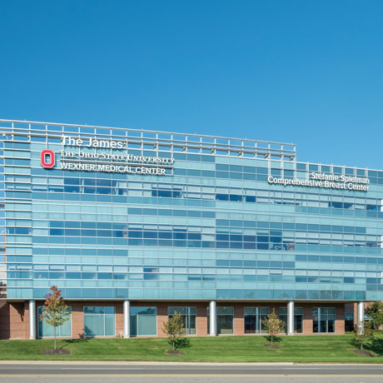
Stephanie Spielman Comprehensive Breast Center
Cancer treatments weekdays
7AM – 5PM (typical)

Slide 22
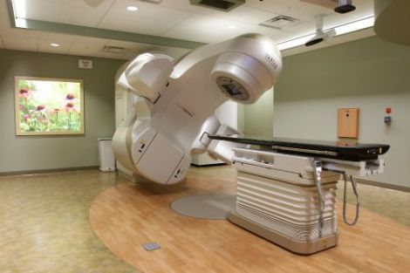
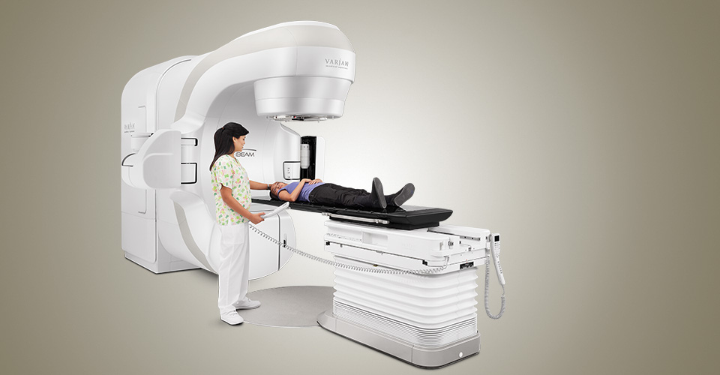
Stephanie Spielman Comprehensive Breast Center
Sensitive cancer treatment equipment requires vibration monitoring
(Varian TrueBeam – LINAC)

Slide 23
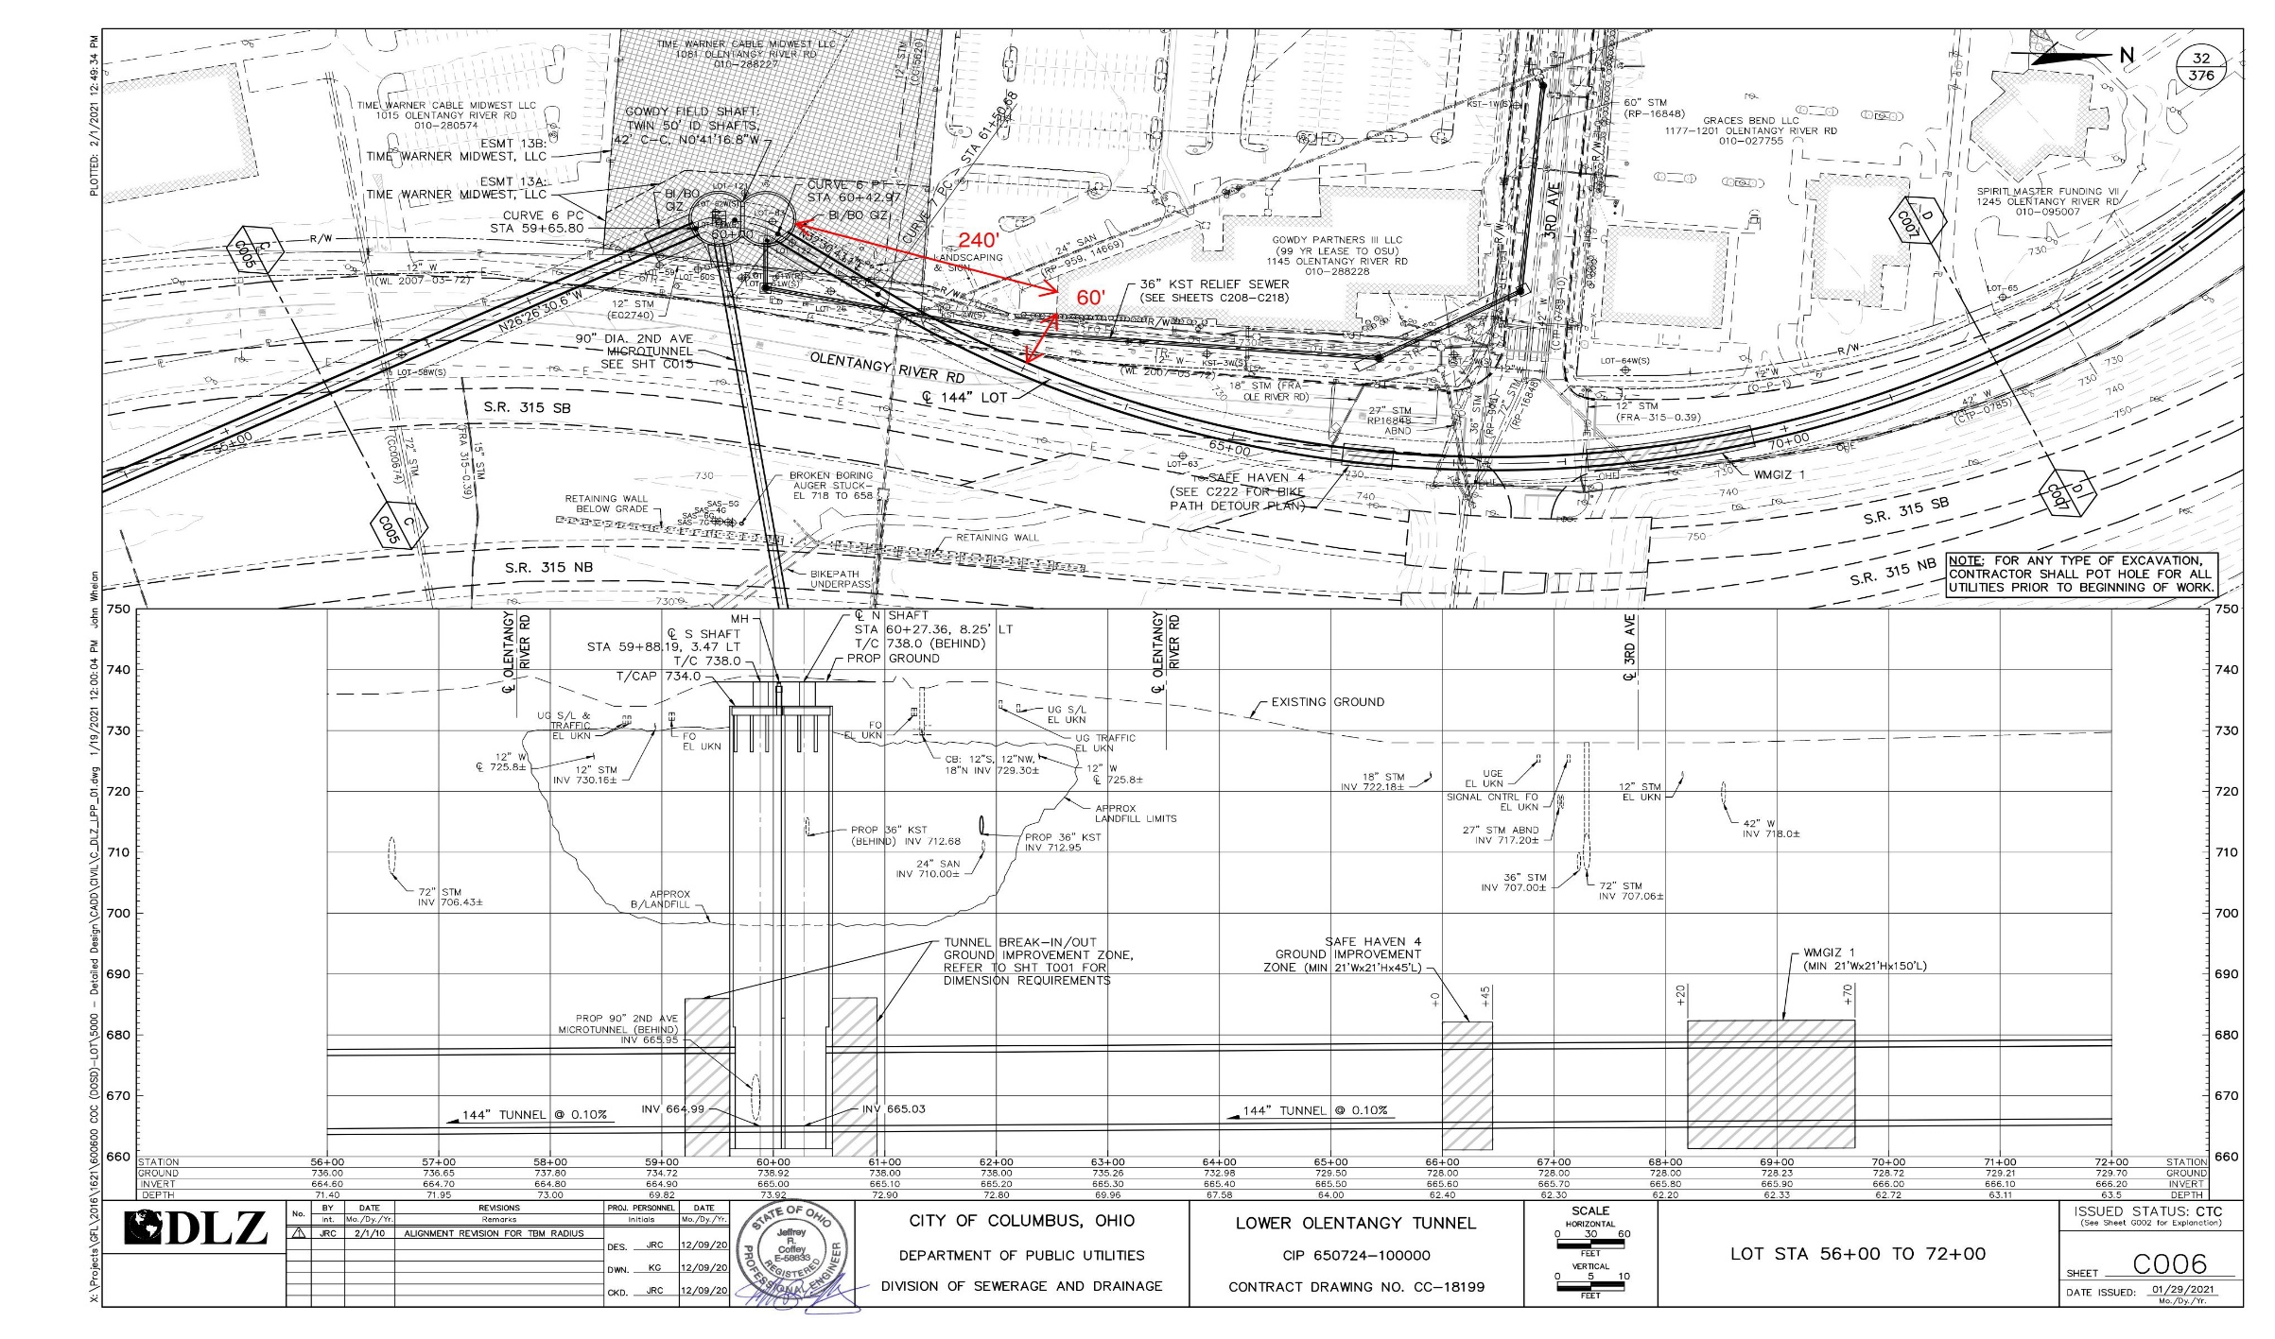
Gowdy Field
Shaft
Site
Primary tunneling work location

Slide 24
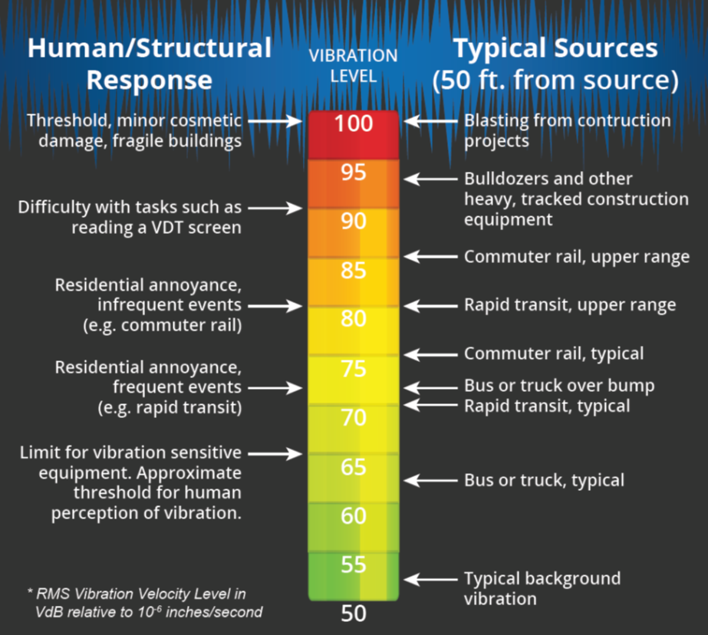
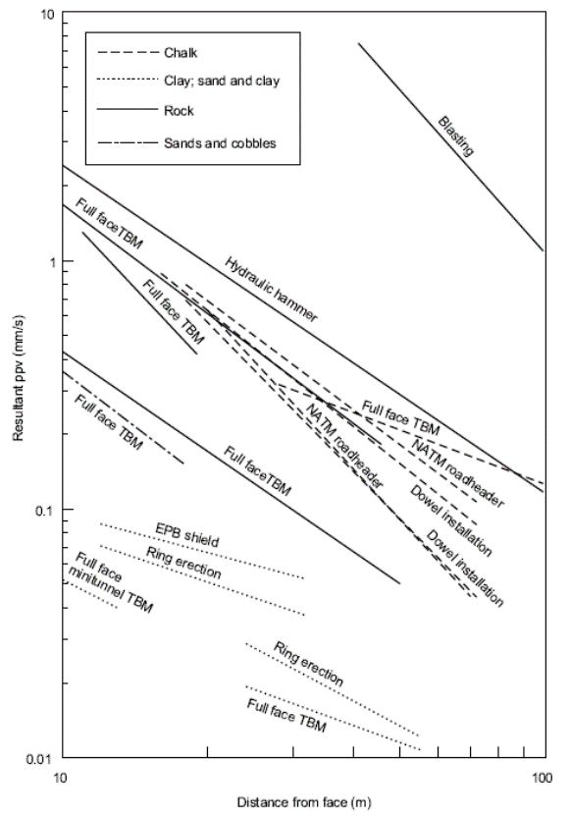
EXPECTED VIBRATION LEVELS

Slide 25
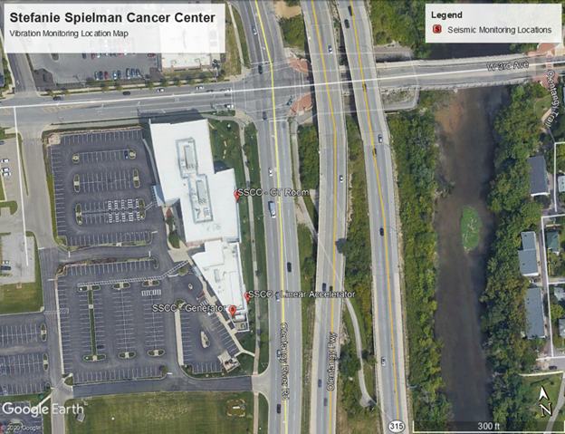
SSCBC Vibration Monitoring Plan
Installed 3 Seismic Monitoring Stations around the perimeter of the building.

Slide 26
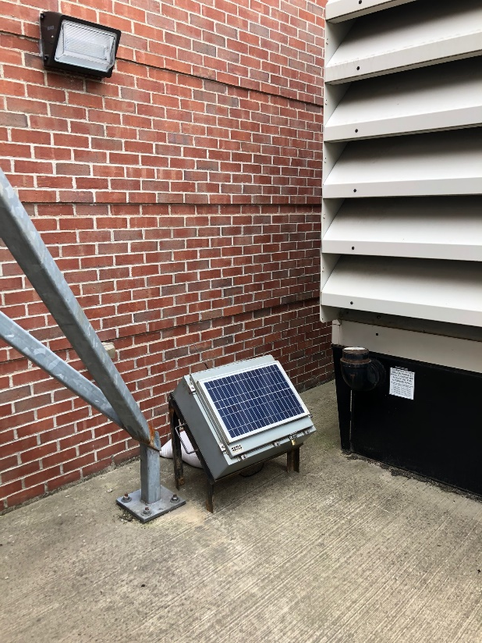
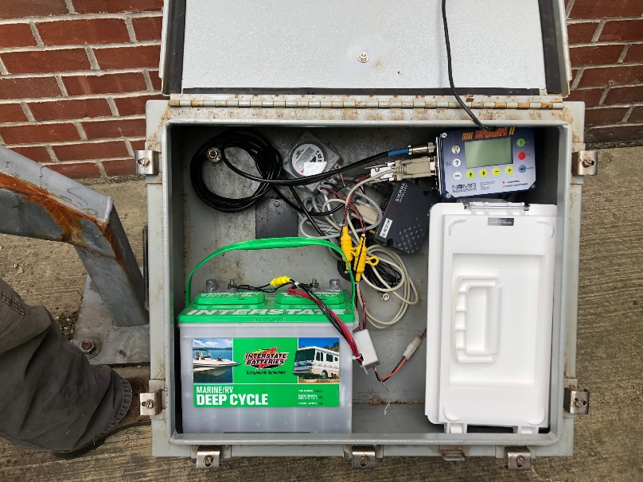
BASELINE MONITORING
February 17 – March 18, 2020
“Trigger Events” in Contract:
Review Level – 75 VdB (0.008 in/sec PPV)
Action Level – 80 VdB (0.0145 in/sec PPV)

Slide 27
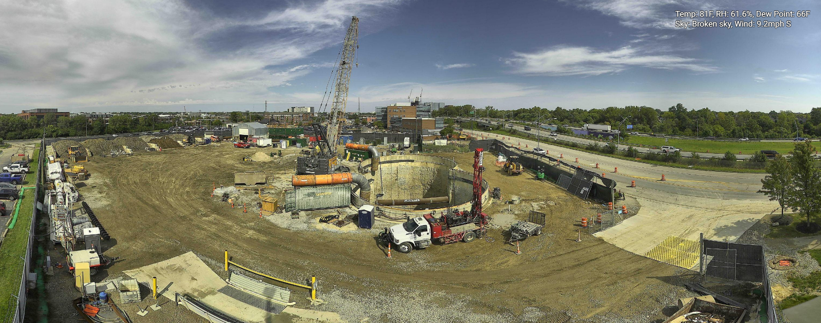
Gowdy Field
Shaft
Site
Gowdy Field Shaft Site (Panoramic)

Slide 28
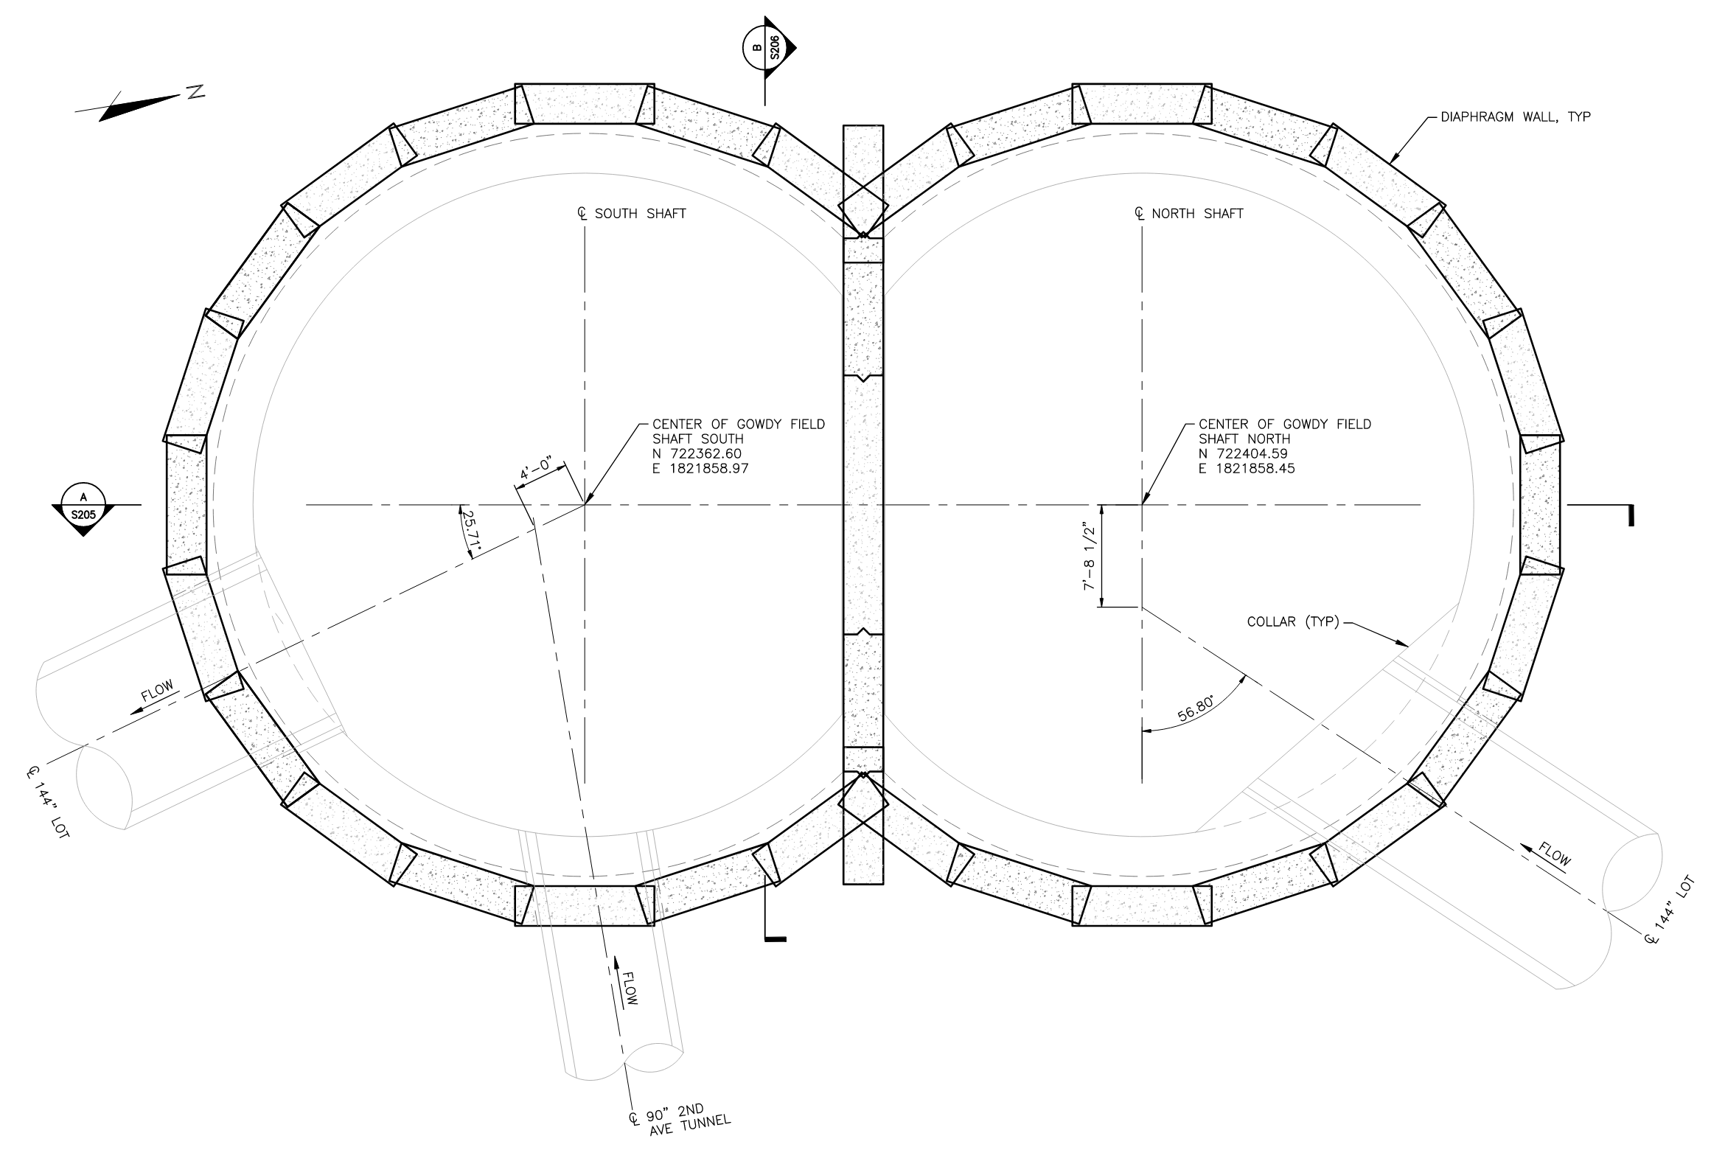
Gowdy Field
Shaft
Watertight shaft support of excavation with slurry panels

Slide 29
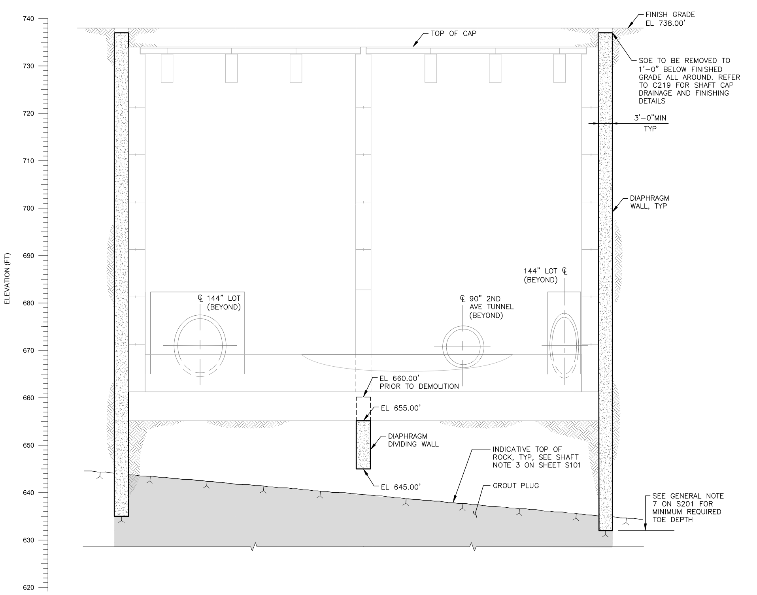
Gowdy Field
Shaft
The slurry wall is socketed into bedrock.

Slide 30
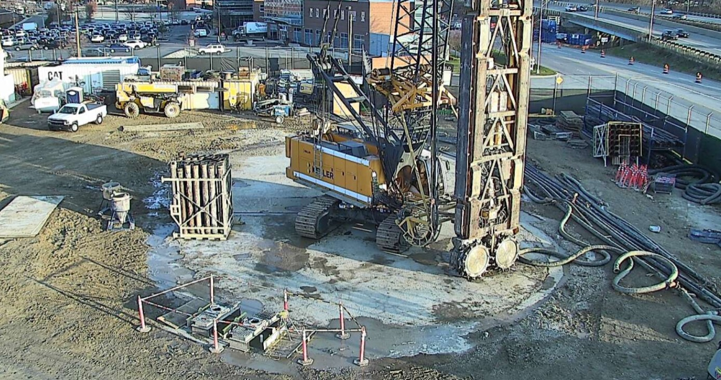
Slurry Panel installation is required to create a watertight support of excavation system.

Slide 31
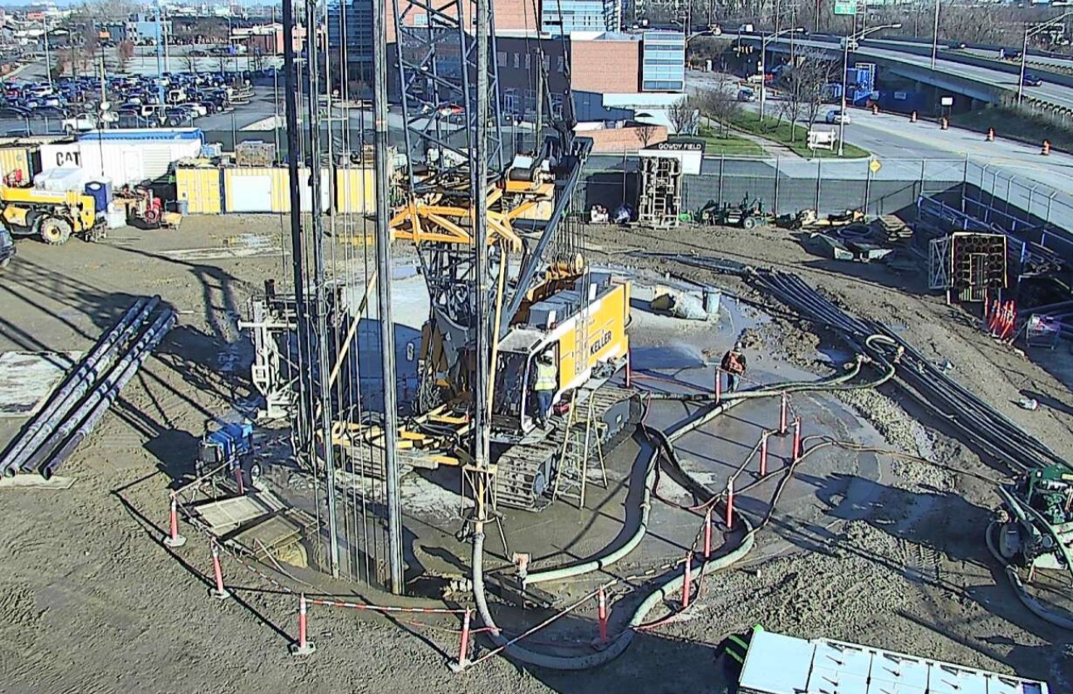
No vibration problems noted with the SSCBC equipment!

Slide 32
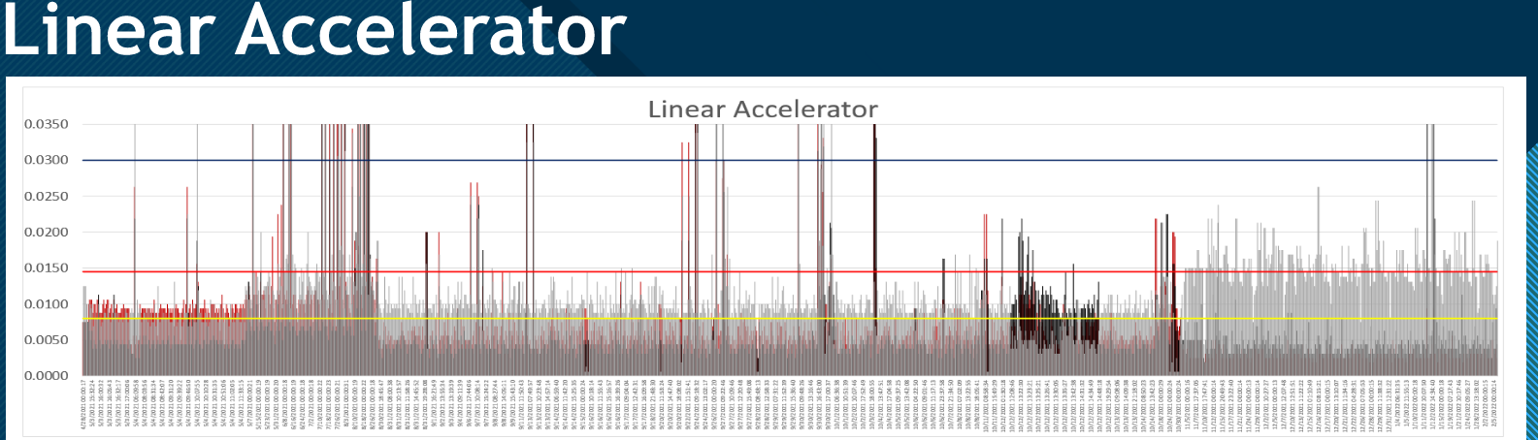
VIBRATION MONITORING RESULTS
OARS System

Slide 33
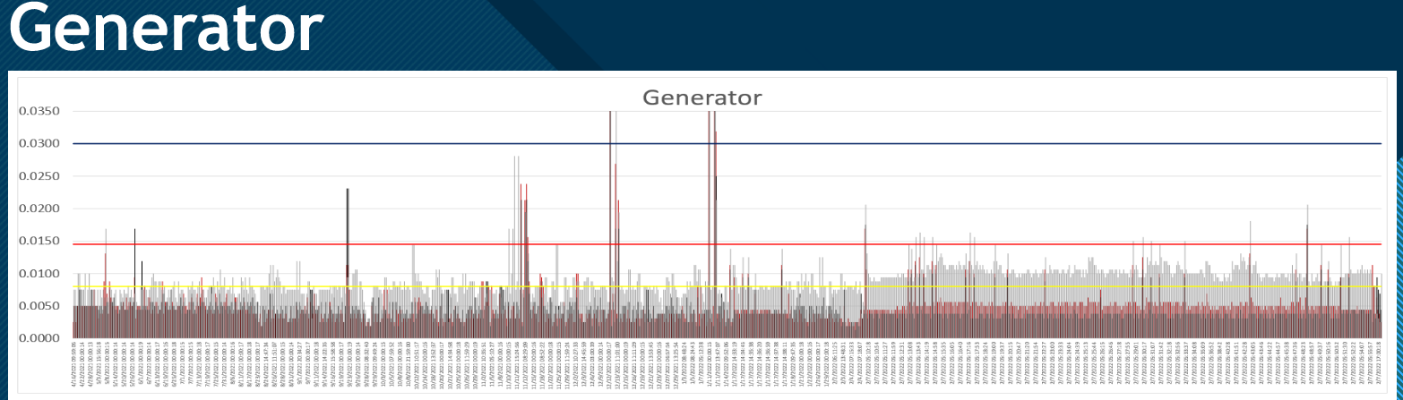
VIBRATION MONITORING RESULTS
OARS System

Slide 34
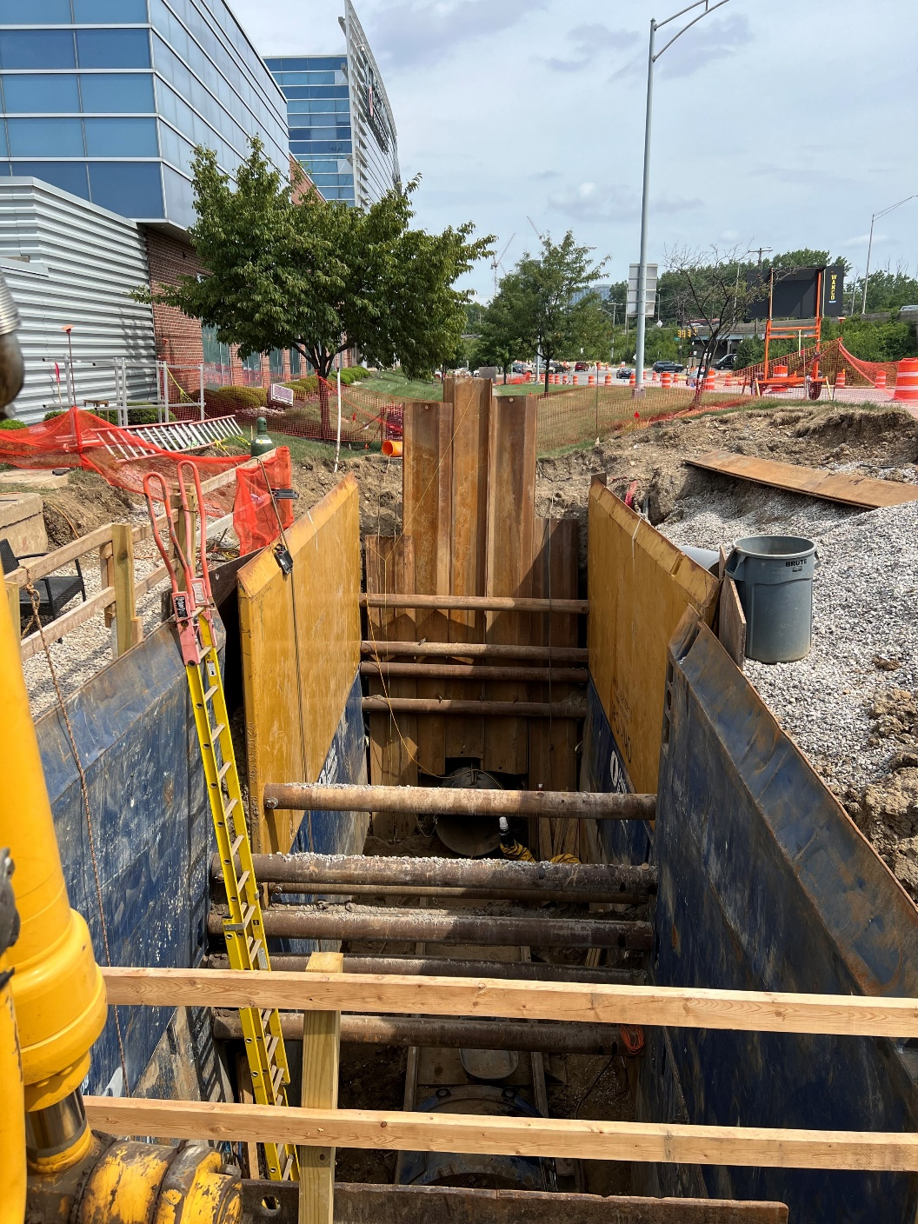
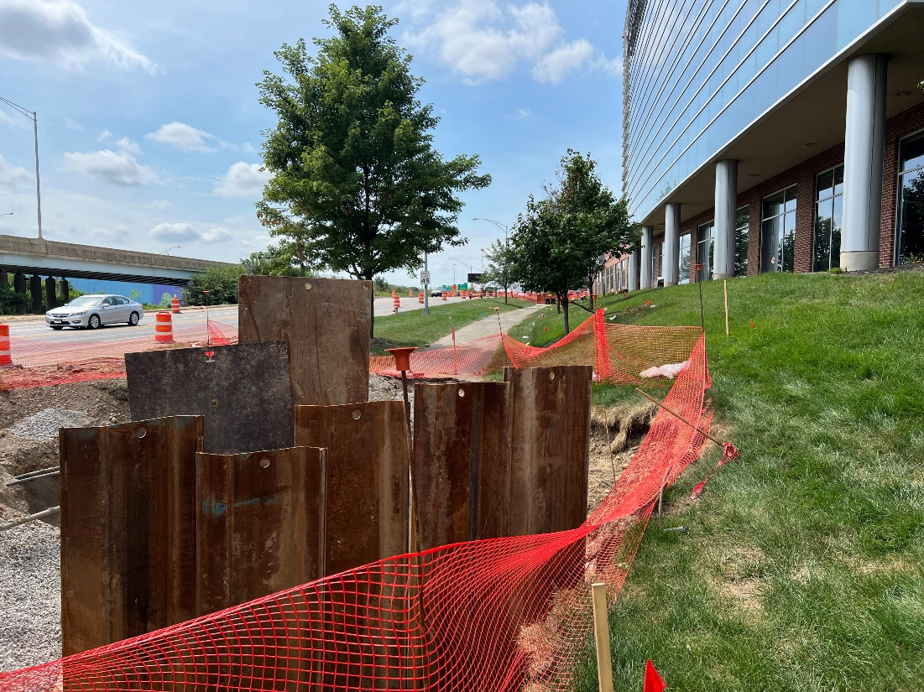
KST Relief Sewer
Jack & Boring a 36” HOBAS pipe within a casing pipe
Work is at night
No vibration problems noted!

Slide 35
Gowdy Field
Tunneling to the south starts in December
Added a monitor to the south

Slide 36
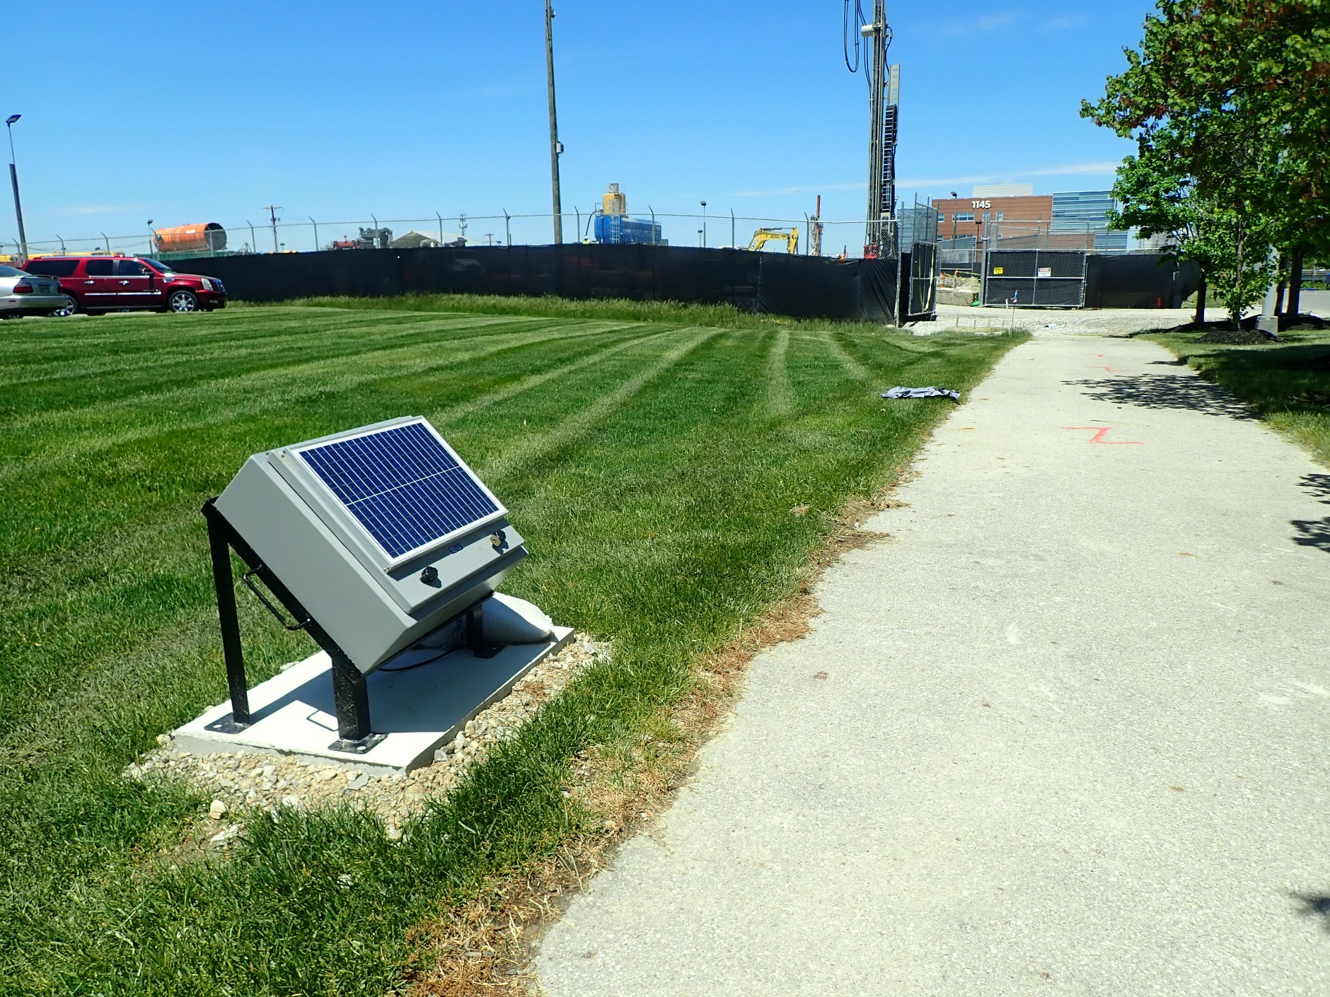
Gowdy Field
Shaft Site
Vibration Monitor set on a pad roughly equal distance from the shaft and tunnel as the SSCBC

Slide 37
LOT
SCHEDULE
CONSTRUCTION MILESTONES:
NTP – 3/2/2021
1. Biofilter 5 – August 31, 2022
2. Biofilter 6 – June 30, 2023
3. Southern LOT & 2nd Ave Operational – June 30, 2025
4. Substantial Completion – June 30, 2026
5. DSR-873 Operational – September 30, 2026
6. Final Completion – December 31, 2026

Slide 38
LOT
2022
WORK
Excavate Vine Street Shaft
Excavate Gowdy Field Shaft
14 Safe Havens - Grouting from surface
5 Water Main Ground Improvement Zones
River Crossing Causeway – Grouting a mixed-face tunnel zone
TBM Delivery to Gowdy Field
Launch the TBM – December
Mobilize to 2nd Avenue Site – October
Mobilize to Tuttle Park Site - October

Slide 39
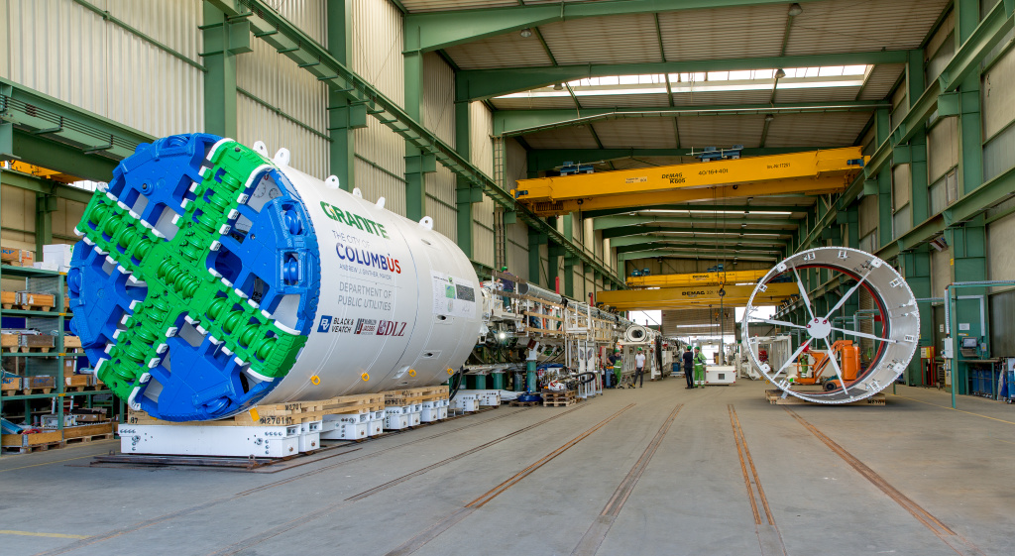
TBM
Factory Witness Test

Slide 40
LOT
TBM
Stats:
TBM with trailing gear is 440 feet long.
15-foot diameter cutter face
EPB – utilizes a screw conveyor to pull excavated material into the TBM, and discharges onto a belt conveyor. Solids are transported to the rear end of the TBM and put into muck cars.
Precast Concrete panels are brought via rail car are used to build the 12-foot diameter finished tunnel liner as the TBM proceeds. Each “ring build” is 5 feet long.

Slide 41
LOT
TBM
Stats:
Electrical service required:
1550 KVA
3.5 MW draw
Extended Medium Voltage (15 kV) power service approximately 2 miles to the Gowdy Field Shaft Site to provide up to 12 MW (sized to accommodate Slurry TBM, MTBM, and ancillary equipment)

Slide 42
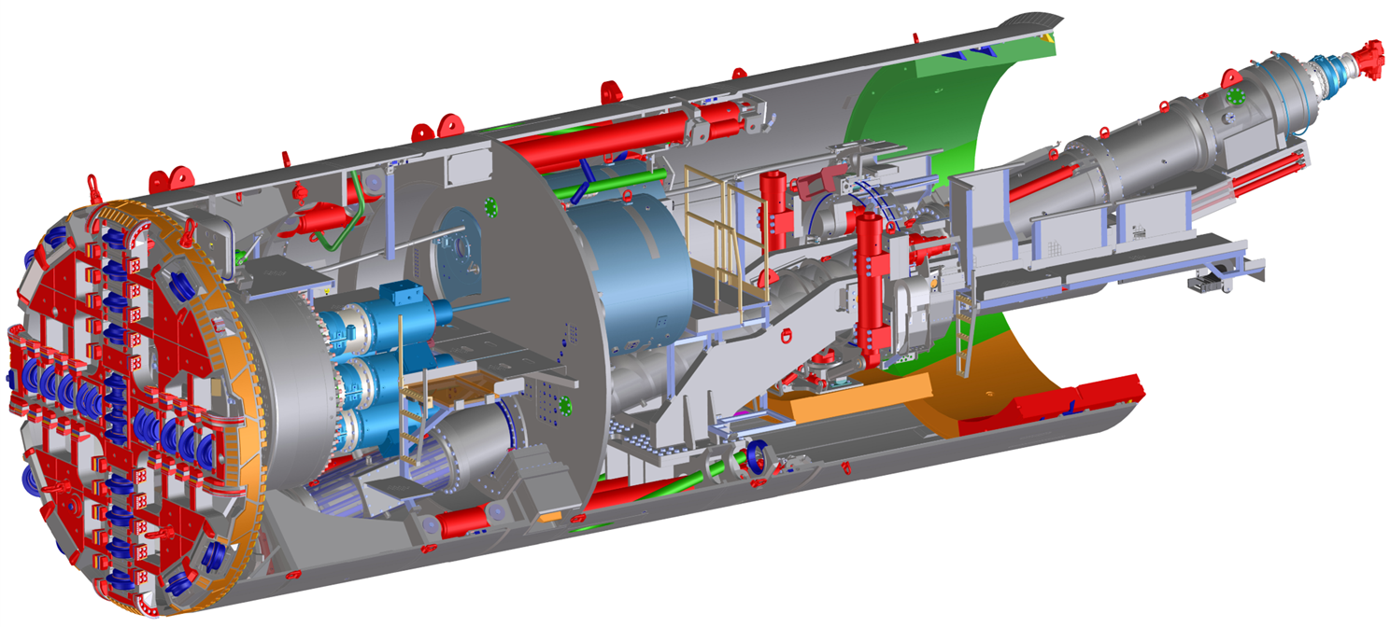
LOT
TBM
CUTTER
HEAD

Slide 43
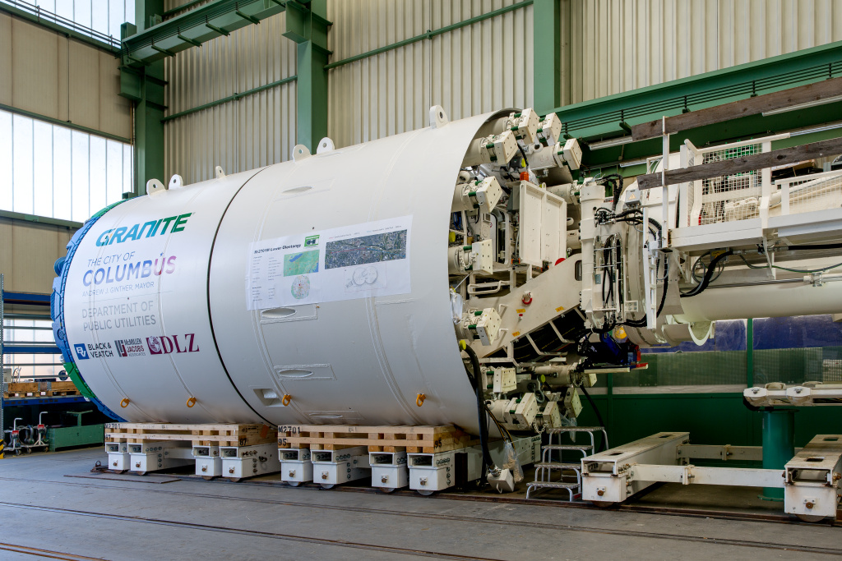
LOT
TBM
Cutter Head & Thrust Cylinder

Slide 44
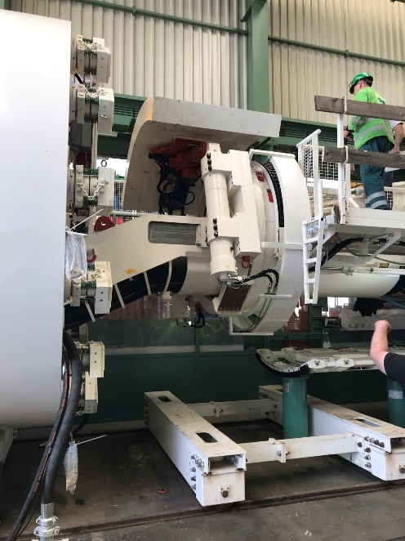
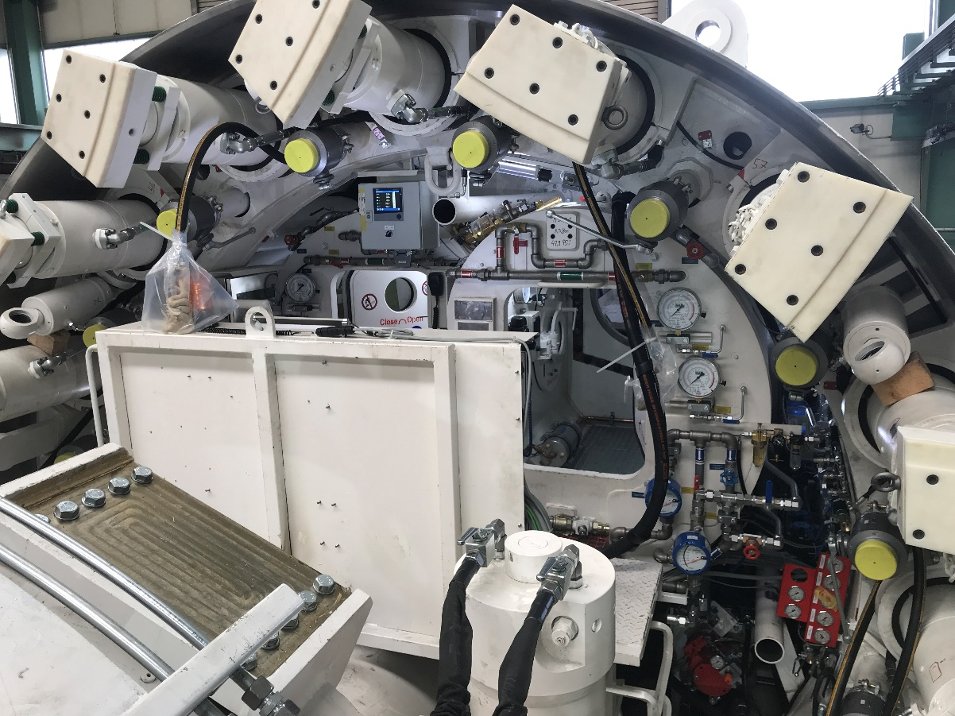
LOT
Thrust Cylinder, Air Lock, & Ring Erector

Slide 45
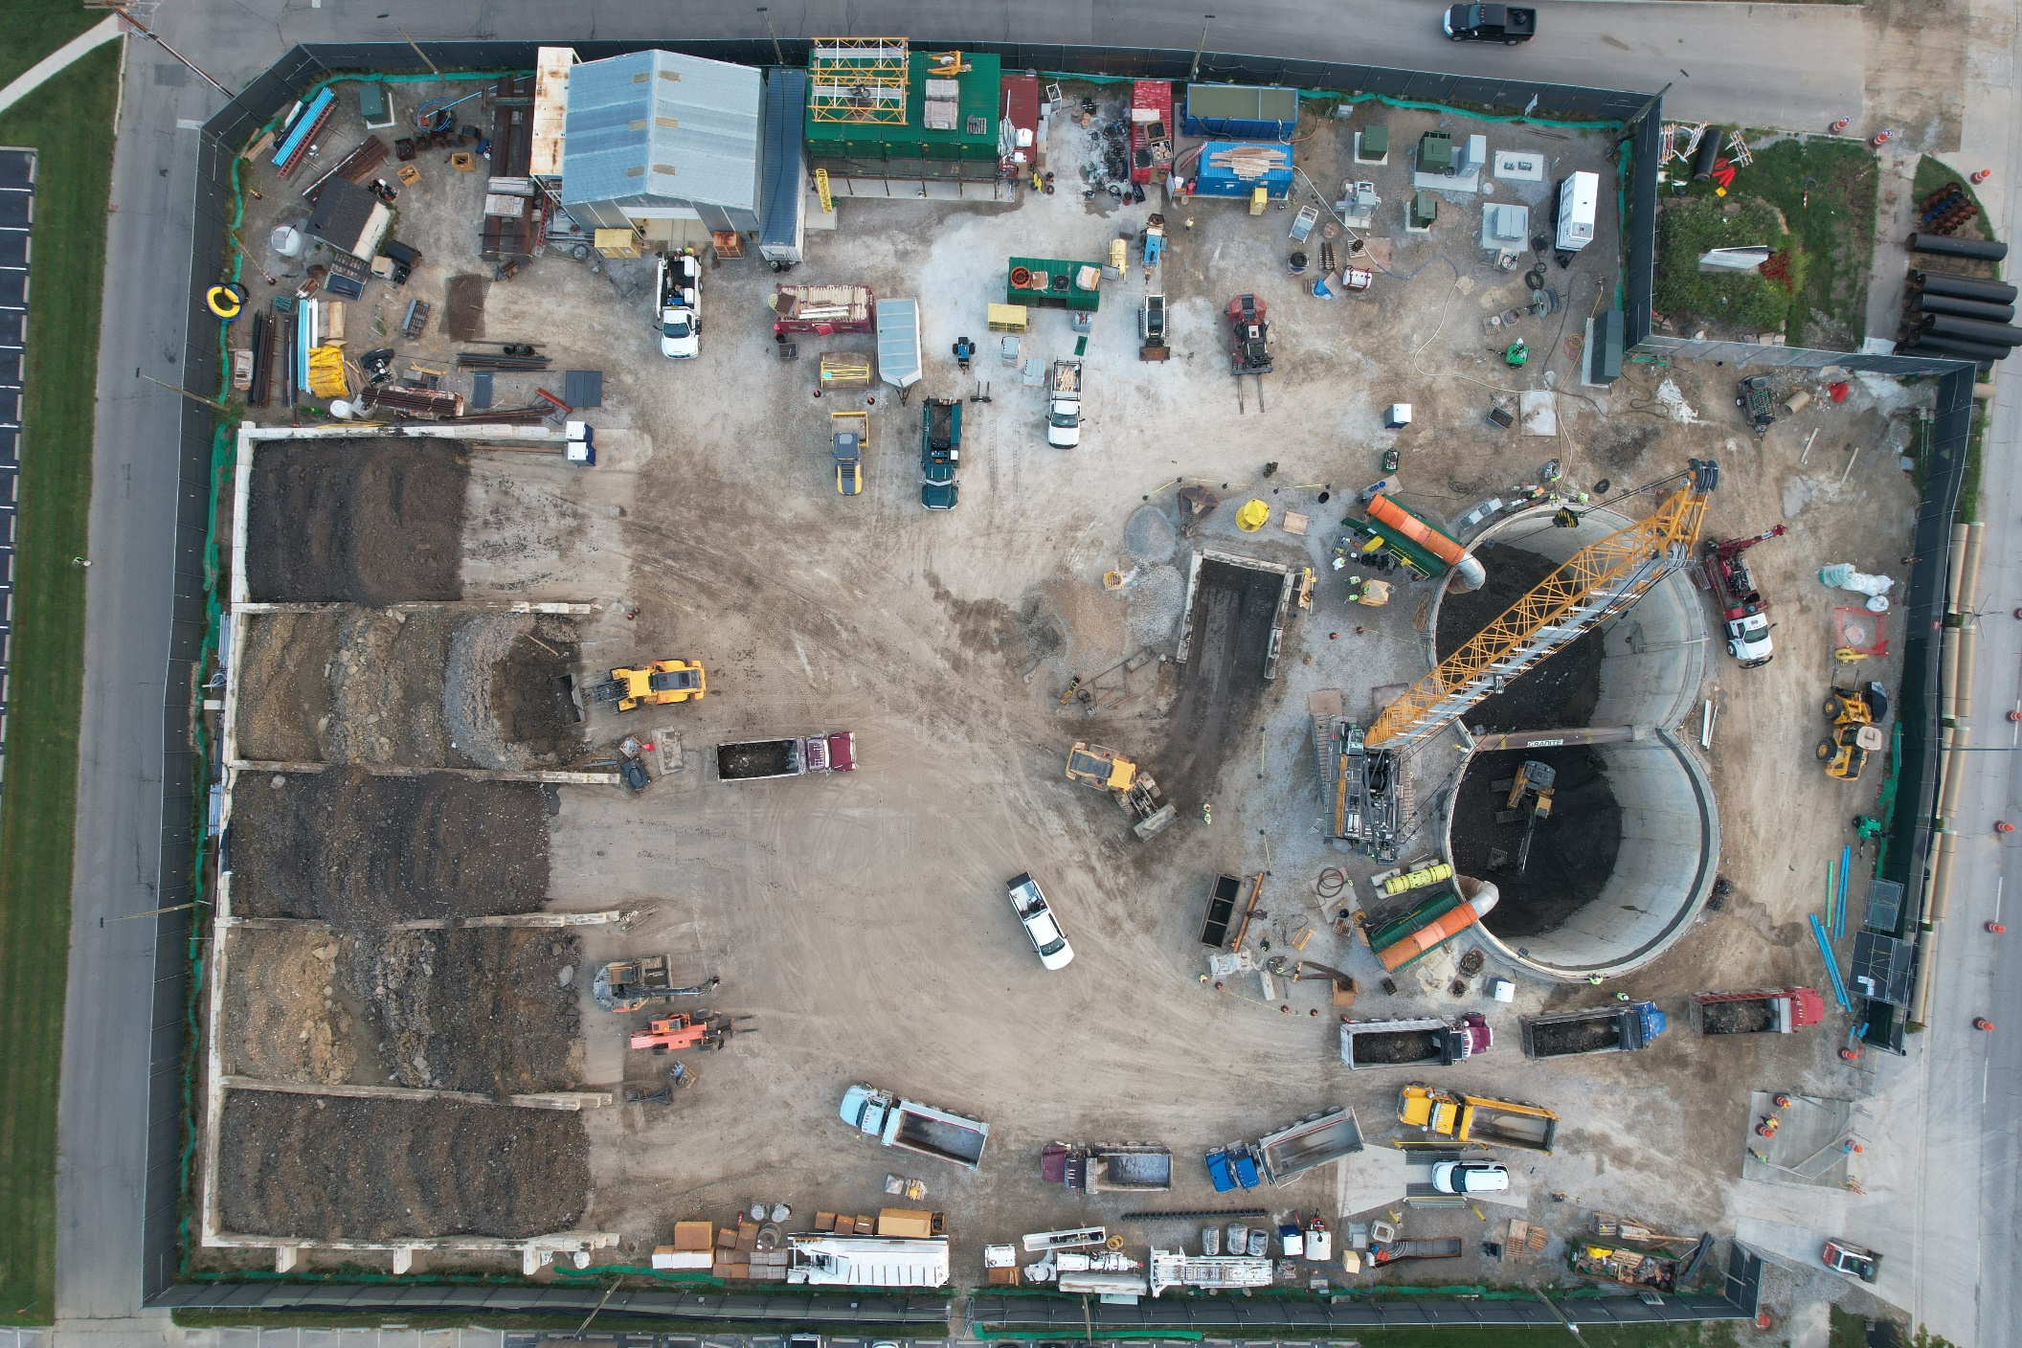
LOT
Gowdy Field Shaft Site

Slide 46
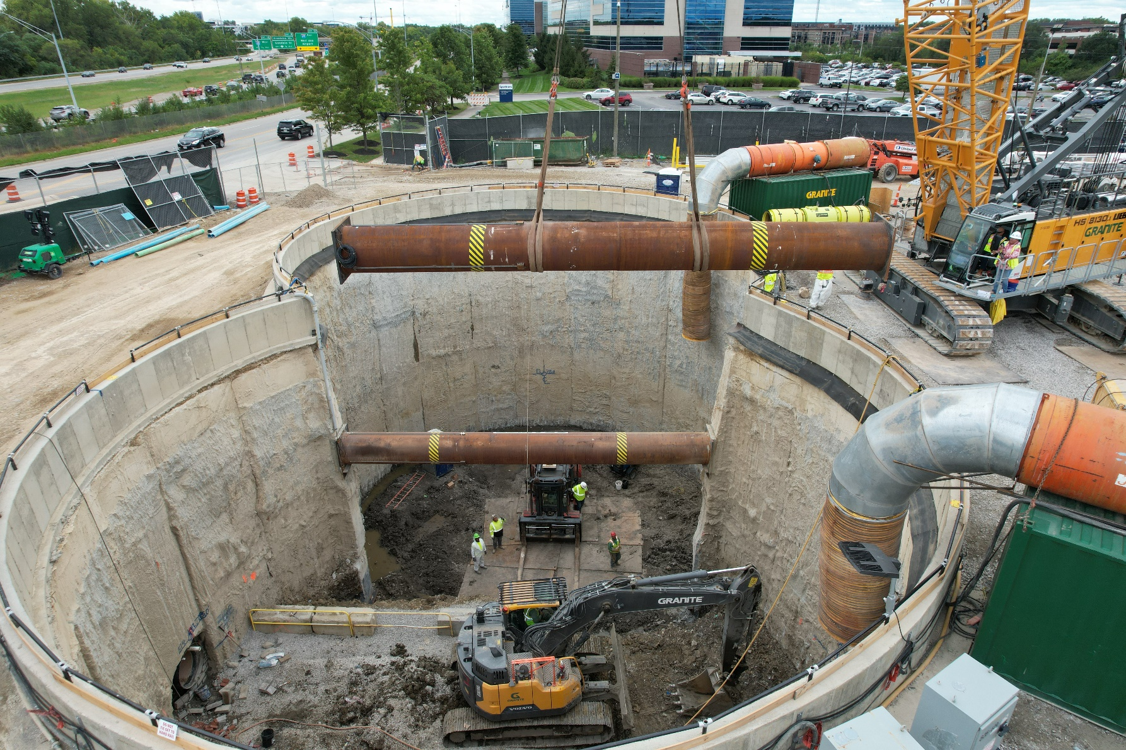
Gowdy Field
Shaft
Site
Gowdy Shaft Site

Slide 47
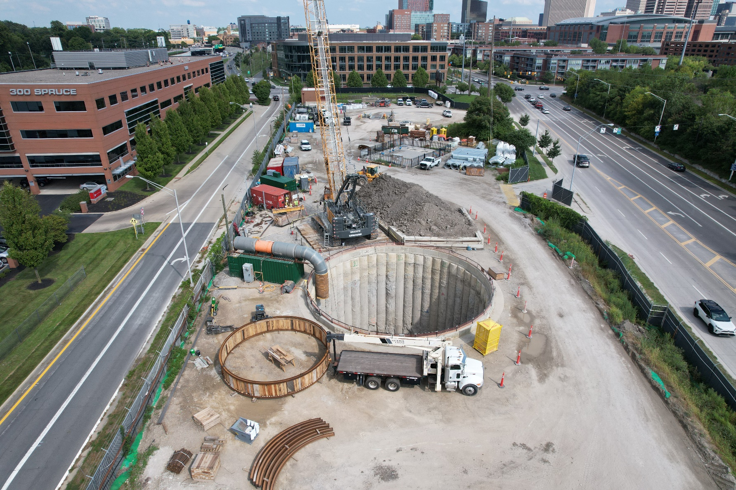
Gowdy Field
Shaft
Site
Vine Street Shaft Site

Slide 48
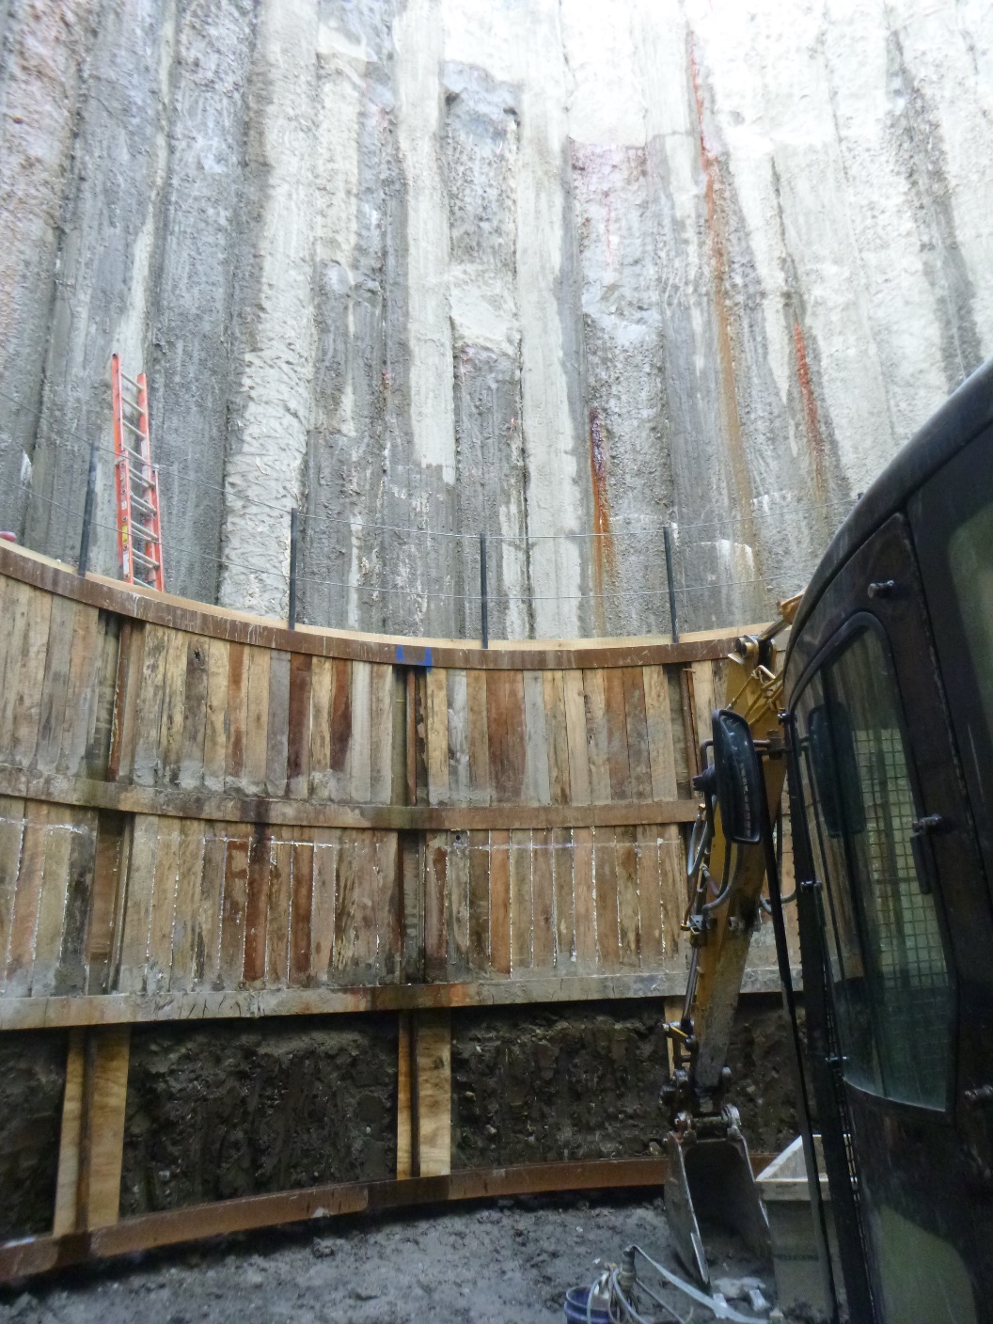
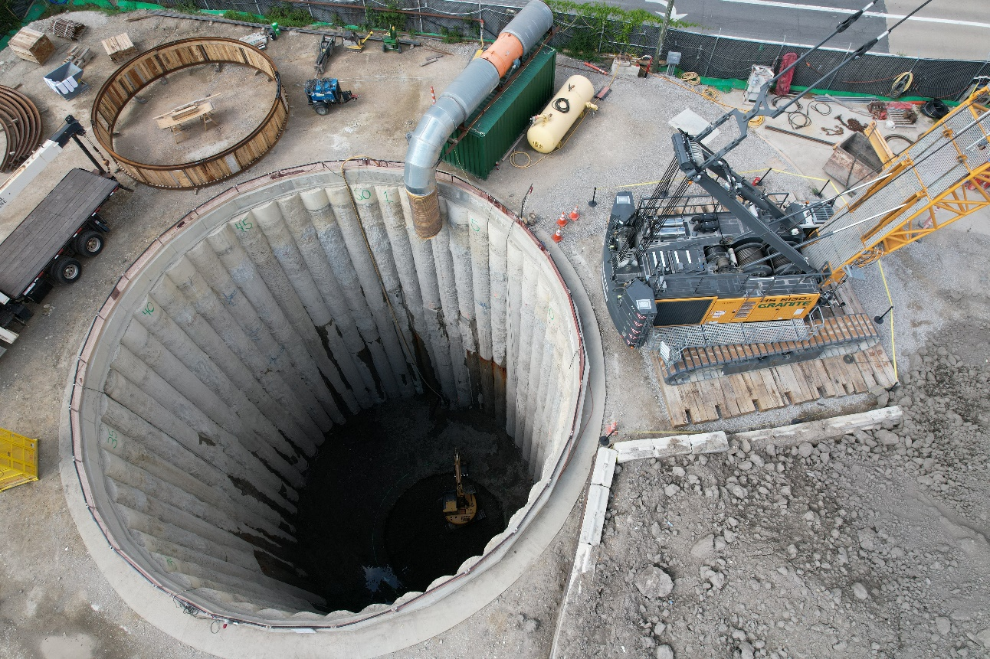
LOT
Vine Street Shaft Excavation

Slide 49
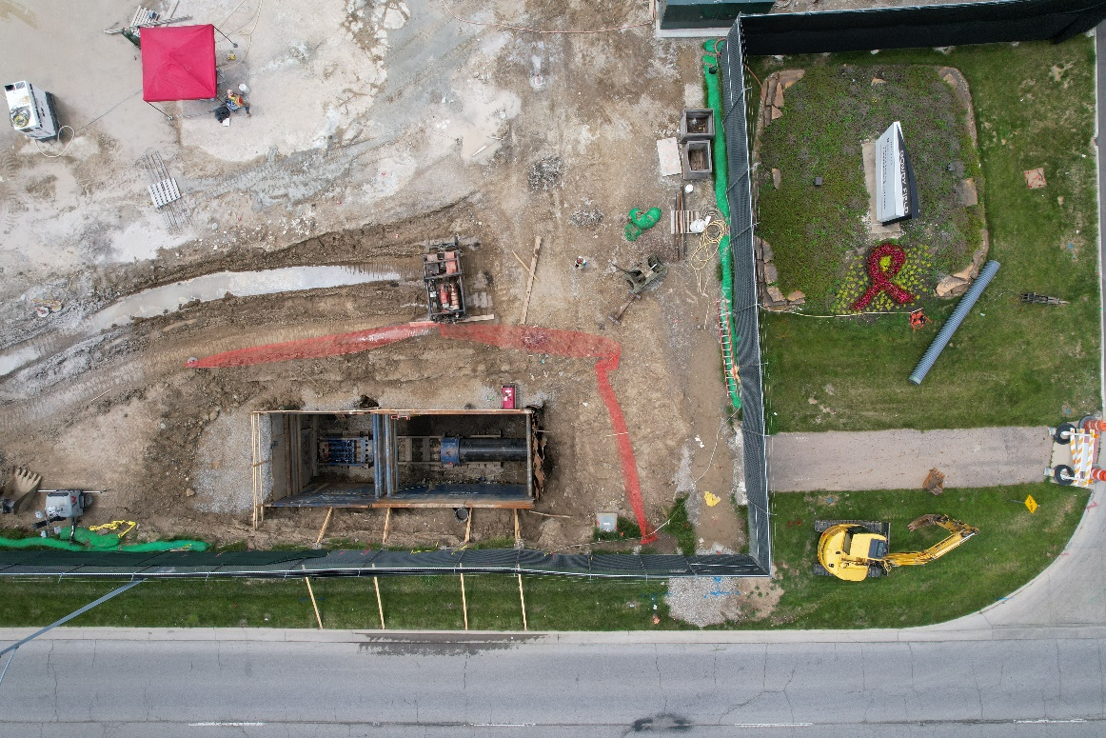
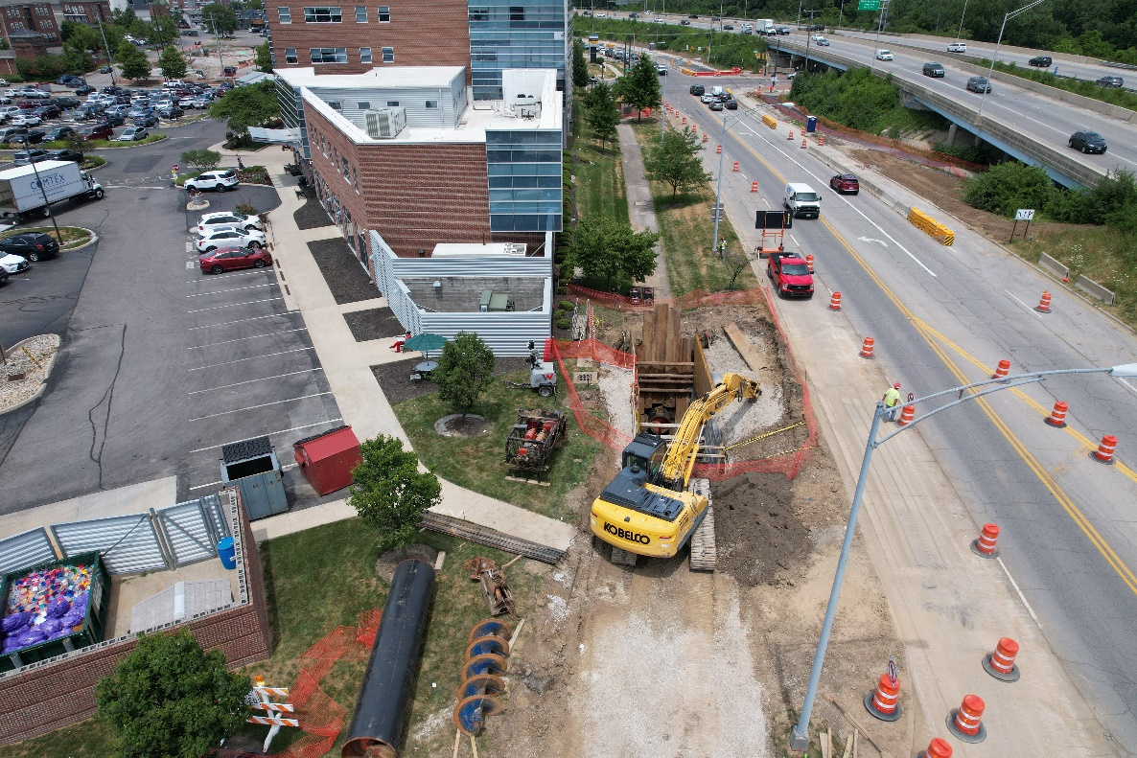
LOT
KST Installation

Slide 50
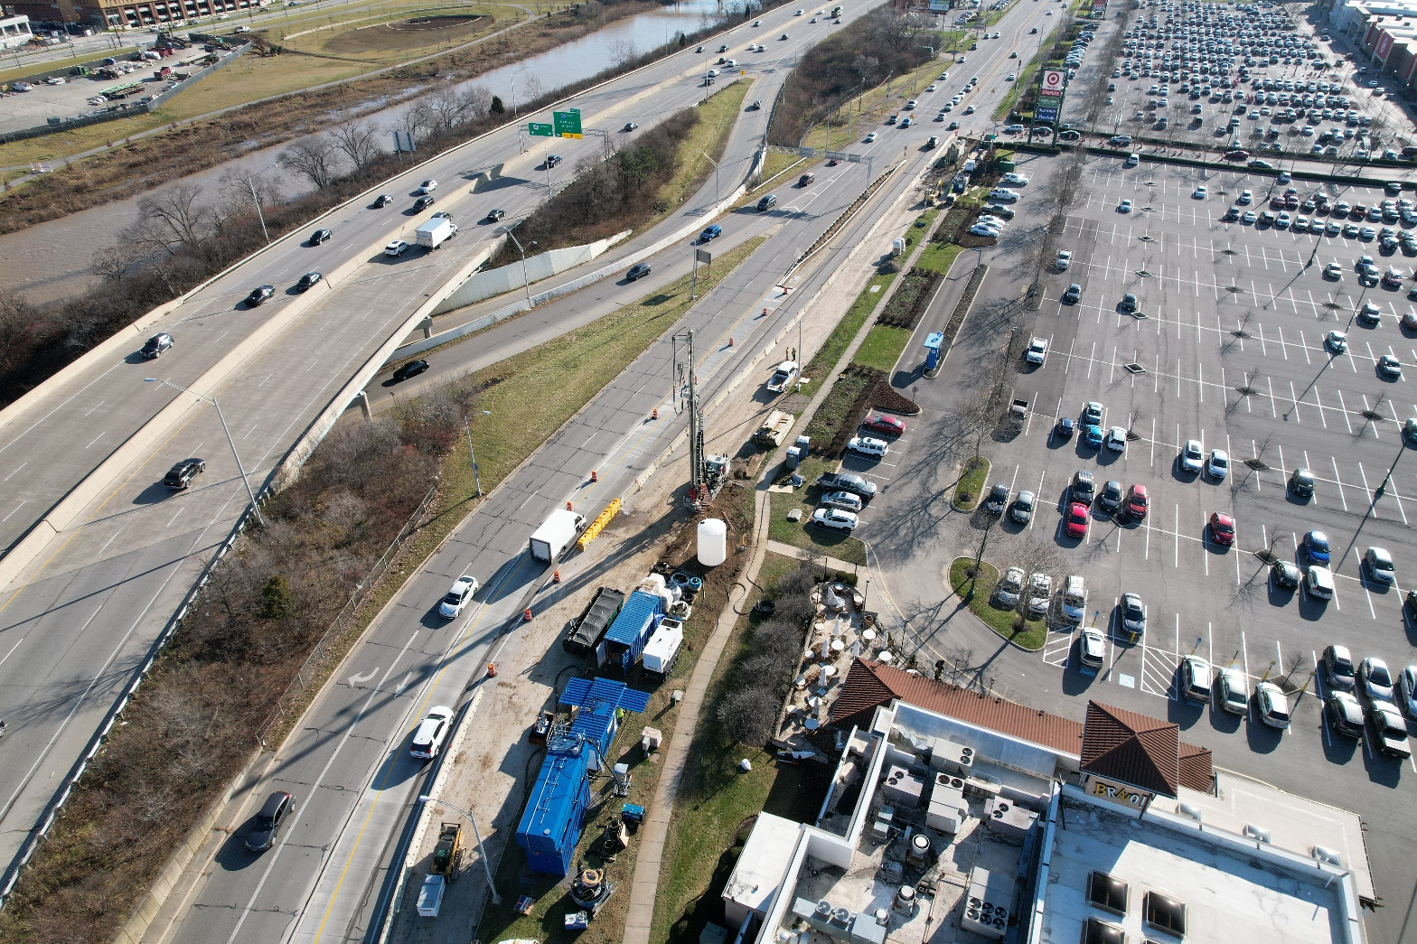
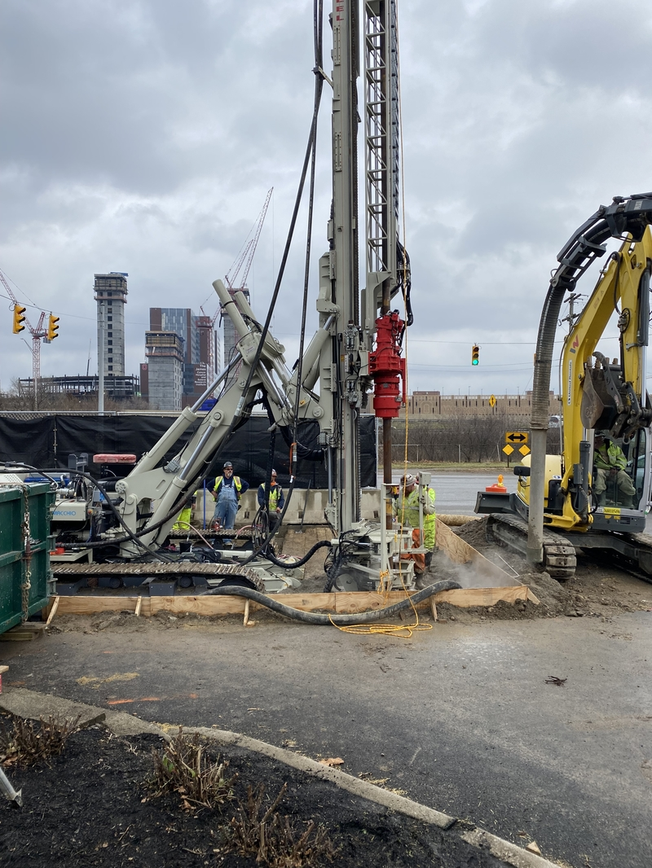
LOT
Ground
Improvement

Slide 51
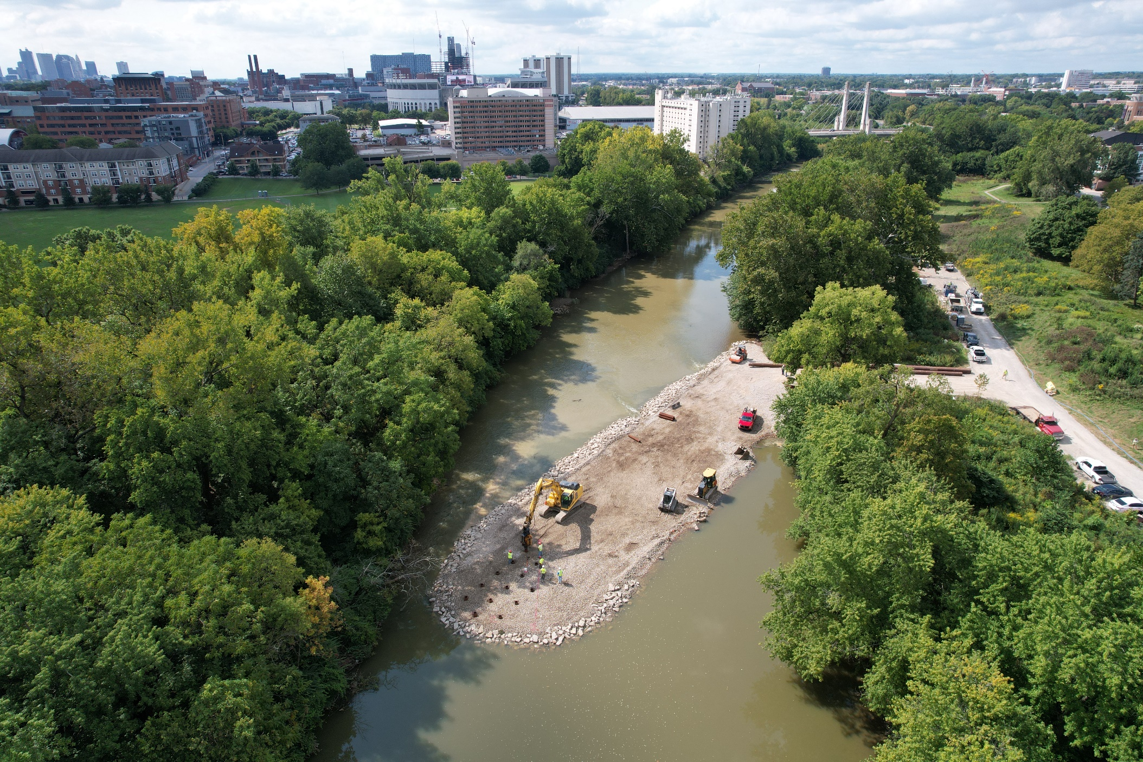
LOT
Ground Improvement:
Causeway Installation

Slide 52
LOT – CONSTRUCTION TEAM
DESIGN TEAM: DLZ / McMillen Jacobs / EMH&T /CDM Smith / Harvey Sorenson / CCG / Eagon
CONSTRUCTION MANAGEMENT: Black & Veatch / Anser Advisory (HR Gray) / Marsh-Wagner
CONTRACTOR: Granite Construction
QUESTIONS ???

