Slide 1
Instituting a DEI Program within a Utility
Diversity, Equity and Inclusion in Action
Kellie S. Watson, Equity and Compliance Officer

Slide 2
Louisville is committed to being a Resilient city by creating a Culture of Equity, Compassion, and Trust.
R = E + C + T

Slide 3
Our Shocks and Stresses
DRUG EPIDEMIC
LACK OF GOVERNMENT FUNDING
ECONOMIC
CRISIS
INFRASTRUCTURE
FAILURE
RIOT / CIVIL UNREST
LOW PERFORMING SCHOOL SYSTEM
DECLINE OF NATURAL /
BUILT ENVIRONMENT
POVERTY
INEQUITY
CRIME AND VIOLENCE
Source: Resilient Louisville Strategy Plan: louisvilleky.gov/resilience

Slide 4
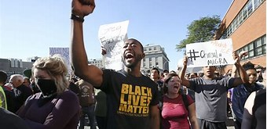
Civil Unrest
Civil unrest or civil disorder is a broad term used to describe unrest caused by a group of people, and can take many forms. The form of civil unrest that we are experiencing is sparked by a major event/events due to racial injustice, compounded by the current economic frustrations caused by COVID-19 pandemic.

Slide 5
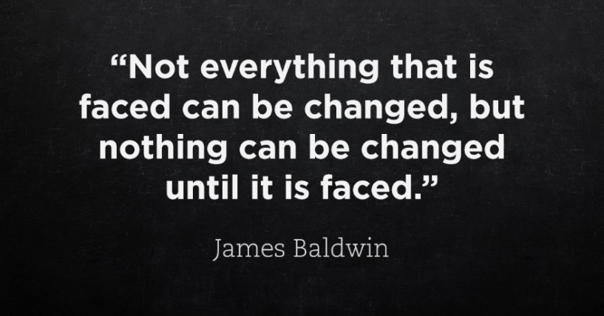
Challenging Times
During these times, it can be challenging to leave concerns at home, and the stress can affect your collaboration, relationships and productivity at work.
The best workplaces are those that have diversity of thoughts and ideas, but this can also lead to head butting in times of high stress or conflict.
Conflict can negatively affect the workplace culture and turn an external crisis into an internal crisis.

Slide 6
Steps To Respond:
Adhere to OSHA, this includes business continuity plans and emergency preparedness plan
Set the tone for appropriate behavior
Create a culture of diversity and inclusion
Following and educate employees on our process for conflict resolution
Understand community dynamics
Effective communication with employees

Slide 7
Community Healing
MSD and utilities are vital contributors to our communities
We must be a part of the healing of the community
Partnering with the organizations for equity and social justice

Slide 8
National Best Practice to Create Equity and Inclusive Culture
Normalize
A shared analysis and definitions
Urgency / prioritize
Operationalize
Racial equity tools
Data to develop strategies and drive results
Organize
Internal infrastructure
Partnerships

Slide 9
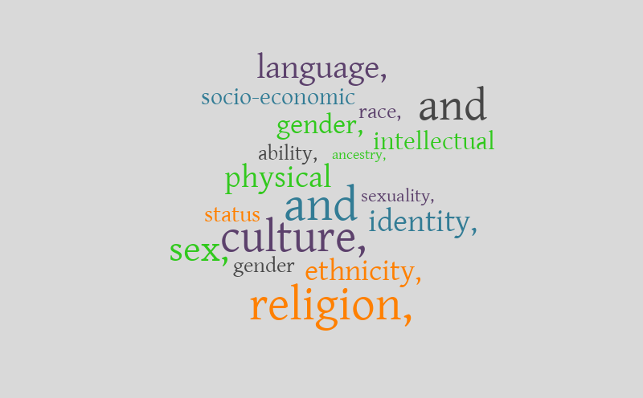
Normalize
Shared Analysis and Definitions
Setting Priorities
Normalize involves:
Training, including implicit or unconscious bias training
Educational opportunities
Courageous conversations
Employee Resource Groups

Slide 10
DEI Training and Educational Opportunities
Training involves more than the training that is legally required
We are moving passed just compliance, and on to removing barriers for full engagement so that everyone can be successful
Educational Opportunities will include Lunch and Learn sessions, speaker forums, and employee book club
Training will include but not be limited to the following:
Shared definitions
Implicit or unconscious bias
Race and Power
Equity Toolkit training

Slide 11
Courageous Conversations
Dr. Martin Luther King Jr. once said “ I am convinced that men hate each other because they fear each other. They fear each other because they don’t know each other, and they don’t know each other because they don’t communicate with each other, and they don’t communicate with each other because they are separated from each other…”
These conversations are designed to reconnect us across and through differences. The conversations aim to bring people together to share stories and experiences. By sharing stories we can begin to understand one another, our personal struggles and our collective struggles, and together commit to bridging the divide

Slide 12
Organize
Vision, Accountability & Sustainability Executive Director
Review, Approval, Alignment Executive Leadership
Planning & Development Core Teams/Work Groups
Implementation Department Equity Teams

Slide 13
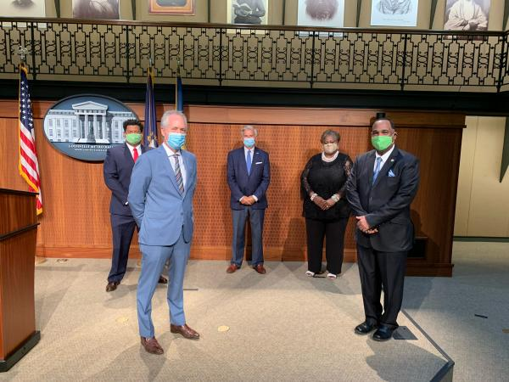
Role of Leadership
Create & support organizational buy-in
Call for authentic engagement
Commit to:
Implementation
Removal of barriers
Evaluation
Accountability

Slide 14
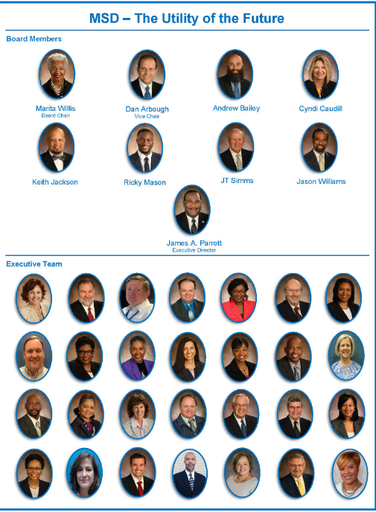
Role of Leadership
Overall
Create shared vision
Create the ability to achieve the vision
With Frontline Staff
Create awareness
Create sense of urgency
Build momentum
As Administrators:
Change policies, practices, programs
Establish accountability

Slide 15
Leaders Can Support DEI
People Support
Explain equity
Listen to concerns
Environmental Support
Create the right atmosphere for equity
Stating a clear case for equity
Ensuring the necessary infrastructure exists
Rewarding support

Slide 16
Internal Change Infrastructure
Establish Team to create organization equity goals and measurements Equity Action Plan
Each department nominates an Equity Liaison to work with Director on Department Equity Action Plan and also have input on the organization equity plan
Department Equity teams implement Department Equity Action Plans, the Courageous Conversations, and educational opportunities

Slide 17
Changing Minds
Most importantly, the best way to change attitudes is to change behavior
Attitudinal change tends to follow behavior change
Requires both short and long term approaches and commitment

Slide 18
Operationalize
Operationalize means turning equity theory to action by:
Using organizational assessments
Using equity tools
Using data to drive outcomes

Slide 19
Approaches
Transactional- are issue-based efforts that help individuals negotiate existing structures. These solutions “transact” with institutions to get a short-term gain for communities but leave the existing structure in place,
Transformational- are initiatives that cross multiple institutions that shift efforts towards pro-active solutions. These solutions alter the ways institutions operate thereby shifting cultural values and political will to create equity

Slide 20
Approaches

Slide 21
Examples of Approaches

Slide 22
Tools for Accountability and Equity
Accountability Tools can be used by the Leadership Team
Accountability agreements and/or performance appraisals
Departmental equity action plans
Equity goals included within the organization strategic plan
Equity toolkit

Slide 23
Purpose of the Toolkit
The tool is considered a national best practice to advance racial equity.
MSD is committed to advancing racial equity and is using this tool to address institutional discrimination.
The tool outlines a process that enables leadership, cross-functional teams, divisions, departments and employees to review policies, initiatives, programs, projects, budget issues, and other decisions which impact the organization with an equity lens.
By analyzing changes or new ideas, this tool will help mitigate unintended consequences and help advance racial equity.

Slide 24
What is an Equity Tool? Actively inserts equity into decision making process
Process
Product

Slide 25
What is an Equity Tool Process?
Data
Desired Results
Analysis of Data
Listen
Analysis
Community Engagement
Strategies for Equity
Action
Implementation
Communications and Accountability

Slide 26
Equity Action Plan
Equity Action Plan
Indicators
Outcomes and Actions
Timeline
Accountability
Performance Measures
Progress Report

Slide 27
Questions or Comments

