Slide 1

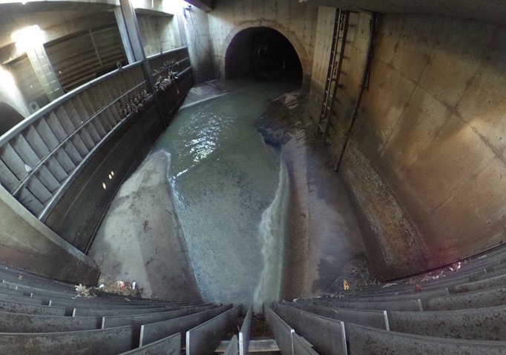
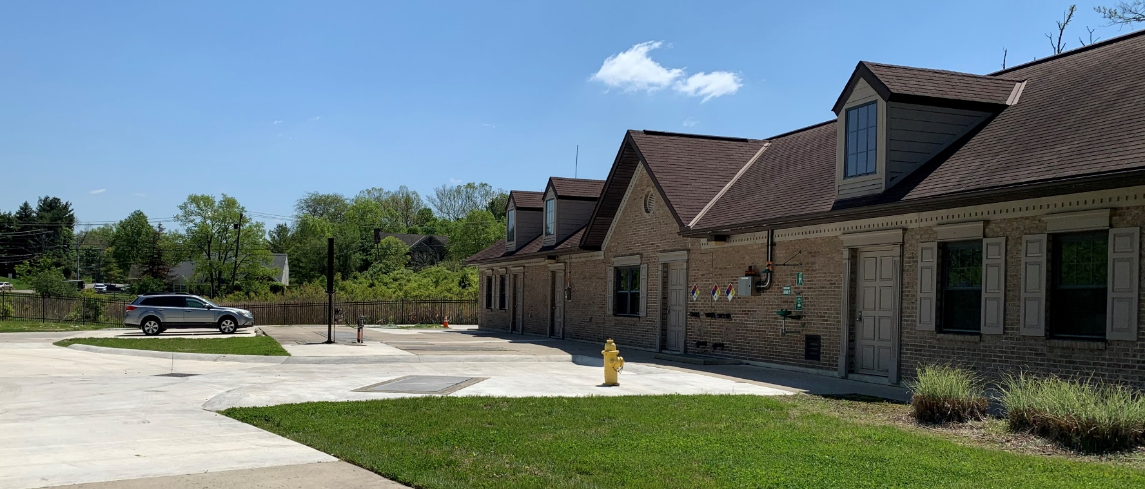
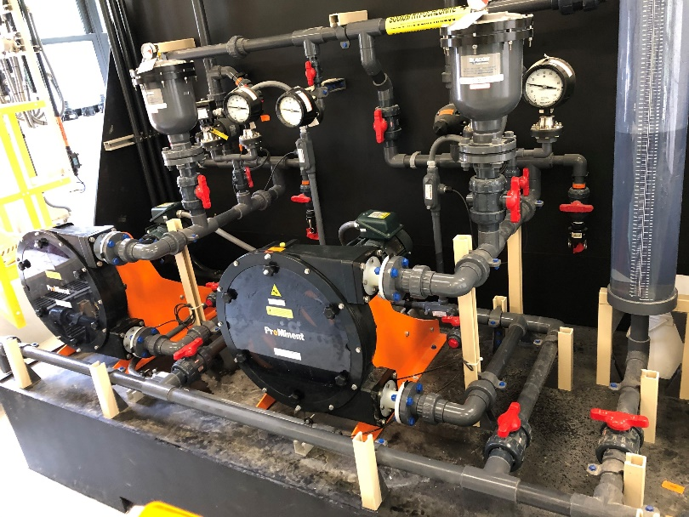
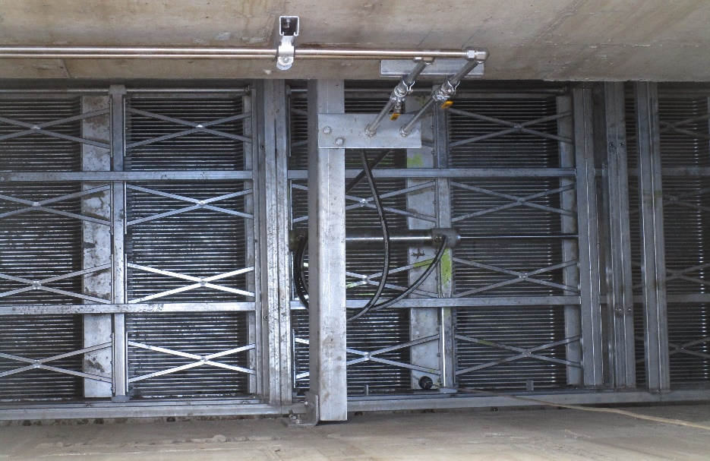
Assessing Performance and Upgrading a Twenty-Year Old HRT
Muddy Creek at Westbourne HRT Facility
September 27, 2022
Nick Jones, PE – Metropolitan Sewer District of Greater Cincinnati
Lindsey Hassenauer, PE – Hazen and Sawyer

Slide 2
Agenda
Muddy Creek at Westbourne HRT Improvements Project
Background
Improvements Project Objectives
Facility Assessment and Analysis
Design and Construction
Initial Operations and Conclusions

Slide 3
Background

Slide 4
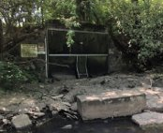

Muddy Creek at Westbourne HRT Facility – Background
Part of MSD strategy in the late 1990s to address CSOs
Prior to this facility, no treatment was provided for CSO 198
Design completed in 1997 to treat overflows from CSO 198 into Muddy Creek
Most treatment components located underground including a post-tensioned concrete settling and disinfection tanks
  1.74 MG total HRT tank capacity
Above ground structure designed to resemble a large residential building
  Control room, chemical room, and fan rooms
Became operational in 2001
No NPDES Permit limits

Slide 5
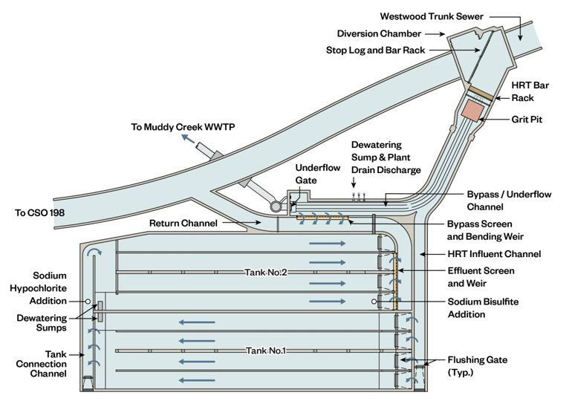
Muddy Creek at Westbourne HRT Facility – Background
Original 1997 Design – HRT
Provide treatment of some combined sewer overflows
Unmanned with gravity flow in and out
Automatic operations with passive underflow regulating gate to WWTP
Diversion structure to divert flow to new HRT Facility
Flow to HRT Facility divided into multiple flow paths
  Dry weather flow to Muddy Creek Interceptor
  Wet weather flow
    HRT facility to undergo settling, disinfection, and fine screening then discharge to CSO 198
    Bending weir & fine screening then discharge to
    CSO 198 (no settling or disinfection)
    Over wall in Diversion Chamber directly to CSO 198
    (no fine screening, settling, or disinfection)
Original Muddy Creek at Westbourne HRT Facility

Slide 6
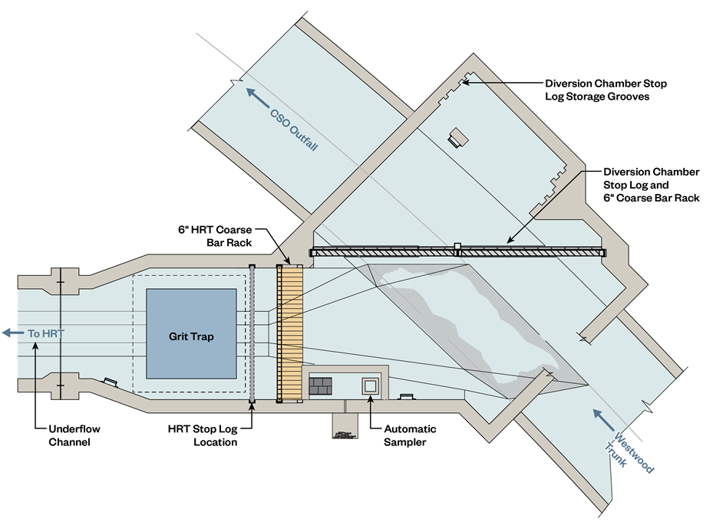
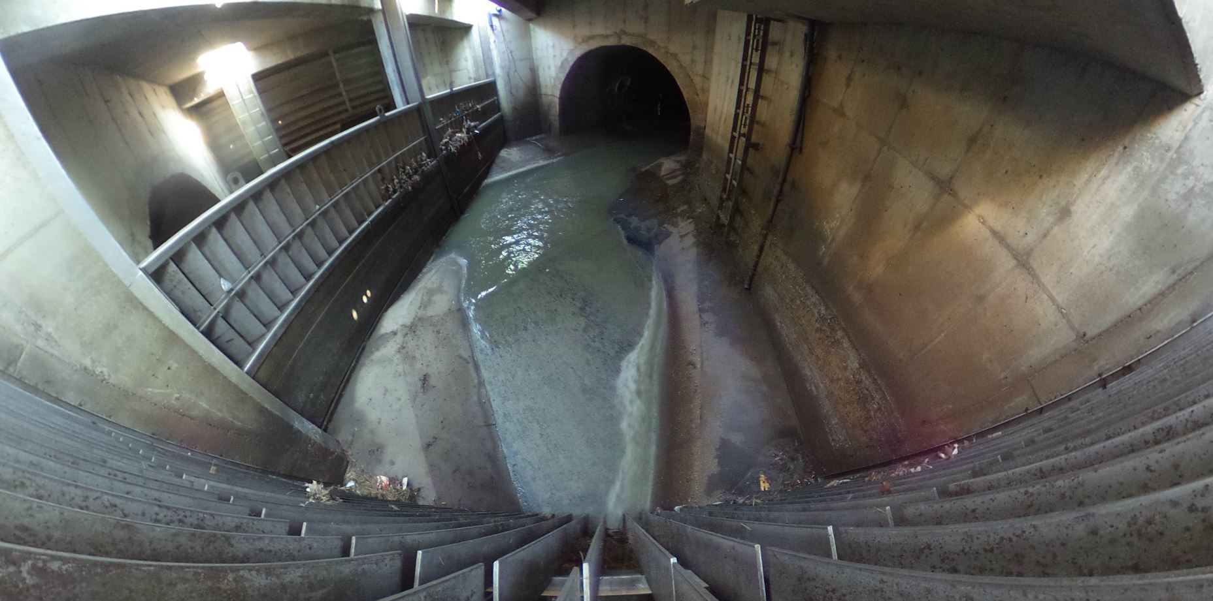
Muddy Creek at Westbourne HRT Facility – Background
Original 1997 Design – Diversion Chamber
Installed in the 15’x10’ Westwood Trunk Sewer (combined sewer)
Dry weather flow and increased combined flows diverted via stop logs to HRT Facility
Initial overflows went through coarse bar rack to CSO 198
(no settling or disinfection)
Higher overflows went above coarse bar rack to CSO 198
(no settling or disinfection)
Original Diversion Chamber

Slide 7
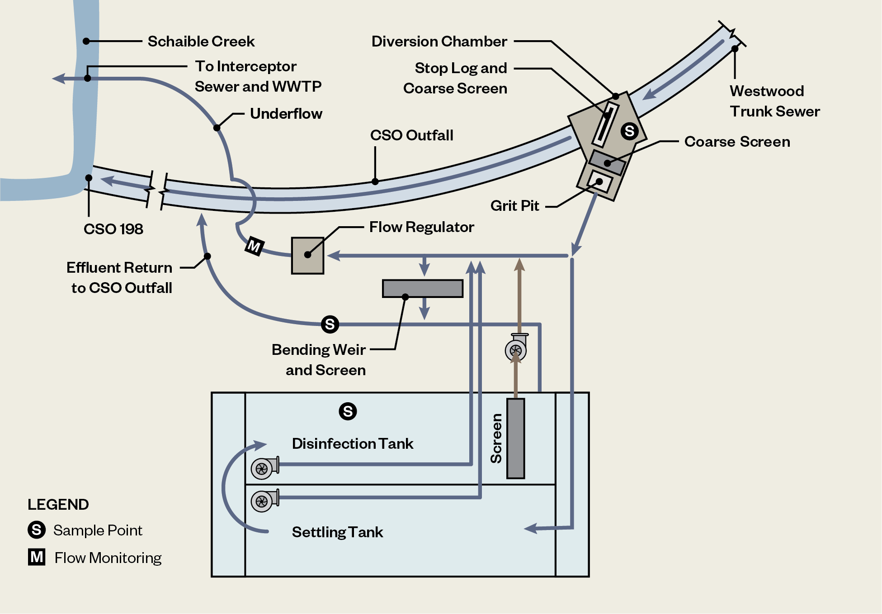
Muddy Creek at Westbourne HRT Facility – Background
Original 1997 Design Criteria
Q_{c}
Q_{U}
Muddy
Creek
Q₄
Q_{B}
Design Flow | CFS | MGD
Q_{C (Trunk Sewer)} | 1844 | 1192
Q_{4 (4 overflows/year)} | 244 | 158
Q_{T (Treatment)} | 79 | 51
Q_{B (Bypass)} | 130 | 84
Q_{U (Underflow)} | 35 | 23
Dry Weather Flow | 2.92 | 1.90
Q_{T}
Regulate Underflow
to 7.8 cfs / 5 MGD

Slide 8
Muddy Creek at Westbourne HRT Facility – Background
2018 Concerns
Increased incidence of SBUs upstream of HRT during extreme wet weather events
Reviewed existing documentation and worked with O&M staff to understand existing facility issues
Equipment | Facility Issues
Diversion Chamber | Coarse bar rack had potential to blind during peak flow Fixed diversion wall could not be adjusted
Underflow Regulating Gate | Passive float-controlled slide gate, no ability to modulate with downstream capacity Debris could catch on float and jam slide gate open
Settling and Disinfection Tanks | Potential for short circuiting in unbaffled tanks
Chemical Storage and Feed Systems | Dosing was not controlled without accurate flow metering Disinfection (chlorination) injection point in second settling tank
Settling Tank Effluent Fine Screening | Vertical screen blinded rapidly during wet weather events Screenings pump does not pull all floatables – requires vactor removal Screens washed down after each event to prevent film buildup & caking
Bypass Bending Weir and Fine Screening | Mechanical screen blinded rapidly during wet weather events and required cleaning Bending weir was frequently inoperable with hydraulic system issues Bypass flow exhibited hydraulic jump and reduced capacity
Instrumentation and Control | Limited flow measurement capability and measurements inaccurate Limited remote monitoring and control capability
Notes:
Increased incidence of SBUs during extreme wet weather events

Slide 9
Improvements Project Objectives

Slide 10
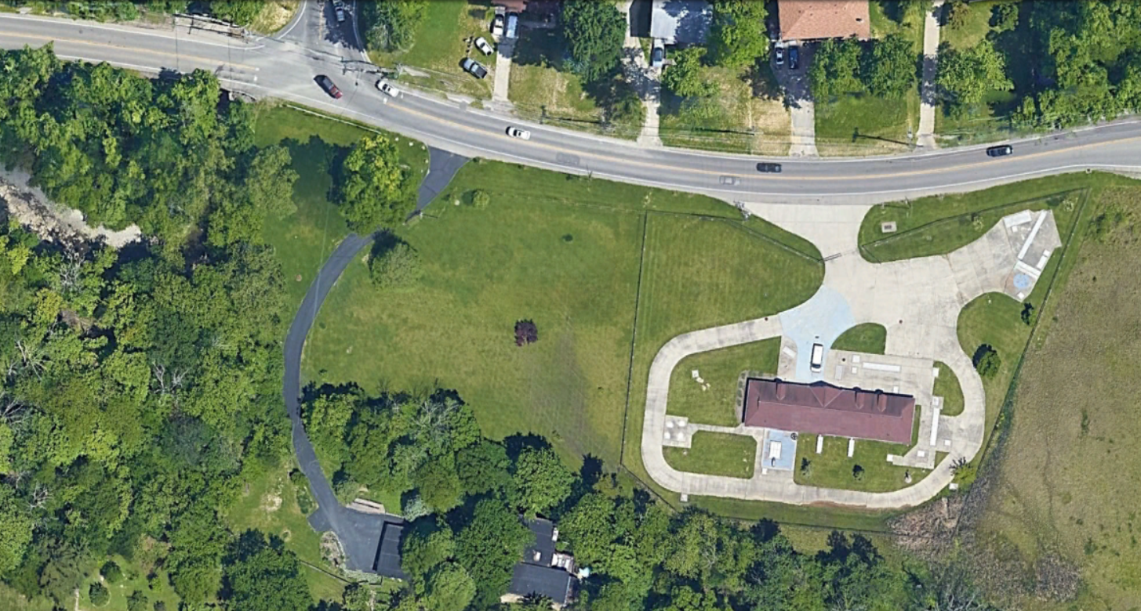
Improvements Project (2017) Objectives
Consent Decree Bridge Project
  Between Consent Decree Phase 1 and Phase 2
  Originally scheduled to be Substantially Complete by 12/31/2019
Improve Performance of Diversion Chamber
  Reduce potential for upstream sewer backups (SBUs)
Improve HRT Facility wet weather performance
  Simplify flow routing
  Improve screening and disinfection
  Increase capacity for settling and disinfection
  Improve flow monitoring and control
Construction budget – $4.125M
CSO 198
Muddy Creek at Westbourne HRT Aerial
Notes:
Westwood trunk sewer from right to left can exceed capacity.
Collect new data to help understand operations

Slide 11
Facility Assessment and Analysis

Slide 12
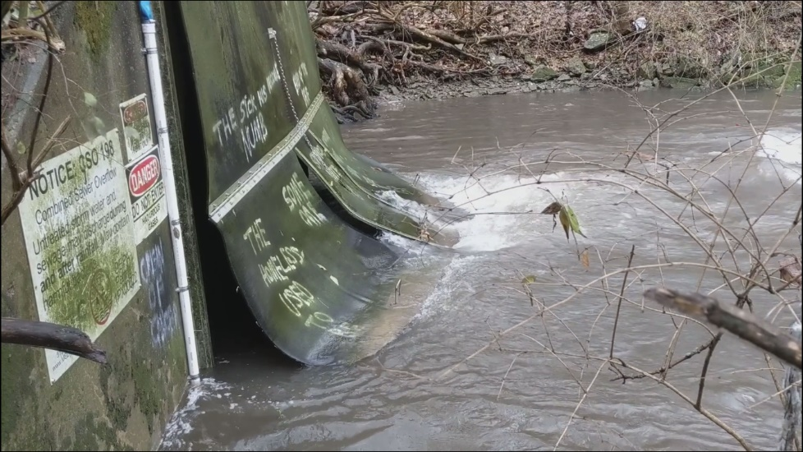
Hydraulic Evaluation
Hydraulic evaluation objectives:
  Evaluate the impact of the receiving stream hydraulics on upstream HGL
    Tailwater conditions during wet weather limiting hydraulic capacity and causing SBUs
  Evaluate the impact of the Diversion Chamber and HRT facility on upstream HGL
    Hydraulic bottle necks limiting hydraulic capacity and causing SBUs
HEC-RAS (by others)
PC-SWMM (by others)
Hydraulic Profile (HazenPro)
Computational Fluid Dynamics (CFD) (Flow3D)
CSO 198 Discharge with High Tailwater Conditions

Slide 13
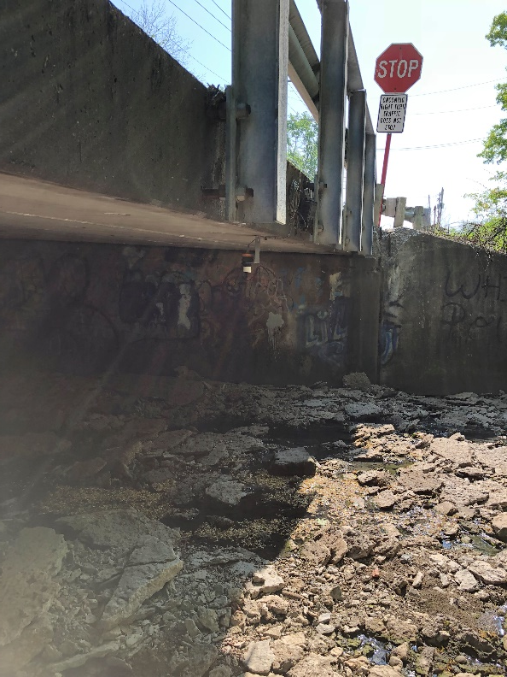
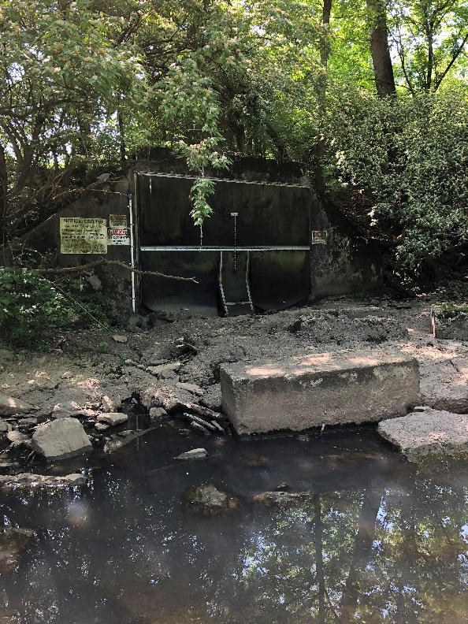
Hydraulic Modeling Performed by Others
HEC RAS/CFD in Receiving Stream (Effluent)
  Widen bridge downstream of CSO 198 outfall (Sidney St Bridge)
  Lower the streambed between CSO 198 and downstream bridge
  Little benefit for the cost
CFD modeling
  Wingwall concept to isolate upstream Schaible Creek flow away from CSO 198 outfall
  Little benefit for the cost
PC-SWMM Model in Trunk Sewer (Influent)
  Impact of HRT on upstream SBUs under design storm conditions
    2 ft of headloss through HRT
  Impact of diversion chamber scenarios on upstream SBUs
    Blinded bar rack above diversion wall
Sidney St Bridge
CSO 198 Discharge
(Muddy Creek headwaters)
Notes:
Flow from two creeks converging at CSO
-Model results indicate that removal of the Sidney Road bridge restriction has a nominal impact on anticipated backwater during the typical year through 5-year design storm events. The impact at larger design storm events increases backwater elevation by over 1 foot for the 25 and 100-year events. Although costing was not performed, modifications to eliminate or mitigate impacts of the Sidney Road Bridge restriction were deemed infeasible due to the expected magnitude of capital costs and minor improvement (lowering) of the backwater elevation at the CSO outfall.
-Stream bed improvements from CSO 198 to the Sidney Road bridge to lower the stream bed elevation were also considered, but deemed infeasible for the same reasons.
-The addition of a wingwall to divert upstream creek flows away from the CSO 198 outfall has a small impact on tailwater elevations for each return interval peak flows (i.e. 5-year storm). Similar to with the Sidney Road Bridge restriction, this alternative was deemed infeasible due to the potential time for implementation (extensive permitting, site assessments, etc.) and anticipated high construction cost.

Slide 14
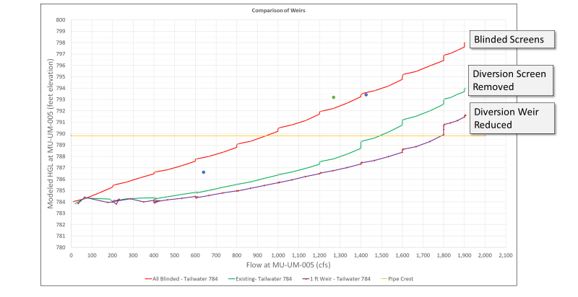
Remove Coarse Bar Rack on Diversion Wall
Goal: Lower HGL Entering HRT
Simulations with blinded coarse bar racks nearly match upstream levels during two historic SBU events
Typical year storm peak Q
SBU Elev. ~ 790
Remove stop plates at peak flow to prevent SBUs at 1800-1900 cfs (Trunk Sewer Capacity)
Remove coarse bar rack in Div. Chamber to eliminate SBUs for 1300-1400 cfs
Notes:
Model results indicate that high creek tailwater elevations (i.e. 784.00 ft) coupled with blinded bar racks in the Diversion Chamber significantly increase the hydraulic grade line (HGL) within the trunk sewer and the potential for upstream SBUs. Blinded bar racks increase the water surface elevation in the upstream sewer by four to five feet relative to the condition where there is no bar rack on top of the Diversion Chamber stop logs. Simulations under this condition nearly match measured conditions upstream during a storm event on 4/16/2017 where basement flooding occurred (i.e. approximate elevation 793.50 ft at flows above 1400 cfs). The basement elevations of nearby and upstream homes range between 788 ft and 792 ft. Simulations also suggest that reduction of the height of the stop logs / diversion wall could significantly reduce upstream water surface elevations during higher flows. For example, reducing the stop logs / diversion wall to one foot above invert at higher flows approaching the capacity of the Westwood Trunk Sewer (approximately 1900 cfs), would result in a reduction in upstream water surface elevation of two to three feet.
Based on these results, Hazen began evaluating alternatives to reduce the hydraulic limitations in the Diversion Chamber, which included both bar racks and a diversion wall structure, but with provisions to remove as much of these structures as possible (e.g. latches on screens and gates in wall to release) during storm events that result in high water levels in the Diversion Chamber (and upstream).

Slide 15
HRT Hydraulics
Influent Sewer
CFD and Hydraulic Model
Return Channel
With Influent Weir
to CSO
HRT Influent
HazenPro
Supercritical flow and hydraulic jump within return channel
Eliminate bypass & flow restriction through HRT tanks
Eliminate influent weir to increase flow to HRT tanks
At 165 cfs to HRT, WSE at top of diversion chamber wall
CFD
Notes:
HazenPro showed Supercritical flow in the trunk sewer from the return channel junction to the CSO outfall, return channel, and effluent channel, due to channel geometry. The supercritical flow regime creates a significant amount of headloss and thus reduces the flow capacity through the HRT. – shallow at higher velocity (dip in CFD line). Creates a hydraulic jump in the return channel.
Removed influent weir – no longer measuring flow from level, installed area-velocity flow meter in influent channel instead
Improved screens so less screen blinding = more capacity

Slide 16
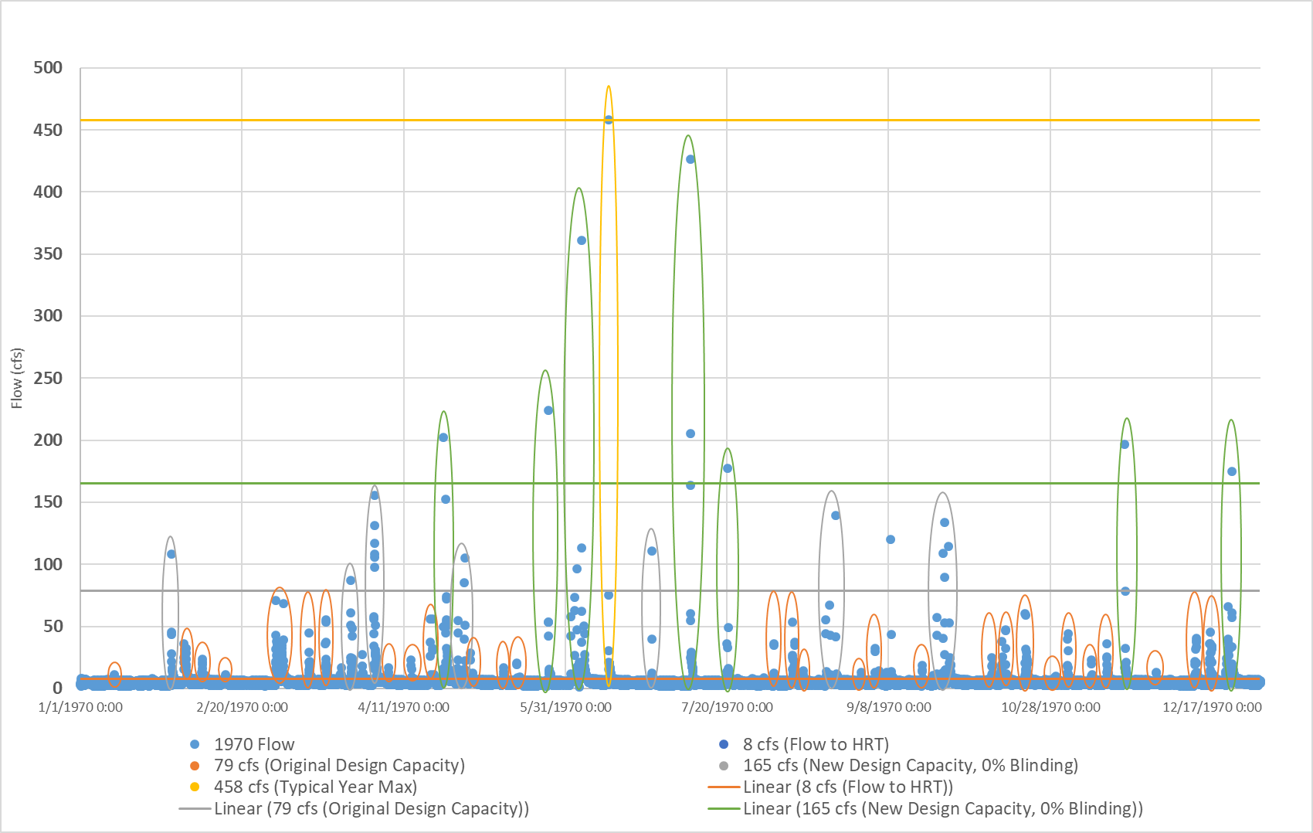
Typical Year Flows / Storm Events
458 cfs
Approx. Storm Count
8-78 cfs | 29 storms
79-164 cfs | 8 storms
165-457 cfs | 7 storms
458 cfs | 1 storm
PC-SWMM System-Wide Model quantified typical year flows and HRT activations
With 165 cfs HRT capacity, 8 storms will overflow Diversion Chamber Wall
165 cfs
79 cfs
Notes:
8 cfs = underflow capacity
79 cfs = original treatment capacity
165 cfs = increased treatment capacity
458 cfs = typical year peak flow

Slide 17

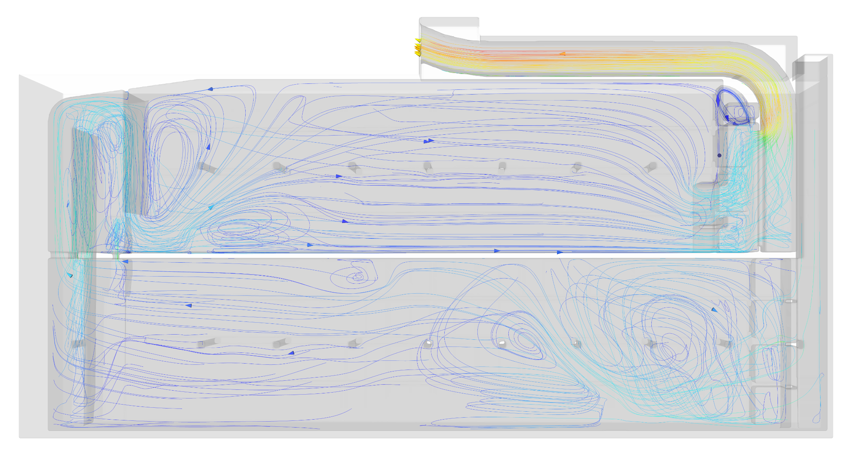
CFD Modeling to Optimize Disinfection
Increase Detention Time with Flow Baffling and Bending Weir Removal
CT = Conc. X Time
Original Chlorination Point Between HRT Tanks 1 & 2
Remove Bending Weir and Screen from HRT Effluent
Less chemical
More time
Tank 2
Alternative | T10 Contact Time | Target CT Dose
165 cfs with New Baffles | 953 sec (15.9 min) | 125 mg-min/L
Tank 1
Relocate Chlorination Point Upstream of HRT Tank 1 Influent
Evaluate Different Baffle Arrangements to Avoid Hydraulic Short-Circuiting
Notes:
CFD modeling showed some hydraulic inefficiencies in the existing configuration with flow short-circuiting from influent to effluent. Our analysis considered baffles to redirect concentrated flow to better use the full tank volume and increase the T10 contact time, which is the minimum contact time for 90% of the flow.

Slide 18
Design and Construction

Slide 19
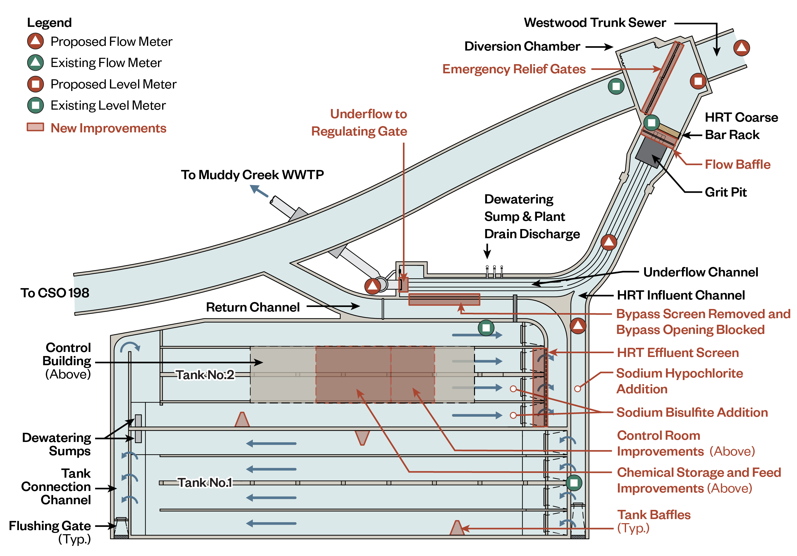
Improvements Overview

Slide 20
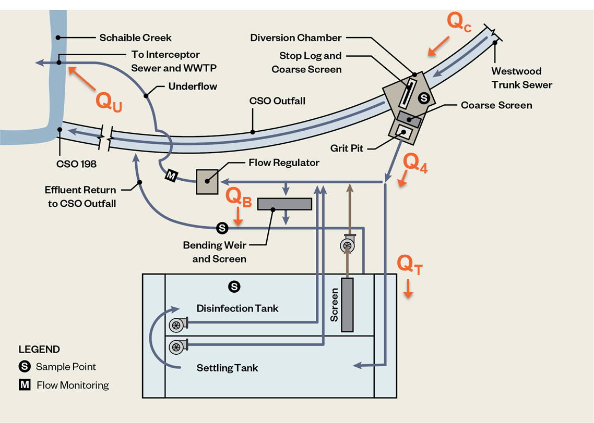

Increase Hydraulic Capacity from 79 cfs to 165 cfs
Simplify Process and Treat Additional Flow through HRT
Previous Criteria
HRT peak flow – 79 cfs (Q_{T})
(settle, disinfect, screen)
Bypass peak flow <130 cfs (screen)
Underflow peak flow – 7.8 cfs
Remove bending weir and screen
Simultaneous Settling/Disinfection
HRT peak flow – 165 cfs (Q_{T})
(settle, disinfect, screen)
Underflow peak flow – 7.8 cfs
Eliminate bypass flow (Q_{B})
Disinfection
(move upstream)
Dechlorination
(same location)

Slide 21
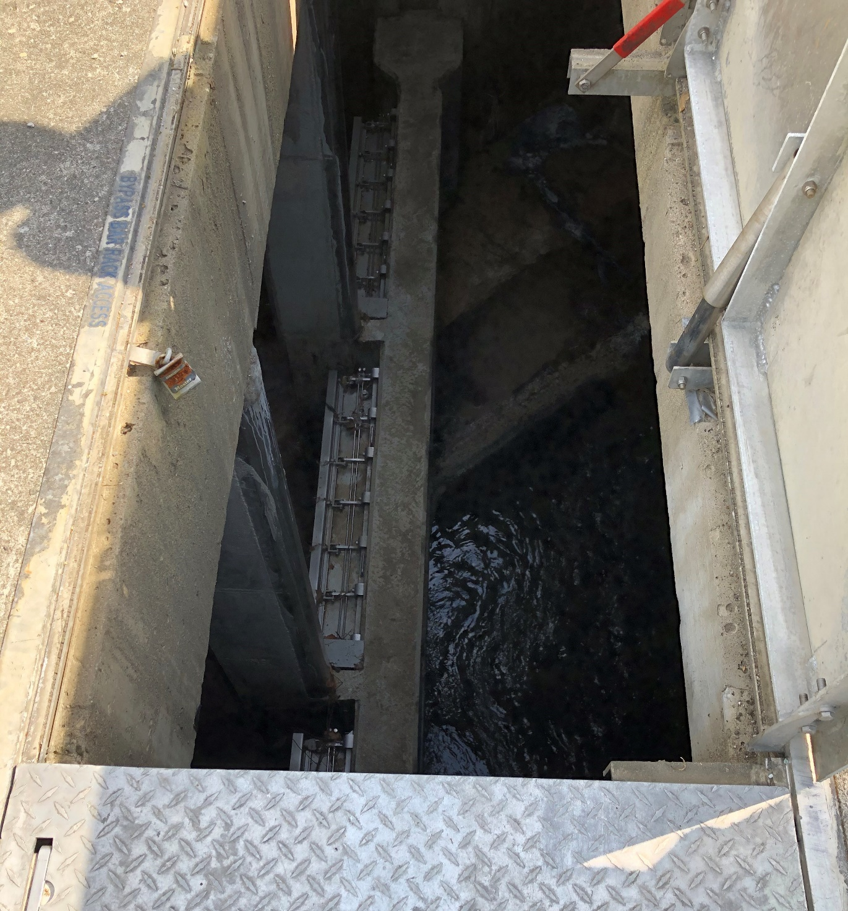
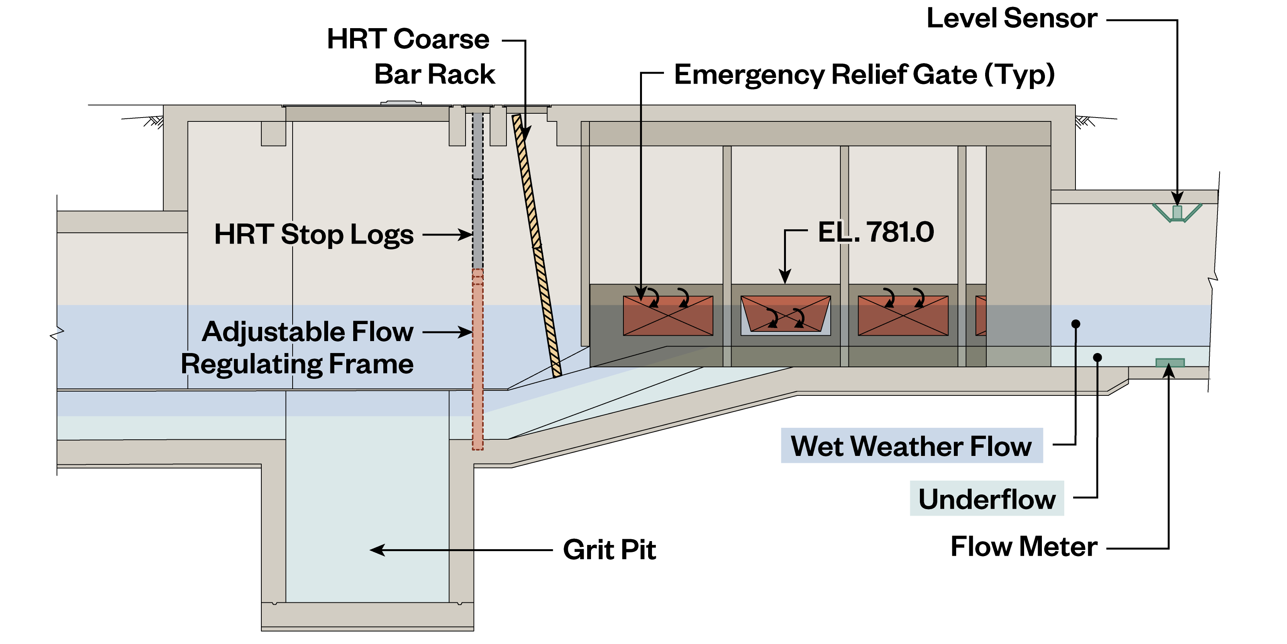
Emergency Relief Gates in Diversion Chamber
Relieve Extreme Flows to CSO to Protect Customers from Upstream SBUs
Four hydraulically-actuated emergency relief gates
New flow meter and level sensors upstream of Diversion Chamber
Regulate high flows into HRT with flow regulating plate after screening
Top of Emergency Relief Latching Flap Gates

Slide 22
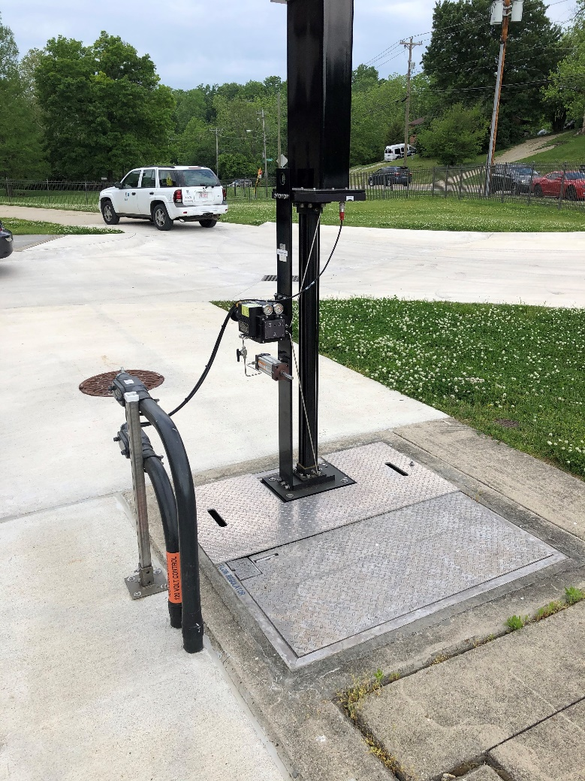
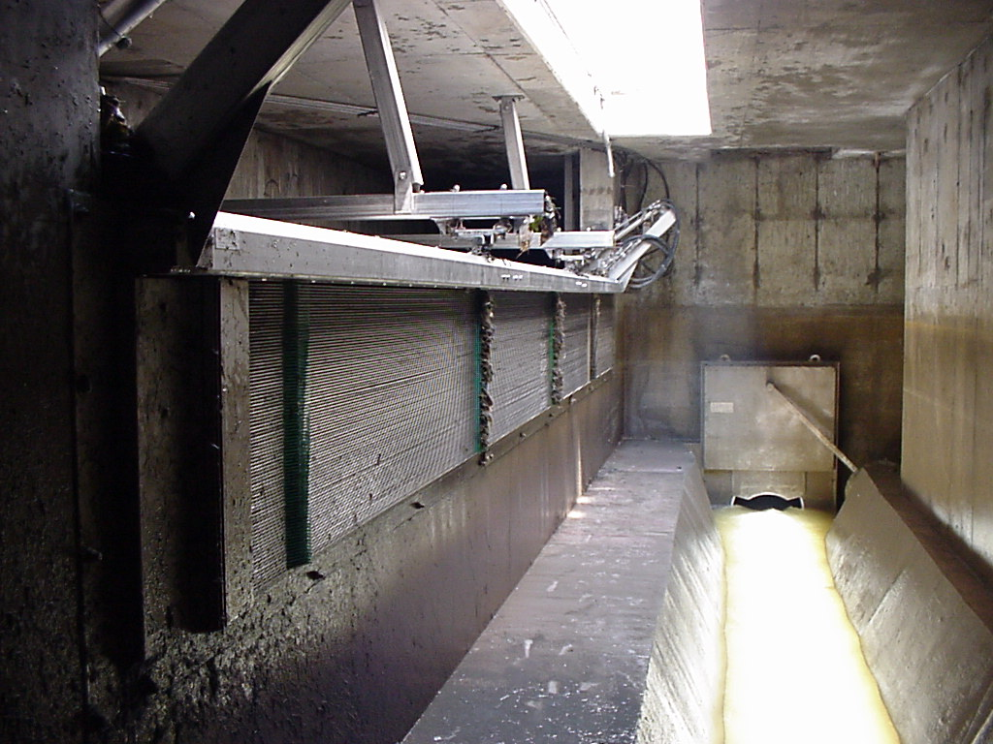
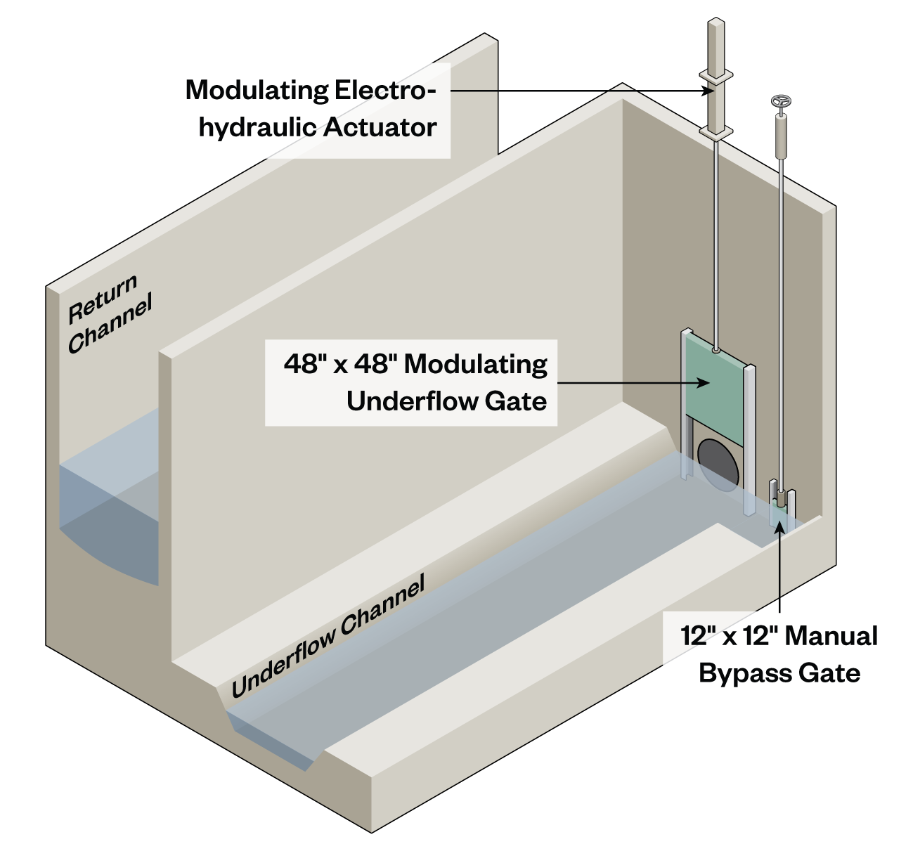
Control Underflow to Muddy Creek Interceptor
Maximize Flow to Treatment
Remove bypass screen and bending weir and fill opening
Remove existing float-controlled underflow gate and install new modulating slide gate
New flow meter downstream of underflow gate
New Electro-hydraulic Actuator on New Underflow Gate

Slide 23
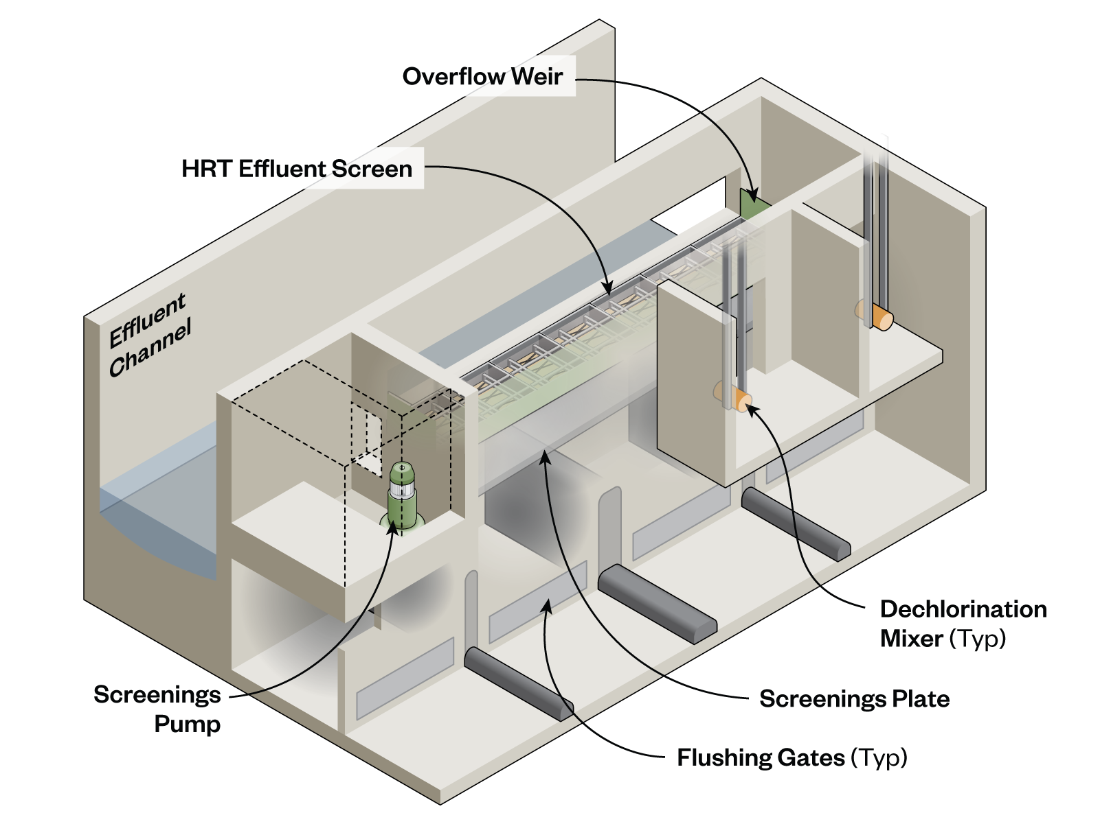
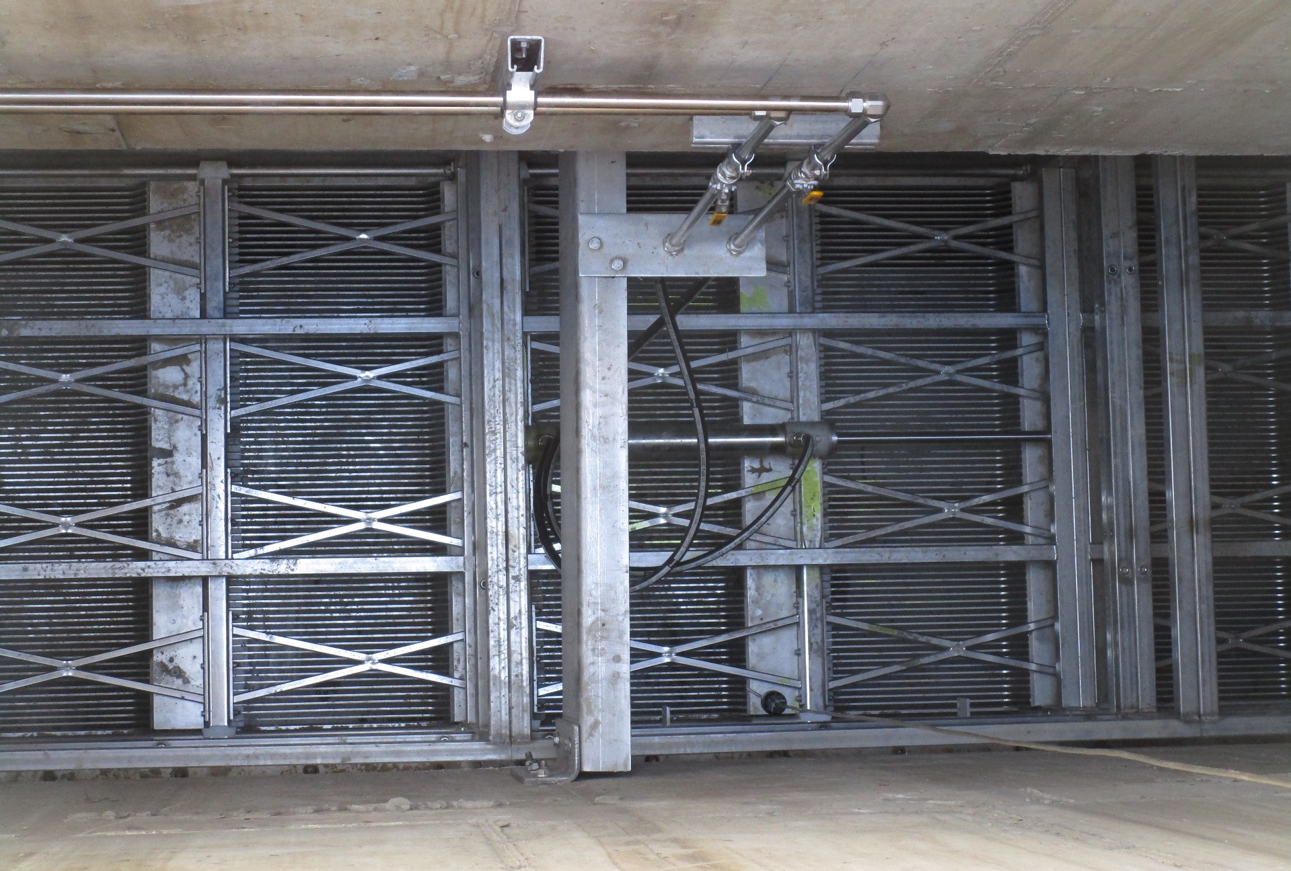
New Effluent Fine Screen
PW Tech horizontal screen with upward flow uses entire area, not just the lower portion with previous vertical screen
12 mm (~1/2-inch) openings with hydraulically-actuated cleaning rake
New Horizontal Effluent Fine Screen
Notes:
Romag Hycor screens. These screens have horizontal wires that are spaced at 1/6-inch (4 mm) with cleaning combs that cycle along the horizontal length of the screen to remove debris during wet weather events.
MSD has reported that both screens have issues with film / debris buildup after events. If left uncleaned after an event, the buildup hardens, causing the cleaning combs to seize up and sometimes break. The bypass screen is known to blind quickly and cause backup in the bypass channel. This can cause flow over the diversion chamber stop logs before the settling tanks are full. The Romag Hycor screens are only available with 1/6-inch (4 mm) bar spacing, so they cannot be retrofitted with larger bar spacing to address blinding.

Slide 24
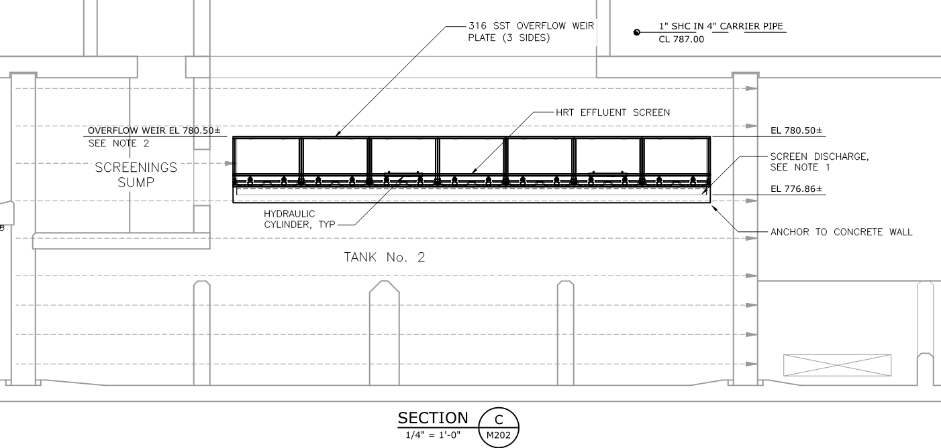
Screenings Capture Below Horizontal Effluent Screen
Capture Screening after Wet Weather Event
Remove screenings with Vactor
Perforated Screenings Sump
SS Plate to Capture Screenings

Slide 25
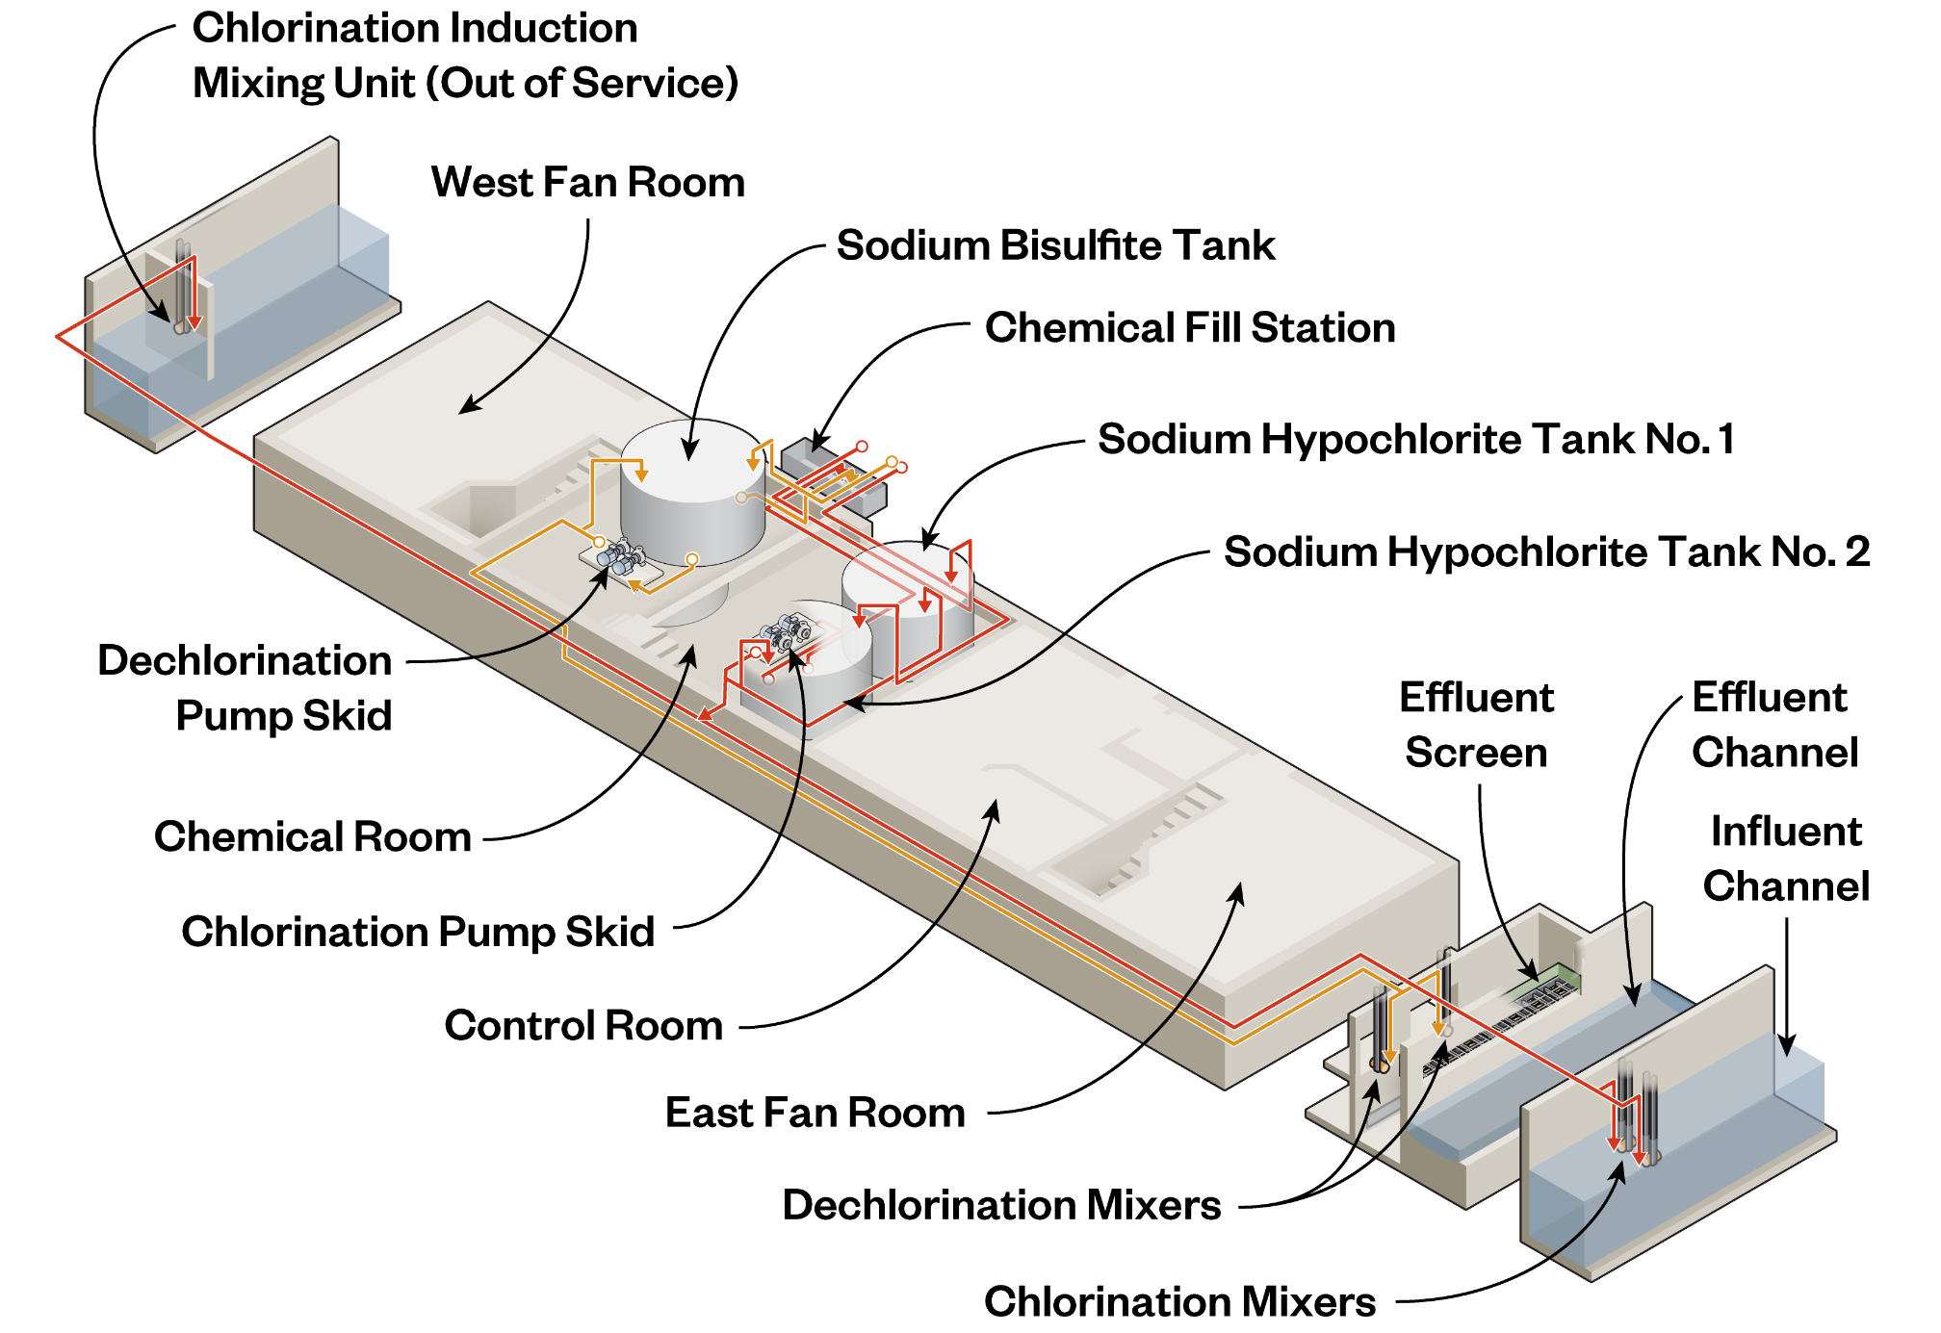
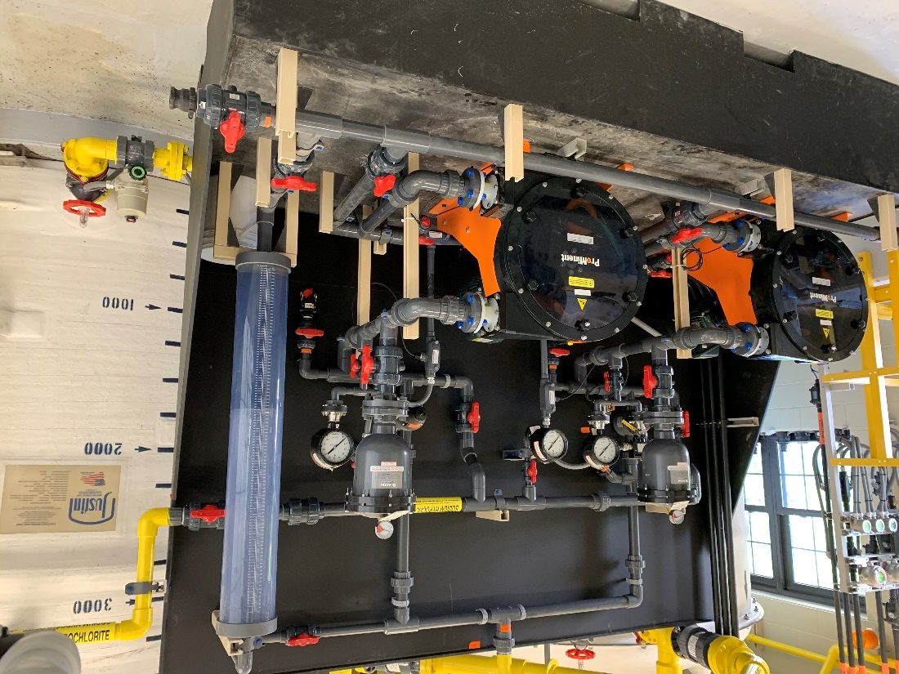
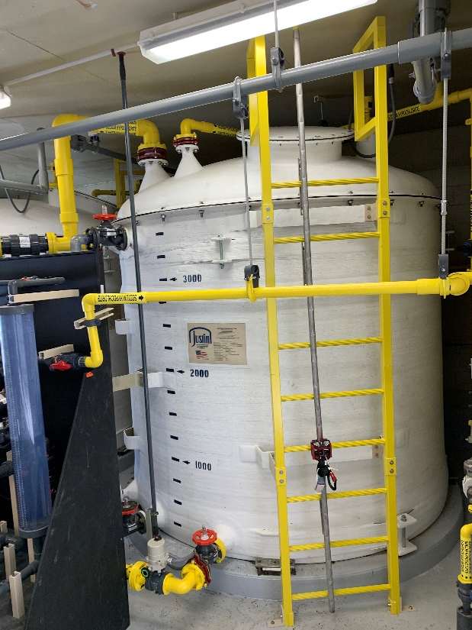
Replace Chemical Feed Systems
Sized for Optimized CT Needs with Simultaneous Sedimentation & Disinfection
 | Sodium Hypochlorite | Sodium Bisulfite
Purpose | Disinfection | Dechlorination
Storage | 2 x 3500-gallon Tanks | 1 x 3500-gallon Tanks
Pumping | 2 x 10.6 gpm Pumps | 2 x 1.2 gpm Pumps
Mixing | 2 x Chemical Mixers | 2 x Chemical Mixers

Slide 26
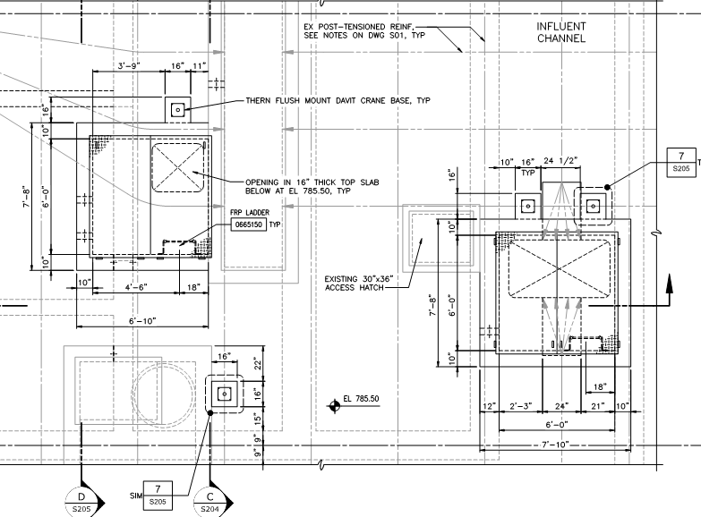
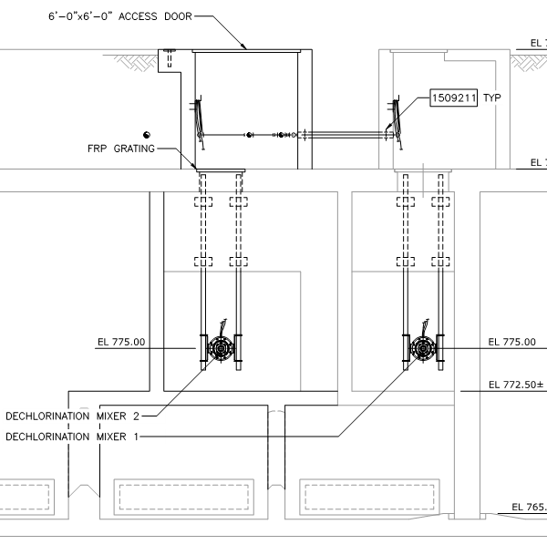
New Chemical Mixers
Openings in HRT top slab (post-tensioned) for chlorination and dechlorination mixers
Opening in baffle wall (wall not post-tensioned) and wall extension for new dechlorination mixer
Access vaults and hatches

Slide 27
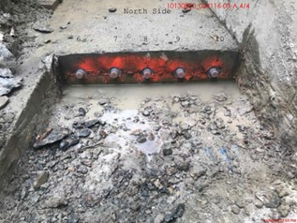
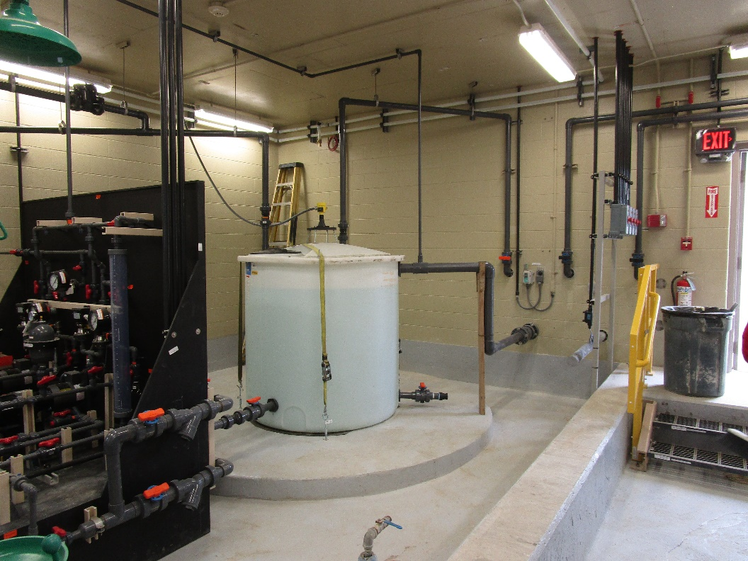
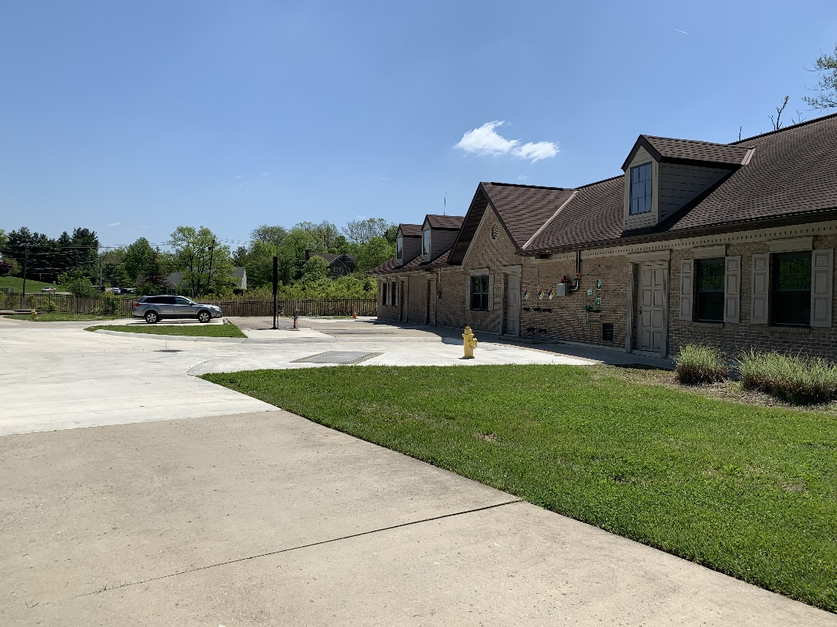
Construction Issues
Construction Work performed by Building Crafts, Inc. (BCI)
Post-Tensioned Concrete Tank
Chemical System Issues
COVID-19 Delays
Openings required in HRT tank deck for chemical mixer installation
Repair damaged post-tensioned tendons in HRT tank deck
Initial delay in identifying vendor to meet schedule
Four-month delay on FRP tanks due to COVID-19
Pumping system pressure and low flow issues
Equipment delivery delays
Construction personnel
Operator training
Facility start-up

Slide 28
Initial Operations and Conclusions

Slide 29
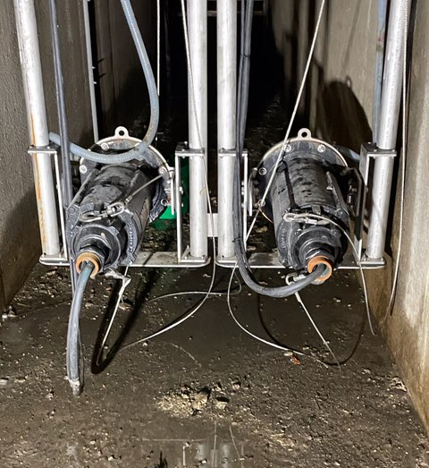

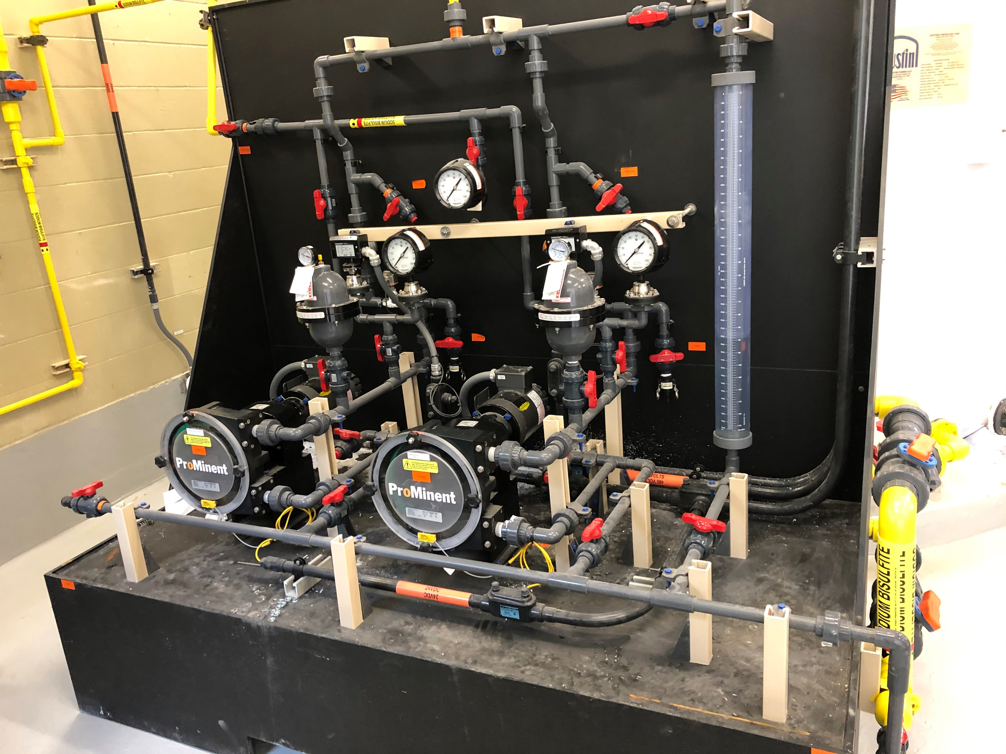
Startup and Commissioning
Startup of individual components
  Staggered startup times
Resolve pressure issues with mixers
  Discovered nozzles within chemical mixers, not intended or shown on shop drawings
  Caused 20 psi headloss and greater pumping heads
Revise disinfection system pump issues for low flows
  Low HRT influent periods vs. high flow (basis of design)
  Pumps on VFD have minimum speed, which exceeded low HRT flow demands
  Programming modifications for intermittent chemical feed
Add isolation valves
  Additional diaphragm valves on chemical feed system
  Additional flexibility to take systems off-line for maintenance

Slide 30
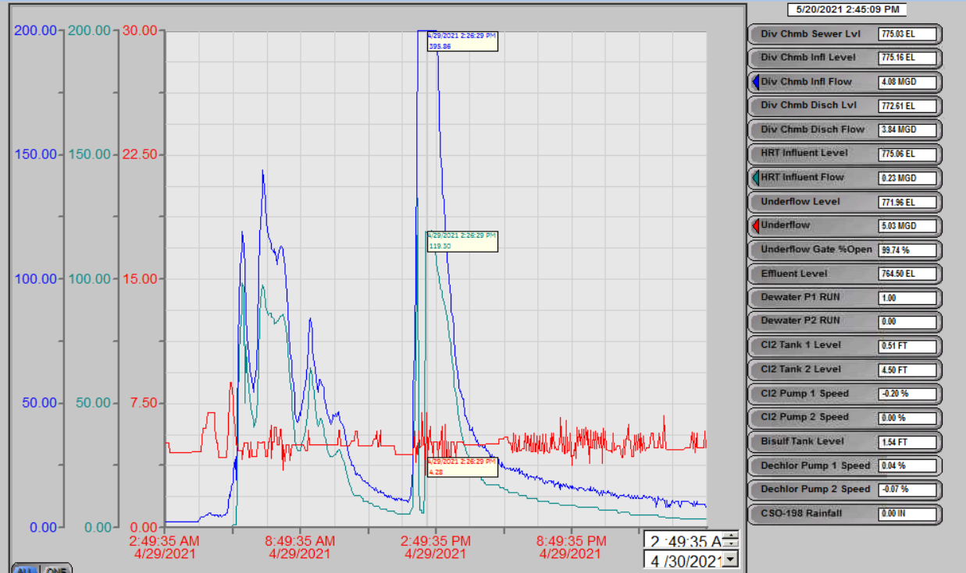
Wet Weather Reliability Testing
90-day Period to Demonstrate Successful Operations
Validate equipment performance, fine-tune chemical systems
Collect TSS and E. coli samples, targeting 4 types of events
  Small Storm: <165 cfs, fill tank, but no discharge
  Small Storm / Short Duration: <165 cfs, fill and discharge, operate > 8 hrs
  Small Storm / Long Duration: <165 cfs, fill and discharge, operate > 24 hrs
  Large Intense Storm: >165 cfs, fill and discharge, operate > 4 hrs
Responded to 9 wet weather events
  Weekly coordination meetings with weather look-ahead
  Monitor SCADA system, primarily flow and level
  Coordinate with contractor on equipment changes and repairs, MSDGC on chemical volumes, Hazen sampling staff to mobilize
Obtained 3 of 4 event conditions with flow/duration and no equipment malfunctions
400 mgd from Trunk Sewer
120 mgd into HRT
5 mgd Underflow
Wet Weather Event Flows at Muddy Creek at Westbourne HRT
Notes:
Many storm peaks only 4-6 hours

Slide 31
TSS Sampling Data
First flush captured, large solids removed

Slide 32
E. coli Sampling Data
2-log reduction with new disinfection system

Slide 33
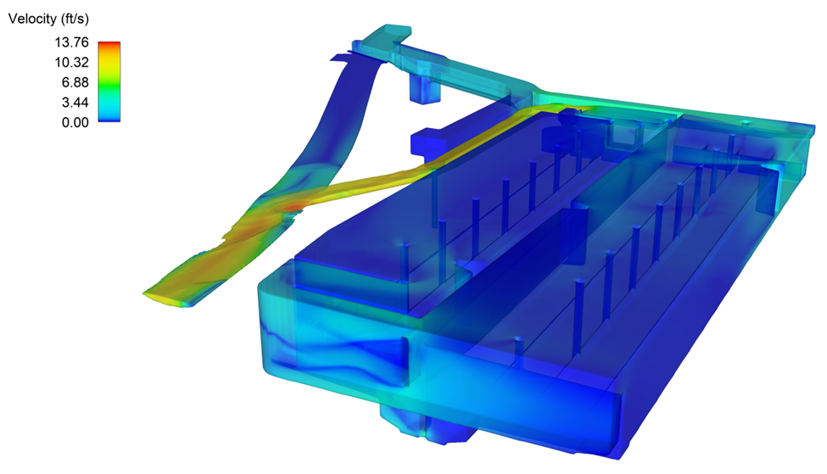
Conclusions
Improved HRT operations
  Improved performance with horizontal screen
  Improved disinfection and settling capability
  Control of HGL in Trunk Sewer with relief gates in diversion structure
Simplified operations
  Eliminate a flow split
  Remove a hydraulic restriction in Return Channel
Add flow meters, level instruments, and controls
  Allow more monitoring of HRT operations and performance
Notes:
Potentially avoid larger enhanced HRT project in the future

Slide 34
Questions?
Nick Jones, PE
Project Manager, Wastewater Engineering
Metropolitan Sewer District of Greater Cincinnati
Nicholas.Jones@cincinnati-oh.gov
Lindsey Hassenauer, PE
Senior Principal Engineer
Hazen and Sawyer
lhassenauer@hazenandsawyer.com

