Slide 1
Serving Northern Kentucky since 1946
Sanitation District No. 1

Slide 2
Mission
To provide the Northern Kentucky region with reliable and efficient wastewater and stormwater services that protect public health, property and the environment while supporting the economic vitality of our community.

Slide 3
Core Values
SAFETY We make the safety of our staff and community our highest priority.
ENVIRONMENTAL LEADERSHIP We protect local waterways for today and tomorrow.
TRUST We work with integrity and transparency, and we welcome accountability.
QUALITY SERVICE We strive to meet the needs of everyone we serve.
INNOVATION We use technology and data to maximize impact and minimize cost.

Slide 4
WASTEWATER
MANAGEMENT

Slide 5
WASTEWATER
SNAPSHOT
Service Area: 190 square miles
Sanitary Sewer Pipe: 1,685 miles
Customer Accounts: 99,197 residential; 10,433 nonresidential
Dry Creek Treatment: 25.3 million gallons per day
Western Regional: 9 million gallons per day
Eastern Regional Treatment: 1.15 millions gallons per day
Notes:
It doesn’t fit the presentation, but I’d mention here that we launched a new website in 2020 and a new billing system in 2022, both aimed at enhancing the customer experience.

Slide 6
WASTEWATER
SNAPSHOT
Final year of 4-year rate restructure.
Creation of a base rate and variable rate to more closely align rates with the actual costs of providing sanitary sewer service.
Over the past four years, as the base rate has gradually increased (from $16 in FY20 to $26 in FY23), the variable rate has gradually decreased (from $8.11 prior to the new structure to $4.72 in FY23).
FY23 Base Rate: $26/month
FY23 Variable Rate: $4.72 per HCF/month

Slide 9
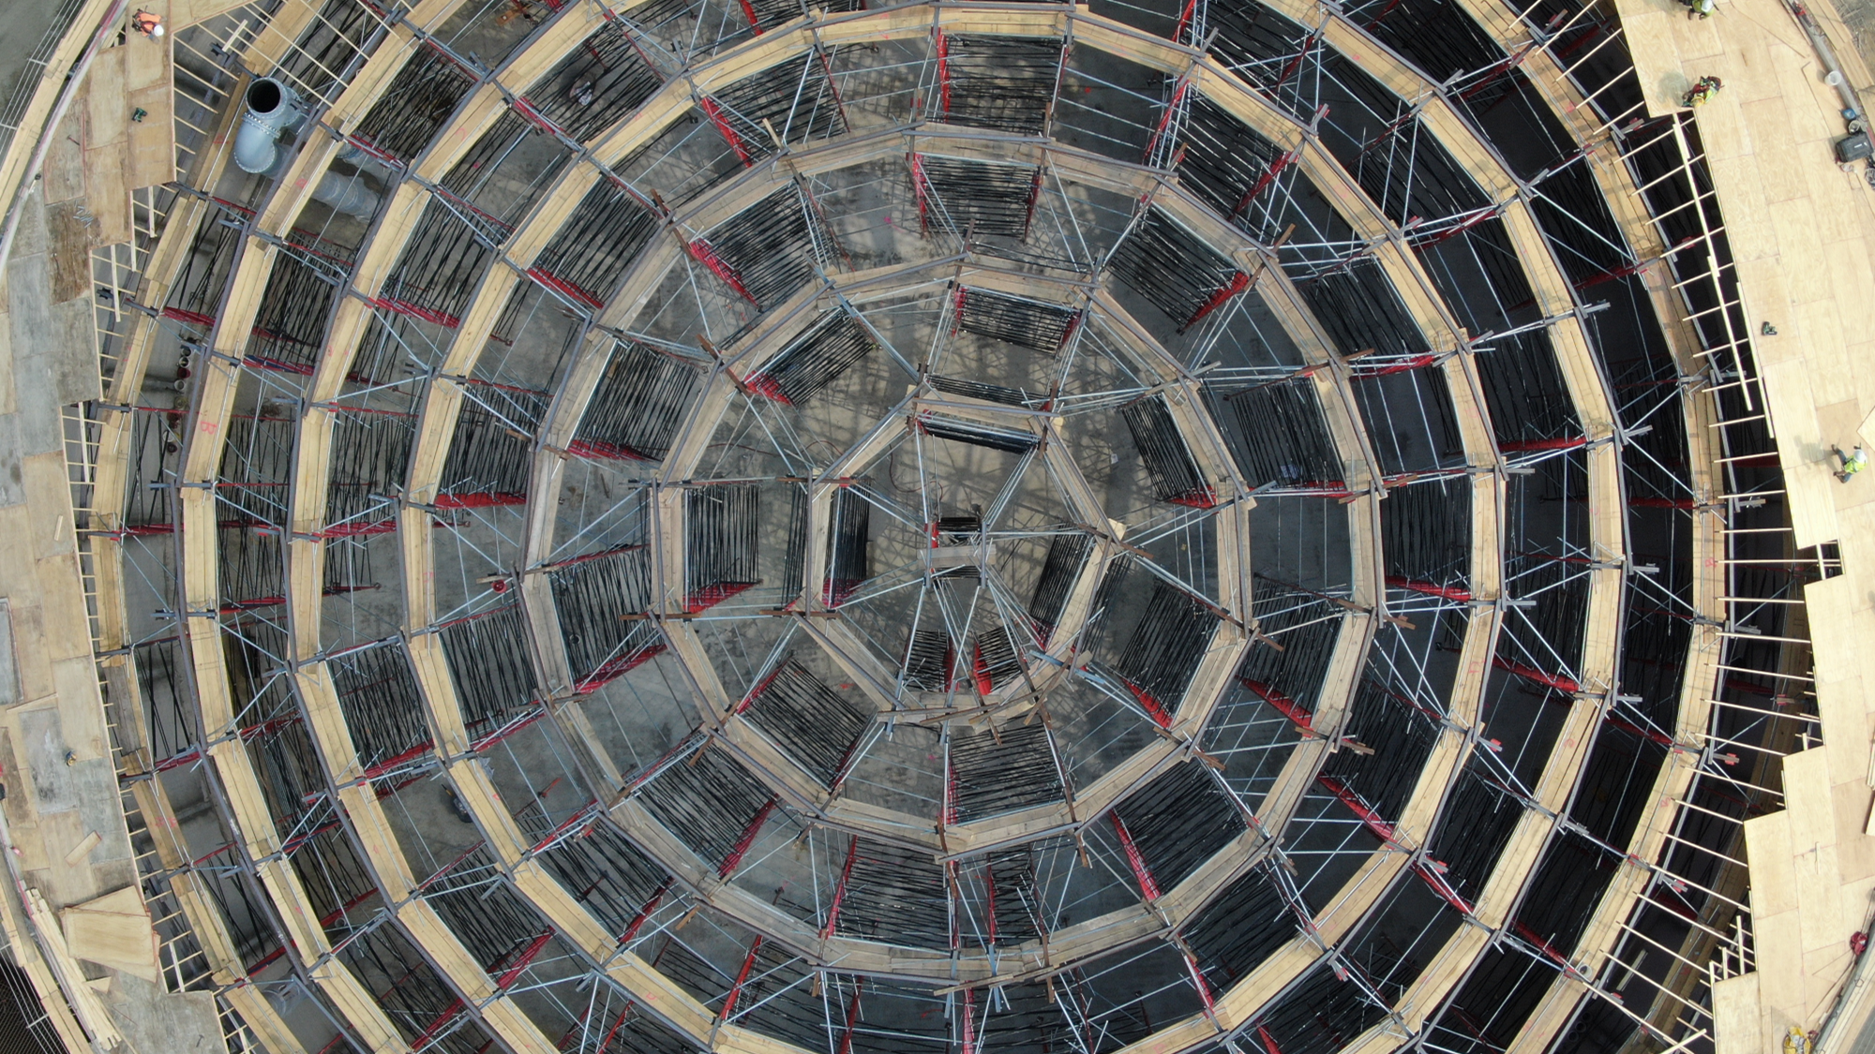
Typical-Year SSO Elimination Goals
July 2023 – Eliminate 20% of TY SSO
July 2029 – Eliminate 75% of TY SSO
July 2034 – Eliminate 90% of TY SSO
January 2040 – Eliminate 100% of TY SSO
Typical-Year CSO Elimination Goals
July 2023 – Capture 67% of TY Combined System Flow
July 2029 – Capture 75% of TY Combined System Flow
July 2034 – Capture 80% of TY Combined System Flow
January 2040 – Capture 85% of TY Combined System Flow

Slide 10
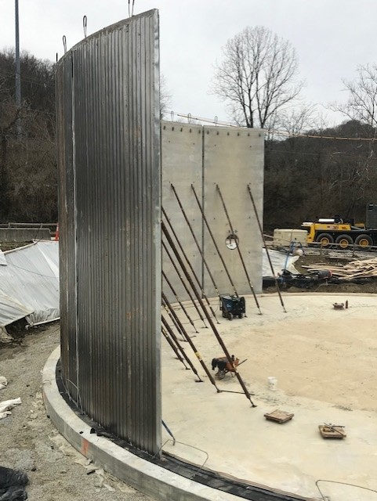
Highland Heights & Silver Grove

Slide 11
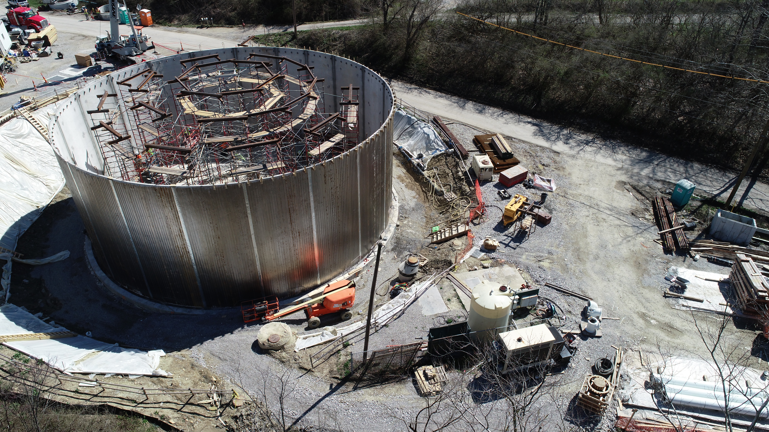

Slide 12
Typical Year SSO Elimination:
21MG
(18% of 2040 goal)

Slide 13
Licking River Siphon & Wilder EQ Tank

Slide 14
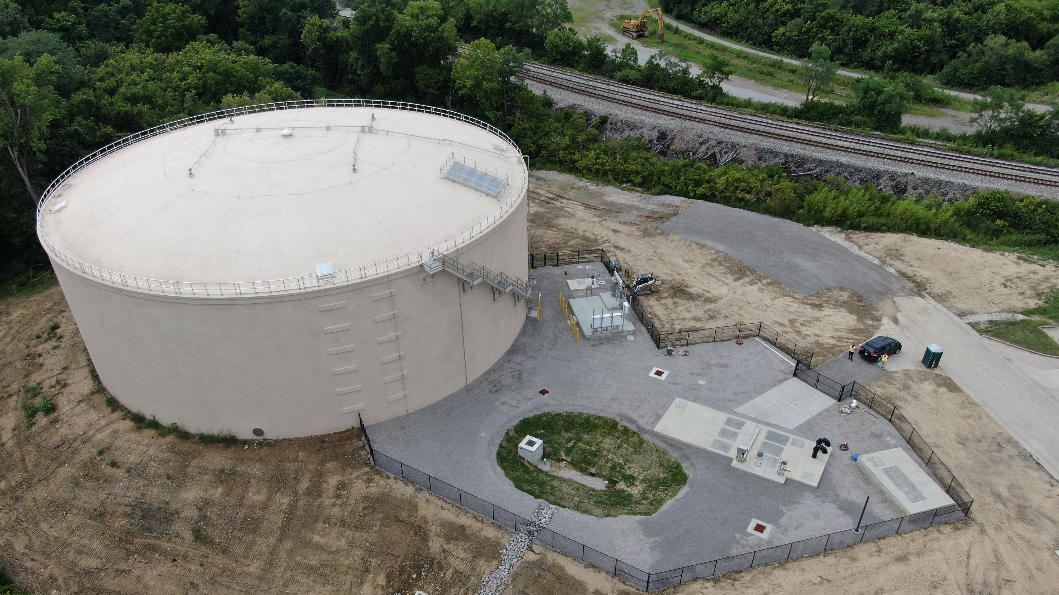
Wilder

Slide 15
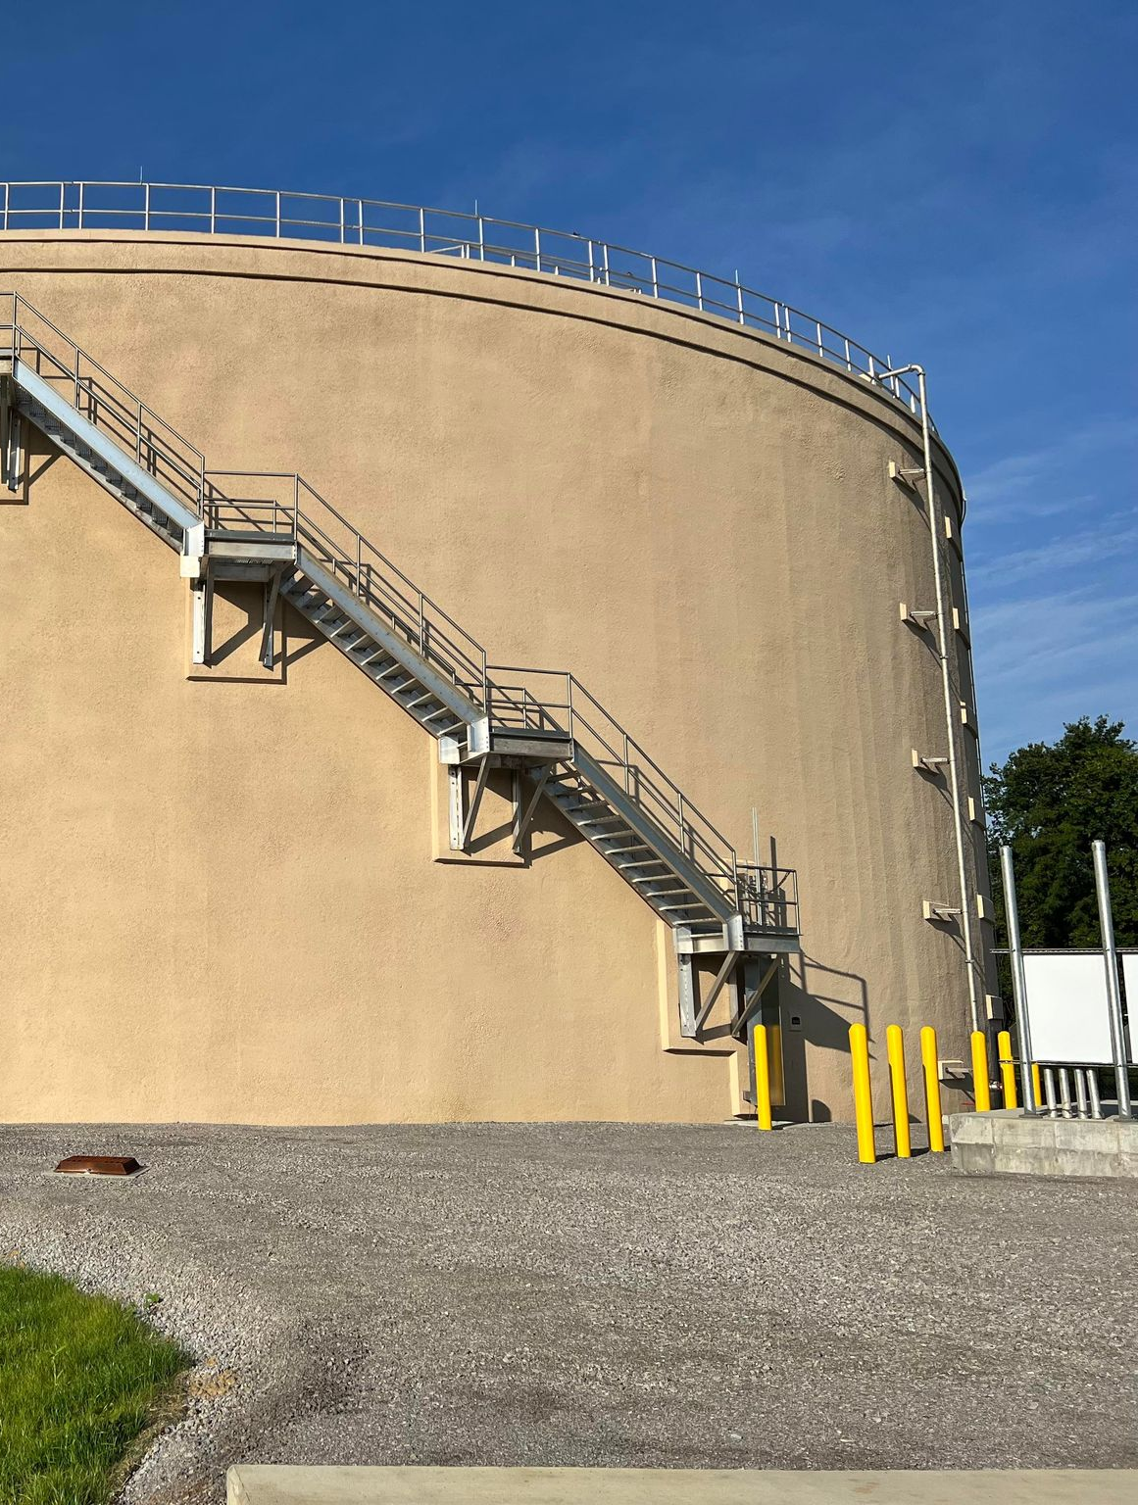
Typical Year SSO Elimination:
47MG
(40% of 2040 goal)

Slide 16
STORMWATER
MANAGEMENT

Slide 17
STORMWATER
SNAPSHOT
Service Area: 170 square miles
Storm Sewer Pipe: 433.89 miles Storm Sewer Structures: 32,300
Customer Accounts: 87,187 residential; 8,359 nonresidential
Residential Storm Water Rate: $4.54/month

Slide 18
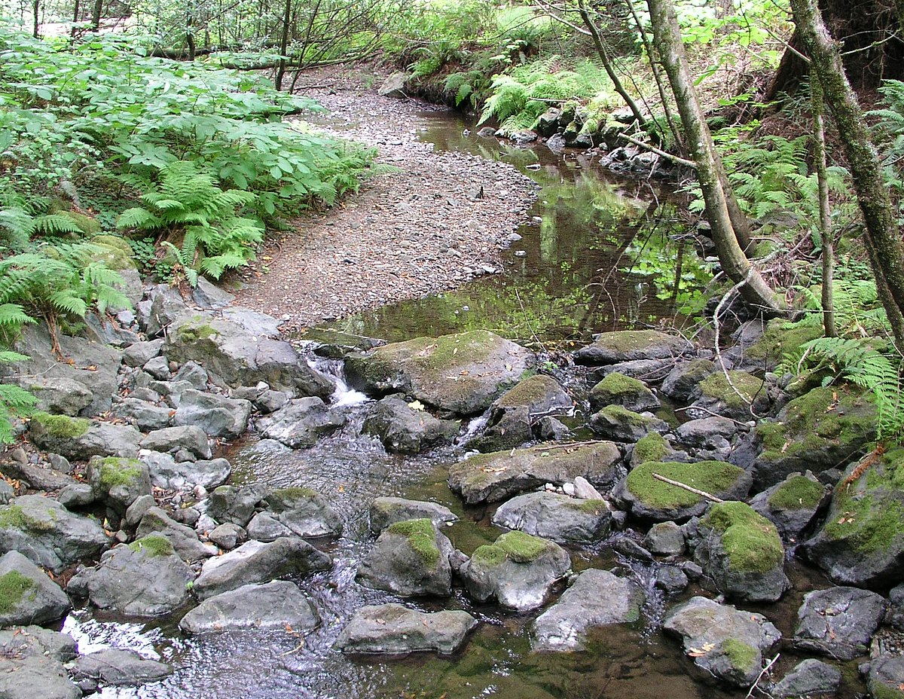
Mitigation Bank Program
Notes:
SD1’s Mitigation Banking program generates credits for restoring, enhancing, or preserving stream habitat that is lost through the development of a piece of land.
Section 404 of the Clean Water Act (CWA) of 1972 requires that stream habitat footage lost to dredge or fill (e.g., development) must be “made up for” or “mitigated.” SD1’s Mitigation Bank Program builds credits by restoring, enhancing or preserving stream habitat.
A developer can then buy these credits as a means of “mitigation” for the loss. Section 404 the CWA in the state of Kentucky is administered by the US Army Corps of Engineers (USACE).

Slide 19
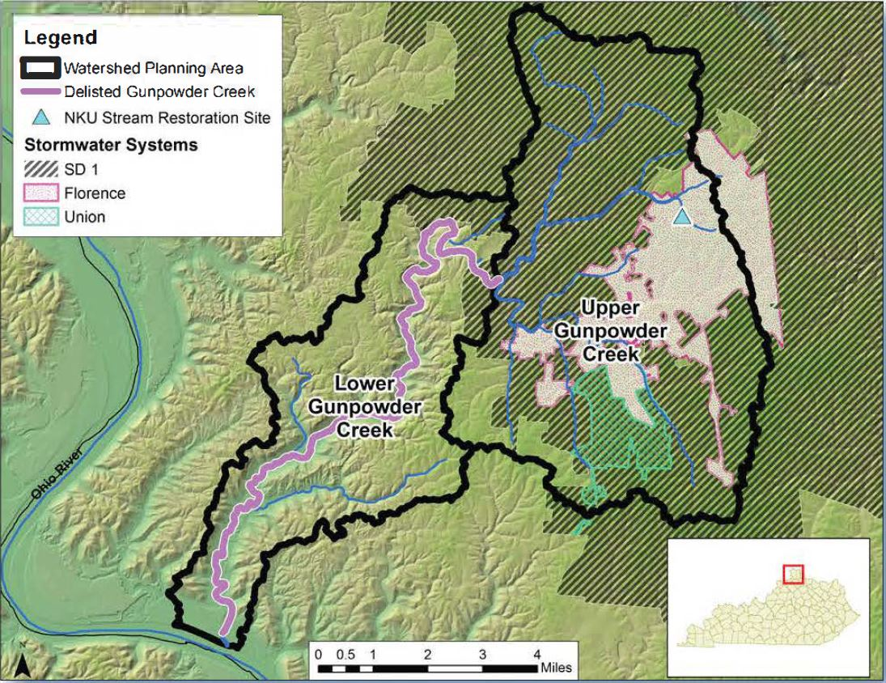
Gunpowder Creek Delisting
Notes:
SD1 partnered with numerous local governments and agencies in NKY on nearly a decade of work.
Gunpowder Creek watershed plan was created in 2009 with $501,000 Clean Water Act grant funding; the plan funded extensive monitoring, planning and collaboration efforts that identified stormwater-driven sediment and bacteria as the primary pollution sources of concern. Partnership included stream restoration, stormwater retention, and riparian buffers to mitigate the problem.
In addition, agencies including SD1 upgraded existing facilities and made changes to their rules and regulations to limit the impact of development. Updating existing structures to current engineering standards made a big difference in holding back more water and allowing it to drain more slowly into the creek. This kept the banks of the creek from eroding and washing out vital habitat for aquatic life. As a result, Gunpowder Creek saw its rating improve from "poor" in 1999 to "fair" in 2011 and "good" by 2014. The creek has now been delisted from the Kentucky Division of Water's 2018/2020 Integrated Report to Congress.
This demonstrates that even small improvements in the watershed, when looked at cumulatively over time, have a positive impact on a receiving stream.

Slide 20
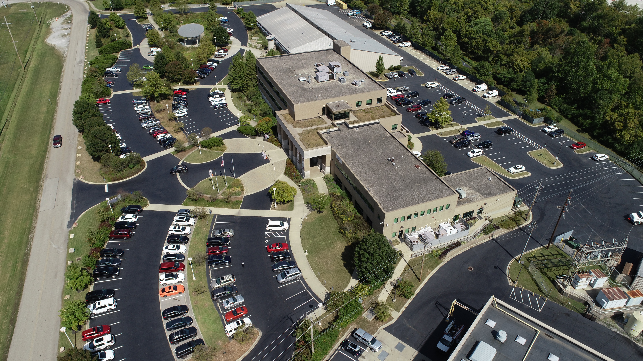
QUESTIONS?

