Slide 1
SARS-CoV-2 Wastewater Monitoring In An Urban Sewershed, Louisville, Kentucky Wastewater Testing to Identify Public Health Trends
Daymond Talley ª, Rochelle H. Holm^{b} and Ted Smith^{b}
ªLouisville/Jefferson County Metropolitan Sewer District, Morris Forman Water Quality Treatment Center, 4522 Algonquin Parkway, Louisville, KY 40211, United States
^{b}Christina Lee Brown Envirome Institute, School of Medicine, University of Louisville, 302 E. Muhammad Ali Blvd., Louisville, KY 40202, United States

Slide 2
Wastewater is a Mirror of Public Health
Monitoring wastewater as a public health indicator is not new
Population-level stress
Illicit drug use
Polio
Louisville MSD was involved in wastewater monitoring before the pandemic reached our community
Partnership with University of Louisville
Tracking air pollution from wastewater in Louisville neighborhoods.
Research partnership expanded in mid-2020 to track community spread of SARS-CoV-2, the virus that causes COVID-19.

Slide 3
Coordinated COVID19 Testing & Monitoring
Severe acute respiratory syndrome coronavirus 2 (SARS-CoV-2) is the virus that causes COVID-19

Slide 4
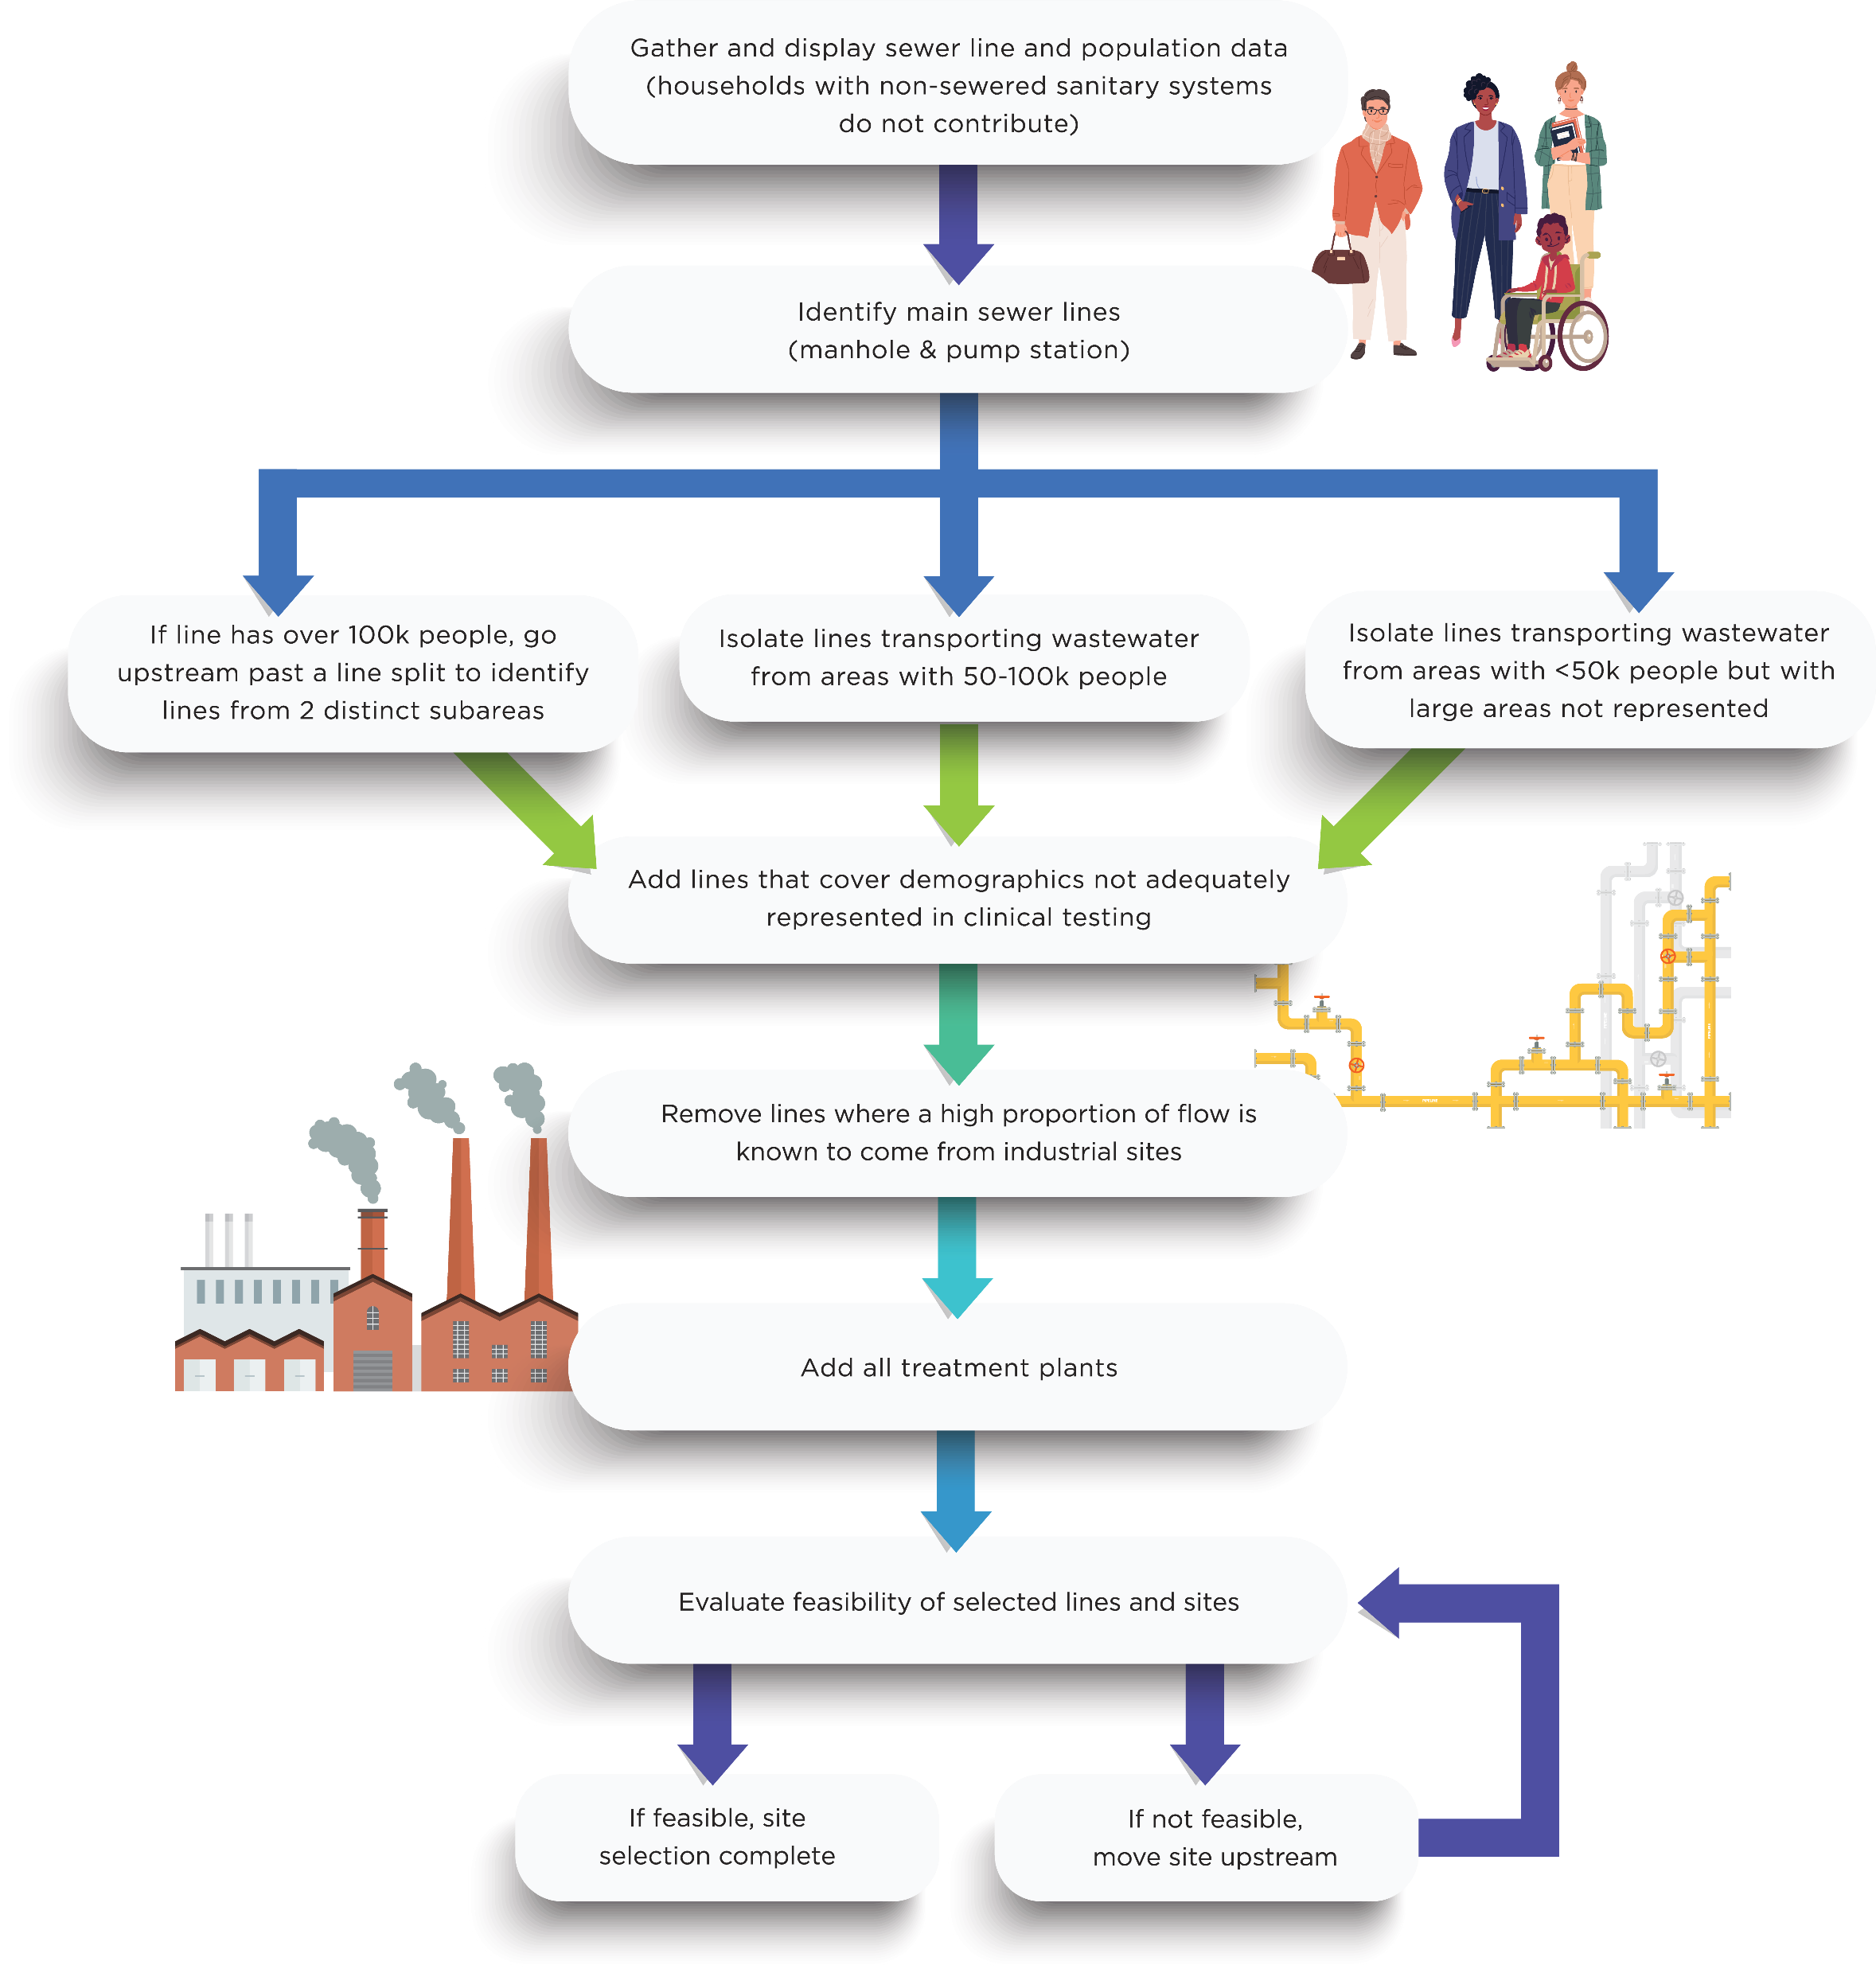
Ensuring Health Equity Through Site Selection
From: Yeager, R. A., Holm, R. H., Saurabh, K., Fuqua, J. L., Talley, D., Bhatnagar, A., Smith, T. R. (2021). Wastewater Sample Site Selection to Estimate Geographically Resolved Community Prevalence of COVID-19: A Sampling Protocol Perspective. GeoHealth 5(7), e2021GH000420

Slide 5
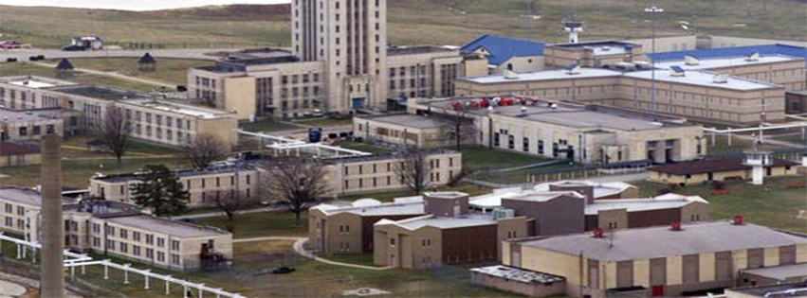
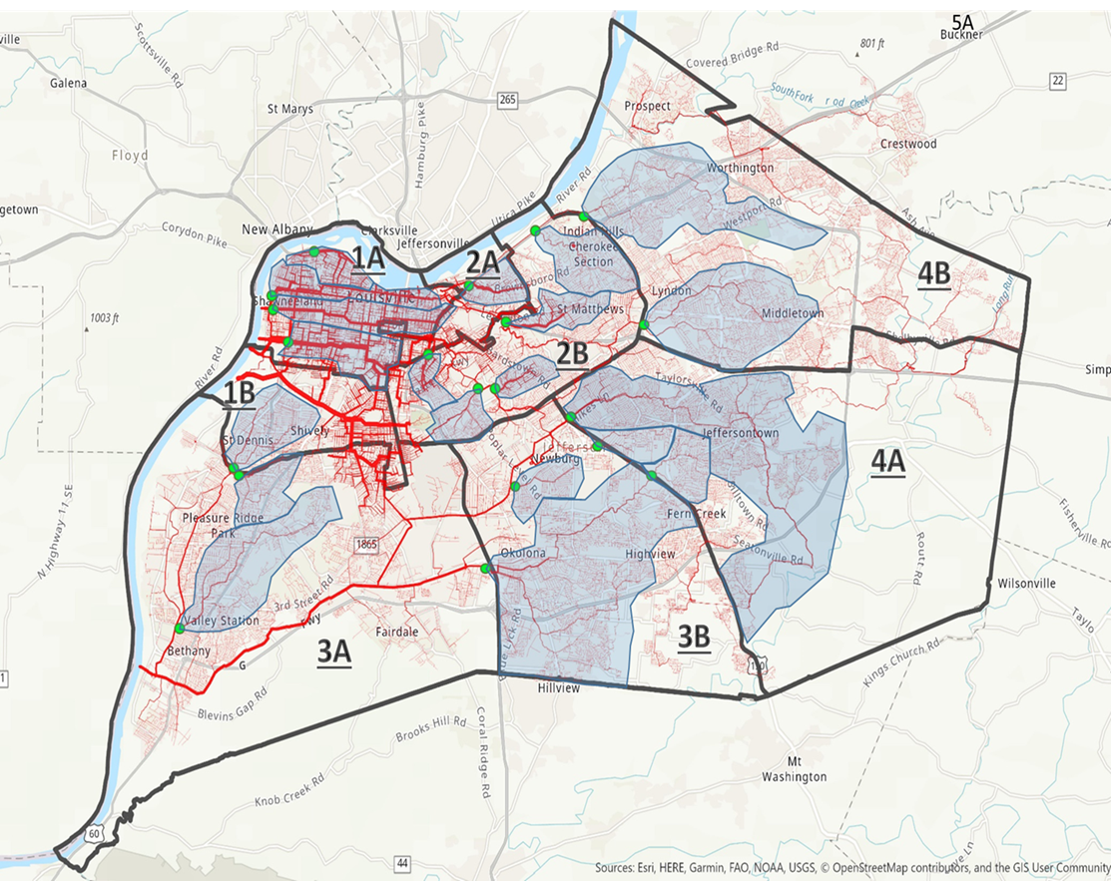
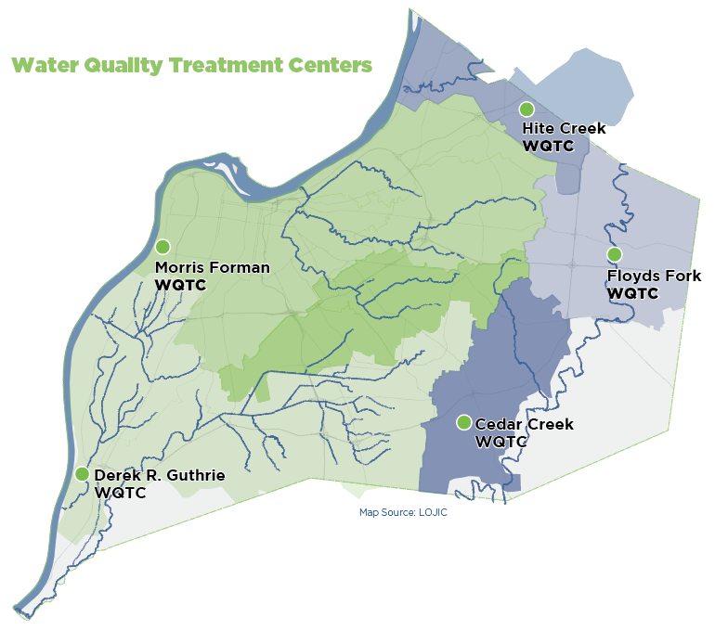
Scaling to Protect Personal Identification
Congregate Living Facility / Campus (hundreds to thousands)
Neighborhood (thousands to tens of thousands)
Community (hundreds of thousands)

Slide 6
COVID-19 Sampling Site Map
From: Yeager, R. A., Holm, R. H., Saurabh, K., Fuqua, J. L., Talley, D., Bhatnagar, A., Smith, T. R. (2021). Wastewater Sample Site Selection to Estimate Geographically Resolved Community Prevalence of COVID-19: A Sampling Protocol Perspective. GeoHealth 5(7), e2021GH000420

Slide 7
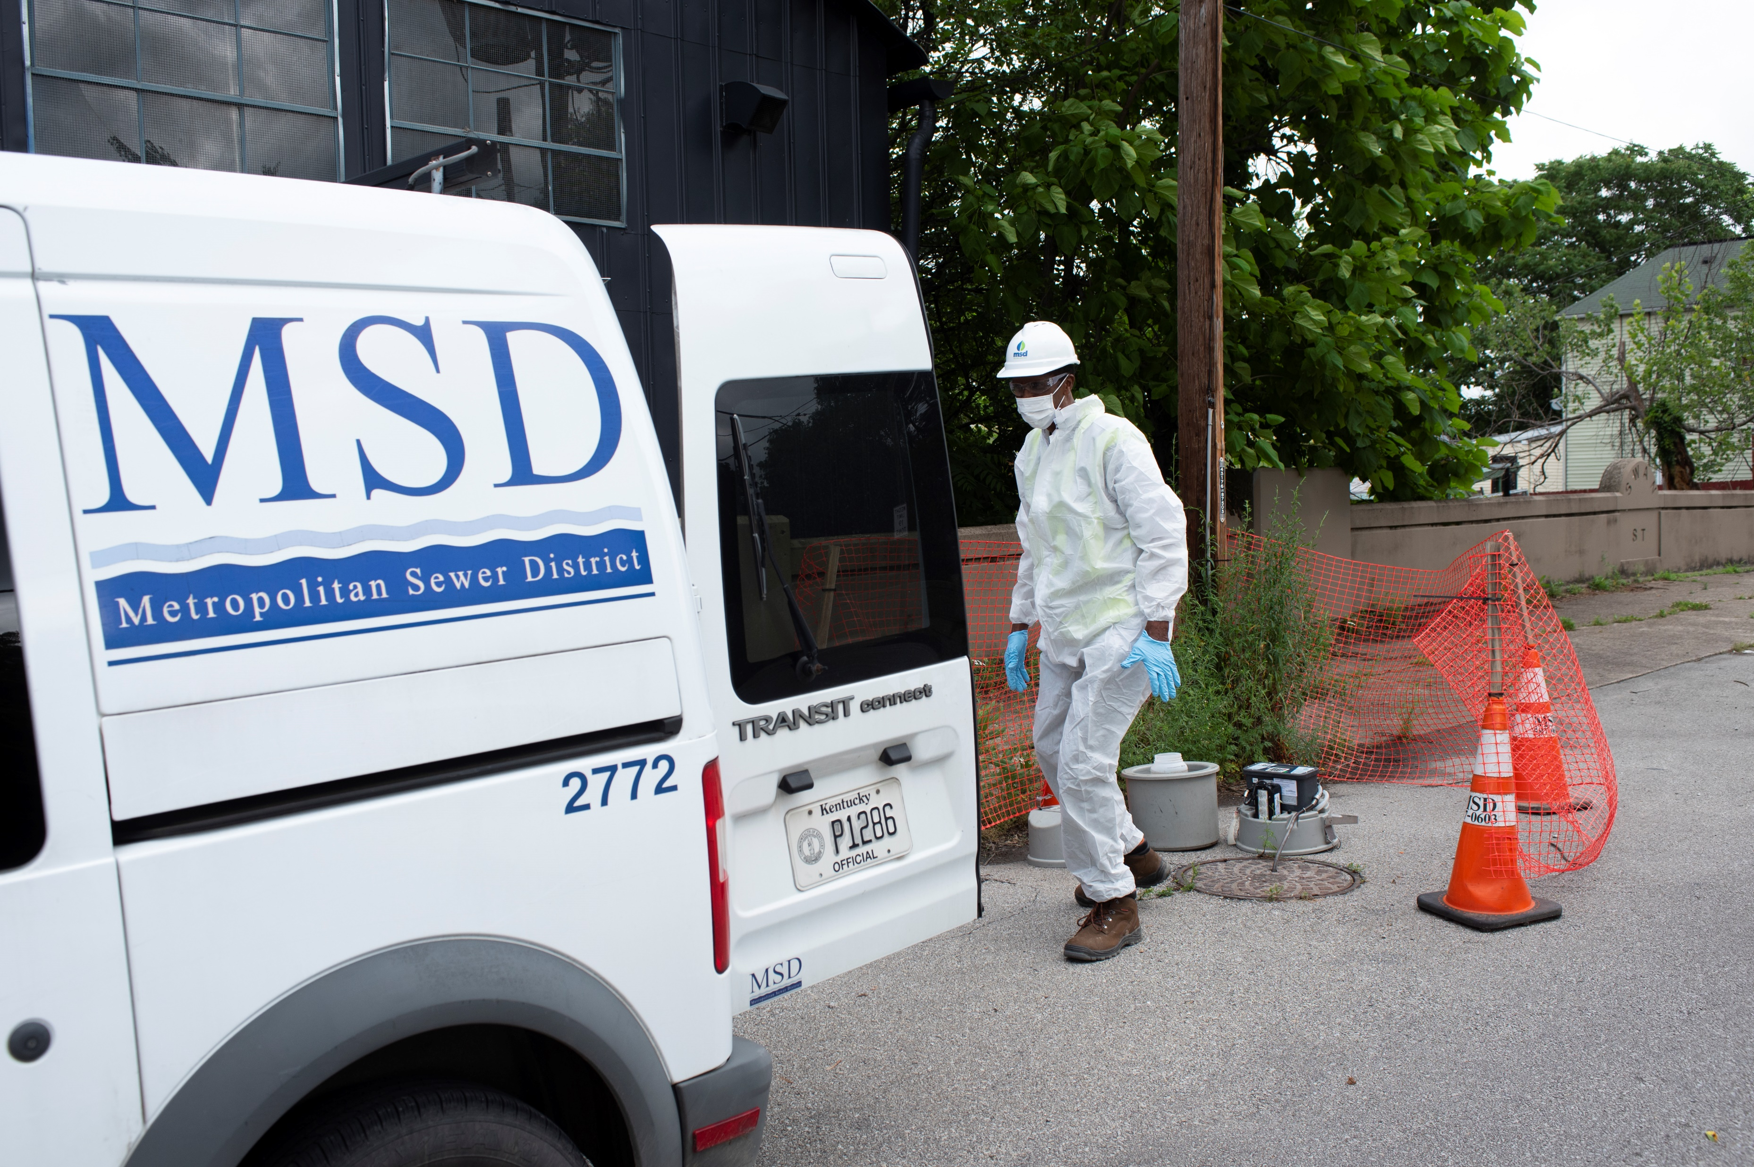
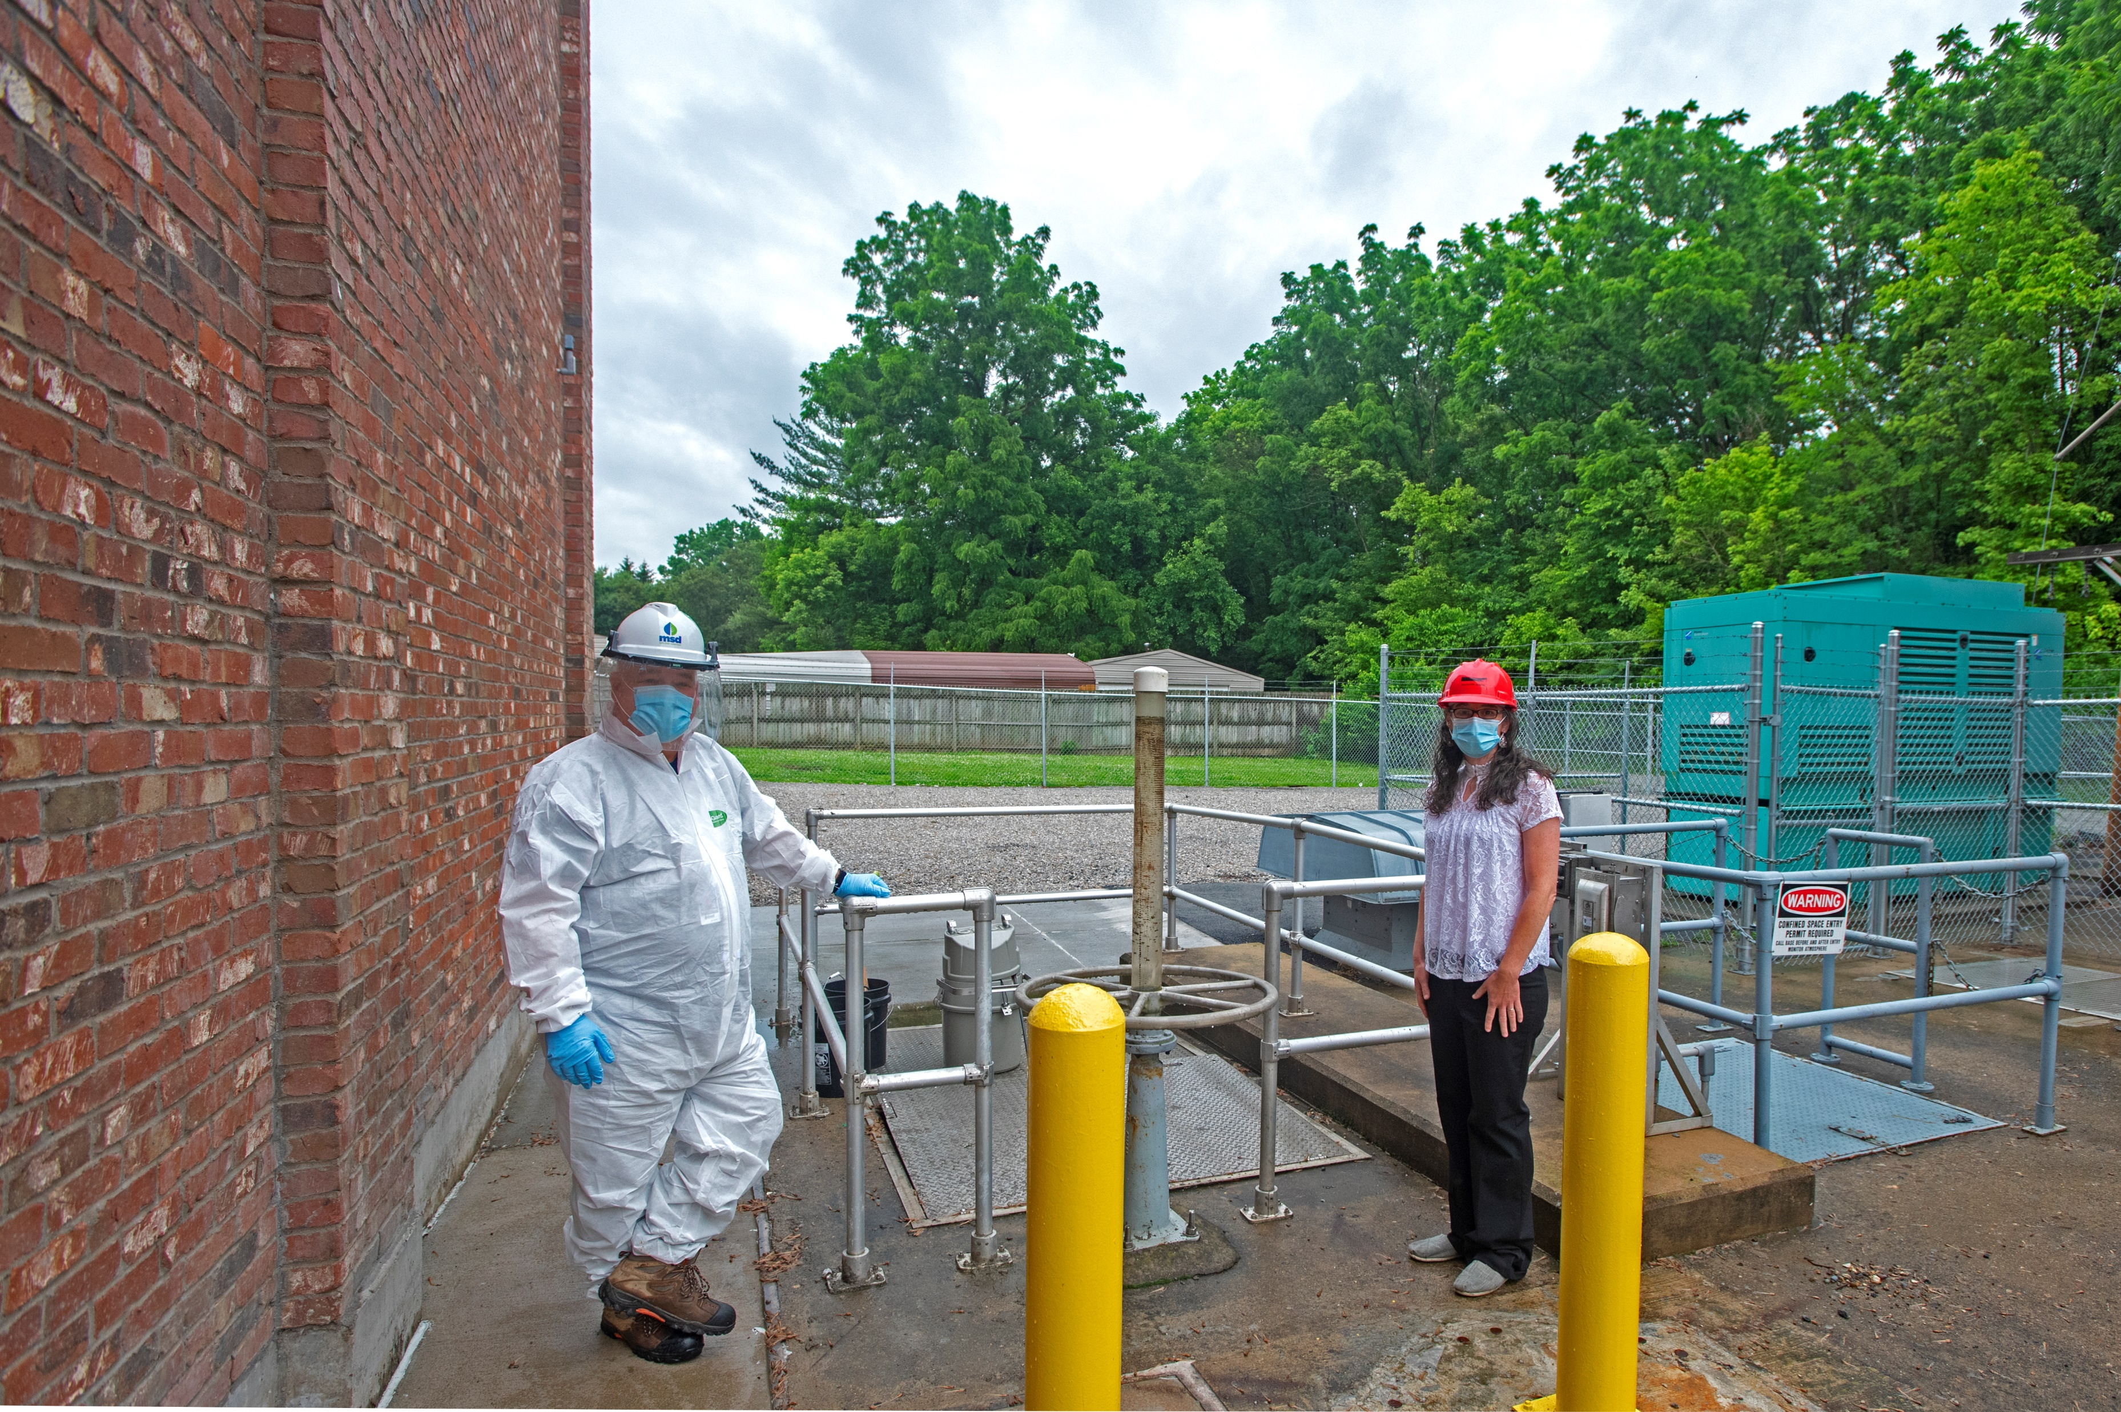
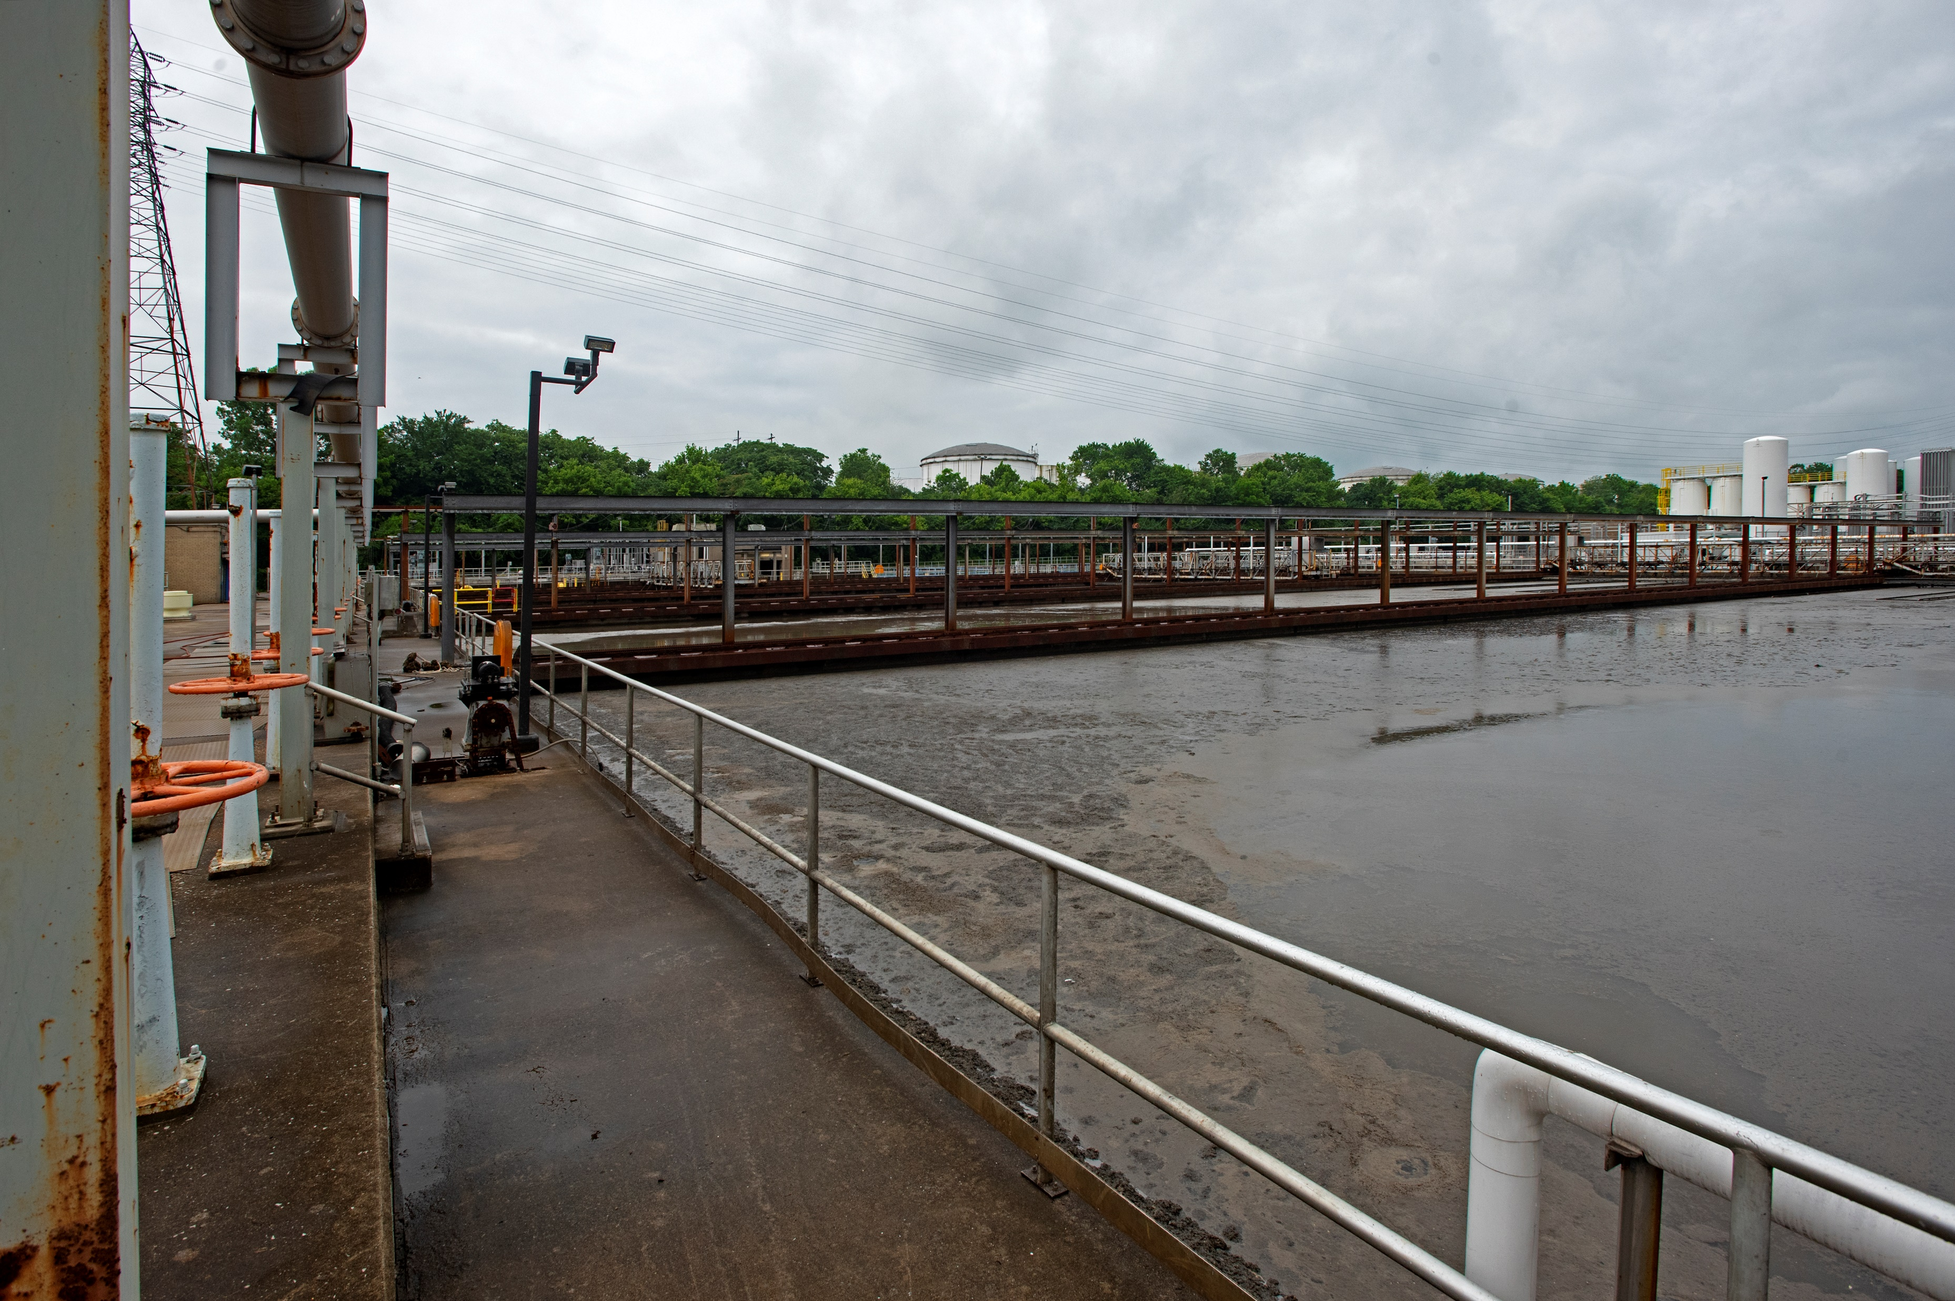
COVID19 Sampling Locations
9 sewer line manholes
5 Water Quality Treatment Centers
3 sanitary pump stations

Slide 8
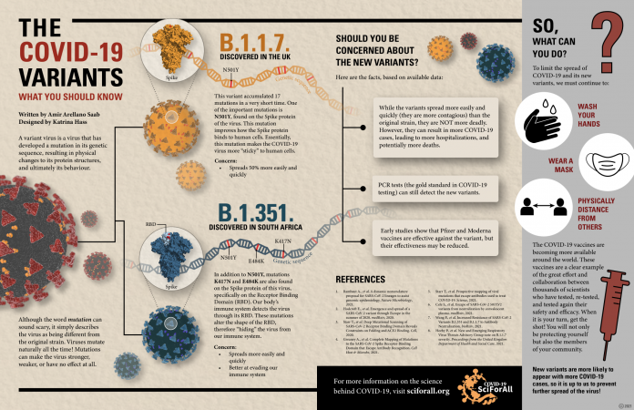
Laboratory Refinement to Track COVID19 Variants
Genomic sequencing added to lab protocols in 2021
Capture SARS-CoV-2 variant spread within the community
Iteratively adapted to anticipate and prepare for emerging variants tracking
Innovative tool to anticipate and prepare for localized public health emergencies
April 2021 the Gamma (P.1) variant confirmed in wastewater one week before the first clinical case and within the same wastewater catchment area
Due to local delays in clinical sequencing the Omicron variant the wastewater results were available 4-days faster to show the Omicron variant presence.

Slide 9
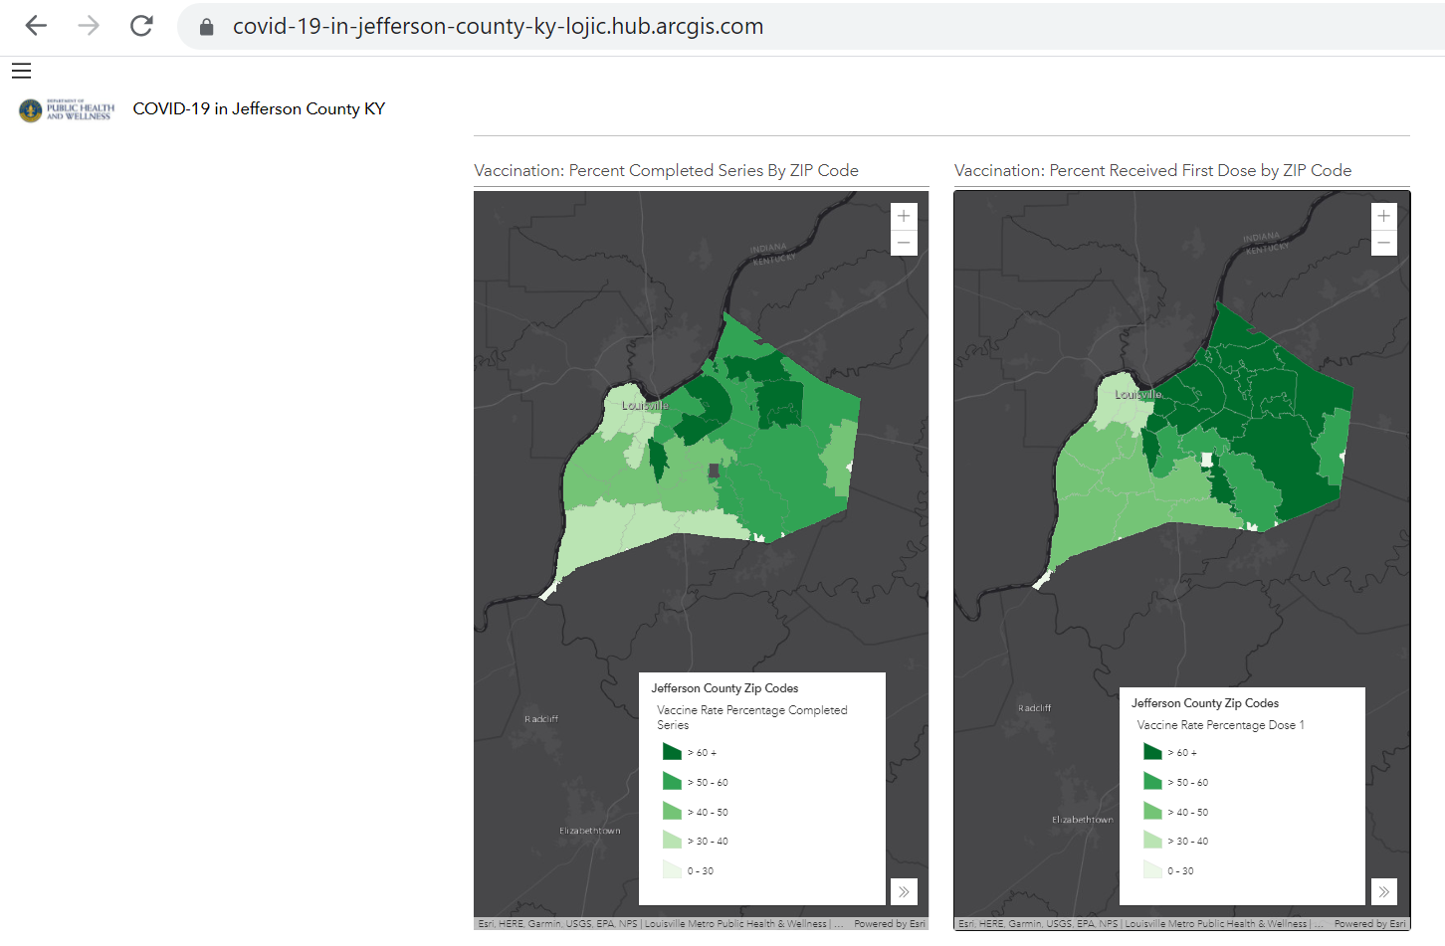
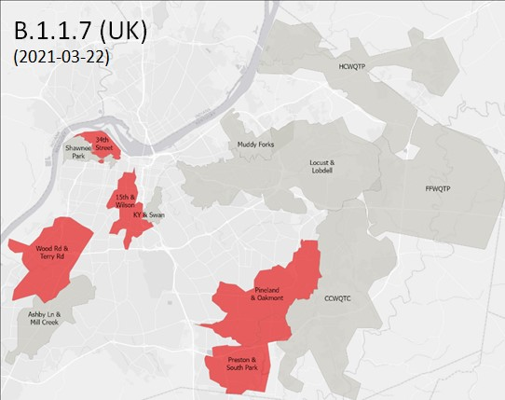
Correlating Vaccination Rates to COVID19 Spread
Vaccination Rates: dark green is highest
Marker concentration highest among least vaccinated
“Wastewater surveillance may reveal the human geography of unvaccinated communities, which could facilitate interventions, such as tailored public health messaging, or suggest more convenient access via pop-up vaccination sites.”
Ted Smith, Gail Cassell, and Aruni Bhatnagar. JAMA Health Forum 2021. doi:10.1001/jamahealthforum.2020.1616

Slide 10
Delta Frequency of Detection over Time
From:
Eric Rouchka
KY-INBRE Bioinformatics Core

Slide 11
Omicron Frequency of Detection over Time
From:
Eric Rouchka
KY-INBRE Bioinformatics Core

Slide 12
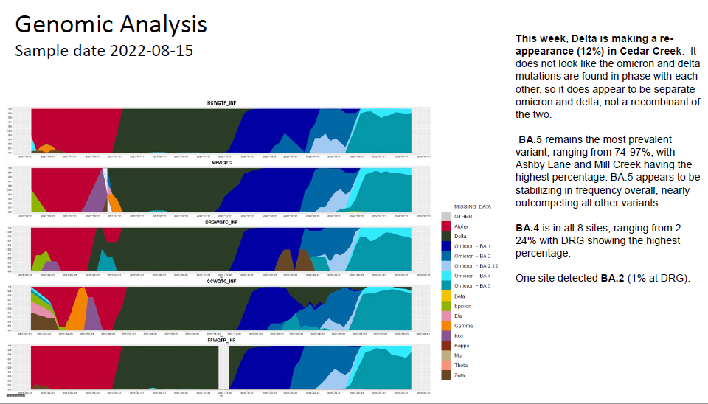
Data Used to Guide Public Health Decisions
Ability to Mobilize Quickly
Louisville MSD and University of Louisville met weekly for implementation of the COVID-19 program
Data was shared with the local public health department in a series of maps and figures weekly in an easy to digest format.
Examples of Data Use
Guide COVID19 Community Testing
Guide COVID19 Workplace policies
Partnership to Continue Beyond COVID-19
Public health work plans include expanded wastewater testing in Louisville being used for a broad panvirome panel
Will include the addition of Monkey Pox in June 2022

Slide 13
Embracing MSD’s Role: Health Research Partner
Health Research Partner Role
Supported the COVID-19 public health emergency response within our community
Demonstrated the promising link of monitoring wastewater to identify emerging public health concerns going forward

Slide 14
Evaluating Community Monitoring Support
Conducted survey of support for use of wastewater for SARS-CoV-2 monitoring
From: Holm, R. H., Brick, J. M., Amraotkar, A. R., Hart, J. L., Mukherjee, A., Zeigler, J., ... & Smith, T. R. (2021). Public awareness and support for use of wastewater for SARS-CoV-2 monitoring: A community survey in Louisville, Kentucky. ACS EST Water, 2022.

Slide 15
Evaluating Community Monitoring Support
Most support for large sampling basins as opposed to localized sampling basins
Individuals with a history of COVID-19 infection were more likely to support highly localized monitoring
From: Holm, R. H., Brick, J. M., Amraotkar, A. R., Hart, J. L., Mukherjee, A., Zeigler, J., ... & Smith, T. R. (2021). Public awareness and support for use of wastewater for SARS-CoV-2 monitoring: A community survey in Louisville, Kentucky. ACS EST Water, 2022.

Slide 16
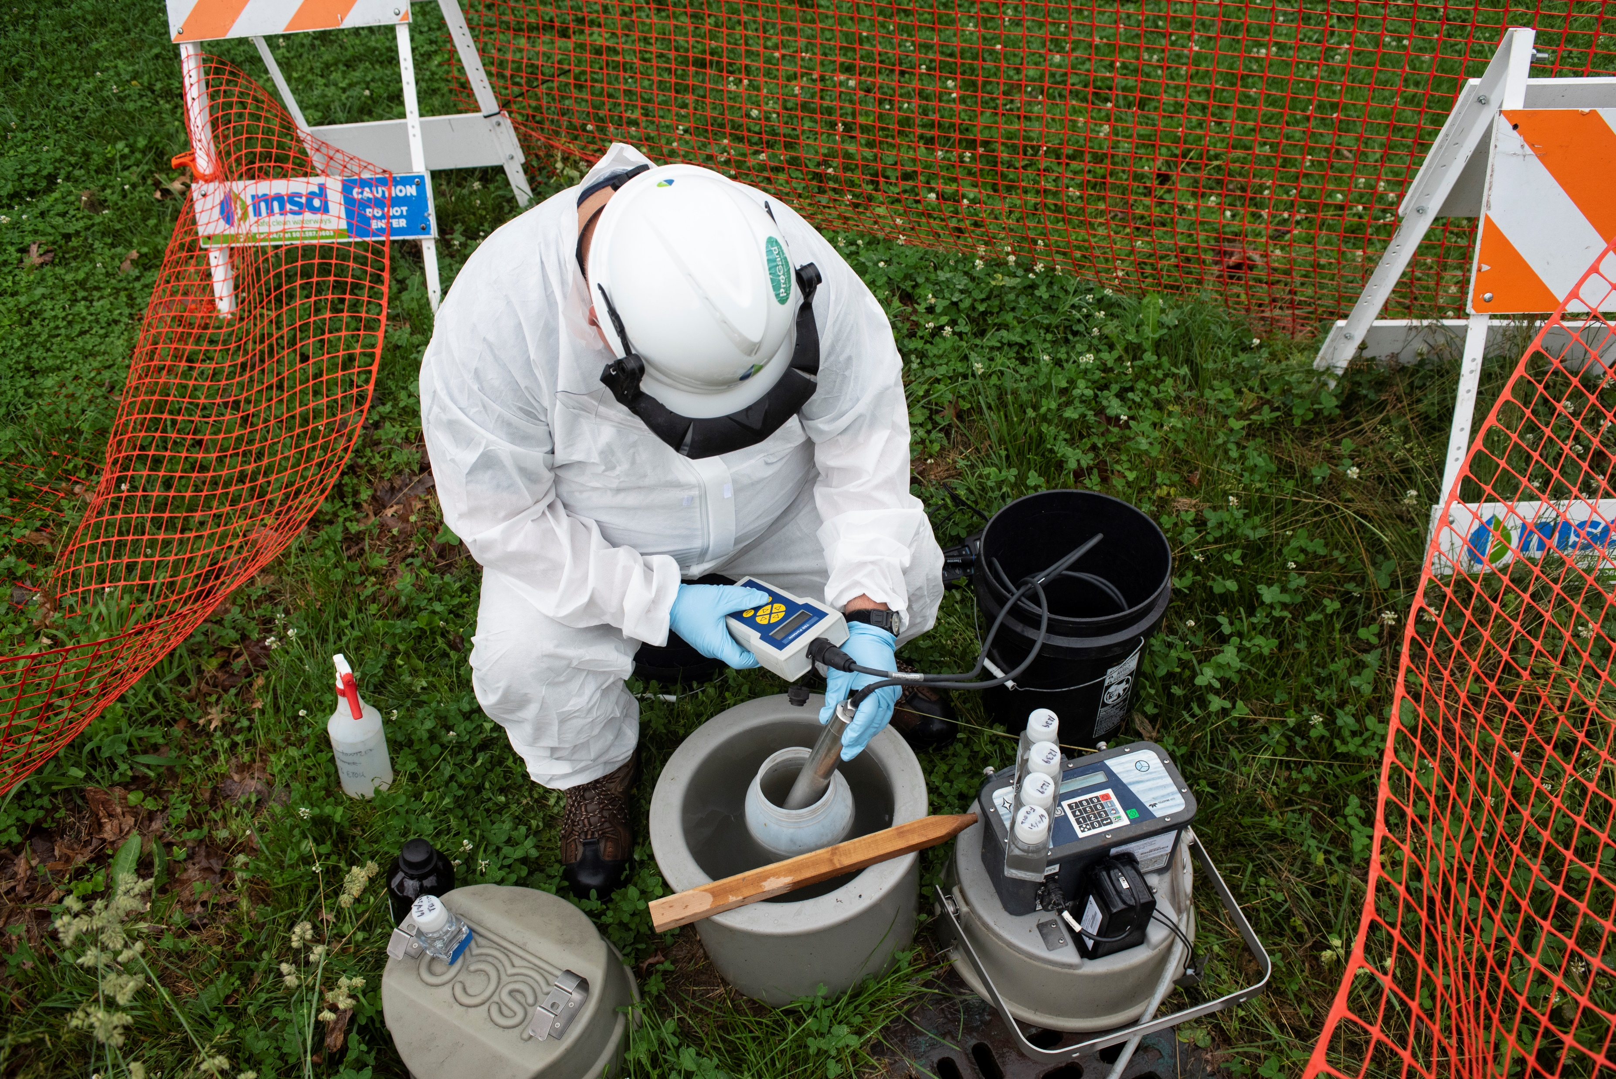
Lessons Learned From COVID-19 Monitoring
How Initial COVID-19 wastewater sampling and testing protocols used for tracking transmission and correlating results to human testing results
Use of wastewater testing and monitoring to inform local health officials on community hotspots and potential for impending localized outbreaks.
Value of utility leadership engagement in the ongoing sampling analysis results
Guide ongoing efforts to manage utility staff health and safety through efforts such as masking, social distancing, remote work, etc.
Inform local health officials and governmental leadership for ongoing management of public health and safety with respect to virus transmission
Establish local media presence with objective of increasing public awareness related to current virus presence and transmission

Slide 17
For more information: Daymond Talley (daymond.talley@louisvillemsd.org) Rochelle Holm (rochelle.holm@louisville.edu) Ted Smith (ted.smith@louisville.edu)

Slide 18
ACKNOWLEDGEMENTS
Christina Lee Brown Envirome Institute:
Aruni Bhatnagar, Ph.D. FAHA,
Ray Yeager, Ph.D.,
Shesh Rai, Ph.D.,
Joe Moore, Ph.D.,
David Hoetker,
Rick Strehl,
Jacob Ziegler,
Mamata Chaudhari,
Dan Riggs
Center for Predictive Medicine:
Joshua Fuqua, Ph.D.,
Kenneth Palmer, Ph.D.,
Saurabh Kumar, Ph.D.
Genomics Core:
Melissa Smith, Ph.D.,
Wolfgang Zacharias, Ph.D.,
Mei Zhang, Ph.D.,
Sabine Waigel
Bioinformatics Core:
Eric Rouchka, D.Sc
Microbiology & Immunology:
Kevin Sokoloski, PhD
Interdisciplinary Studies:
Tamara Sluss, Ph.D.,
Cullen Hunter, M.A.
Arizona State University:
Rolf Halden, Ph.D.,
Arvind Varsani, Ph.D,
Erin Driver, Ph.D.
The Ohio State University:
Mark Weir, Ph.D.,
Grzegorz Rempala, D.Sc.,
Boseung Choi, Ph.D.
Louisville Metropolitan Sewer District
Louisville Metro Public Health & Wellness:
Sarah Moyer, M.D.,
William Altman, J.D.
Kentucky State Laboratory:
Vaneet Arora
Kentucky Waterways Alliance:
Ward Wilson
Funding Provided by:
Louisville Metro Government LMPHW
Commonwealth of Kentucky DPH/DOC
James Graham Brown Foundation
Owsley Brown II Family Foundation
Foundation for a Healthy Kentucky
Newman’s Own Foundation
CDC

Slide 19
Questions???

