Slide 1

Equity Journey: Making Equity the
Core of Outreach
5 Cities Plus Conference
September 26, 2022
Notes:
Tiffany

Slide 2
Welcome
Presenters
Tiffany Conn,
Community Relations Coordinator
City of Columbus, Department of Public Utilities, Sustainability
Mo Wright,
President & CEO
RAMA Consulting
Notes:
Tiffany introduces herself and Mo. Explains the relationship of RAMA Consulting with the City. Time working together—going on 10 years
RAMA has been leading the equitable engagement strategy for this project since it’s conception. Today we would like to present on how that strategy has developed over time.

Slide 3

Agenda
Blueprint 101
City of Columbus Equity
Building Equity into Projects
Evolution of Equity Strategy
Blueprint’s Path Forward
Takeaways

Slide 4
What is Blueprint?
Notes:
TIFFANY

Slide 5
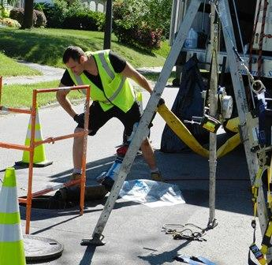
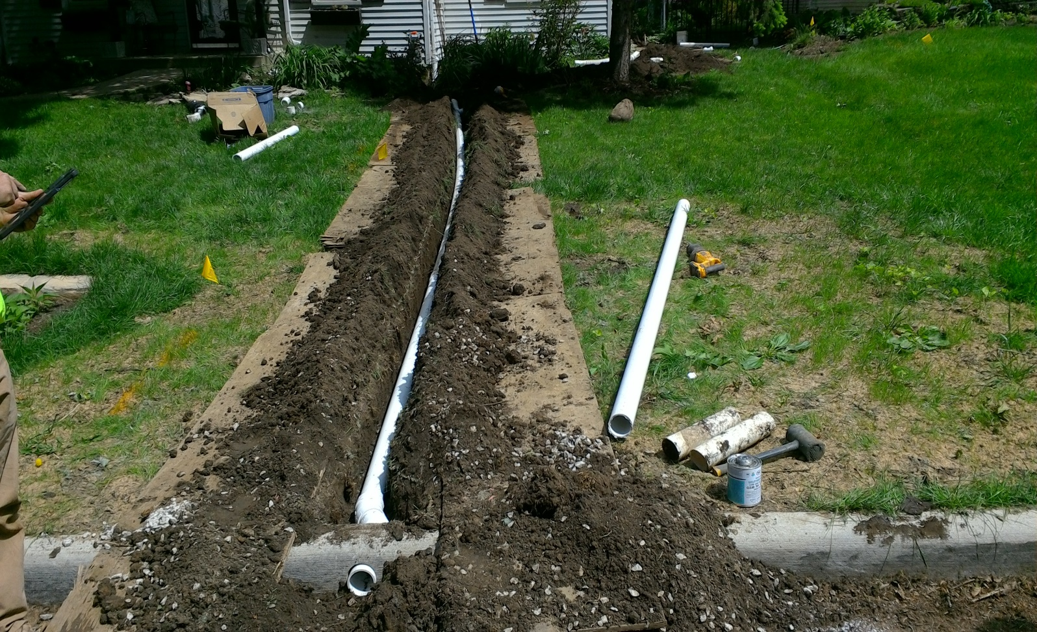
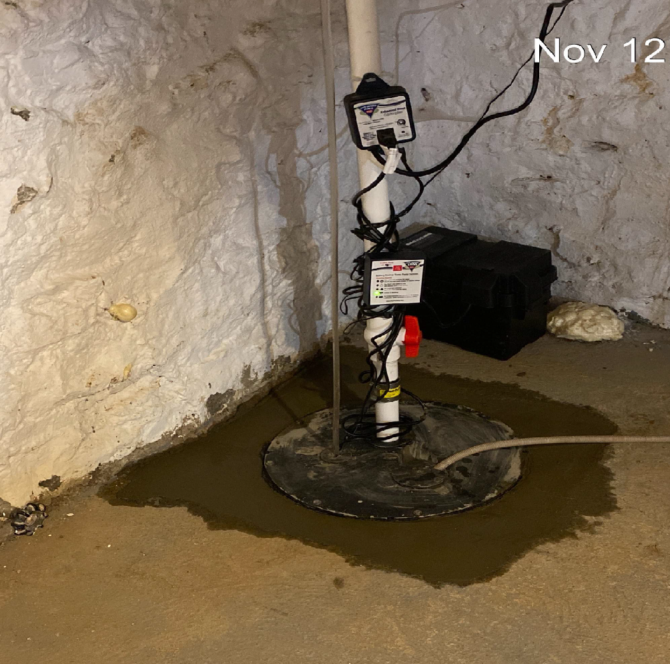
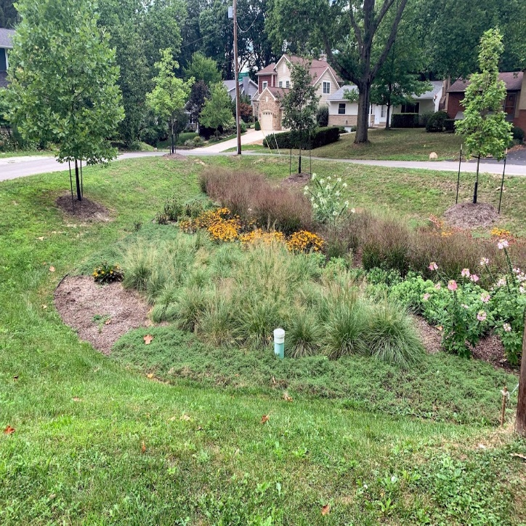
Blueprint Columbus is a City program to keep rainwater OUT of sanitary sewers with the goal of eliminating SSO’s and sewage backups in basements and improving the water quality of storm water discharges.
Lateral Lining
Roof Water Redirection
Sump Pumps
Green Infrastructure
Notes:
TIFFANY

Slide 6
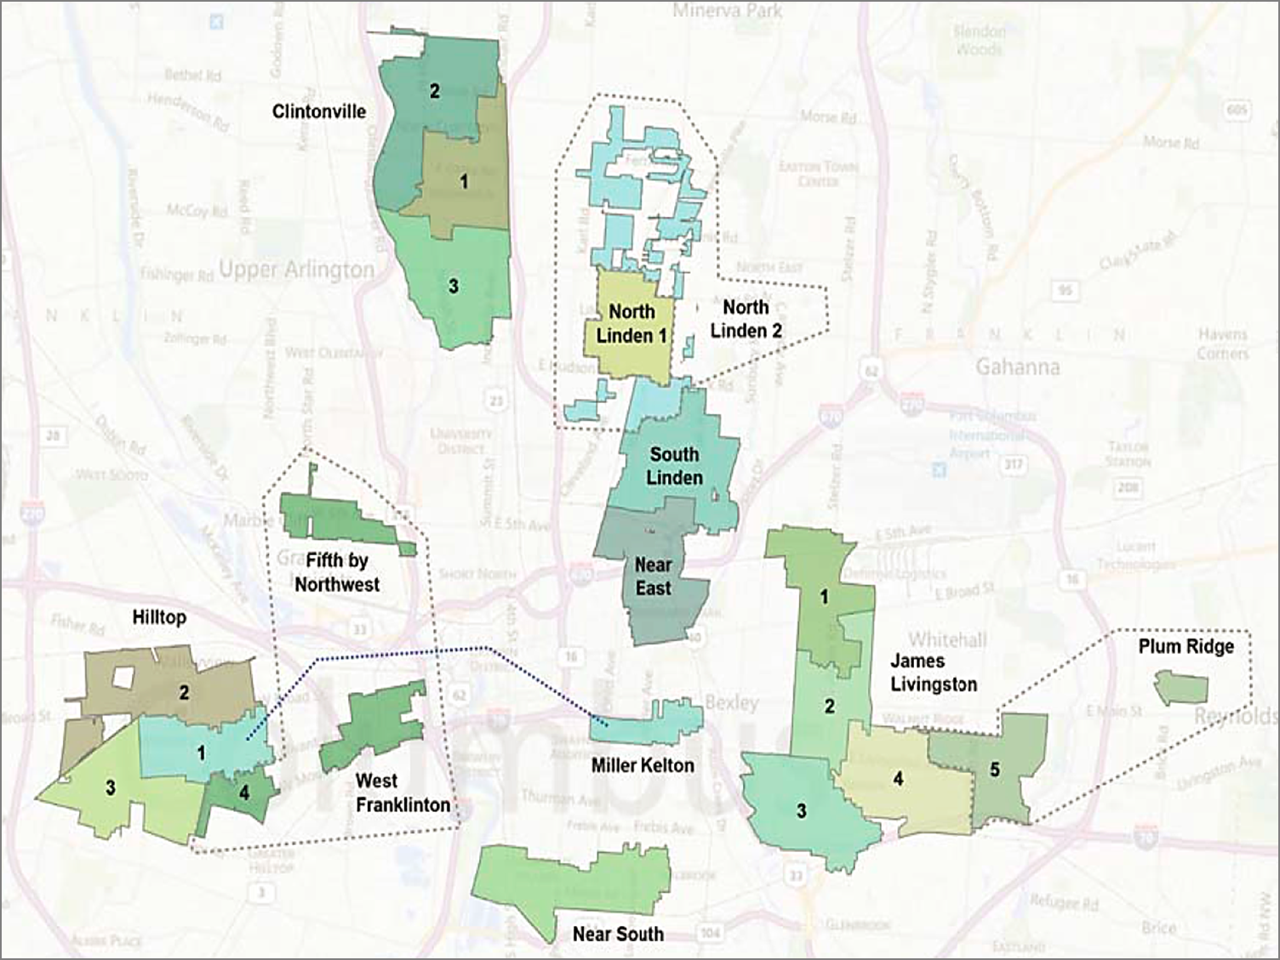
Blueprint Columbus
18,404 acres & 21 project areas throughout Columbus
Notes:
TIFFANY
With a project that spans this must of the City and lasts for over 30 years, we must realize the importance of being nimble when it comes to our approach to outreach. The boundaries drawn on this map—to a resident—seem very arbitrary. They do not follow the way the community itself defines each neighborhood. In order to successfully execute our project in each of these areas, we must look at them with an equitable lens. What works for one, may not work for others.
21 neighborhoods, 30-year project, determined by separate sanitary and storm sewers, locations of SSOs, frequency of SSOs and basement backups, as well as proximity of SSOs to schools, water sources, etc.

Slide 7
City of Columbus
Declaration of Equity
Notes:
Tiffany
As an outreach team, we can implement an equitable lens to our approach to engagement in many ways. However, sometimes it is a losing battle when the decision makers aren’t on the same page or policies do not support our intentions. • Structural Equity where decision-makers institutionalize accountability is therefore, extremely important. Structural equity means that decisions are made with recognition of historical, cultural and institutional dynamics and structures that have routinely advantaged privileged groups in society and resulted in chronic, cumulative disadvantage for subordinated groups.

Slide 8
City of Columbus Equity Definition
Equity is the fair treatment, access, opportunity, and advancement for all people, while at the same time, identifying and eliminating the barriers that have prevented the full participation of some groups.
Equity involves recognizing and understanding root causes of outcome disparities within our society
Notes:
Tiffany
While we have already addressed the fact that equitable engagement isn’t a new concept, the equity priority from our government is fairly new. In 2020 Mayor Ginther announced the City of Columbus Equity Agenda that calls out racism and discrimination where it exists and his plans to address it. Calling it “equity” and institutionalizing this in policy is the “new” part…Here is what the City of Columbus defines equity as…

Slide 9
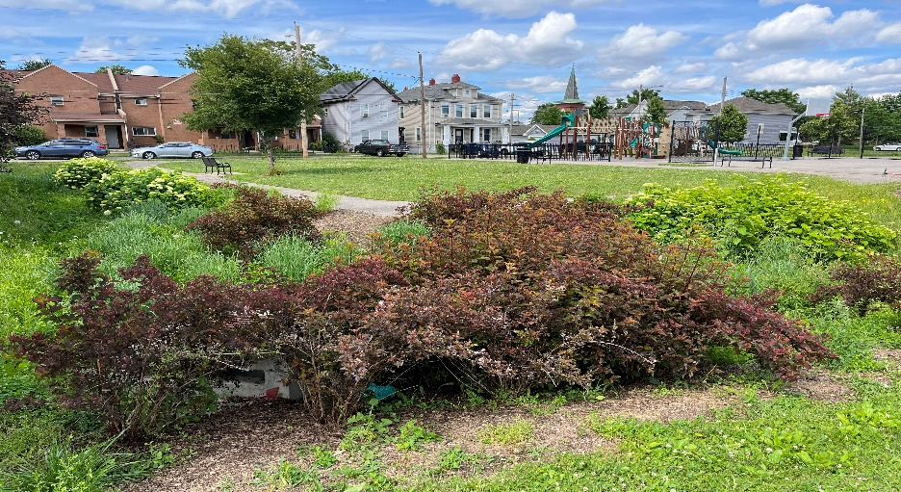
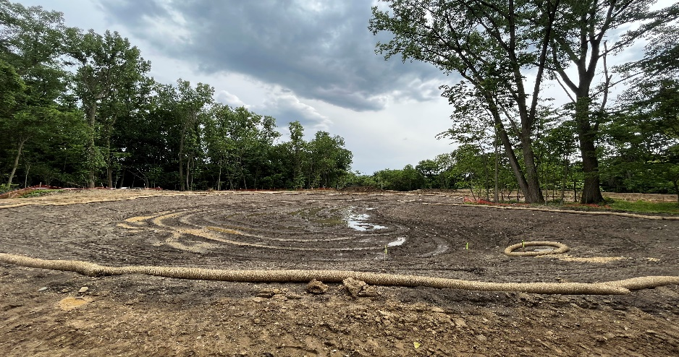
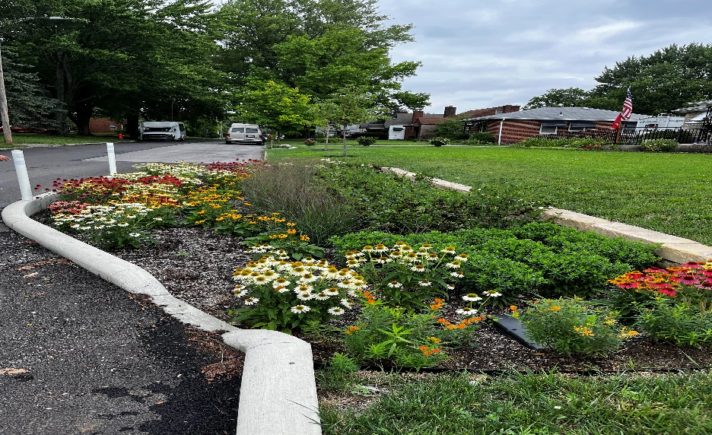
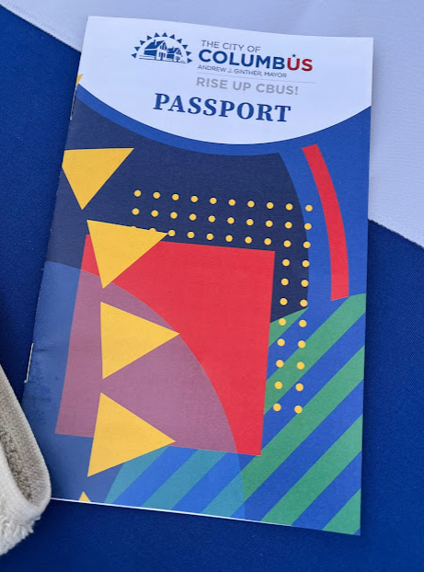
City Outreach Efforts
(Distributional Equity)
Setting Equity Goals
Doubling outreach contract
Coordinating with other city projects to find win-wins and ensure comprehensive solutions
  Slow Streets
  Park Development
  Community Gardens/green spaces
  Opportunity Rising
Notes:
Tiffany
These are some of the steps forward the City was able to take to further the Mayor’s agenda and begin to fine-tune our equity lens. With the expectation from the Mayor that equity should be a part of City programs, we were able make a more robust effort to intentionally incorporate these elements into our strategies.
Opportunity rising:
Opportunity Rising names 21 aspirations that Mayor Andrew J. Ginther has for every Columbus resident. In order to get everyone to a place of opportunity, we’ll need to think, act and invest our resources differently. Equitably.
To achieve the aspirations of Opportunity Rising, the City of Columbus will boldly collaborate with partners and residents, growing prosperity by dismantling racism together. This will benefit every Columbus resident through the community’s improved economic stability, stronger health and wellbeing, and safer, more resilient neighborhoods.

Slide 10
Building Equity into Projects
Notes:
Mo

Slide 11
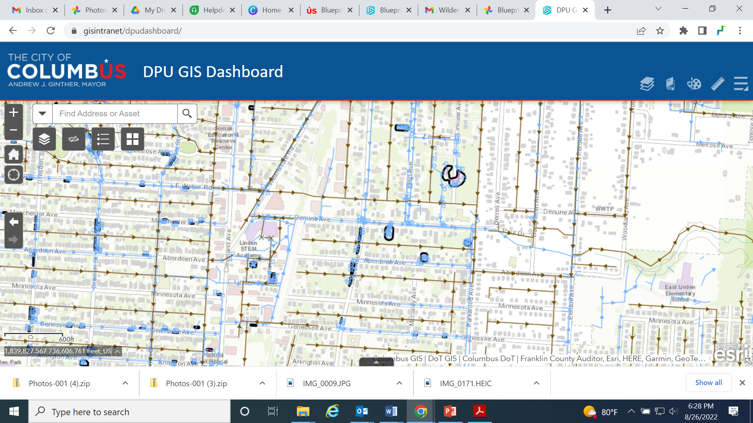
Blueprint is Unique
(Distributional Equity)
Project goals and methods are mandated by external regulatory body
Work on private property
“Neighborhood” boundaries defined by sewers (not neighborhood identity)
Day-to-day implementation is performed by external contractors
Notes:
Blueprint Columbus is different than any infrastructure project the Columbus Department of Public Utilities has ever done. Because green infrastructure is such a visible leave behind, using an equitable approach in our community engagement strategy has been critical to long-term community buy-in and effective solution development. In addition, creating the intention of equity throughout our project has resulted in important design and policy decisions that will help us to implement our program equitably throughout the city. Private property work….Had to get this right for the project to be successful.
Distributional Equity – programs and policies result in fair distribution of benefits and burdens across all. segments of a community, prioritizing those with highest need.

Slide 12
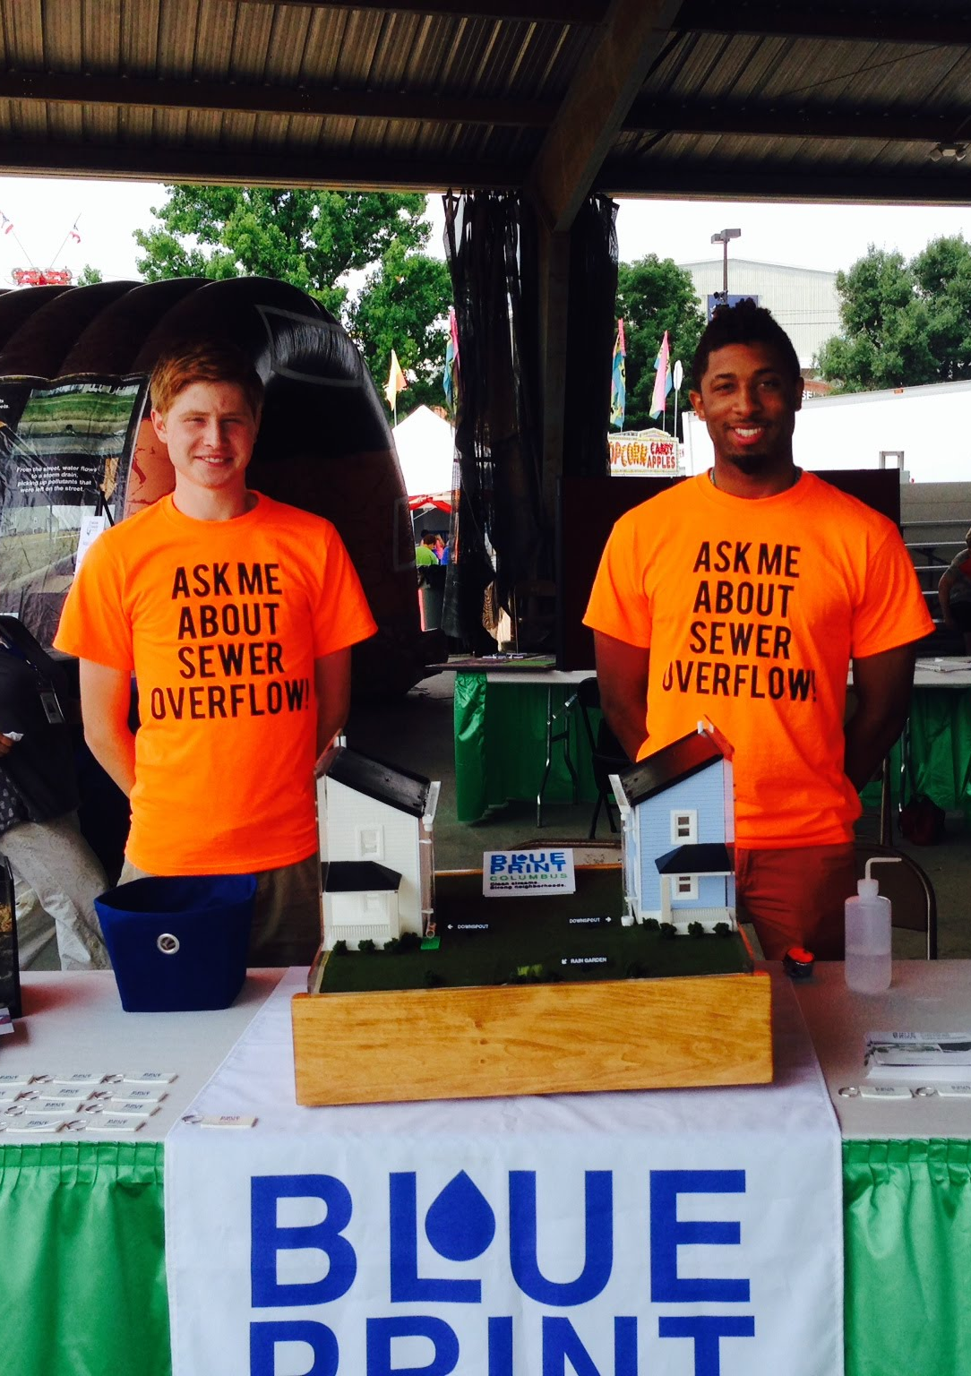
Early Thoughts About Equity
Balancing needs of neighborhood vs. consent decree requirements
Who are the faces of this project?
Outreach partner that can successfully engage with communities across the City
Notes:
Mo

Slide 13
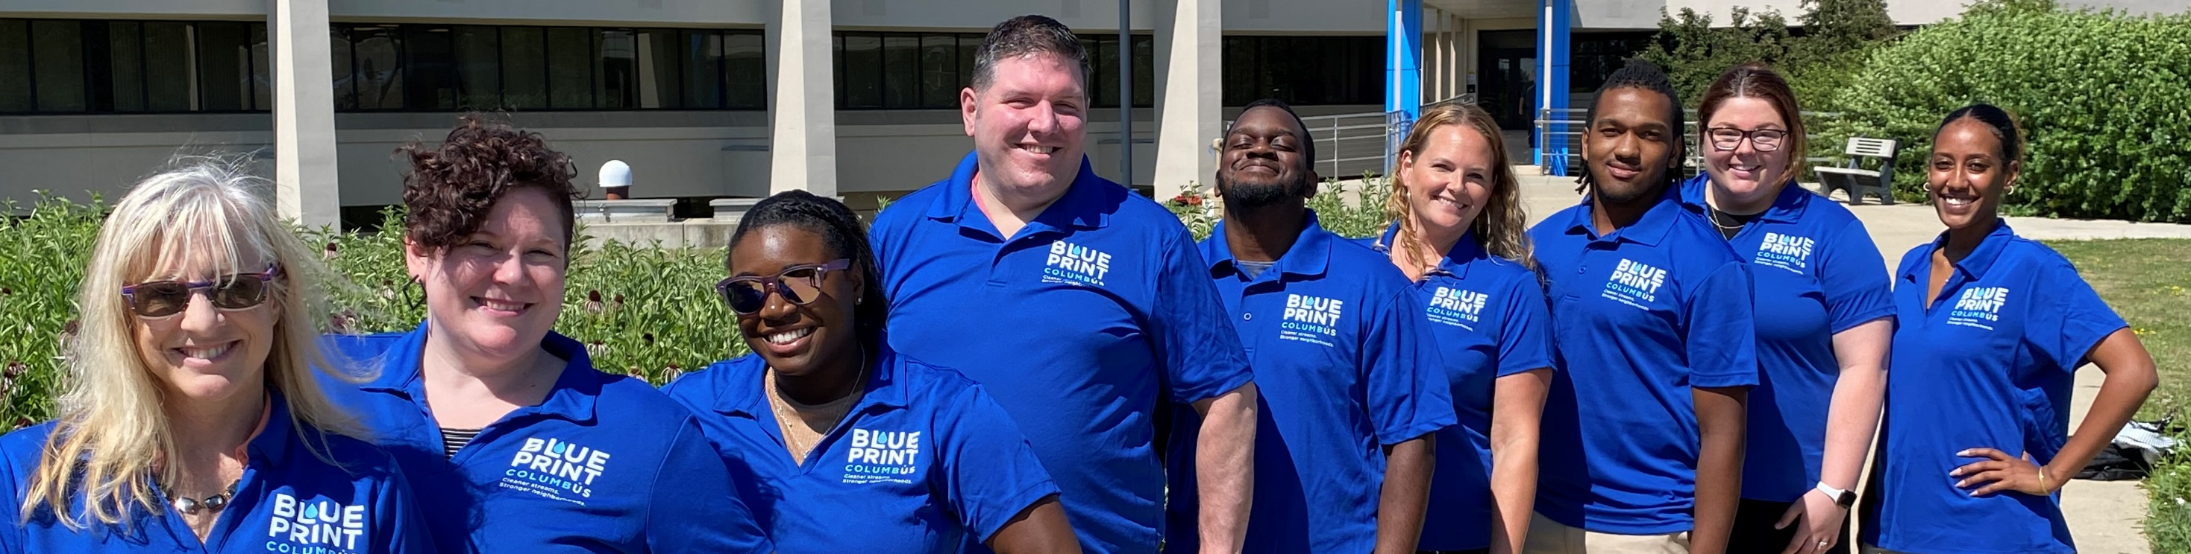
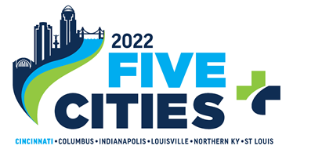
Blueprint’s Outreach Team
Notes:
Mo

Slide 14
Blueprint's Equity Evolution
Notes:
Mo

Slide 15
RAMA’s Engagement Strategies
Focus on meeting people where they are.
Staff Training
Training for contractor employees (who perform
day-to-day implementation)
Developing Buy-in
Surveys
Develop multiple messages to speak to different
needs / areas of interest
Communicating with Residents
Area commission Meetings
Translating Written Web materials
Relationships with Neighborhood Liaisons
311 data
Hosting Public Meetings
Attending Community Fairs, events, etc.
Create/Utilize advisory groups made up of representatives from the community
Notes:
Setting a strong foundation early with these engagement strategies.

Slide 16
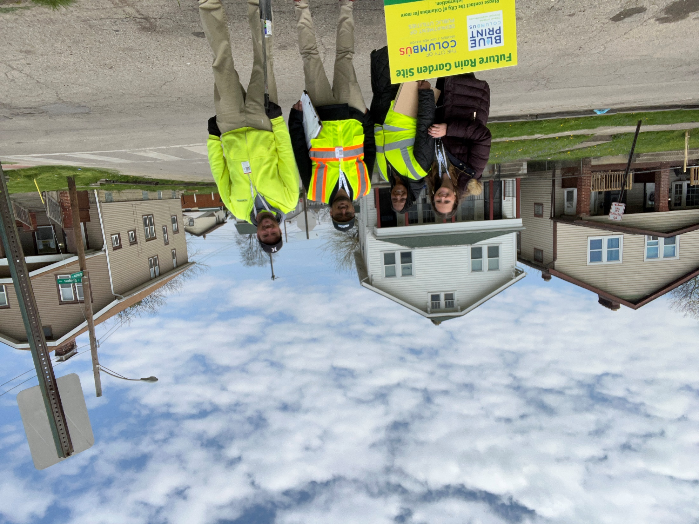
Blueprint’s Equity Evolution
  No one person can-or should-represent the project!
Approaching each neighborhood uniquely.
Personas
NET Training evolution
  Incorporating implicit bias training
Marketing efforts
  Bus bench ads
  Radio spots
  Posters
Virtual meetings
  Increased attendance
Community leader involvement
  Listening
  Canvassing door to door when recommended
  Smaller in-community meetings
Emphasis on translation and interpretation
Faces of our project
    More engineer involvement
    Focused areas for outreach team
Notes:
Mo

Slide 17
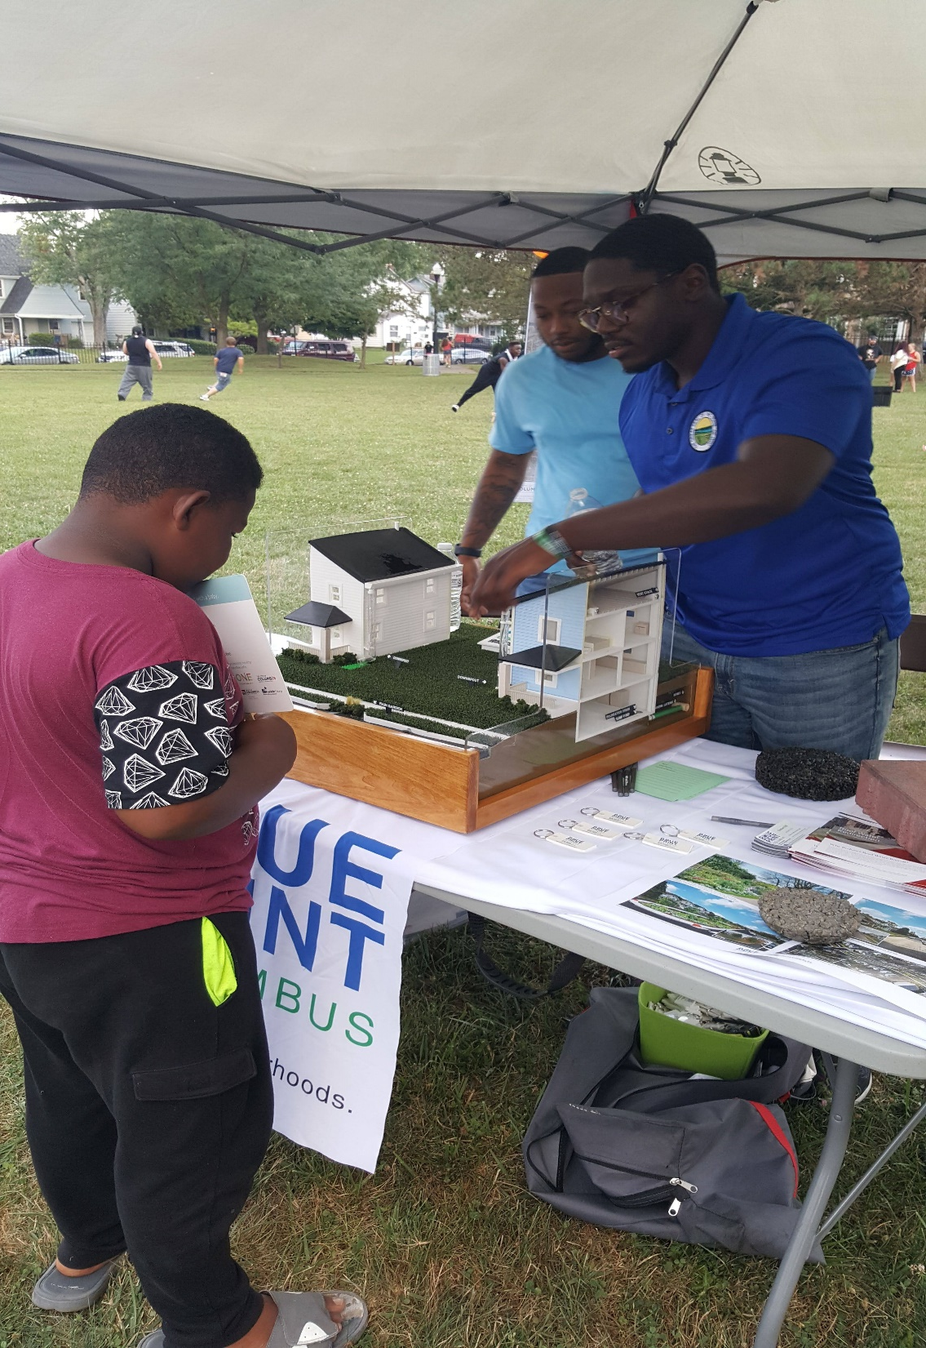
Equity is Intentional
Building equity into projects doesn’t necessarily require major organizational shifts
No matter where you sit in the organization, equity can be built into your processes or activities
Equity simply requires a willingness to listen, learn, and adjust your procedures to create space for different kinds of people
Equity is going back to grassroots—it’s meeting people where they ARE.
Appreciating the uniqueness of a neighborhood when planning outreach.
Notes:
Mo

Slide 18
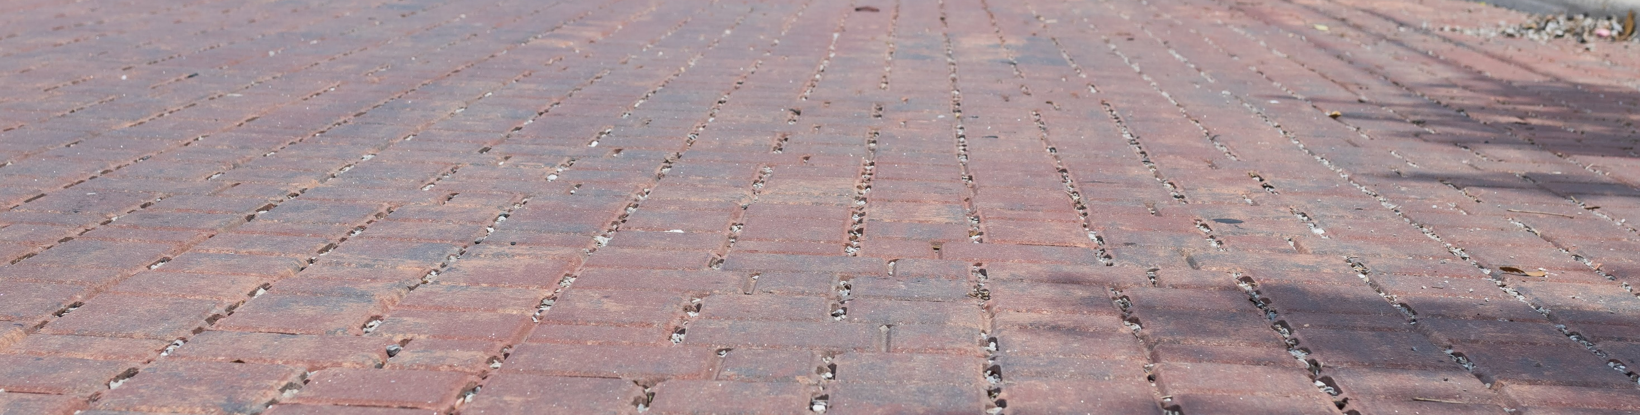
Blueprint’s Path Forward
Notes:
Where do we go from here
Where do we fall short?

Slide 19
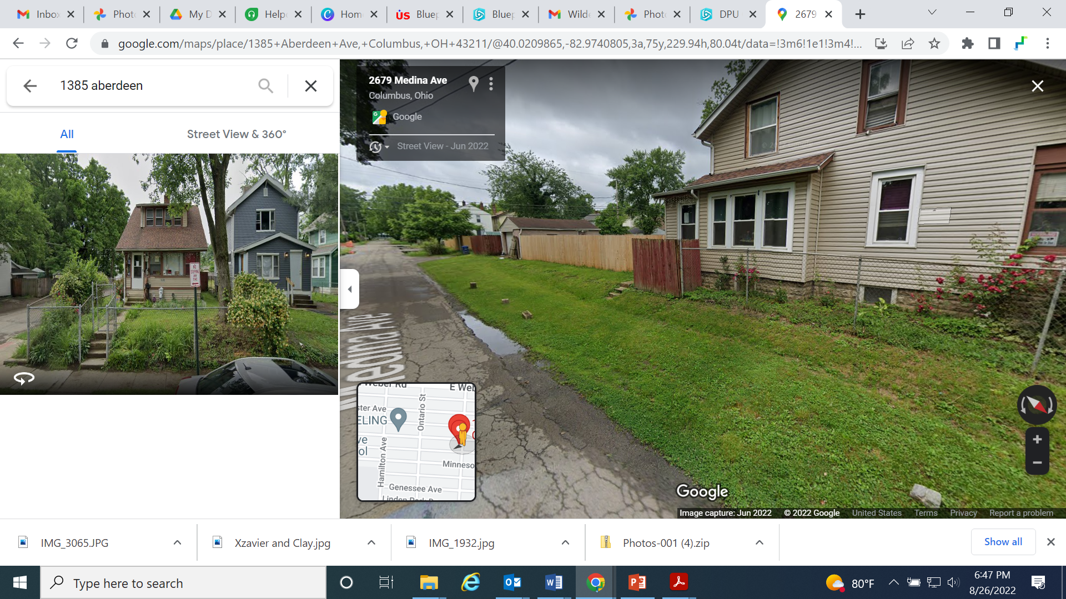
Cost of Progress
Unintended Consequences
Rules surrounding fences and other infrastructure in the right of way
Planting new trees
  leaves
Fear of code violations
Indirect impacts
  Waterline breaks
Notes:
Unintended consequences-people will not experience the project the same way, depending on their neighborhood or situation

Slide 20
Things that keep us up at night
  How do we make public in person meetings more accessible?
  How can we employ people from our neighborhoods to spread the message?
  How can we better work with businesses in our neighborhoods to spread support and message?
  How do we identify decision-making opportunities for the residents so that our final product is something the community values and can take pride in?
Notes:
for those with disabilities, elderly, the non-tech savvy, feed people

Slide 21
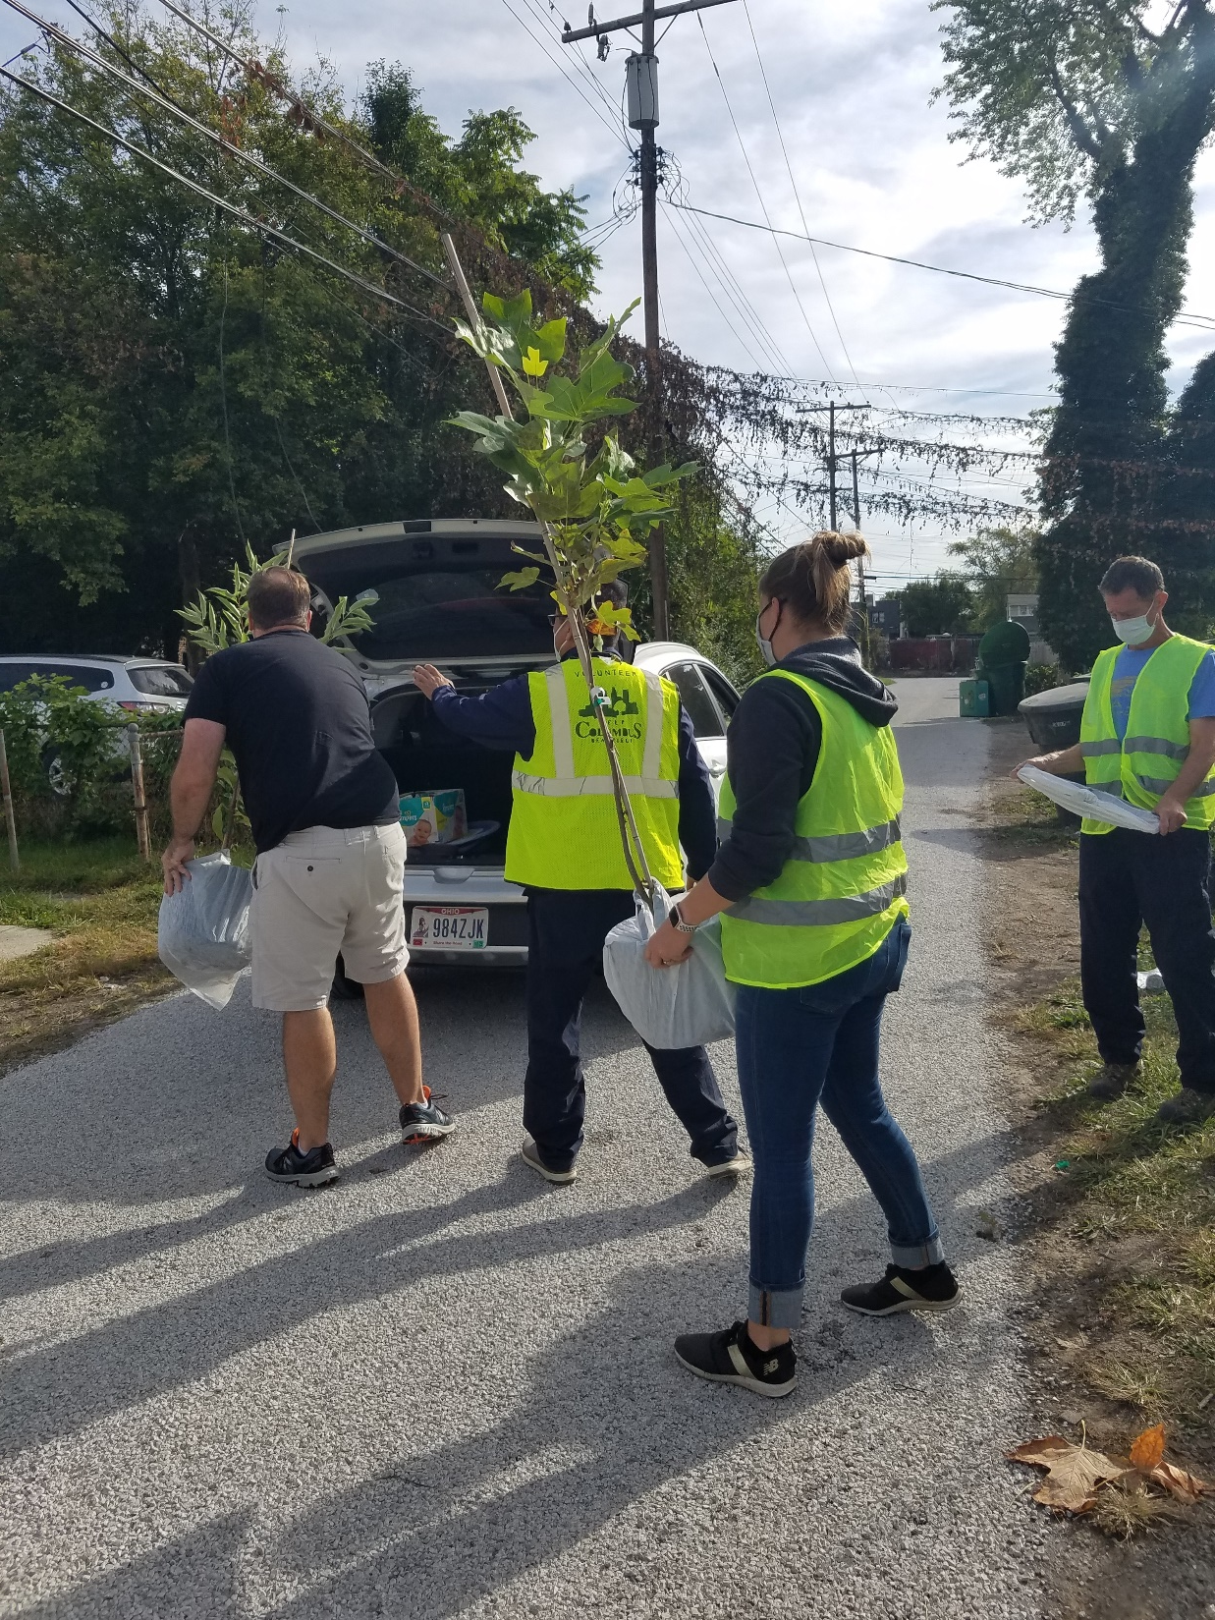
Where do we go from here?
Increasing our community partners and strong voices in neighborhoods
Collaborating with organizations that already have gained the trust of the community
Partnering with local businesses
Community committees
Volunteers
Notes:
What can we do to further our equitable approach to outreach? How can we do better and keep growing?

Slide 22
Bringing Equity into your infrastructure project
USDN Equity Self Assessment 2019
USDN Equity Foundations 2.0 2022
Green Infrastructure Leadership Exchange members
  Equity Peer Learning Group meets monthly
SENR Capstone (Outside Assessment)
  Environmental Justice and Equity Framework developed
    Used Opportunity Index
    Suggested working with community leaders
    Suggested taking into consideration the effects of green infrastructure on communities—small businesses, parking, safety, etc.
Notes:
Tiffany—things we did to get started…
We have taken some steps to build up our knowledge and fluency around equity and equitable engagement. We began by taking a look at our own personal and programmatic “level” of equity understanding by taking a self-assessment. We then were invited to be a part of the Green Infrastructure Leadership Exchange to have regular conversation with others nationally and internationally. This group has been an incredible source of information, tools, ideas, and guidance.
We asked the students at the Ohio State University’s School of Environmental and Natural Resources to assess our current equitable lens and suggest improvements. We were given an environmental justice and equity framework which was created using the Opportunity Index:
The Opportunity Index is an annual report developed by Opportunity Nation, a campaign of the Forum for Youth Investment, and Child Trends. The Index provides data that show what opportunity looks like in the United States.
Since 2011, the Index has provided a snapshot of conditions that can be used to identify and improve access to opportunity—in comprehensive terms—for residents and their communities. The data and full analysis online show how Opportunity Index scores have changed over time and what access to opportunity looks like today. The Index provides Opportunity Scores for all 50 states plus the District of Columbia and 2,065 counties, which together represent 97 percent of the US population.
Many factors influence the kinds of opportunity people have, starting with unchangeable characteristics such as gender, race and ethnicity, genetic factors and family background. The quality of parenting, a family’s income and individual health as well as the health and safety of neighborhoods, the quality of schools and the inclusiveness of one’s community—all of these can respond to improvement efforts at personal, institutional and societal levels. These conditions vary from place to place, as well as over time, and that is why these conditions are the focus of the Opportunity Index.
The multidimensional nature of the Opportunity Index provides a broad picture of opportunity that goes beyond economics alone. The 2019 Index includes indicators within four dimensions of community well-being:
Economy
Education
Health
Community

Slide 23
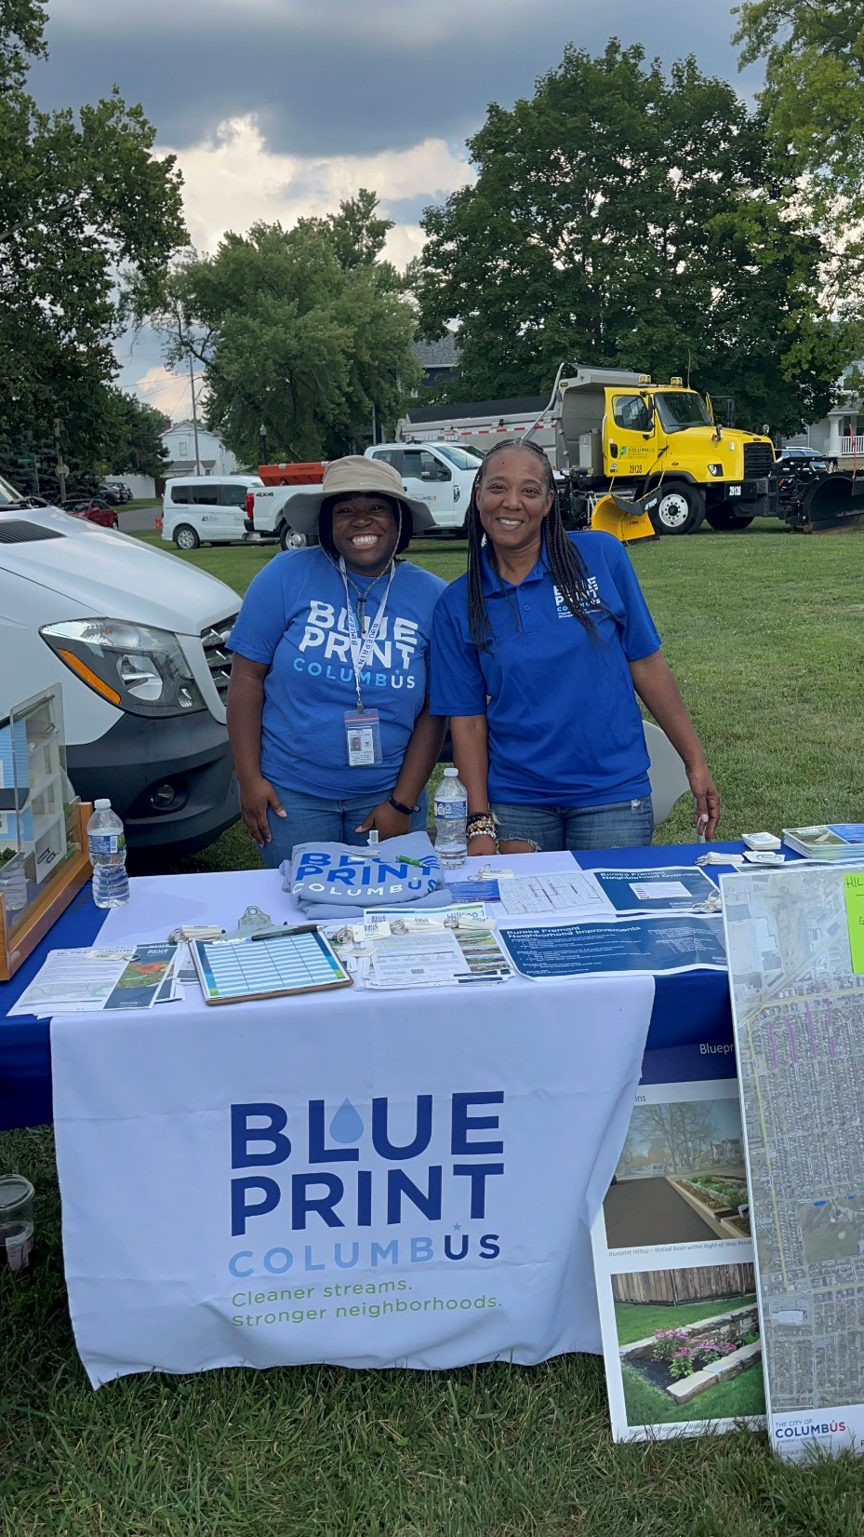
Takeaways
Equity is a journey, not a destination.
Team cohesiveness regarding looking at the program with an equitable lens is critical.
It’s the little things:
  Speaking someone’s language
  Appreciating the value of the community’s time
Who you bring to the table matters.
Let go of the need to be the main message bearer: trusted faces are more effective than City badges.
Notes:
We are always learning and developing our understanding of what equity means.

Slide 24


Thank you!
blueprintneighborhoods.com
Follow us!
@blueprintcbus
Notes:
Questions

