Slide 1


Brian Hoelscher, PE, ED & CEO
Executive Director Report
September 28, 2022
Notes:
B

Slide 2

STORMWATER SERVICE IN THE ST. LOUIS AREA
01
Regulatory (MS4)
Funded since 1954
02
5 Cities
Storm Sewer O&M
Funded since 2016
03
Stormwater Capital for
Flooding & Erosion
Minimal
Notes:
B

Slide 3
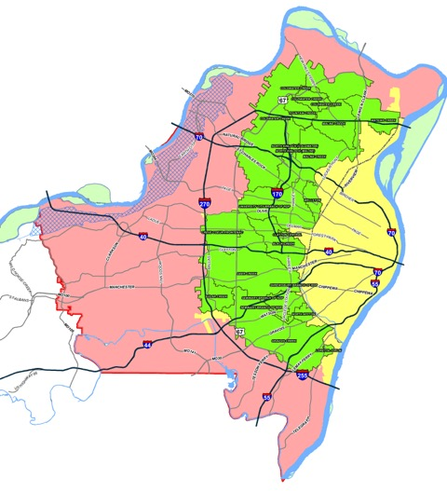
Service Boundaries
Notes:
B

Slide 4
Current Situation
  $700 million in problems identified
  $9.8 million/year in OMCI revenue
            $51 million ARPA grant request, using $7.4 million local match
                Selection criteria—water quality, environmental justice, level of local match
                Focus on 4 packages / 7 projects--$17.3 million grant, $5.9 million local match
                Proposed ballot election in April 2024
Notes:
B

Slide 5
Public Acceptance
  Research shows people are willing to pay $25/year
  In 2019, stormwater vote lost—53% yes to 47% no
  Proposal–revenue, expenditures, implementation
Notes:
B

Slide 6
Revenue
  Property tax of 7 ½ cent ($25/year) for residential properties (affordability)
  Impervious area rate for non-residential (equity)
  Together, these will generate $30 million/year
Notes:
B

Slide 7
Expenditures
  60% District-wide capital program
  30% Municipal grants
  10% Environmental Justice-area capital program
Notes:
B

Slide 8
Implementation
  Election in April 2024
  Impervious charge—start collecting monthly in January 2025
  Existing OMCI tax—turn off after calendar year 2024
  New property tax—collect at end of calendar year 2025
Notes:
B

Slide 9
Notes:
B

Slide 10
Notes:
B

Slide 11
Notes:
B

Slide 12
Our Focus
  Area-wide attention to the issue and implementation
  “Don’t forget the $700 million.”
Notes:
B

Slide 13
Thank you
September 28, 2022
Notes:
B

