Slide 1
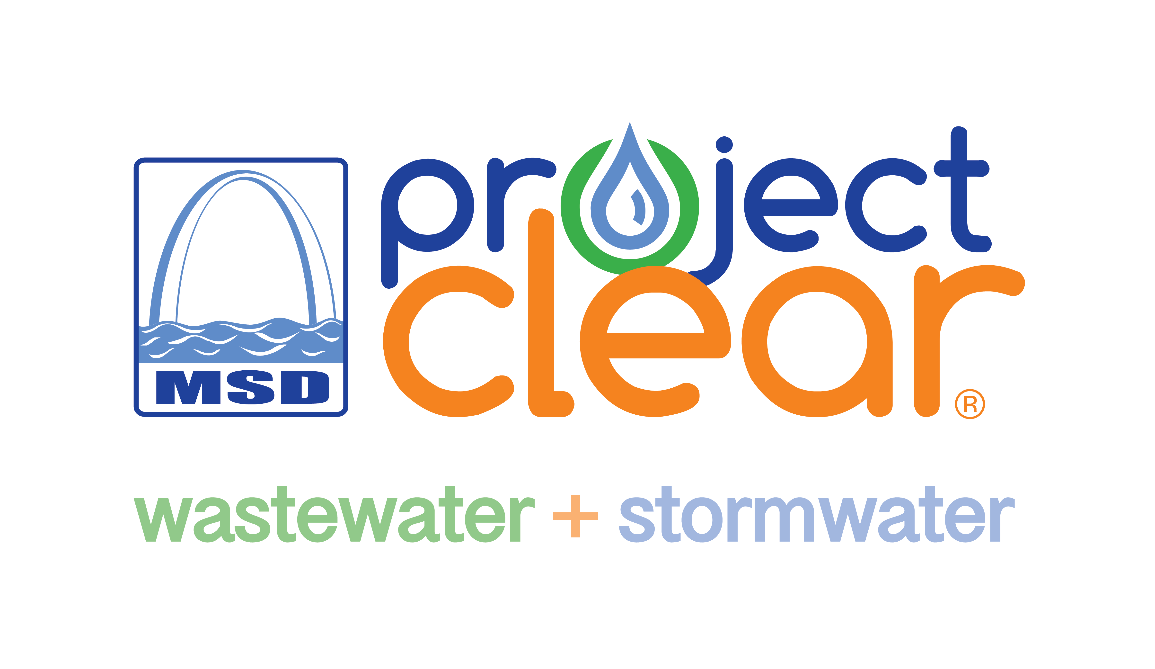
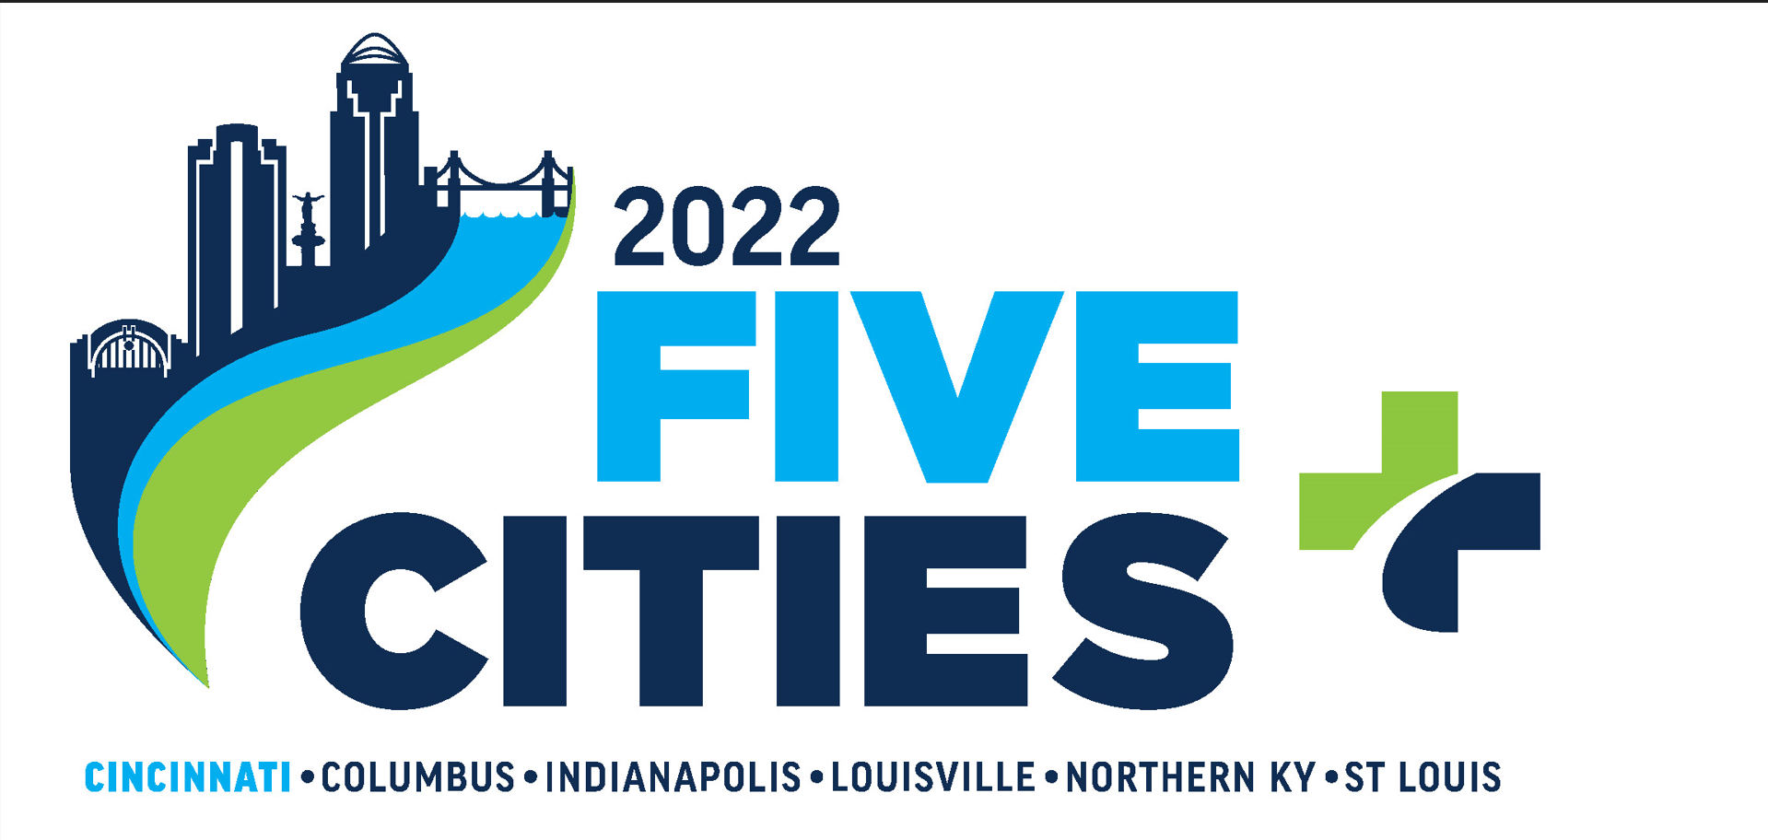
A Pragmatic Approach to Cybersecurity Risk
MSD St. Louis Missouri
Ginny Kienstra – CTO/Assistant Director Technology

Slide 2
Presentation Topics
Cybersecurity risk trends for Water and Wastewater Utilities.
Why are Water and Wastewater utilities targets for cybersecurity exploit?
3. Cybersecurity tools and services market growth.
4. Pragmatic approach to reducing Cybersecurity Risk: Process, Policy and Audit

Slide 3
Cybersecurity risk trends for Water and Wastewater Utilities

Slide 4
Water and Wastewater Utilities Risk Trends
2018
2020
2021
2022
Notes:
Describe CISA or WaterISAC

Slide 5
Water and Waster Water Utility Attacks
2019 -> Ellsworth County Kansas, Post Rock Rural Water District – a former employee used remote control system and attempted to shut-down the plant’s cleaning and disinfecting operations.
2021 ->Cybercriminals used an unknown ransomware variant against a Nevada-based WWS facility. The ransomware affected the victim's SCADA system and backup systems.
2021 -> San Francisco Bay California, an attacker reportedly took control of a local water treatment facility and deleted computer programs involved in the treatment of drinking water.
2021-> Oldsmar Florida Water Treatment Plant, a hacker gained access to a TeamViewer account and raised the levels of lye in the drinking water to poisonous levels. The usernames and passwords for at least 11 Oldsmar employees have been traded on the dark web.

Slide 6
Why are Water and Wastewater utilities targets for ransomware and cybersecurity exploit?

Slide 7
Why are Water and Wastewater Utilities Targets for Cybersecurity Exploit?
Water and Wastewater utilities run by small government entities have limited budget for information technology and security.
Due to the pandemic, remote work software and connectivity to the Business network expanded areas for cybercriminals to exploit vulnerabilities.
Advances in mobile technology and the increased use by utilities have opened external access areas for cybercriminals to exploit.
Interconnectivity between the Business Network and the Operational Network occurred (membership, backup and internet services). This interconnectivity allows attackers access to both networks with a single foothold.
50,000 security disasters waiting to Happen: The Problem of America's water Supplies..
Notes:
Public Health and safety examples: 2021 Florida Water system – an ex-employee remotely accessed the network and increased the level of sodium hydroxide content

Slide 8
Why are Water and Wastewater Utilities Targets for Cybersecurity Exploit?
Cybercriminals and Nation State actors can impact on Public Health and Safety causing overflows, flooding or un-safe drinking water.
Older SCADA and PLC devices were developed prior to the emergence of the internet therefore preventive security controls were not a design requirement.
Technology trends in Operational Technology for remote monitoring (Smart Meters) lack standard remote access security (encryption, authentication).
Notes:
Public Health and safety examples: 2021 Florida Water system – an ex-employee remotely accessed the network and increased the level of sodium hydroxide content

Slide 9
Cybersecurity Tools and Services Market Growth

Slide 10
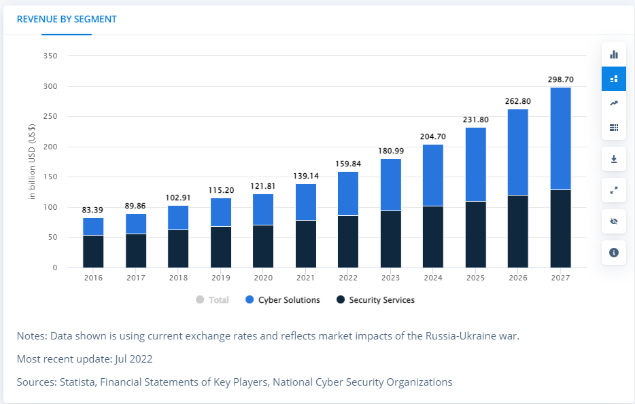
Cybersecurity Tools and Services Market Growth
So which tools and services should we deploy to minimize security risk?
Notes:
2016 – 2022 – market doubled and will again – hard to determine what to buy or what needed
Must spend some budget but more appropriate or targeted – otherwise you can get lost in tools and services

Slide 11
Reducing risk using a Pragmatic Approach

Slide 12
Three-pronged pragmatic approach – Process, Policy, and Audit
Utilize process Standards and Guidance from Water sector organizations.
NIST CSF - Identify, Protect, Detect, Respond, and Recover from cyber attacks.) framework.
Membership in AWWA, WaterISAC, GovTech, CISA and utilize practical, specific guidance and publications.
2. Implement security Policies to proactively reduce risk.
Security Awareness policy and program for end-user education.
Implement policies as specified by cybersecurity standards – password complexity, appropriate use, remote access, mobile device, vulnerability management.
Policy requiring N-1 version and patching compliance to address vulnerabilities.
3. Audit and Monitor
Annual Penetration Testing ( internal/external).
Phishing exercises.
Utilize security rating services to measure and monitor external risk.
Communicate security ratings and audit results to Executives and Board.
Notes:
Water Information Sharing and Analysis Center
NIST and CSF - The National Institute of Standards and Technology’s (NIST) Cybersecurity Framework

Slide 13
1. Process Standards and Guidance
For example:
Cyber Security Warning to Water and Wastewater Systems
The USEPA and WaterISAC are alerting the water and wastewater systems sector to new information regarding a potential cyber threat to United States critical infrastructure related to geo-political tensions.
WaterISAC recommended the following key actions for water and wastewater
Require Strong, Unique Passwords.
Implement Multi-Factor Authentication.
Address known exploited vulnerabilities.
4) Surge Support.
5) Network/Systems Awareness.
6) Backup Data.
7) Incident Response Plans.
8) Manual Operations.
Implemented Feb 2020
Implemented June 2021
Adopted N-1 Patching Policy Oct 2021
Added 24X7 Security Services Dec 2021
Added IDS security tools Jan 2022
Disaster Recovery Site – Oct 2021
Created April 2021
The District EOP established

Slide 14
1. Process standards and guidance
For example:
Water ISAC published – 15 Cybersecurity Fundamentals for Water and Wastewater Utilities
Best Practices to Reduce Exploitable Weaknesses and Attacks
Perform Asset Inventories
Assess Risk
Minimize Control System Exposure
Enforce User Access Controls
Safeguard from un-authorized physical access
Install Independent Cyber-Physical Systems.
Embrace vulnerability management
Create a Cybersecurity Culture
Develop and Enforce Cybersecurity Policies and Procedures
Implement Threat Detection and Monitoring
11. Plan for Incidents, Emergencies and Disaster
12. Tackle Insider Threats
Secure Supply Chain
Address All Smart Devices (IoT, Mobile, etc.)
15. Participate in information sharing and collaboration communities.
Notes:
NIST framework is extensive but recommendations and publications like this WaterISAC are more specific and practical

Slide 15
2. Implement Policies to reduce risk
Security Policy Development:
Use templates provided by SANS Institute and CIS (Center for Internet Security)
IT Risk assessments and audits will identify required policies
Important to publish then require all employees/users read and acknowledge at the point of hire and then annually.
Review annually because as technology changes, policies must align
Security Awareness Training and Education:
Annual Phishing and Social Engineering training
Periodic simulated social engineering exercises in the form of phishing (email)
Additional training is assigned to employees who fall prey to the simulated tests to help improve identification and awareness of social engineering techniques and avenues.
Quarterly security blogs and security awareness posters and messages are posted at all locations.
82% of data breaches involve a human element, like a user clicking a link in a phishing email, according to the Verizon 2022 Data Breach Investigations Report.
Notes:
MSD uses KnowB4 but there are others – Proofpoint

Slide 16
Patching Policy example:
Policy for lifecycle management N-1
Issues that drove the change:
Existing patch and upgrade practice applied only when the application or operation system went out of support.
Lead to increased risk of operating critical business applications on software that was not supported by vendors or patched for security
Effort for upgrades was greater since prior versions were require to be applied to move up to the next version
The organization did not realize any new functionality that version upgrades provided
Internal Audit Penetration testing exploited vulnerabilities and breached the network and then performed un-authorized access to the systems.
Approach to address lifecycle and vulnerability management.
Policy instituted that mandates computing assets (servers, databases, network devices and applications) be either
on the latest version = N (OS/App/IOS)
Or one version prior N-1.
KPIs implemented to measure compliance – following Plan, Do, Check.
Notes:
The Pen test was eye opener and drove change

Slide 17
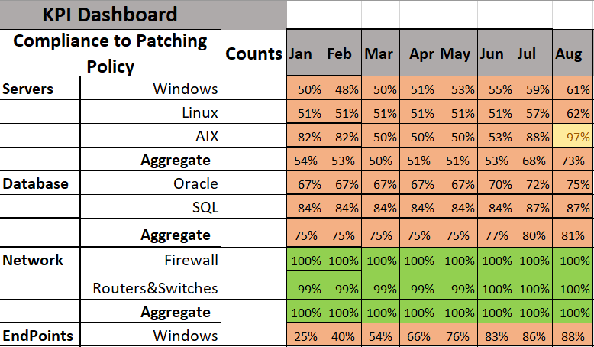
Server Compliance 8/2022
Monitor and measure policy compliance using Key Performance Indicators – KPIs

Slide 18
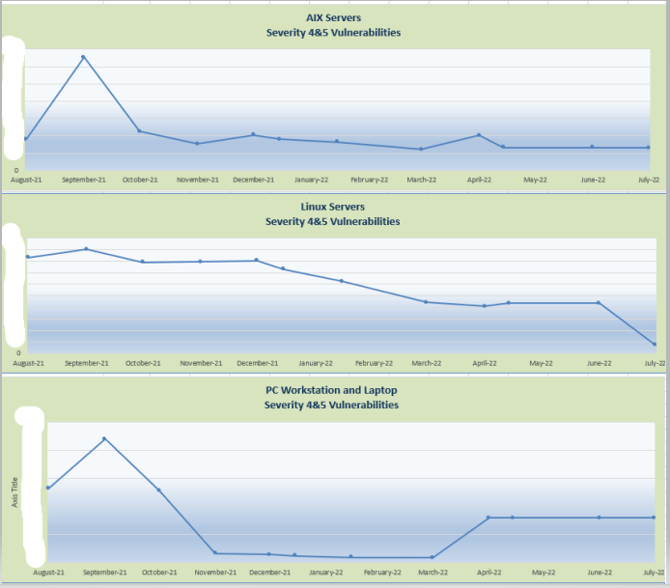
Server Compliance 8/2022
Vulnerability Reduction as a Result of N-1 Policy Compliance progress

Slide 19
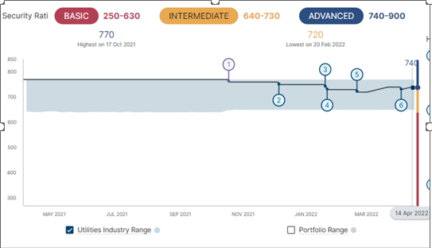
3. Audit, Monitor, and Measure Security Risk
Computed by BitSight (other tools - Security Scorecard)
A cybersecurity ratings company that analyzes companies, government agencies and educational institutions.
Ratings are supplied to banks and insurance companies (like a Credit Score).
External view – no special access, what a cybercriminal could assess without any special access given.
Notes:
Like credit score -

Slide 20
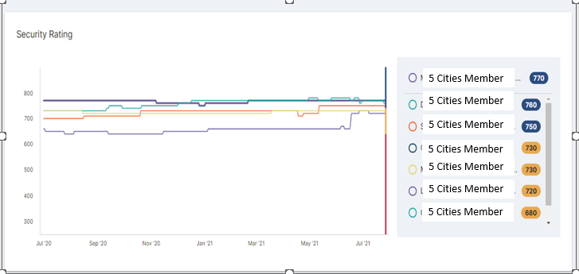
Security Rating - Third Party Comparison
The tool can be used to review vendor and business partner security ratings.

Slide 21
In Summary:
To reduce cybersecurity risk – a three-pronged pragmatic approach can be used.
Standards and Guidance– Follow and implement standards, utilize security guidance from organizations specific to Water and Wastewater management.
Policy – Implement policies identified thru audit and standards, then educate and communicate to employees. Implement a security awareness program to educate employees about security risk.
Audit and Monitor– conduct routine security audits
Measure external security rating (what the cybercriminal can see).
Execute phishing exercises to help employees develop skills and measure / report results.
Execute annual penetration testing
Notes:
Like credit score -

Slide 22
Questions ?

Slide 23
2018 -> American Water Works Association (AWWA ) issued the following:
“Government intelligence confirms the water and wastewater sector is under a direct threat as part of a foreign government’s multi-stage intrusion campaign, and individual criminal actors and groups threaten the security of our nation’s water and wastewater systems’ operations and data.”

Slide 24
2019 -> Cybersecurity Infrastructure Security Agency (CISA) issued:
“CISA is aware of a recent rise in malicious cyber activity directed at United States industries and government agencies by Iranian regime actors and proxies. We will continue to work with our intelligence community and cybersecurity partners to monitor Iranian cyber activity, share information, and take steps to keep America and our allies safe.

Slide 25
2020 -> Cybersecurity Infrastructure Security Agency (CISA) issued:
Risk Management for Novel Coronavirus:
Malicious cyber actors could take advantage of public concern surrounding COVID-19 by conducting phishing attacks and disinformation campaigns.

Slide 26
2021 -> CISA/FBI/EPA/NSA issued Cybersecurity Alert:
“ highlight ongoing malicious cyber activity—by both known and unknown actors—targeting the information technology (IT) and operational technology (OT) networks, systems, and devices of U.S. Water and Wastewater Systems (WWS) sector facilities.”

Slide 27
2022 -> The US EPA and Water Information Sharing & Analysis Center (WaterISAC) issued the following alert :
Due to current events between Russia and Ukraine, WaterISAC and the US EPA strongly encourage water and wastewater system owners and operators to maintain a heightened awareness for possible intrusions into their operational networks and to prepare to maintain critical operations if process control networks are disabled.

Slide 28
Links to articles related to Attacks on Drinking and Water and Wastewater Utilities and links to references made in this presentation
https://dnr.mo.gov/cyber-security-warning-water-wastewater-systems
https://www.cisa.gov/sites/default/files/publications/infographic-manage-wastewater-national-critical-function-102021-508.pdf
www.cisa.gov/uscert/ics/waterisac-releases-cybersecurity-fundamentals
50,000 security disasters waiting to happen: The problem of America's water supplies
https://www.statista.com/outlook/tmo/cybersecurity/worldwide
https://www.verizon.com/business/en-sg/resources/reports/dbir/

Slide 29
Links to articles related to Attacks on Drinking and Water and Wastewater Utilities and links to references made in this presentation
The Water Information Sharing and Analysis Center (WaterISAC) is the designated communications arm of the United States Water and Wastewater Sector. WaterISAC helps utilities in the U.S., Canada, and Australia measure and reduce risk, improve resiliency, prepare for physical and cyber threats, and recover from disasters.
WaterISAC members have access to the world’s largest and richest source of information and tools for strengthening water and wastewater utility security, preparedness, resilience, and emergency management.
WaterISAC also supports federal, state, and local government agencies involved in water resources, law enforcement, emergency response, intelligence, and public health to inform programs and initiatives to protect critical infrastructure and public health.
WaterISAC is a non-profit organization created in 2002 by utility managers and is governed by a board appointed by the leading national water and wastewater organizations.
To log in to WaterISAC’s secure portal, go to www.waterisac.org.

Slide 30
Links to articles related to Attacks on Drinking and Water and Wastewater Utilities and links to references made in this presentation
The Cybersecurity and Infrastructure Security Agency (CISA) leads the national effort to understand, manage, and reduce risk to our cyber and physical infrastructure. We connect our stakeholders in industry and government to each other and to resources, analyses, and tools to help them build their own cyber, communications, and physical security and resilience, in turn helping to ensure a secure and resilient infrastructure for the American people.

Slide 31
Links to articles related to Attacks on Drinking and Water and Wastewater Utilities and links to references made in this presentation
National Institute of Standards and Technology - NIST develops cybersecurity standards, guidelines, best practices, and other resources to meet the needs of U.S. industry, federal agencies and the broader public. Our activities range from producing specific information that organizations can put into practice immediately to longer-term research that anticipates advances in technologies and future challenges.
Some NIST cybersecurity assignments are defined by federal statutes, executive orders and policies. For example, the Office of Management and Budget (OMB) mandates that all federal agencies implement NIST’s cybersecurity standards and guidance for non-national security systems. Our cybersecurity activities also are driven by the needs of U.S. industry and the broader public. We engage vigorously with stakeholders to set priorities and ensure that our resources address the key issues that they face.
NIST also advances understanding and improves the management of privacy risks, some of which relate directly to cybersecurity.

