Slide 1
City of Columbus Update
September 28, 2022

Slide 2
Consent Order History
2002 Sanitary Sewer Overflow (SSO) Consent Order
  System Evaluation and Capacity Assurance Plan (SECAP)
    2045 Completion Date
2004 Combined Sewer Overflow (CSO) Consent Order
  CSO Long Term Control Plan (LTCP)
    2025 Completion Date
SECAP and LTCP were combined to form the 2005 Wet Weather Management Plan (WWMP)
  Submitted July 1, 2005

Slide 3
WWMP Capital Program
Major Capital Projects focused on treatment plant and tunnels to address CSO and SSO
First of these projects started in 2005 at the WWTPs
Treatment plant project highlights
  Treatment Plant work increased each plant capacity 50%
    Projects completed in 2011
    Jackson Pike WWTP: ($96 Million)
    Southerly WWTP: ($550 Million)
Collection System Project Highlight
  OARS tunnel provides approximately 55 MG of storage
    Project Completed in 2017 ($371 Million)

Slide 4

Blueprint Plan
In December 2015, Ohio EPA granted approval for City to revamp WWMP with Blueprint Columbus
  Treat the root cause of overflows – Inflow/Infiltration
Ohio EPA in 2018 extended deadline of completion to 2045 to match original WWMP

Slide 5
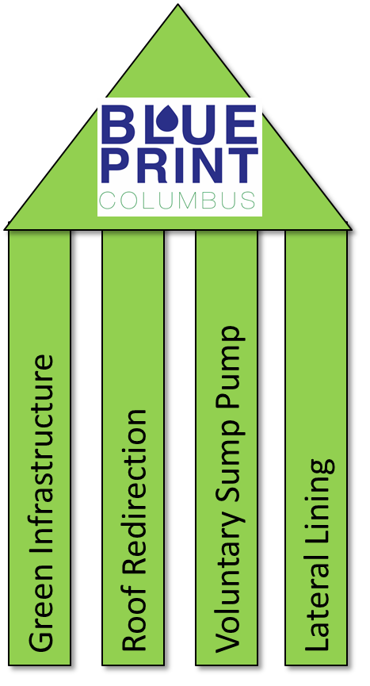
Blueprint Plan
Core Changes from the WWMP
  Blueprint Neighborhoods
    4 Pillar Approach
  Chemically Enhanced Primary Treatment (CEPT)
    Substantially Completed in 2021
  Lower Olentangy Tunnel (LOT)
  Real Time Control (RTC)
Combined Sewer Overflow (CSO) projects from the WWMP generally remained

Slide 6
Blueprint Clintonville 1 (2012)
Green Infrastructure
  All 6 projects complete
  415 rain gardens constructed
  4 Blocks of Pervious Pavers
Sump Pump Program
  Over 585 sump pumps installed
Downspout Redirection/lateral lining
  All 6 project areas completed
  2370 laterals lined
  1790 Homes with redirected downspouts
Active post-construction monitoring

Slide 7
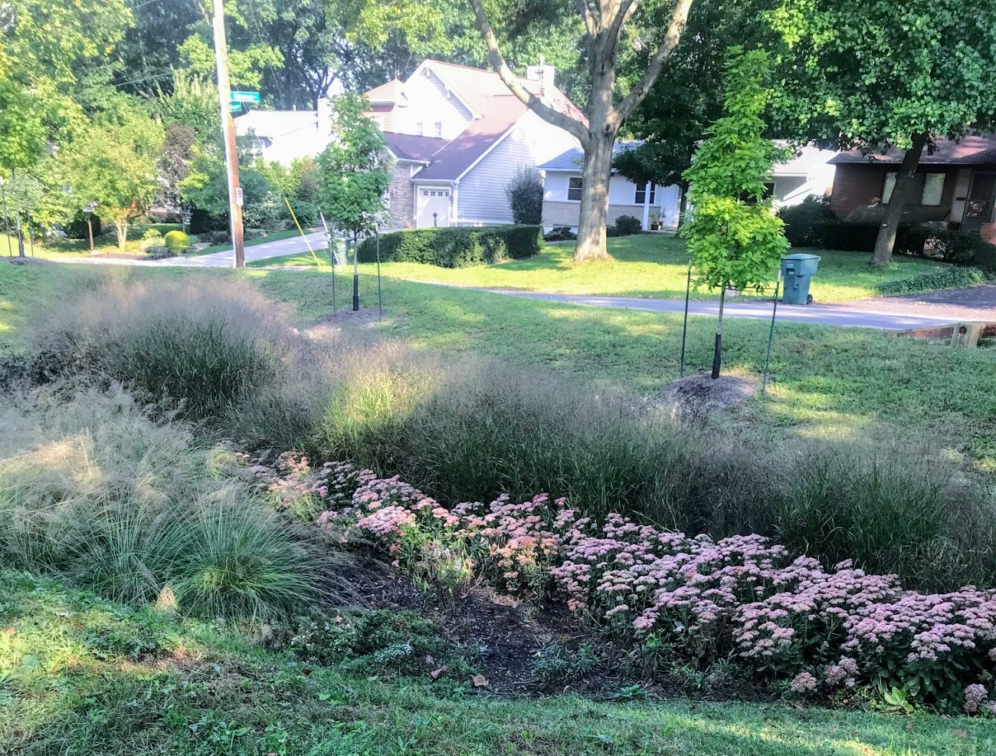
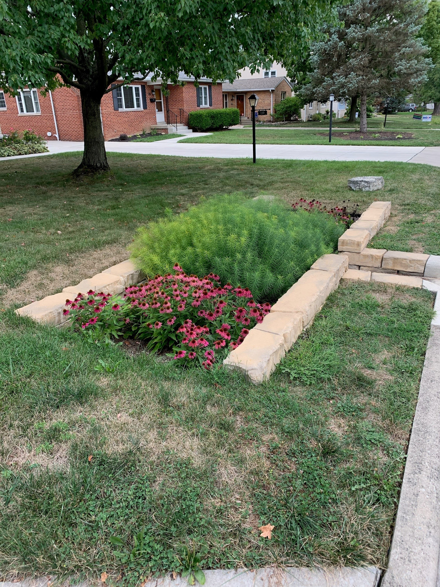
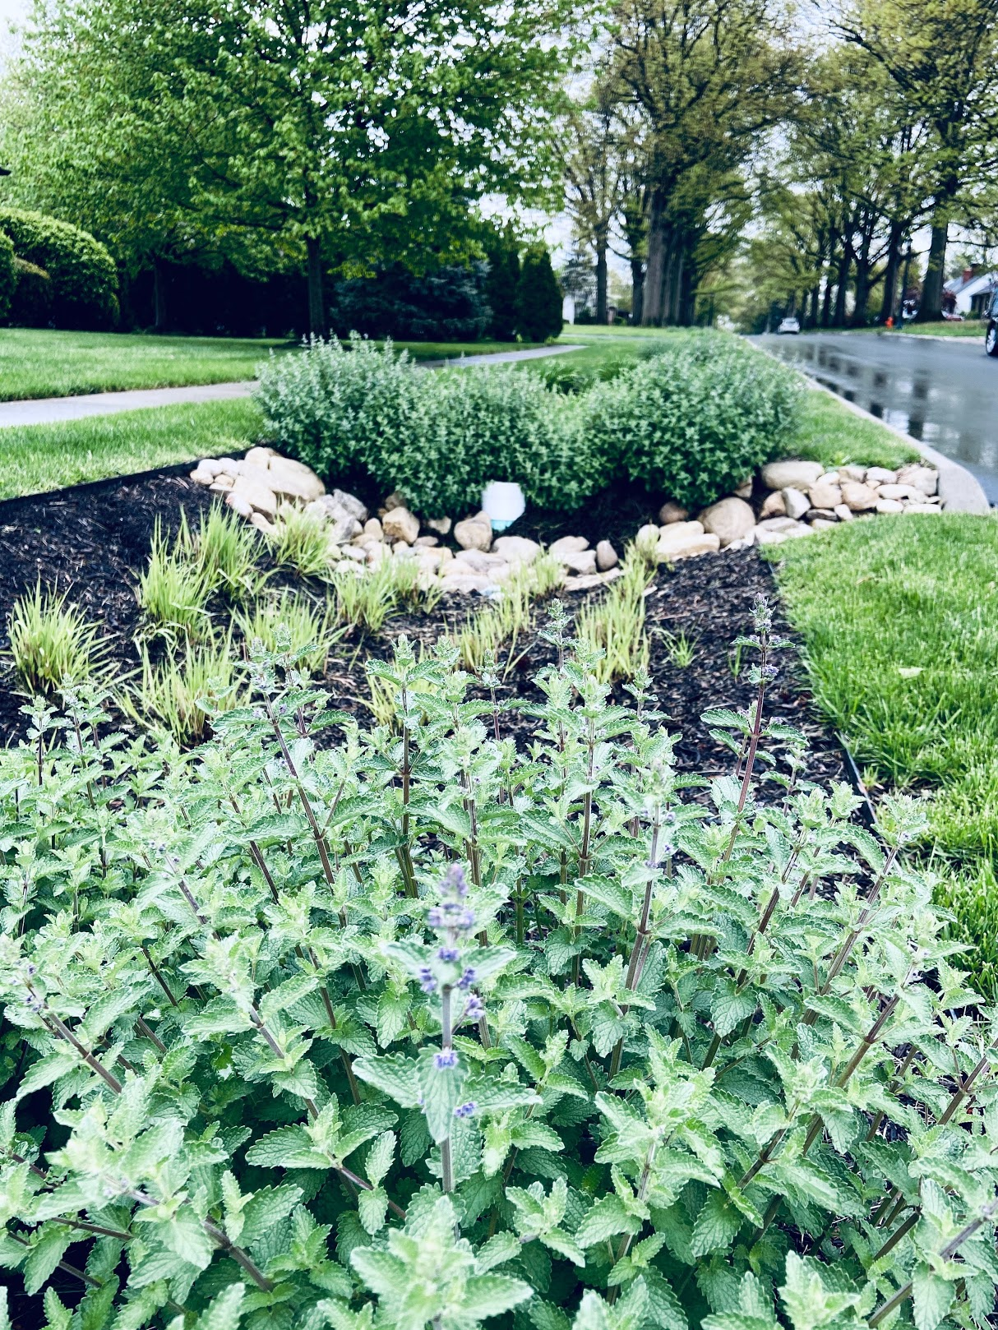
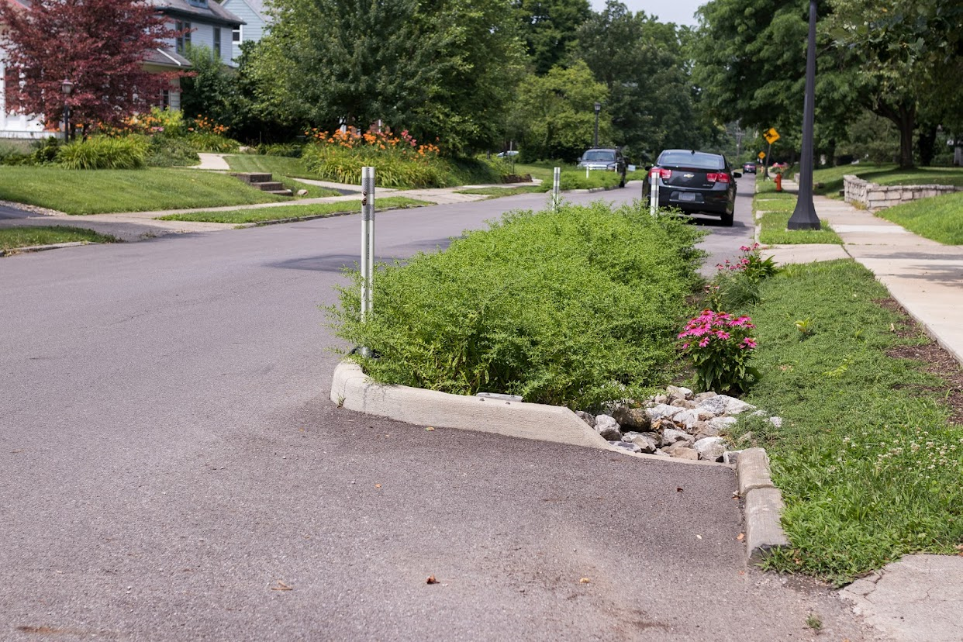
Blueprint Clintonville 1 (2012)

Slide 8
Blueprint Clintonville 1 (2012)
Coordination with OSU on Blueprint Neighborhood objectives:
  Two of the primary objectives:
    Analyzing the change in stormwater flows
    Water quality improvements
Coordination with Model Team and Data Analysis:
  Evaluation of the effectiveness in meeting the Blueprint objective

Slide 9
Blueprint Neighborhoods
Blueprint Neighborhood Areas
Currently in various phases in these upcoming neighborhoods:
  Hilltop (2014)
  Miller/Kelton (2014)
  W. Franklinton (2015)
  Fifth by Northwest (2015)
  Near South (2017)
  James/Livingston (2019)
  PROJECTS TO CONTINUE

Slide 10
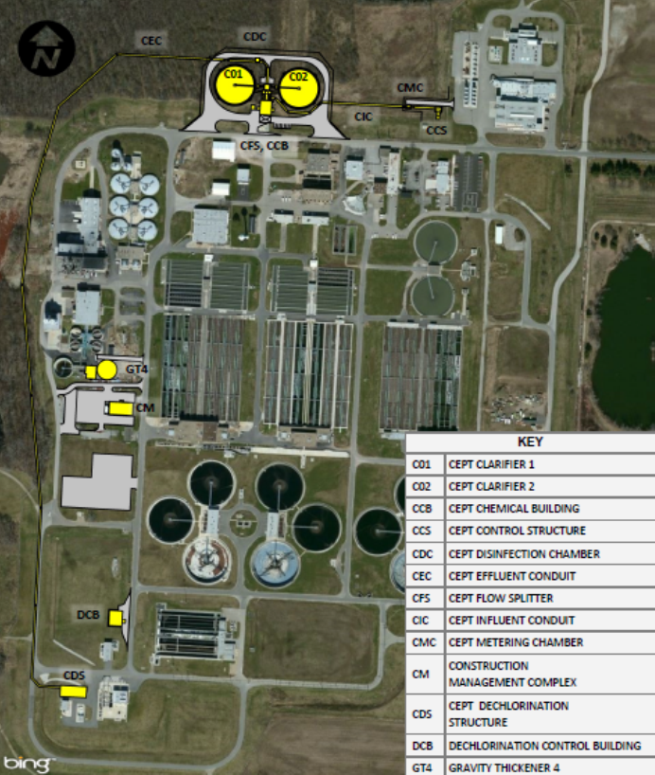
Chemically Enhanced Primary Treatment (CEPT)
Located at the SWWTP
Add 110 million gallons per day (mgd) of high rate treatment capacity to assist during wet weather events
Construction substantially completed in 2019
Still in process of “tuning” operation – flexibility established in NPDES permit

Slide 11
CSO Program
LOT Tunnel
  17,000 LF of 12-foot diameter sewer via tunnel boring machine through soft-ground, mixed-face conditions and rock.
  Notice to Proceed issued to Granite Construction on 3/2/21
  Awarded Contract Amount of $267,753,000
Inflow Redirection Projects
Weir Raise Projects
CSO completion July 2025

Slide 12
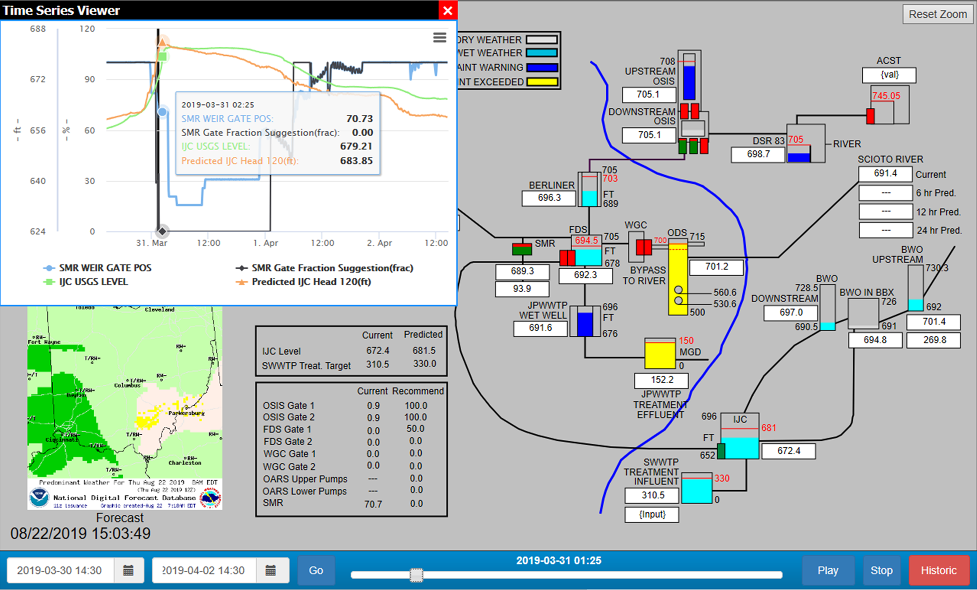
Real Time Control (RTC)
“WAZE for sewers”
Maximize treatment and storage
Minimize overflows
Design system for real time analysis
Enhance awareness of current sewer conditions
Predict future depth and flow at key locations
Develop operational recommendations

Slide 13
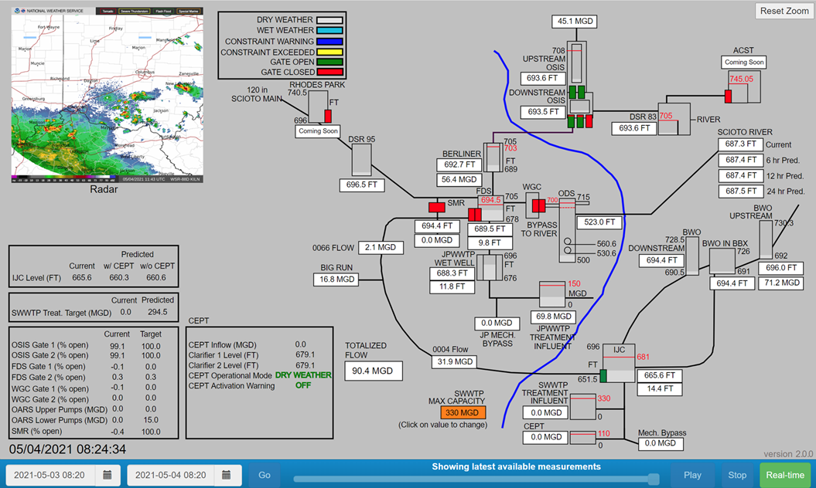
Real Time Control (RTC)
Ongoing development
  More sensors
  Precipitation data
  Operation recommendations
Added features
  Flight simulator
  CEPT warning
  Tuning of existing recommendations

Slide 14
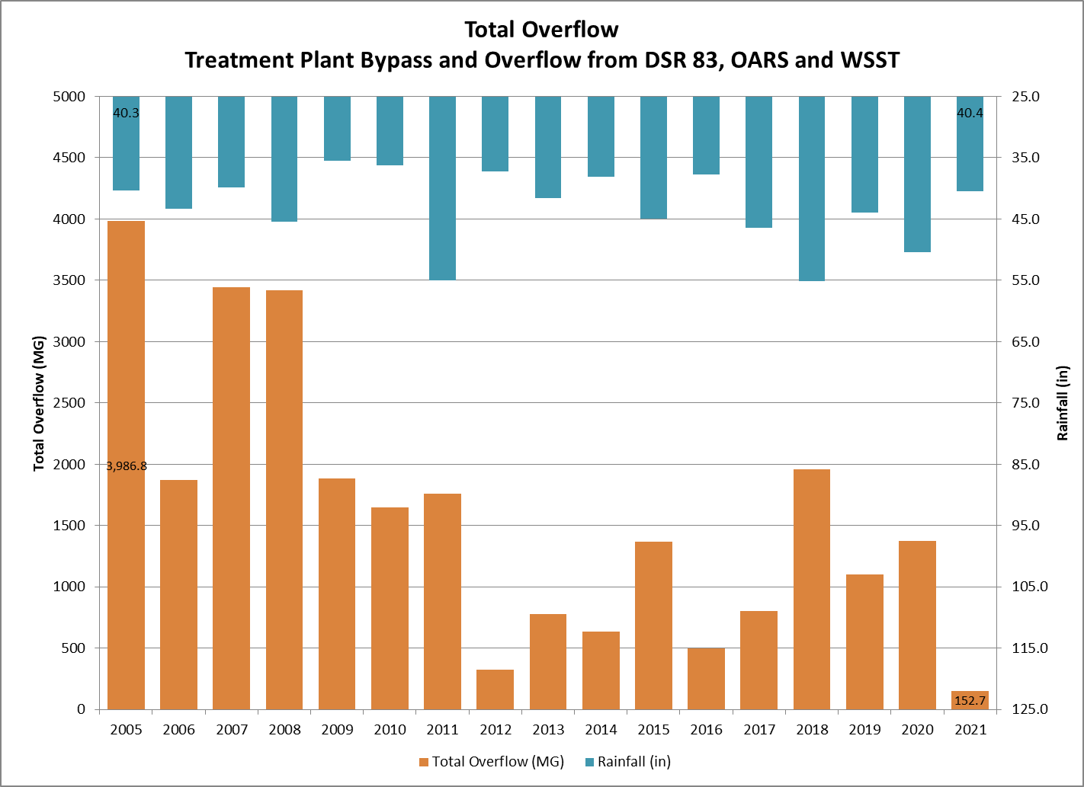
Overflow Performance

Slide 15
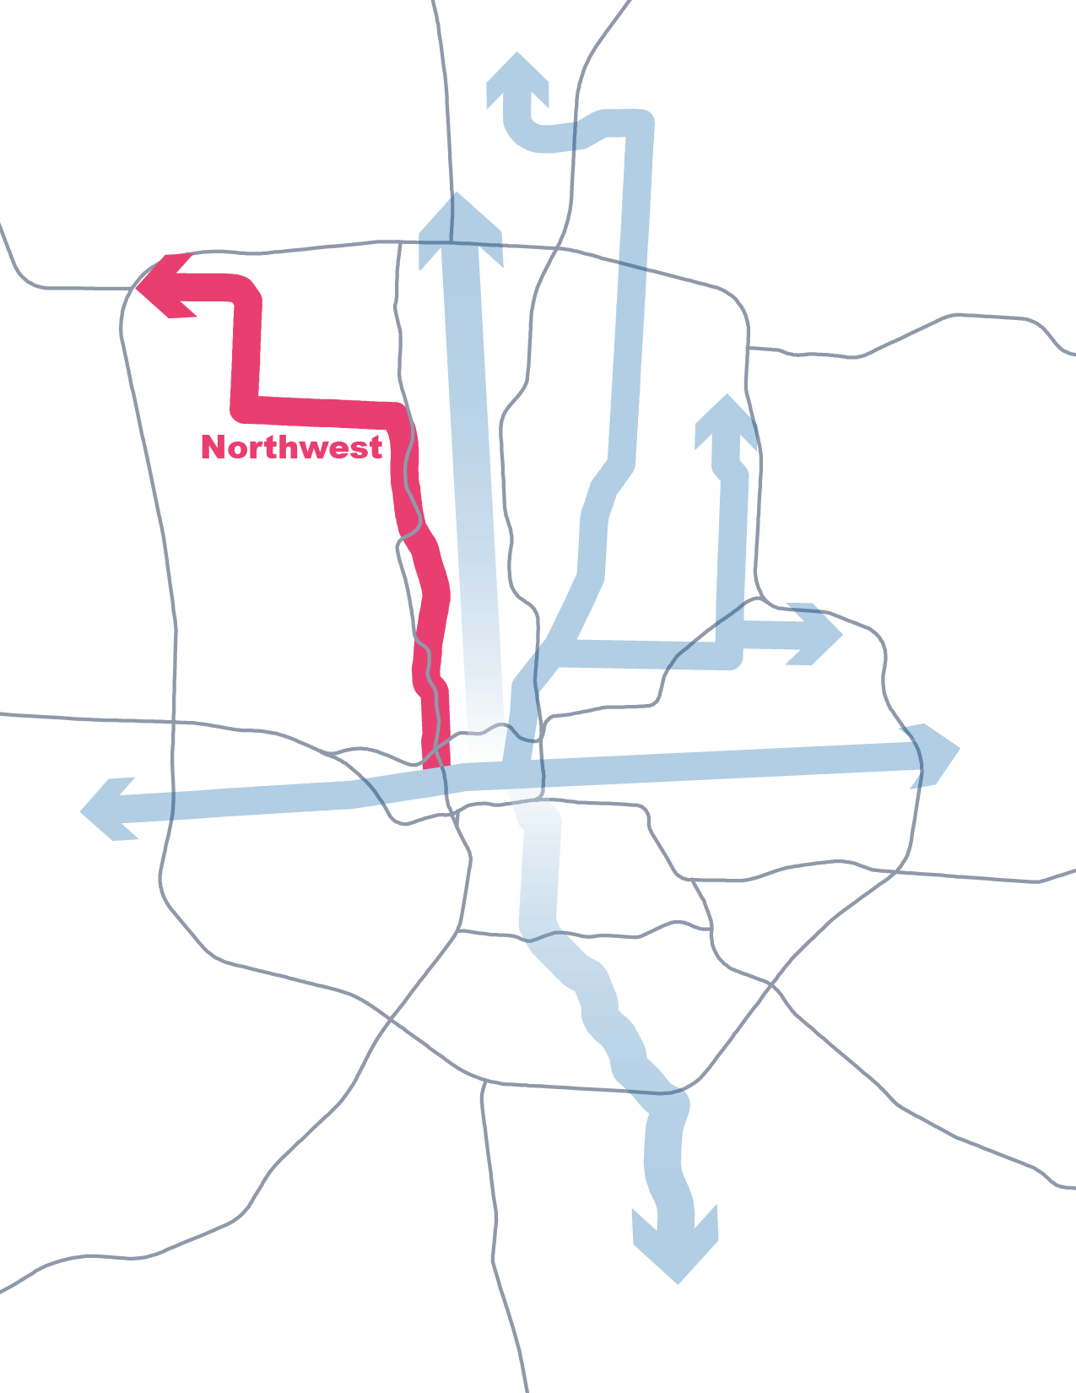
Central Ohio Growth
Recent Growth trends showing expedited growth in Central Ohio
Working with City and Regional Partners to move forward
Corridor concept a major initiative of the City where the Utility plays a critical role
In addition - a new major industry will significantly change our landscape…

Slide 16
Intel
Impacts to recent capital plan with major capital investments in next 6 years
  In addition to commodity pricing and labor shortage
First project in 2023
  RTC of gate structure off recently constructed tunnel

Slide 17

